Slide 1
TLIN1028 State Transitions
February 2020

Slide 2
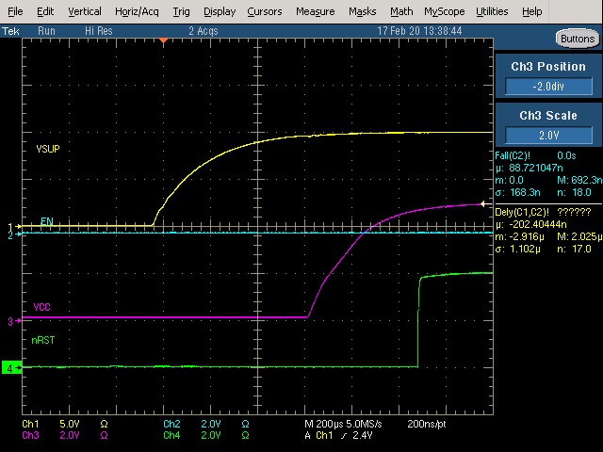
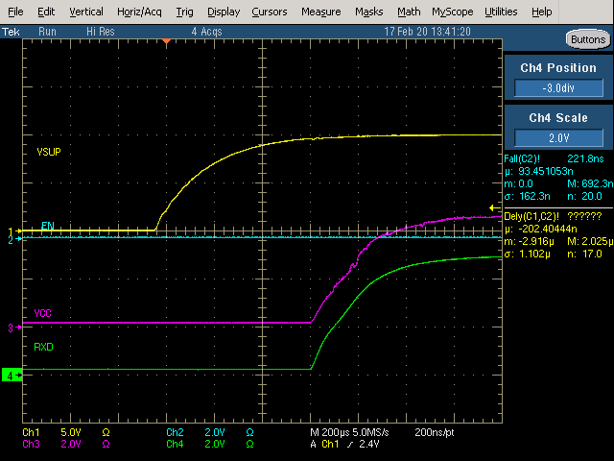
Unpowered -> Standby (Ramp VSUP)

Slide 3
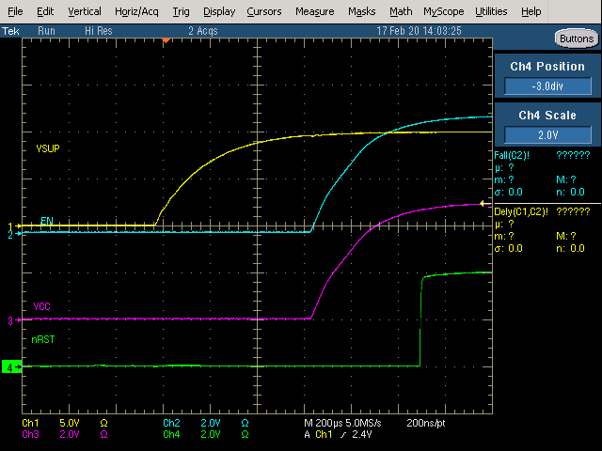
Unpowered -> Normal (Ramp VSUP, EN tied to VCC)
EN tied to VCC

Slide 4
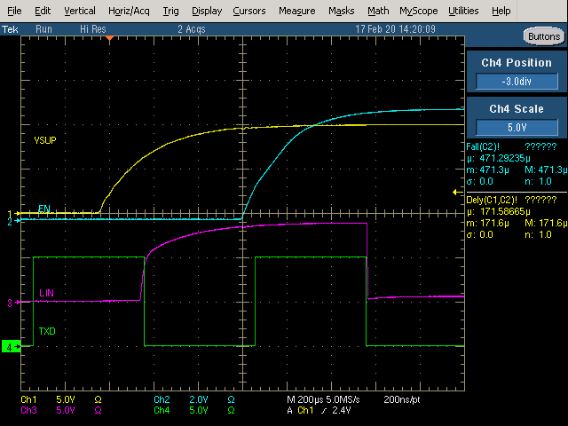
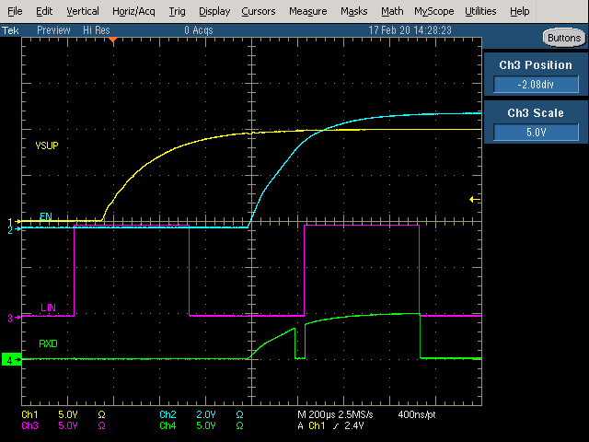
Unpowered -> Normal (Ramp VSUP, EN tied to VCC)
TXD toggling reflected on LIN
LIN toggling reflected on RXD

Slide 5
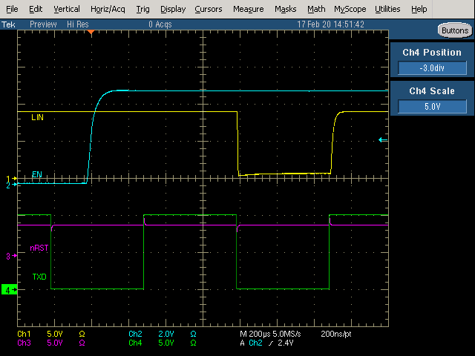
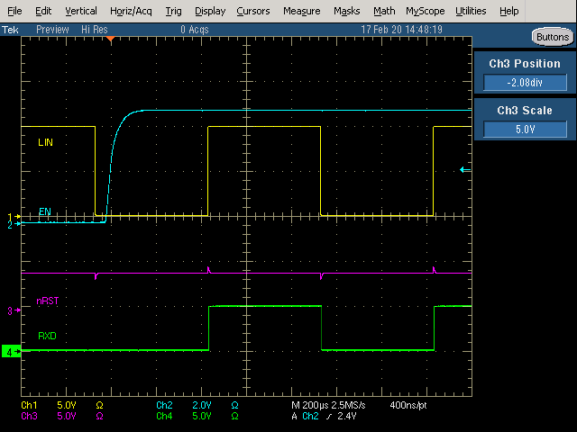
Standby -> Normal (Toggle EN)
TXD toggling reflected on LIN
LIN toggling reflected on RXD

Slide 6
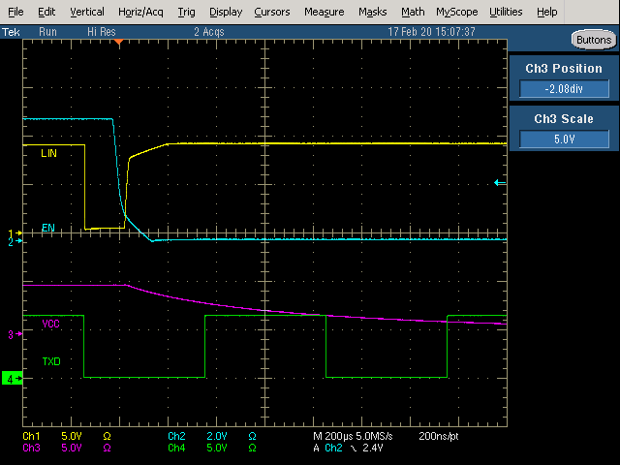
Normal -> Sleep (Toggle EN)
Setting EN to Low turns off VCC

Slide 7
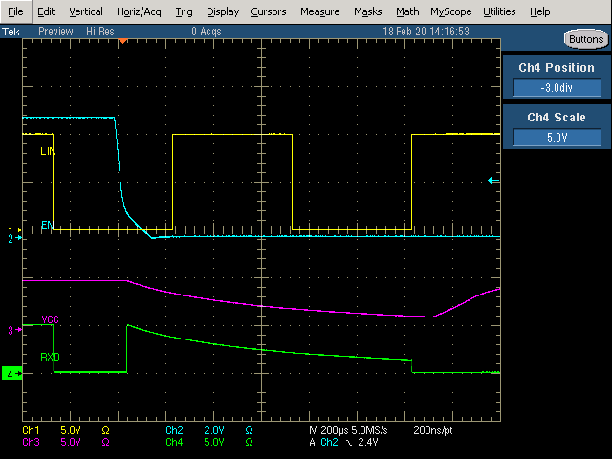
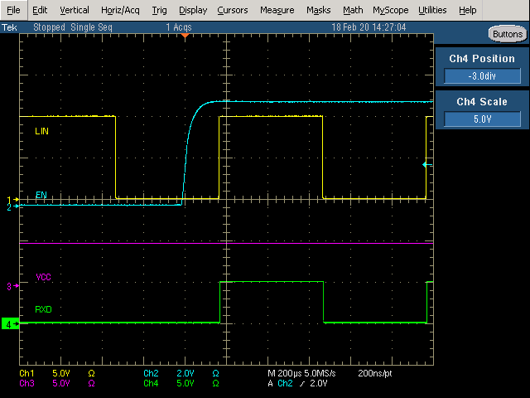
Sleep -> LIN Wakeup Event -> Normal
Sleep Mode –> LIN Wakeup Event
EN High after LIN Wakeup Event

