Slide 1
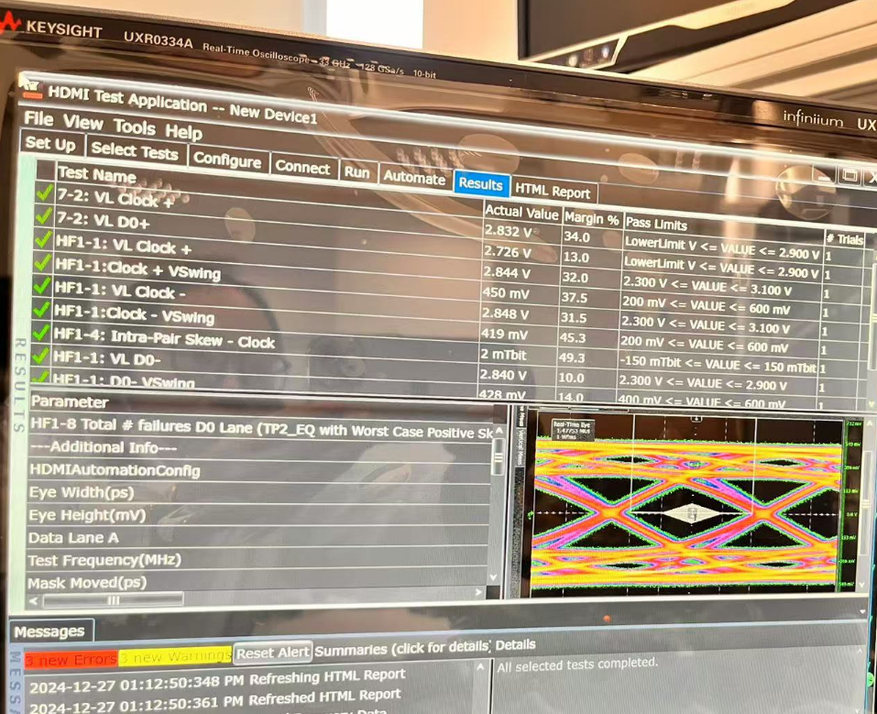
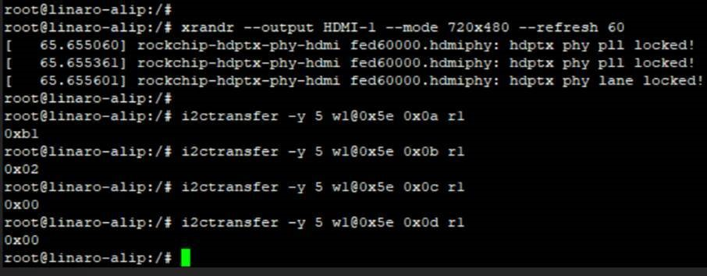
Refresh 60
Register dump
0x0a 0xb1
0x0b 0x02
0x0c 0x00
0x0d 0x00
Other default

Slide 2
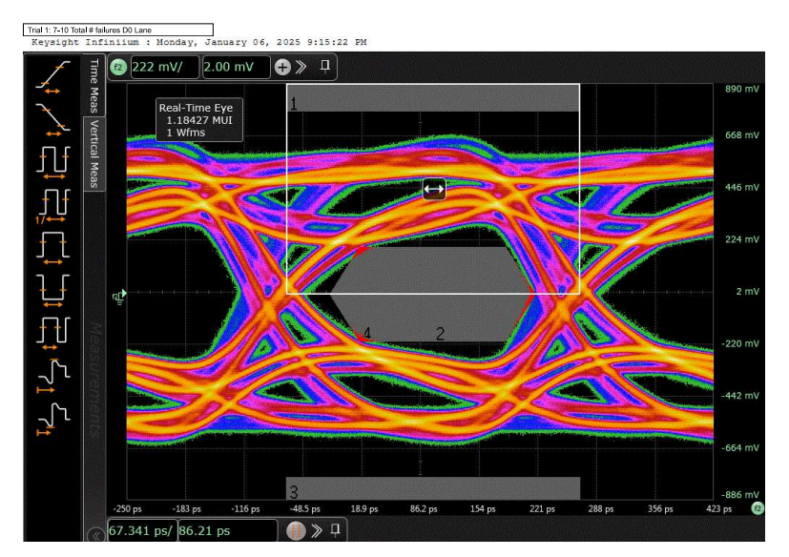
Refresh 30 - fail
Register dump
0x0a 0xb1
0x0b 0x02
0x0c 0x00
0x0d 0x00
Other default
4096*2160 – refresh30.pdf

Slide 3
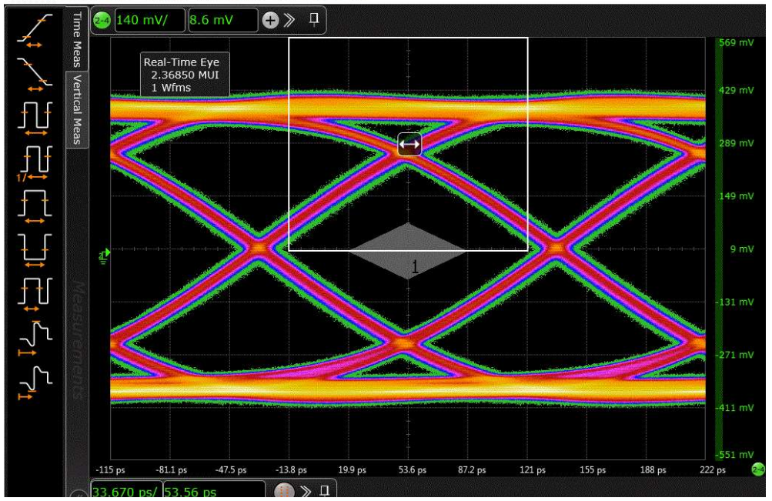
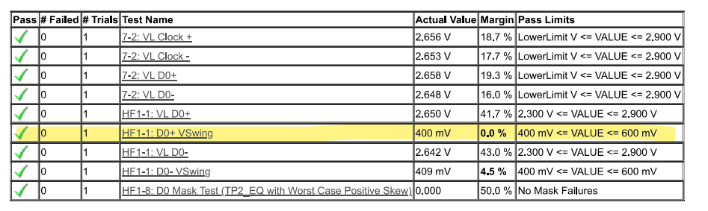
Refresh 30 – pass but Vswing has no margin (D0+ 400mv spec 400mv)
Register dump
0x0a 0xb1
0x0b 0x18
0x0c 0x00
0x0d 0x01
Other default
7-03K 0x0b 0x18 0x0d 0x01 0x0c 0x40.pdf

Slide 4
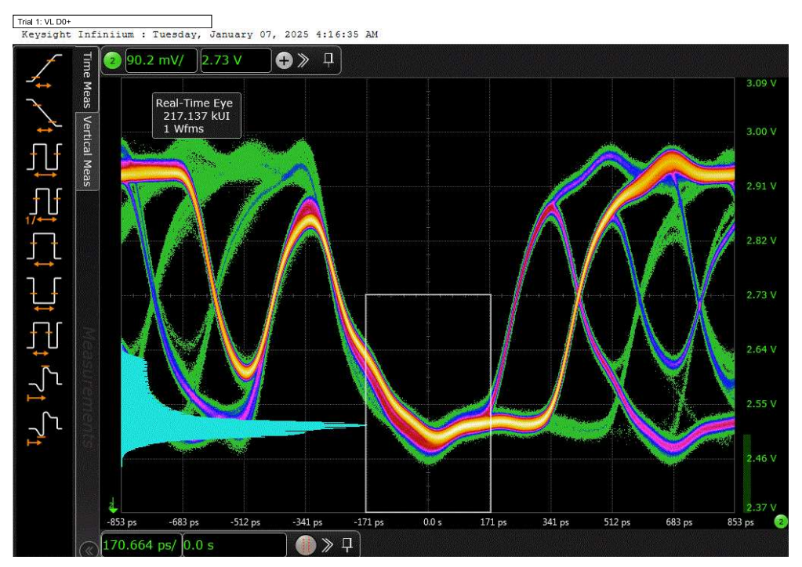
Refresh 30 – pass but Date VL less than 2.6V
Register dump
0x0a 0xb1
0x0b 0x18
0x0c 0x40
0x0d 0x01
Other default
7-03K 0x0b 0x18 0x0d 0x01 0x0c 0x40.pdf

