Slide 1
TMDS181 HDMI2.0 Compliance Test Results

Slide 2
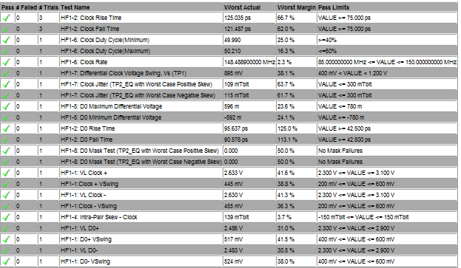
TMDS181 HDMI2.0 Compliance Test Results 1/2

Slide 3
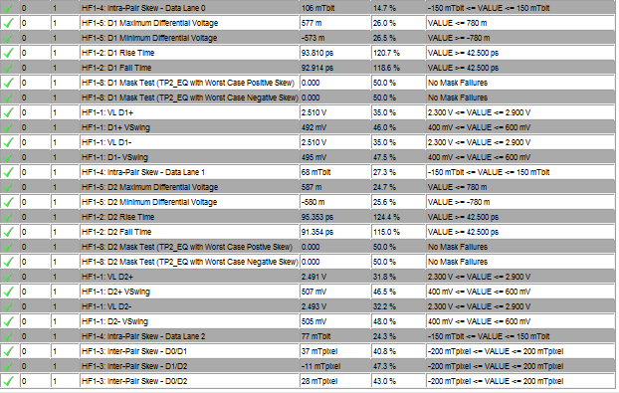
TMDS181 HDMI2.0 Compliance Test Results 2/2

