Slide 1
TPS65987DH in dead battery mode
Customer reported:
“We are having difficulty detecting whether the device was woken up by a charger attach event. When booting from "dead battery" with the charger connected, after the patch file is loaded I read the Power Status Register (0x3F) and it is all 0's ( PowerConnection = No Connection, Charger Detect Status = Charger detection disabled or not run, etc). This has our firmware believe that we booted without a cable attached which puts us in an undesired state. Is there a reliable way at startup to detect that the charger is connected without an arbitrary wait time? ”

Slide 2
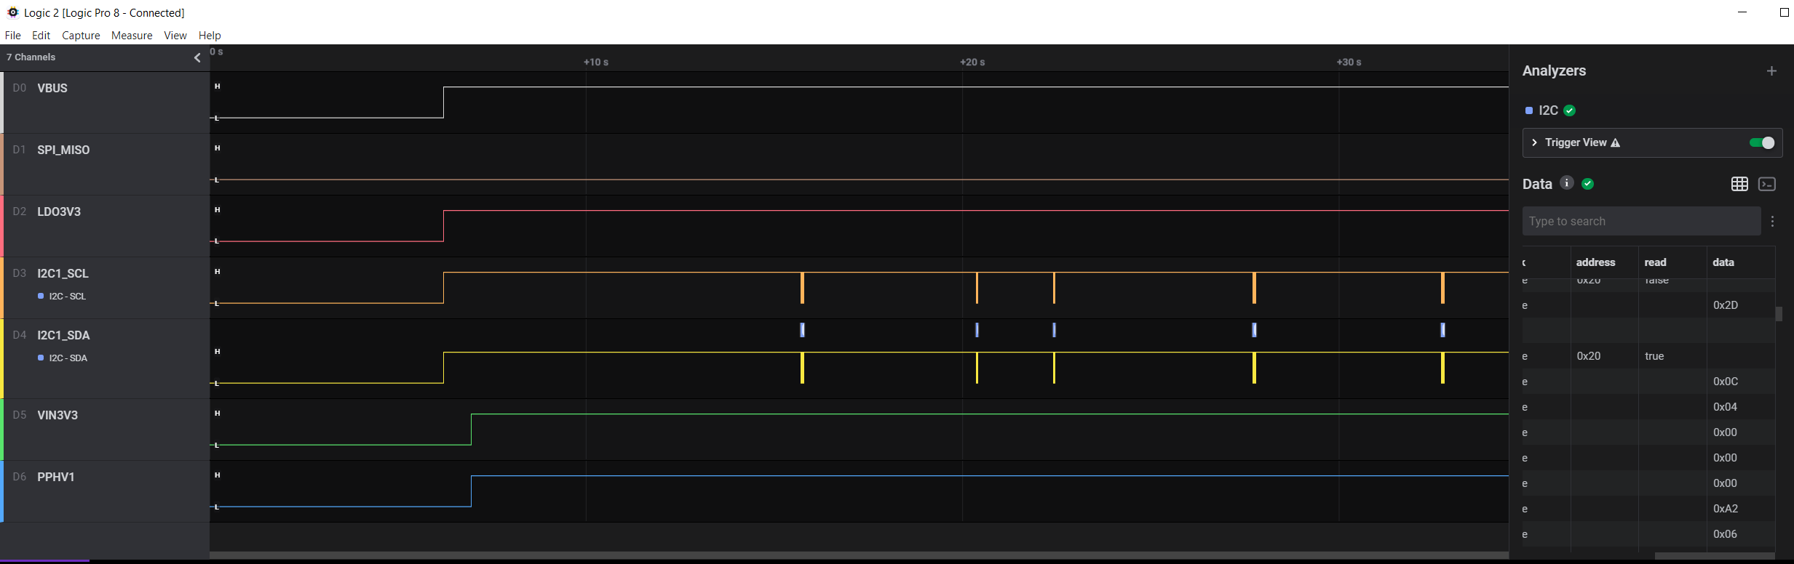
TI testing using TPS65987 EVM
Load using customer project file (4705.TPS65987DDH_file.pjt )
Configure EVM to boot per the customer condition:
  SPI_MISO = 0
  ADCIN1 = 0.44 -> BP_NoWait with Configuration 3 (UFP Only – Internal Switch)
External power is provided by Charger Power Cable GL0102 (5V, 3A)
Capture following signals on the EVM and read the respective registers to verify the status with APP GUI
When Charger connected
See next slide
LDO3V3 is up
& I2C1 pulled up
2
3
4
5
1
After PPHV1 Switch closed, VIN3V3 comes up
PPHV1 Sink Path closed

Slide 3
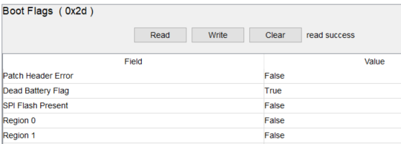
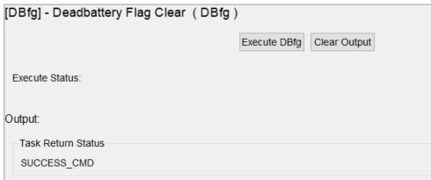
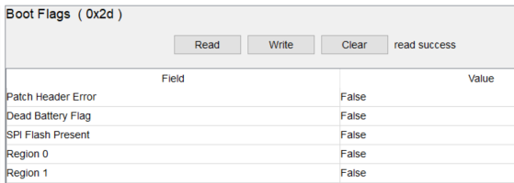
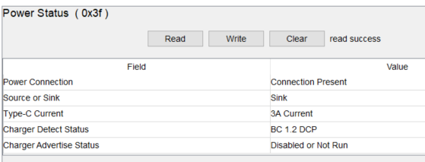
TI testing using TPS65987 EVM
Read Boot Flag (0x2d) to verify dead battery flag is true
Write DBfg command to clear dead battery flag
Read DBfg command successfully executed
Read Boot Flags (0x2d) to verify dead battery flag is false
Read Power Status Register (0x3f) to verify connection
2
1
3
4
5

