Slide 1
RS232
Replacement
Notes:
From: Wang (FAE), Brian Sent: Tuesday, October 24, 2017 11:11 AM To: Shell, Joe; Lin (TWN Analog FAE), Brian Cc: Huang, Murphy; Shen, Kidder; Lin, Jin; Hsu, Elvis Subject: RE: Rockwell Automation / Delta - Ironman Project
Hi Joe,
Thanks for INFO.
In fact we had promoted the TPS65400 on Sep. to instead of the original solution of the ADP5014 that should be used in prior RA projects. However We’ve sent 20pcs samples and an EVM of TPS65400 to DELTA already.
DELTA mentioned they have done both layouts for DP83822 and RA’s original Ethernet solution. And DELTA thinks the decision maker should be RA’s engineer. DELTA says we can send the EMC test report with TIDA-00299 to Rockwell directly.
Any update will keep you posted. Thanks.
Regards,
Brian
From: Shell, Joe Sent: Tuesday, October 24, 2017 11:25 PM To: Lin (TWN Analog FAE), Brian; Wang (FAE), Brian Cc: Huang, Murphy; Shen, Kidder Subject: RE: Rockwell Automation / Delta - Ironman Project
Hello Brian(s),
FYI – We’ve been working with the Rockwell engineer in Shanghai on the POL power for the FPGA in the control structure on the Ironman project. It looks like he’s going to proceed with TPS65400. From the engineer in Shanghai:
“TPS65400 is comprehensive solution with 4 outpus, and sequencing, supervisor and soft-start. So it is the right one for our application.”
I have updated our project plan accordingly.
Have you received any additional feedback regarding the DP83822H decision from Delta?
Thank you,
Joe
Joseph Shell
Texas Instruments Incorporated
WW Account Manager
Office: 262-780-1632
Cell: 262-227-1406
From: Shell, Joe Sent: Friday, October 20, 2017 9:22 AM To: Shen, Kidder Cc: Lin (TWN Analog FAE), Brian; Wang (FAE), Brian; Huang, Murphy Subject: RE: Rockwell Automation / Delta - Ironman Project
Hello Kidder et al,
Wondering if you have any further questions/comments about the Ironman project that Rockwell Automation and Delta are working on together. For more information about the product that they are developing you can refer to the following Rockwell Automation product websites.
This is Rockwell’s current low end servo drive. The Ironman product is being developed to offer Rockwell’s latest servo drive features at a low price point similar to this existing K350 family:
http://ab.rockwellautomation.com/Motion-Control/Servo-Drives/Kinetix-Integrated-Motion-on-EIP/Kinetix-350-Servo-Drive
although it will not replace the K350 product entirely. Rockwell almost never obsoletes existing products (kind of like TI). To understand some of the more advanced features they are trying to enable in this low end product you can review this latest end high end family:
http://ab.rockwellautomation.com/Motion-Control/Servo-Drives/Kinetix-Integrated-Motion-on-EIP/Kinetix-5700-Servo-Drive
The control hardware architecture of Ironman will be based on a similar Altera FPGA + C2000 device. Rockwell’s engineers are currently developing another product with the TMS320F28075 and will likely try to leverage that effort to enable the Ironman front end although they will likely move to an F28004x for the cost savings.
Please let me know if you have any other questions about the project.
Best regards,
Joseph Shell
Texas Instruments Incorporated
WW Account Manager
Office: 262-780-1632
Cell: 262-227-1406
From: Shell, Joe Sent: Wednesday, October 11, 2017 4:52 AM To: Shen, Kidder Cc: Lin (TWN Analog FAE), Brian; Wang (FAE), Brian; Huang, Murphy Subject: Re: Rockwell Automation / Delta - Ironman Project
Hello Kidder Shen
Rockwell Automation is providing the control architecture for this project. It will be based based on an existing Rockwell servo drive system architecture based on an Altera FPGA + TMS320F28075. The Rockwell engineers working on the project are located in Shanghai. The Ironman control structure is being designed with explicit intent to work with a family of Delta motor drive power structures. Delta is also involved with implementation of the control structure design. This will include evaluation of critical components, schematic capture, board layout, and manufacturing / assembly of the final system in their facilities in Taiwan.
This similar OEM/ODM model exists between Rockwell & Delta on the existing PowerFlex 520 AC Drive product family. The control structure in that case was designed by Rockwell Singapore and leveraged a family of Delta power structures as well. See Rockwell’s PowerFlex 523, PowerFlex 525, and PowerFlex 527 for reference.
I look forward to working with you and your team on this project.
Best regards,
Joseph Shell
Texas Instruments
WW Account Manager
Office: 262-780-1632
Cell: 262-227-1406
On Oct 10, 2017, at 11:18 PM, Shen, Kidder <kiddershen@ti.com> wrote:

Slide 2
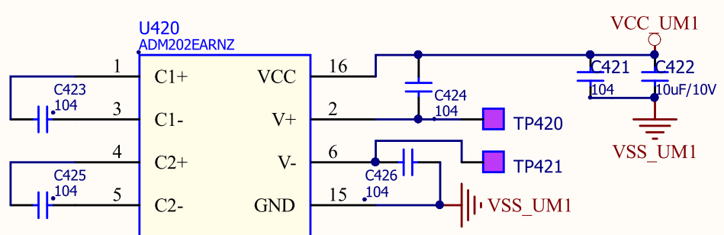
Problem Description:
Customer would like to use TRS232 instead of ADM202E since they are p2p compatible devices. However We found the voltage ripple of TRS232 is worse than ADI event though the communication is ok so far.
We’d like to know how come the ripple voltage is worse than ADI at the same conditions? And is this influenced to the communication performance potentially?
Schematic
Notes:
From: Wang (FAE), Brian Sent: Tuesday, October 24, 2017 11:11 AM To: Shell, Joe; Lin (TWN Analog FAE), Brian Cc: Huang, Murphy; Shen, Kidder; Lin, Jin; Hsu, Elvis Subject: RE: Rockwell Automation / Delta - Ironman Project
Hi Joe,
Thanks for INFO.
In fact we had promoted the TPS65400 on Sep. to instead of the original solution of the ADP5014 that should be used in prior RA projects. However We’ve sent 20pcs samples and an EVM of TPS65400 to DELTA already.
DELTA mentioned they have done both layouts for DP83822 and RA’s original Ethernet solution. And DELTA thinks the decision maker should be RA’s engineer. DELTA says we can send the EMC test report with TIDA-00299 to Rockwell directly.
Any update will keep you posted. Thanks.
Regards,
Brian
From: Shell, Joe Sent: Tuesday, October 24, 2017 11:25 PM To: Lin (TWN Analog FAE), Brian; Wang (FAE), Brian Cc: Huang, Murphy; Shen, Kidder Subject: RE: Rockwell Automation / Delta - Ironman Project
Hello Brian(s),
FYI – We’ve been working with the Rockwell engineer in Shanghai on the POL power for the FPGA in the control structure on the Ironman project. It looks like he’s going to proceed with TPS65400. From the engineer in Shanghai:
“TPS65400 is comprehensive solution with 4 outpus, and sequencing, supervisor and soft-start. So it is the right one for our application.”
I have updated our project plan accordingly.
Have you received any additional feedback regarding the DP83822H decision from Delta?
Thank you,
Joe
Joseph Shell
Texas Instruments Incorporated
WW Account Manager
Office: 262-780-1632
Cell: 262-227-1406
From: Shell, Joe Sent: Friday, October 20, 2017 9:22 AM To: Shen, Kidder Cc: Lin (TWN Analog FAE), Brian; Wang (FAE), Brian; Huang, Murphy Subject: RE: Rockwell Automation / Delta - Ironman Project
Hello Kidder et al,
Wondering if you have any further questions/comments about the Ironman project that Rockwell Automation and Delta are working on together. For more information about the product that they are developing you can refer to the following Rockwell Automation product websites.
This is Rockwell’s current low end servo drive. The Ironman product is being developed to offer Rockwell’s latest servo drive features at a low price point similar to this existing K350 family:
http://ab.rockwellautomation.com/Motion-Control/Servo-Drives/Kinetix-Integrated-Motion-on-EIP/Kinetix-350-Servo-Drive
although it will not replace the K350 product entirely. Rockwell almost never obsoletes existing products (kind of like TI). To understand some of the more advanced features they are trying to enable in this low end product you can review this latest end high end family:
http://ab.rockwellautomation.com/Motion-Control/Servo-Drives/Kinetix-Integrated-Motion-on-EIP/Kinetix-5700-Servo-Drive
The control hardware architecture of Ironman will be based on a similar Altera FPGA + C2000 device. Rockwell’s engineers are currently developing another product with the TMS320F28075 and will likely try to leverage that effort to enable the Ironman front end although they will likely move to an F28004x for the cost savings.
Please let me know if you have any other questions about the project.
Best regards,
Joseph Shell
Texas Instruments Incorporated
WW Account Manager
Office: 262-780-1632
Cell: 262-227-1406
From: Shell, Joe Sent: Wednesday, October 11, 2017 4:52 AM To: Shen, Kidder Cc: Lin (TWN Analog FAE), Brian; Wang (FAE), Brian; Huang, Murphy Subject: Re: Rockwell Automation / Delta - Ironman Project
Hello Kidder Shen
Rockwell Automation is providing the control architecture for this project. It will be based based on an existing Rockwell servo drive system architecture based on an Altera FPGA + TMS320F28075. The Rockwell engineers working on the project are located in Shanghai. The Ironman control structure is being designed with explicit intent to work with a family of Delta motor drive power structures. Delta is also involved with implementation of the control structure design. This will include evaluation of critical components, schematic capture, board layout, and manufacturing / assembly of the final system in their facilities in Taiwan.
This similar OEM/ODM model exists between Rockwell & Delta on the existing PowerFlex 520 AC Drive product family. The control structure in that case was designed by Rockwell Singapore and leveraged a family of Delta power structures as well. See Rockwell’s PowerFlex 523, PowerFlex 525, and PowerFlex 527 for reference.
I look forward to working with you and your team on this project.
Best regards,
Joseph Shell
Texas Instruments
WW Account Manager
Office: 262-780-1632
Cell: 262-227-1406
On Oct 10, 2017, at 11:18 PM, Shen, Kidder <kiddershen@ti.com> wrote:

Slide 3
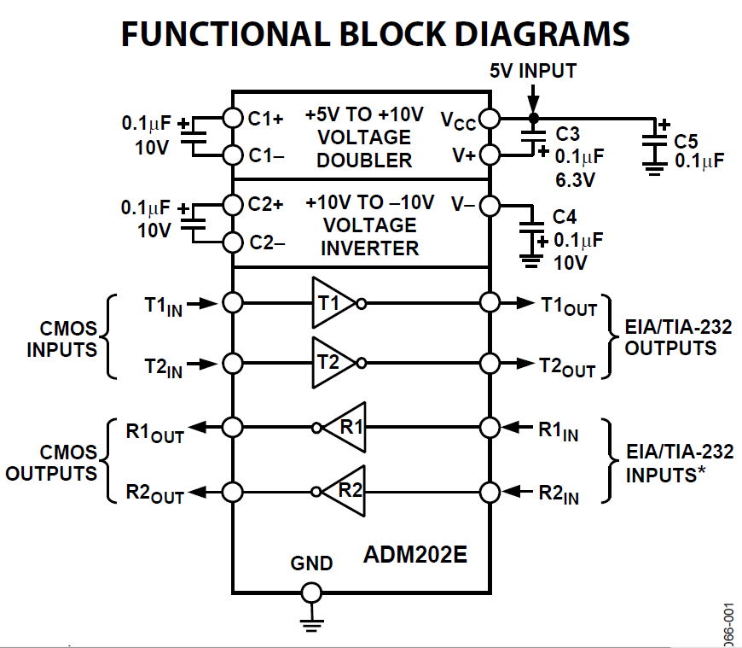
RS232 Replacement
ADM202E
C3 location is between
VCC and V+
The same w/ Customer Board
Notes:
From: Wang (FAE), Brian Sent: Tuesday, October 24, 2017 11:11 AM To: Shell, Joe; Lin (TWN Analog FAE), Brian Cc: Huang, Murphy; Shen, Kidder; Lin, Jin; Hsu, Elvis Subject: RE: Rockwell Automation / Delta - Ironman Project
Hi Joe,
Thanks for INFO.
In fact we had promoted the TPS65400 on Sep. to instead of the original solution of the ADP5014 that should be used in prior RA projects. However We’ve sent 20pcs samples and an EVM of TPS65400 to DELTA already.
DELTA mentioned they have done both layouts for DP83822 and RA’s original Ethernet solution. And DELTA thinks the decision maker should be RA’s engineer. DELTA says we can send the EMC test report with TIDA-00299 to Rockwell directly.
Any update will keep you posted. Thanks.
Regards,
Brian
From: Shell, Joe Sent: Tuesday, October 24, 2017 11:25 PM To: Lin (TWN Analog FAE), Brian; Wang (FAE), Brian Cc: Huang, Murphy; Shen, Kidder Subject: RE: Rockwell Automation / Delta - Ironman Project
Hello Brian(s),
FYI – We’ve been working with the Rockwell engineer in Shanghai on the POL power for the FPGA in the control structure on the Ironman project. It looks like he’s going to proceed with TPS65400. From the engineer in Shanghai:
“TPS65400 is comprehensive solution with 4 outpus, and sequencing, supervisor and soft-start. So it is the right one for our application.”
I have updated our project plan accordingly.
Have you received any additional feedback regarding the DP83822H decision from Delta?
Thank you,
Joe
Joseph Shell
Texas Instruments Incorporated
WW Account Manager
Office: 262-780-1632
Cell: 262-227-1406
From: Shell, Joe Sent: Friday, October 20, 2017 9:22 AM To: Shen, Kidder Cc: Lin (TWN Analog FAE), Brian; Wang (FAE), Brian; Huang, Murphy Subject: RE: Rockwell Automation / Delta - Ironman Project
Hello Kidder et al,
Wondering if you have any further questions/comments about the Ironman project that Rockwell Automation and Delta are working on together. For more information about the product that they are developing you can refer to the following Rockwell Automation product websites.
This is Rockwell’s current low end servo drive. The Ironman product is being developed to offer Rockwell’s latest servo drive features at a low price point similar to this existing K350 family:
http://ab.rockwellautomation.com/Motion-Control/Servo-Drives/Kinetix-Integrated-Motion-on-EIP/Kinetix-350-Servo-Drive
although it will not replace the K350 product entirely. Rockwell almost never obsoletes existing products (kind of like TI). To understand some of the more advanced features they are trying to enable in this low end product you can review this latest end high end family:
http://ab.rockwellautomation.com/Motion-Control/Servo-Drives/Kinetix-Integrated-Motion-on-EIP/Kinetix-5700-Servo-Drive
The control hardware architecture of Ironman will be based on a similar Altera FPGA + C2000 device. Rockwell’s engineers are currently developing another product with the TMS320F28075 and will likely try to leverage that effort to enable the Ironman front end although they will likely move to an F28004x for the cost savings.
Please let me know if you have any other questions about the project.
Best regards,
Joseph Shell
Texas Instruments Incorporated
WW Account Manager
Office: 262-780-1632
Cell: 262-227-1406
From: Shell, Joe Sent: Wednesday, October 11, 2017 4:52 AM To: Shen, Kidder Cc: Lin (TWN Analog FAE), Brian; Wang (FAE), Brian; Huang, Murphy Subject: Re: Rockwell Automation / Delta - Ironman Project
Hello Kidder Shen
Rockwell Automation is providing the control architecture for this project. It will be based based on an existing Rockwell servo drive system architecture based on an Altera FPGA + TMS320F28075. The Rockwell engineers working on the project are located in Shanghai. The Ironman control structure is being designed with explicit intent to work with a family of Delta motor drive power structures. Delta is also involved with implementation of the control structure design. This will include evaluation of critical components, schematic capture, board layout, and manufacturing / assembly of the final system in their facilities in Taiwan.
This similar OEM/ODM model exists between Rockwell & Delta on the existing PowerFlex 520 AC Drive product family. The control structure in that case was designed by Rockwell Singapore and leveraged a family of Delta power structures as well. See Rockwell’s PowerFlex 523, PowerFlex 525, and PowerFlex 527 for reference.
I look forward to working with you and your team on this project.
Best regards,
Joseph Shell
Texas Instruments
WW Account Manager
Office: 262-780-1632
Cell: 262-227-1406
On Oct 10, 2017, at 11:18 PM, Shen, Kidder <kiddershen@ti.com> wrote:

Slide 4
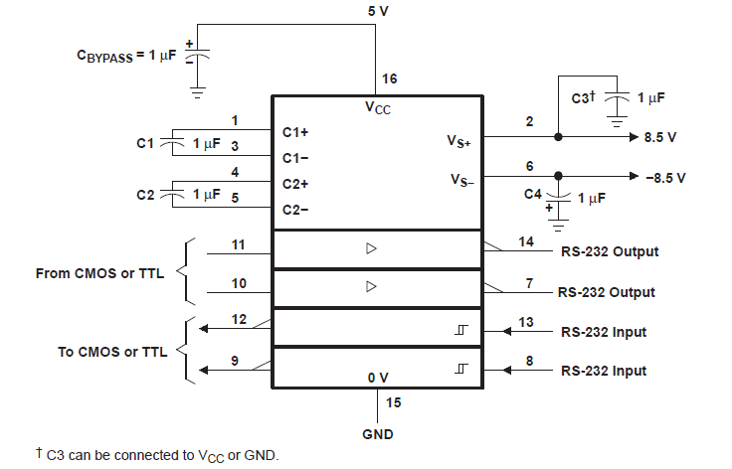
RS232 Replacement
Notes:
From: Wang (FAE), Brian Sent: Tuesday, October 24, 2017 11:11 AM To: Shell, Joe; Lin (TWN Analog FAE), Brian Cc: Huang, Murphy; Shen, Kidder; Lin, Jin; Hsu, Elvis Subject: RE: Rockwell Automation / Delta - Ironman Project
Hi Joe,
Thanks for INFO.
In fact we had promoted the TPS65400 on Sep. to instead of the original solution of the ADP5014 that should be used in prior RA projects. However We’ve sent 20pcs samples and an EVM of TPS65400 to DELTA already.
DELTA mentioned they have done both layouts for DP83822 and RA’s original Ethernet solution. And DELTA thinks the decision maker should be RA’s engineer. DELTA says we can send the EMC test report with TIDA-00299 to Rockwell directly.
Any update will keep you posted. Thanks.
Regards,
Brian
From: Shell, Joe Sent: Tuesday, October 24, 2017 11:25 PM To: Lin (TWN Analog FAE), Brian; Wang (FAE), Brian Cc: Huang, Murphy; Shen, Kidder Subject: RE: Rockwell Automation / Delta - Ironman Project
Hello Brian(s),
FYI – We’ve been working with the Rockwell engineer in Shanghai on the POL power for the FPGA in the control structure on the Ironman project. It looks like he’s going to proceed with TPS65400. From the engineer in Shanghai:
“TPS65400 is comprehensive solution with 4 outpus, and sequencing, supervisor and soft-start. So it is the right one for our application.”
I have updated our project plan accordingly.
Have you received any additional feedback regarding the DP83822H decision from Delta?
Thank you,
Joe
Joseph Shell
Texas Instruments Incorporated
WW Account Manager
Office: 262-780-1632
Cell: 262-227-1406
From: Shell, Joe Sent: Friday, October 20, 2017 9:22 AM To: Shen, Kidder Cc: Lin (TWN Analog FAE), Brian; Wang (FAE), Brian; Huang, Murphy Subject: RE: Rockwell Automation / Delta - Ironman Project
Hello Kidder et al,
Wondering if you have any further questions/comments about the Ironman project that Rockwell Automation and Delta are working on together. For more information about the product that they are developing you can refer to the following Rockwell Automation product websites.
This is Rockwell’s current low end servo drive. The Ironman product is being developed to offer Rockwell’s latest servo drive features at a low price point similar to this existing K350 family:
http://ab.rockwellautomation.com/Motion-Control/Servo-Drives/Kinetix-Integrated-Motion-on-EIP/Kinetix-350-Servo-Drive
although it will not replace the K350 product entirely. Rockwell almost never obsoletes existing products (kind of like TI). To understand some of the more advanced features they are trying to enable in this low end product you can review this latest end high end family:
http://ab.rockwellautomation.com/Motion-Control/Servo-Drives/Kinetix-Integrated-Motion-on-EIP/Kinetix-5700-Servo-Drive
The control hardware architecture of Ironman will be based on a similar Altera FPGA + C2000 device. Rockwell’s engineers are currently developing another product with the TMS320F28075 and will likely try to leverage that effort to enable the Ironman front end although they will likely move to an F28004x for the cost savings.
Please let me know if you have any other questions about the project.
Best regards,
Joseph Shell
Texas Instruments Incorporated
WW Account Manager
Office: 262-780-1632
Cell: 262-227-1406
From: Shell, Joe Sent: Wednesday, October 11, 2017 4:52 AM To: Shen, Kidder Cc: Lin (TWN Analog FAE), Brian; Wang (FAE), Brian; Huang, Murphy Subject: Re: Rockwell Automation / Delta - Ironman Project
Hello Kidder Shen
Rockwell Automation is providing the control architecture for this project. It will be based based on an existing Rockwell servo drive system architecture based on an Altera FPGA + TMS320F28075. The Rockwell engineers working on the project are located in Shanghai. The Ironman control structure is being designed with explicit intent to work with a family of Delta motor drive power structures. Delta is also involved with implementation of the control structure design. This will include evaluation of critical components, schematic capture, board layout, and manufacturing / assembly of the final system in their facilities in Taiwan.
This similar OEM/ODM model exists between Rockwell & Delta on the existing PowerFlex 520 AC Drive product family. The control structure in that case was designed by Rockwell Singapore and leveraged a family of Delta power structures as well. See Rockwell’s PowerFlex 523, PowerFlex 525, and PowerFlex 527 for reference.
I look forward to working with you and your team on this project.
Best regards,
Joseph Shell
Texas Instruments
WW Account Manager
Office: 262-780-1632
Cell: 262-227-1406
On Oct 10, 2017, at 11:18 PM, Shen, Kidder <kiddershen@ti.com> wrote:

Slide 5
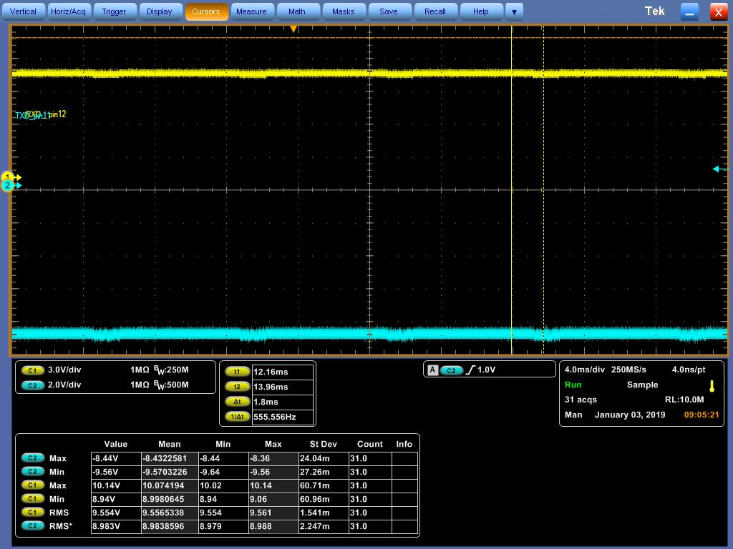
V+ and V-
ADM202E
C1+=C1-=C2+=C2- => 1uF
Notes:
From: Wang (FAE), Brian Sent: Tuesday, October 24, 2017 11:11 AM To: Shell, Joe; Lin (TWN Analog FAE), Brian Cc: Huang, Murphy; Shen, Kidder; Lin, Jin; Hsu, Elvis Subject: RE: Rockwell Automation / Delta - Ironman Project
Hi Joe,
Thanks for INFO.
In fact we had promoted the TPS65400 on Sep. to instead of the original solution of the ADP5014 that should be used in prior RA projects. However We’ve sent 20pcs samples and an EVM of TPS65400 to DELTA already.
DELTA mentioned they have done both layouts for DP83822 and RA’s original Ethernet solution. And DELTA thinks the decision maker should be RA’s engineer. DELTA says we can send the EMC test report with TIDA-00299 to Rockwell directly.
Any update will keep you posted. Thanks.
Regards,
Brian
From: Shell, Joe Sent: Tuesday, October 24, 2017 11:25 PM To: Lin (TWN Analog FAE), Brian; Wang (FAE), Brian Cc: Huang, Murphy; Shen, Kidder Subject: RE: Rockwell Automation / Delta - Ironman Project
Hello Brian(s),
FYI – We’ve been working with the Rockwell engineer in Shanghai on the POL power for the FPGA in the control structure on the Ironman project. It looks like he’s going to proceed with TPS65400. From the engineer in Shanghai:
“TPS65400 is comprehensive solution with 4 outpus, and sequencing, supervisor and soft-start. So it is the right one for our application.”
I have updated our project plan accordingly.
Have you received any additional feedback regarding the DP83822H decision from Delta?
Thank you,
Joe
Joseph Shell
Texas Instruments Incorporated
WW Account Manager
Office: 262-780-1632
Cell: 262-227-1406
From: Shell, Joe Sent: Friday, October 20, 2017 9:22 AM To: Shen, Kidder Cc: Lin (TWN Analog FAE), Brian; Wang (FAE), Brian; Huang, Murphy Subject: RE: Rockwell Automation / Delta - Ironman Project
Hello Kidder et al,
Wondering if you have any further questions/comments about the Ironman project that Rockwell Automation and Delta are working on together. For more information about the product that they are developing you can refer to the following Rockwell Automation product websites.
This is Rockwell’s current low end servo drive. The Ironman product is being developed to offer Rockwell’s latest servo drive features at a low price point similar to this existing K350 family:
http://ab.rockwellautomation.com/Motion-Control/Servo-Drives/Kinetix-Integrated-Motion-on-EIP/Kinetix-350-Servo-Drive
although it will not replace the K350 product entirely. Rockwell almost never obsoletes existing products (kind of like TI). To understand some of the more advanced features they are trying to enable in this low end product you can review this latest end high end family:
http://ab.rockwellautomation.com/Motion-Control/Servo-Drives/Kinetix-Integrated-Motion-on-EIP/Kinetix-5700-Servo-Drive
The control hardware architecture of Ironman will be based on a similar Altera FPGA + C2000 device. Rockwell’s engineers are currently developing another product with the TMS320F28075 and will likely try to leverage that effort to enable the Ironman front end although they will likely move to an F28004x for the cost savings.
Please let me know if you have any other questions about the project.
Best regards,
Joseph Shell
Texas Instruments Incorporated
WW Account Manager
Office: 262-780-1632
Cell: 262-227-1406
From: Shell, Joe Sent: Wednesday, October 11, 2017 4:52 AM To: Shen, Kidder Cc: Lin (TWN Analog FAE), Brian; Wang (FAE), Brian; Huang, Murphy Subject: Re: Rockwell Automation / Delta - Ironman Project
Hello Kidder Shen
Rockwell Automation is providing the control architecture for this project. It will be based based on an existing Rockwell servo drive system architecture based on an Altera FPGA + TMS320F28075. The Rockwell engineers working on the project are located in Shanghai. The Ironman control structure is being designed with explicit intent to work with a family of Delta motor drive power structures. Delta is also involved with implementation of the control structure design. This will include evaluation of critical components, schematic capture, board layout, and manufacturing / assembly of the final system in their facilities in Taiwan.
This similar OEM/ODM model exists between Rockwell & Delta on the existing PowerFlex 520 AC Drive product family. The control structure in that case was designed by Rockwell Singapore and leveraged a family of Delta power structures as well. See Rockwell’s PowerFlex 523, PowerFlex 525, and PowerFlex 527 for reference.
I look forward to working with you and your team on this project.
Best regards,
Joseph Shell
Texas Instruments
WW Account Manager
Office: 262-780-1632
Cell: 262-227-1406
On Oct 10, 2017, at 11:18 PM, Shen, Kidder <kiddershen@ti.com> wrote:

Slide 6
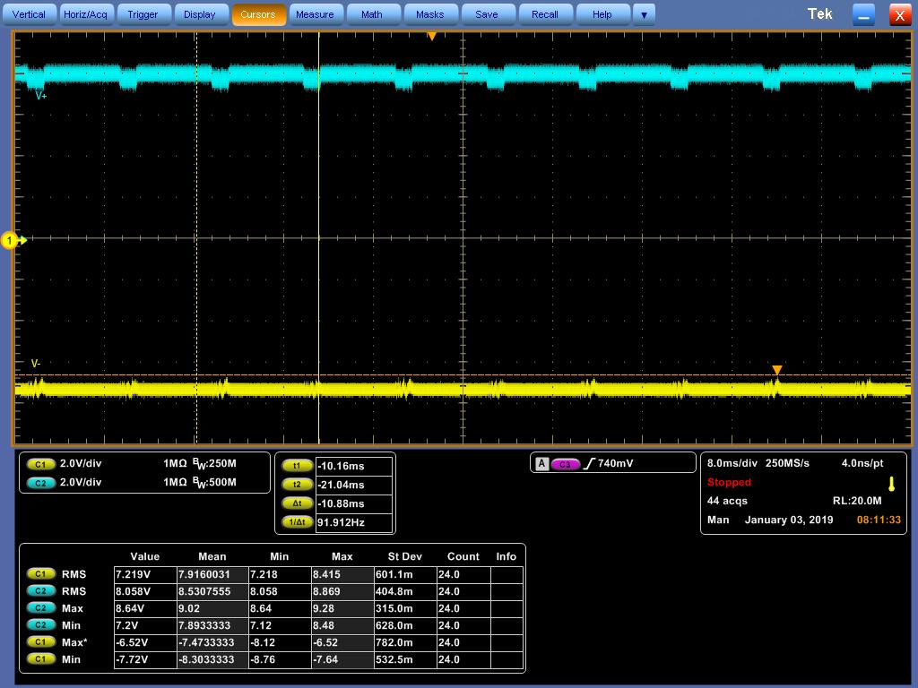
V+ and V-
TRS232EIDR
C1+=C1-=C2+=C2- => 0.1uF
Ripple
Notes:
From: Wang (FAE), Brian Sent: Tuesday, October 24, 2017 11:11 AM To: Shell, Joe; Lin (TWN Analog FAE), Brian Cc: Huang, Murphy; Shen, Kidder; Lin, Jin; Hsu, Elvis Subject: RE: Rockwell Automation / Delta - Ironman Project
Hi Joe,
Thanks for INFO.
In fact we had promoted the TPS65400 on Sep. to instead of the original solution of the ADP5014 that should be used in prior RA projects. However We’ve sent 20pcs samples and an EVM of TPS65400 to DELTA already.
DELTA mentioned they have done both layouts for DP83822 and RA’s original Ethernet solution. And DELTA thinks the decision maker should be RA’s engineer. DELTA says we can send the EMC test report with TIDA-00299 to Rockwell directly.
Any update will keep you posted. Thanks.
Regards,
Brian
From: Shell, Joe Sent: Tuesday, October 24, 2017 11:25 PM To: Lin (TWN Analog FAE), Brian; Wang (FAE), Brian Cc: Huang, Murphy; Shen, Kidder Subject: RE: Rockwell Automation / Delta - Ironman Project
Hello Brian(s),
FYI – We’ve been working with the Rockwell engineer in Shanghai on the POL power for the FPGA in the control structure on the Ironman project. It looks like he’s going to proceed with TPS65400. From the engineer in Shanghai:
“TPS65400 is comprehensive solution with 4 outpus, and sequencing, supervisor and soft-start. So it is the right one for our application.”
I have updated our project plan accordingly.
Have you received any additional feedback regarding the DP83822H decision from Delta?
Thank you,
Joe
Joseph Shell
Texas Instruments Incorporated
WW Account Manager
Office: 262-780-1632
Cell: 262-227-1406
From: Shell, Joe Sent: Friday, October 20, 2017 9:22 AM To: Shen, Kidder Cc: Lin (TWN Analog FAE), Brian; Wang (FAE), Brian; Huang, Murphy Subject: RE: Rockwell Automation / Delta - Ironman Project
Hello Kidder et al,
Wondering if you have any further questions/comments about the Ironman project that Rockwell Automation and Delta are working on together. For more information about the product that they are developing you can refer to the following Rockwell Automation product websites.
This is Rockwell’s current low end servo drive. The Ironman product is being developed to offer Rockwell’s latest servo drive features at a low price point similar to this existing K350 family:
http://ab.rockwellautomation.com/Motion-Control/Servo-Drives/Kinetix-Integrated-Motion-on-EIP/Kinetix-350-Servo-Drive
although it will not replace the K350 product entirely. Rockwell almost never obsoletes existing products (kind of like TI). To understand some of the more advanced features they are trying to enable in this low end product you can review this latest end high end family:
http://ab.rockwellautomation.com/Motion-Control/Servo-Drives/Kinetix-Integrated-Motion-on-EIP/Kinetix-5700-Servo-Drive
The control hardware architecture of Ironman will be based on a similar Altera FPGA + C2000 device. Rockwell’s engineers are currently developing another product with the TMS320F28075 and will likely try to leverage that effort to enable the Ironman front end although they will likely move to an F28004x for the cost savings.
Please let me know if you have any other questions about the project.
Best regards,
Joseph Shell
Texas Instruments Incorporated
WW Account Manager
Office: 262-780-1632
Cell: 262-227-1406
From: Shell, Joe Sent: Wednesday, October 11, 2017 4:52 AM To: Shen, Kidder Cc: Lin (TWN Analog FAE), Brian; Wang (FAE), Brian; Huang, Murphy Subject: Re: Rockwell Automation / Delta - Ironman Project
Hello Kidder Shen
Rockwell Automation is providing the control architecture for this project. It will be based based on an existing Rockwell servo drive system architecture based on an Altera FPGA + TMS320F28075. The Rockwell engineers working on the project are located in Shanghai. The Ironman control structure is being designed with explicit intent to work with a family of Delta motor drive power structures. Delta is also involved with implementation of the control structure design. This will include evaluation of critical components, schematic capture, board layout, and manufacturing / assembly of the final system in their facilities in Taiwan.
This similar OEM/ODM model exists between Rockwell & Delta on the existing PowerFlex 520 AC Drive product family. The control structure in that case was designed by Rockwell Singapore and leveraged a family of Delta power structures as well. See Rockwell’s PowerFlex 523, PowerFlex 525, and PowerFlex 527 for reference.
I look forward to working with you and your team on this project.
Best regards,
Joseph Shell
Texas Instruments
WW Account Manager
Office: 262-780-1632
Cell: 262-227-1406
On Oct 10, 2017, at 11:18 PM, Shen, Kidder <kiddershen@ti.com> wrote:

Slide 7
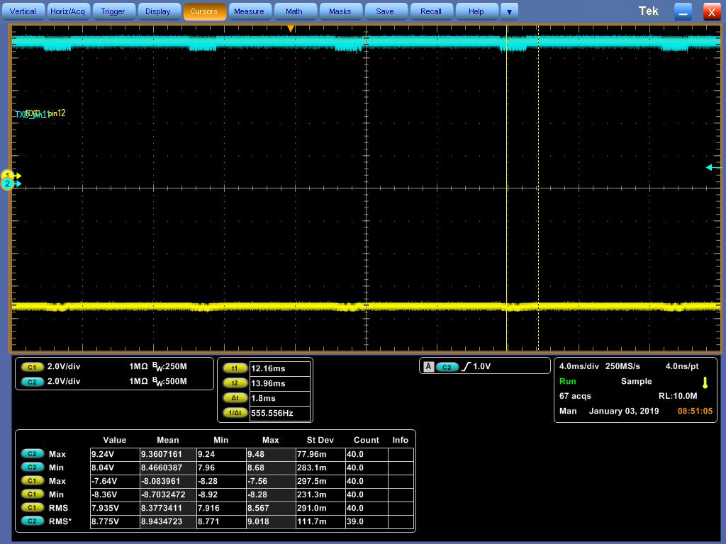
V+ and V-
TRS232EIDR
C1+=C1-=C2+=C2- => 1uF
Ripple
1uF
1uF
Notes:
From: Wang (FAE), Brian Sent: Tuesday, October 24, 2017 11:11 AM To: Shell, Joe; Lin (TWN Analog FAE), Brian Cc: Huang, Murphy; Shen, Kidder; Lin, Jin; Hsu, Elvis Subject: RE: Rockwell Automation / Delta - Ironman Project
Hi Joe,
Thanks for INFO.
In fact we had promoted the TPS65400 on Sep. to instead of the original solution of the ADP5014 that should be used in prior RA projects. However We’ve sent 20pcs samples and an EVM of TPS65400 to DELTA already.
DELTA mentioned they have done both layouts for DP83822 and RA’s original Ethernet solution. And DELTA thinks the decision maker should be RA’s engineer. DELTA says we can send the EMC test report with TIDA-00299 to Rockwell directly.
Any update will keep you posted. Thanks.
Regards,
Brian
From: Shell, Joe Sent: Tuesday, October 24, 2017 11:25 PM To: Lin (TWN Analog FAE), Brian; Wang (FAE), Brian Cc: Huang, Murphy; Shen, Kidder Subject: RE: Rockwell Automation / Delta - Ironman Project
Hello Brian(s),
FYI – We’ve been working with the Rockwell engineer in Shanghai on the POL power for the FPGA in the control structure on the Ironman project. It looks like he’s going to proceed with TPS65400. From the engineer in Shanghai:
“TPS65400 is comprehensive solution with 4 outpus, and sequencing, supervisor and soft-start. So it is the right one for our application.”
I have updated our project plan accordingly.
Have you received any additional feedback regarding the DP83822H decision from Delta?
Thank you,
Joe
Joseph Shell
Texas Instruments Incorporated
WW Account Manager
Office: 262-780-1632
Cell: 262-227-1406
From: Shell, Joe Sent: Friday, October 20, 2017 9:22 AM To: Shen, Kidder Cc: Lin (TWN Analog FAE), Brian; Wang (FAE), Brian; Huang, Murphy Subject: RE: Rockwell Automation / Delta - Ironman Project
Hello Kidder et al,
Wondering if you have any further questions/comments about the Ironman project that Rockwell Automation and Delta are working on together. For more information about the product that they are developing you can refer to the following Rockwell Automation product websites.
This is Rockwell’s current low end servo drive. The Ironman product is being developed to offer Rockwell’s latest servo drive features at a low price point similar to this existing K350 family:
http://ab.rockwellautomation.com/Motion-Control/Servo-Drives/Kinetix-Integrated-Motion-on-EIP/Kinetix-350-Servo-Drive
although it will not replace the K350 product entirely. Rockwell almost never obsoletes existing products (kind of like TI). To understand some of the more advanced features they are trying to enable in this low end product you can review this latest end high end family:
http://ab.rockwellautomation.com/Motion-Control/Servo-Drives/Kinetix-Integrated-Motion-on-EIP/Kinetix-5700-Servo-Drive
The control hardware architecture of Ironman will be based on a similar Altera FPGA + C2000 device. Rockwell’s engineers are currently developing another product with the TMS320F28075 and will likely try to leverage that effort to enable the Ironman front end although they will likely move to an F28004x for the cost savings.
Please let me know if you have any other questions about the project.
Best regards,
Joseph Shell
Texas Instruments Incorporated
WW Account Manager
Office: 262-780-1632
Cell: 262-227-1406
From: Shell, Joe Sent: Wednesday, October 11, 2017 4:52 AM To: Shen, Kidder Cc: Lin (TWN Analog FAE), Brian; Wang (FAE), Brian; Huang, Murphy Subject: Re: Rockwell Automation / Delta - Ironman Project
Hello Kidder Shen
Rockwell Automation is providing the control architecture for this project. It will be based based on an existing Rockwell servo drive system architecture based on an Altera FPGA + TMS320F28075. The Rockwell engineers working on the project are located in Shanghai. The Ironman control structure is being designed with explicit intent to work with a family of Delta motor drive power structures. Delta is also involved with implementation of the control structure design. This will include evaluation of critical components, schematic capture, board layout, and manufacturing / assembly of the final system in their facilities in Taiwan.
This similar OEM/ODM model exists between Rockwell & Delta on the existing PowerFlex 520 AC Drive product family. The control structure in that case was designed by Rockwell Singapore and leveraged a family of Delta power structures as well. See Rockwell’s PowerFlex 523, PowerFlex 525, and PowerFlex 527 for reference.
I look forward to working with you and your team on this project.
Best regards,
Joseph Shell
Texas Instruments
WW Account Manager
Office: 262-780-1632
Cell: 262-227-1406
On Oct 10, 2017, at 11:18 PM, Shen, Kidder <kiddershen@ti.com> wrote:

Slide 8
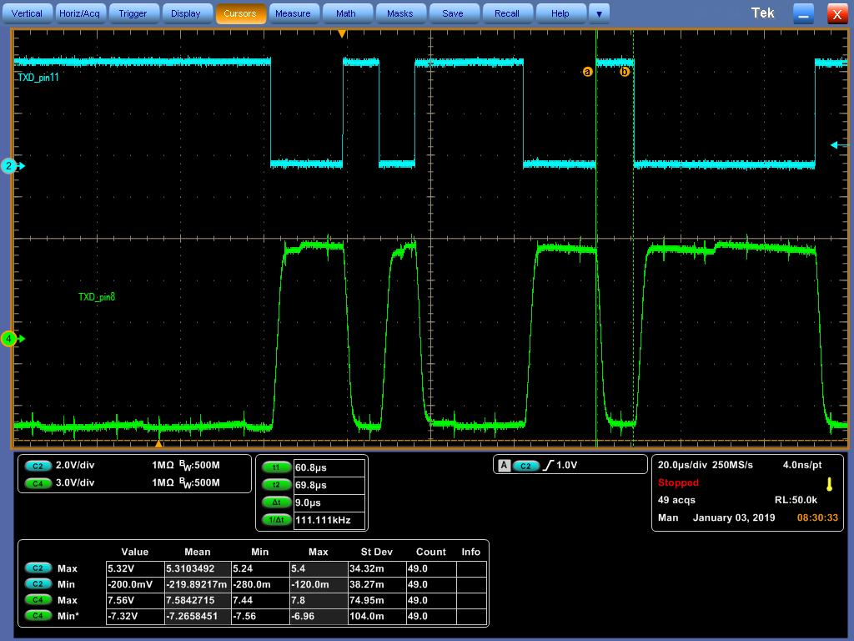
TxD Waveform with TRS232EIDR
TRS232EIDR
C1+=C1-=C2+=C2- => 0.1uF
Notes:
From: Wang (FAE), Brian Sent: Tuesday, October 24, 2017 11:11 AM To: Shell, Joe; Lin (TWN Analog FAE), Brian Cc: Huang, Murphy; Shen, Kidder; Lin, Jin; Hsu, Elvis Subject: RE: Rockwell Automation / Delta - Ironman Project
Hi Joe,
Thanks for INFO.
In fact we had promoted the TPS65400 on Sep. to instead of the original solution of the ADP5014 that should be used in prior RA projects. However We’ve sent 20pcs samples and an EVM of TPS65400 to DELTA already.
DELTA mentioned they have done both layouts for DP83822 and RA’s original Ethernet solution. And DELTA thinks the decision maker should be RA’s engineer. DELTA says we can send the EMC test report with TIDA-00299 to Rockwell directly.
Any update will keep you posted. Thanks.
Regards,
Brian
From: Shell, Joe Sent: Tuesday, October 24, 2017 11:25 PM To: Lin (TWN Analog FAE), Brian; Wang (FAE), Brian Cc: Huang, Murphy; Shen, Kidder Subject: RE: Rockwell Automation / Delta - Ironman Project
Hello Brian(s),
FYI – We’ve been working with the Rockwell engineer in Shanghai on the POL power for the FPGA in the control structure on the Ironman project. It looks like he’s going to proceed with TPS65400. From the engineer in Shanghai:
“TPS65400 is comprehensive solution with 4 outpus, and sequencing, supervisor and soft-start. So it is the right one for our application.”
I have updated our project plan accordingly.
Have you received any additional feedback regarding the DP83822H decision from Delta?
Thank you,
Joe
Joseph Shell
Texas Instruments Incorporated
WW Account Manager
Office: 262-780-1632
Cell: 262-227-1406
From: Shell, Joe Sent: Friday, October 20, 2017 9:22 AM To: Shen, Kidder Cc: Lin (TWN Analog FAE), Brian; Wang (FAE), Brian; Huang, Murphy Subject: RE: Rockwell Automation / Delta - Ironman Project
Hello Kidder et al,
Wondering if you have any further questions/comments about the Ironman project that Rockwell Automation and Delta are working on together. For more information about the product that they are developing you can refer to the following Rockwell Automation product websites.
This is Rockwell’s current low end servo drive. The Ironman product is being developed to offer Rockwell’s latest servo drive features at a low price point similar to this existing K350 family:
http://ab.rockwellautomation.com/Motion-Control/Servo-Drives/Kinetix-Integrated-Motion-on-EIP/Kinetix-350-Servo-Drive
although it will not replace the K350 product entirely. Rockwell almost never obsoletes existing products (kind of like TI). To understand some of the more advanced features they are trying to enable in this low end product you can review this latest end high end family:
http://ab.rockwellautomation.com/Motion-Control/Servo-Drives/Kinetix-Integrated-Motion-on-EIP/Kinetix-5700-Servo-Drive
The control hardware architecture of Ironman will be based on a similar Altera FPGA + C2000 device. Rockwell’s engineers are currently developing another product with the TMS320F28075 and will likely try to leverage that effort to enable the Ironman front end although they will likely move to an F28004x for the cost savings.
Please let me know if you have any other questions about the project.
Best regards,
Joseph Shell
Texas Instruments Incorporated
WW Account Manager
Office: 262-780-1632
Cell: 262-227-1406
From: Shell, Joe Sent: Wednesday, October 11, 2017 4:52 AM To: Shen, Kidder Cc: Lin (TWN Analog FAE), Brian; Wang (FAE), Brian; Huang, Murphy Subject: Re: Rockwell Automation / Delta - Ironman Project
Hello Kidder Shen
Rockwell Automation is providing the control architecture for this project. It will be based based on an existing Rockwell servo drive system architecture based on an Altera FPGA + TMS320F28075. The Rockwell engineers working on the project are located in Shanghai. The Ironman control structure is being designed with explicit intent to work with a family of Delta motor drive power structures. Delta is also involved with implementation of the control structure design. This will include evaluation of critical components, schematic capture, board layout, and manufacturing / assembly of the final system in their facilities in Taiwan.
This similar OEM/ODM model exists between Rockwell & Delta on the existing PowerFlex 520 AC Drive product family. The control structure in that case was designed by Rockwell Singapore and leveraged a family of Delta power structures as well. See Rockwell’s PowerFlex 523, PowerFlex 525, and PowerFlex 527 for reference.
I look forward to working with you and your team on this project.
Best regards,
Joseph Shell
Texas Instruments
WW Account Manager
Office: 262-780-1632
Cell: 262-227-1406
On Oct 10, 2017, at 11:18 PM, Shen, Kidder <kiddershen@ti.com> wrote:

