Slide 1
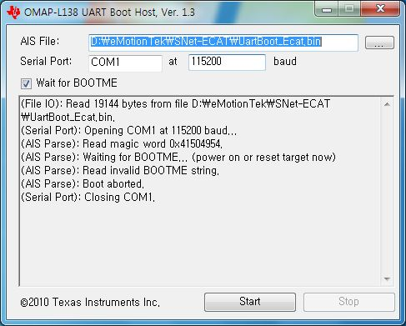
lot : CNQG
  0x41504954 transmitted from DSP to UART Boot Host (TI's SW) via RS232C Serial Port at Power On
  If a miss-match occurs, the error ends.
2. Phenomenon
  A miss-match error occurs during serial boot communication
  Normal communication normal (Receive side 1ST byte error at power on)

Slide 2
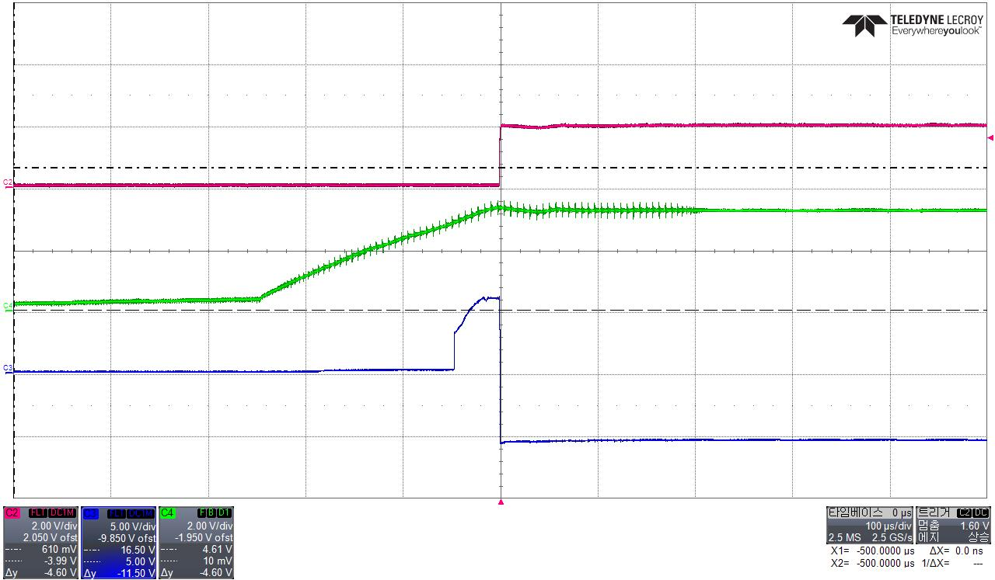
When I turned on the power From TRS3221 TxD Out Port(Pin13) One Pulse Output
UART Boot Host recognizes as RS232C specification communication Start Bit and causes a Miss-Match Error
① TxD Input Port(Pin11)
② +3.3V Power
③ TxD Output Port(Pin13)
< TRS3221EI CNQG Lot > EN, FORCEOFF# Pin -> +3.3V, FORCE ON Pin -> Logic

Slide 3
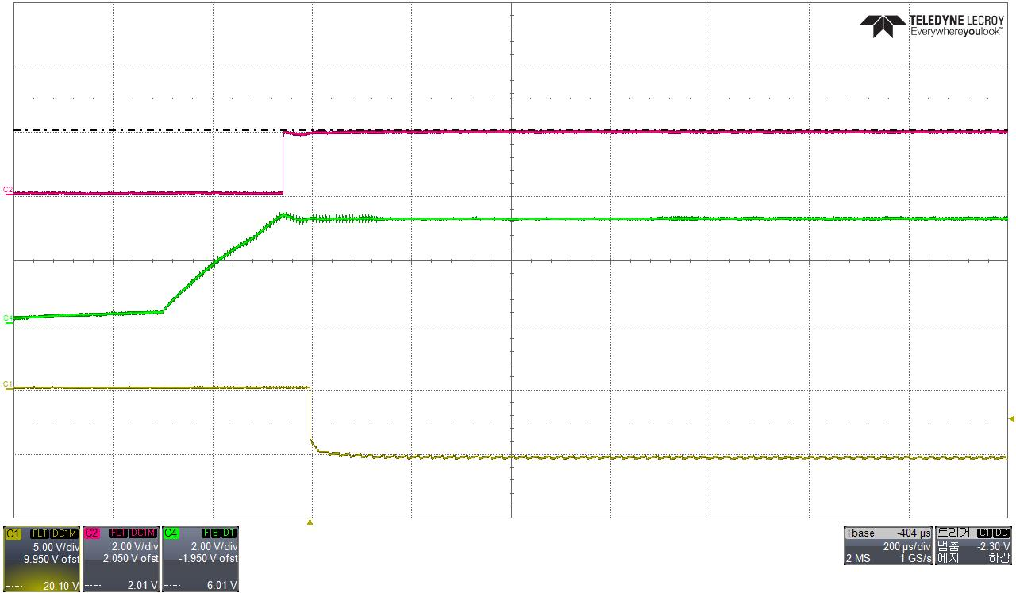
C7KV Lot Waveform for Comparison
① TxD Input Port(Pin11)
② +3.3V Power
③ TxD Output Port(Pin13)
< TRS3221EI C7KV > EN, FORCEOFF# Pin -> +3.3V, FORCE ON Pin -> Logic

Slide 4
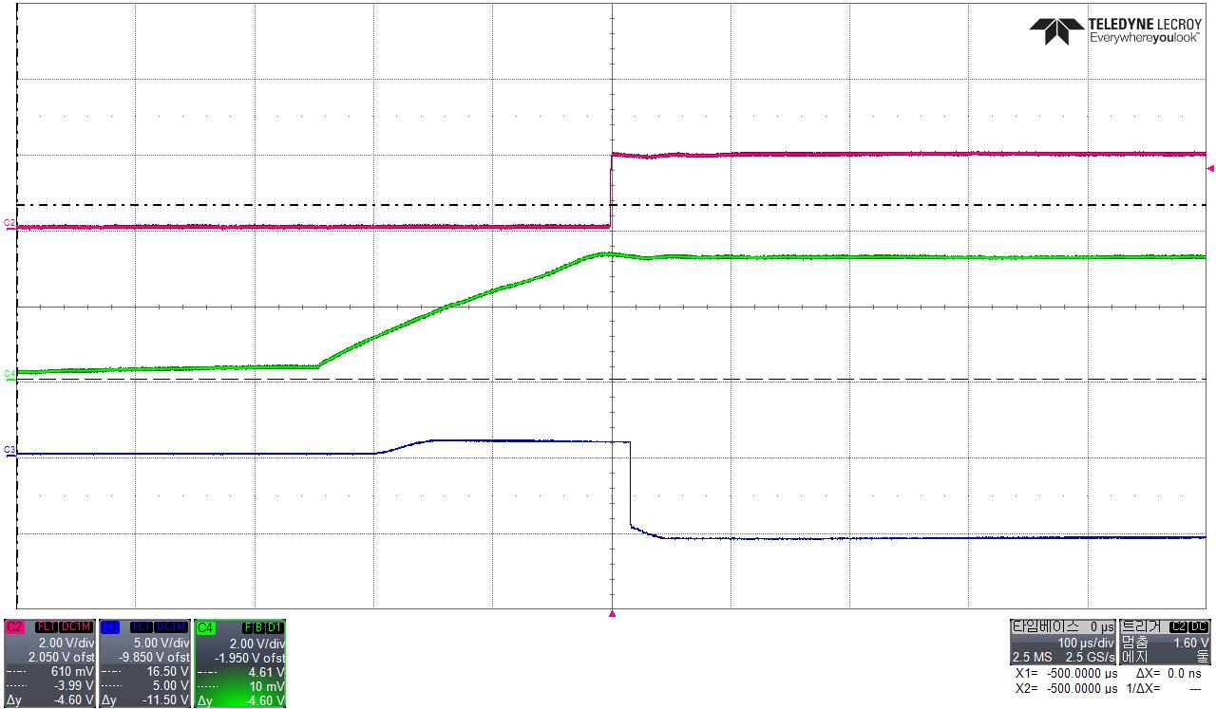
MAX3221E Waveform for Comparison
① TxD Input Port(Pin11)
② +3.3V Power
③ TxD Output Port(Pin13)
< MAX3221E> EN, FORCEOFF# Pin -> +3.3V, FORCE ON Pin -> Logic

