Slide 1
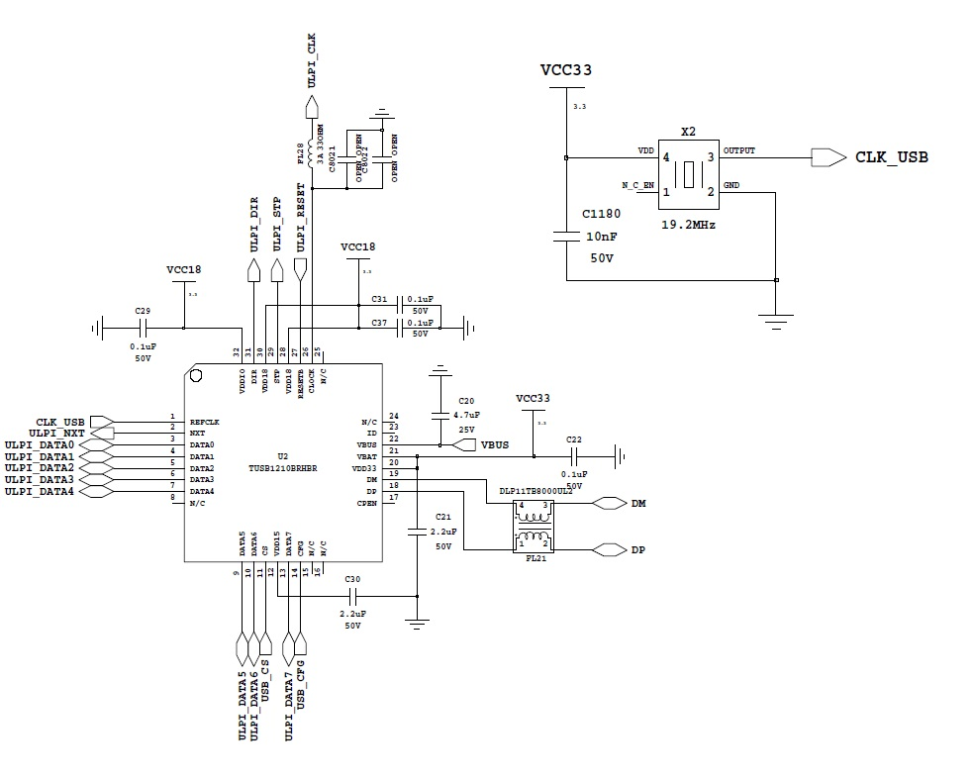

Slide 2
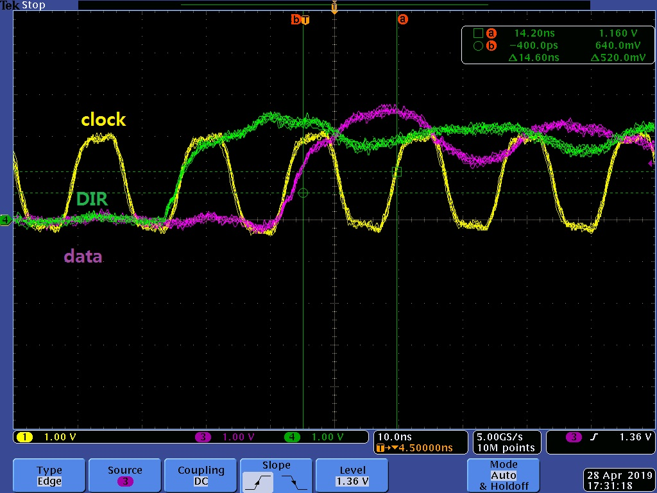
Setup time(data ~ clk rising) 14.6ns is right? , according to datasheet table 5-4(output clock) its max. is 6ns.
Would you mark on the waveform for Tsd, Tsc, Thd exactly?

Slide 3
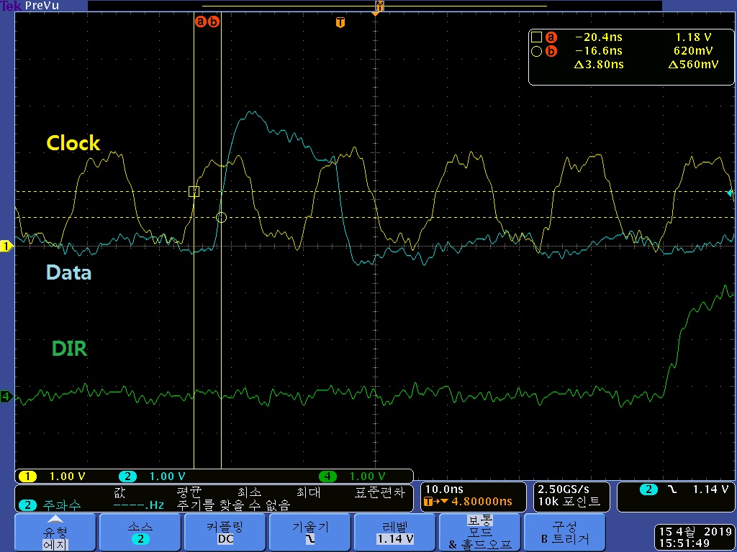
Dfd

