Slide 1
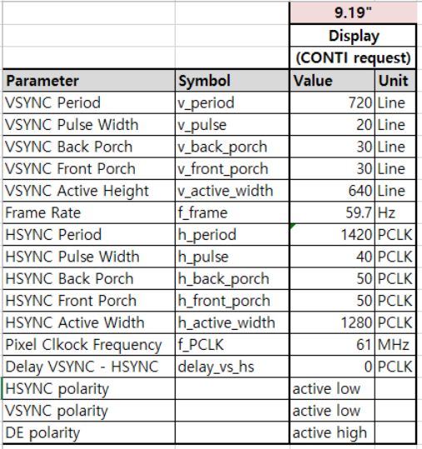
Display timing info

Slide 2
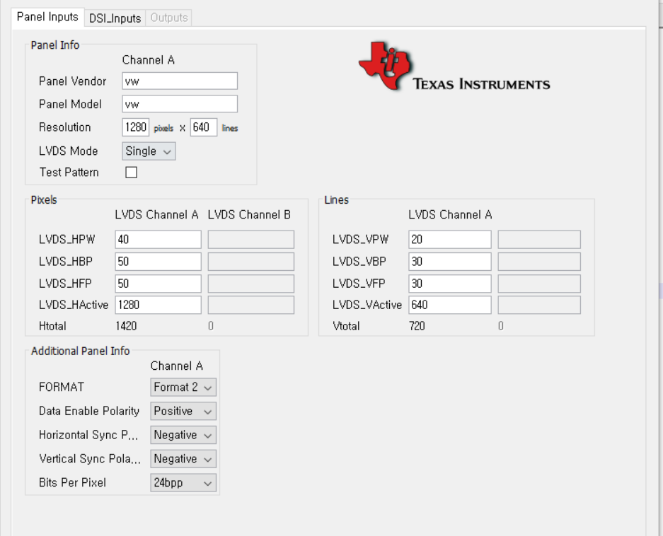
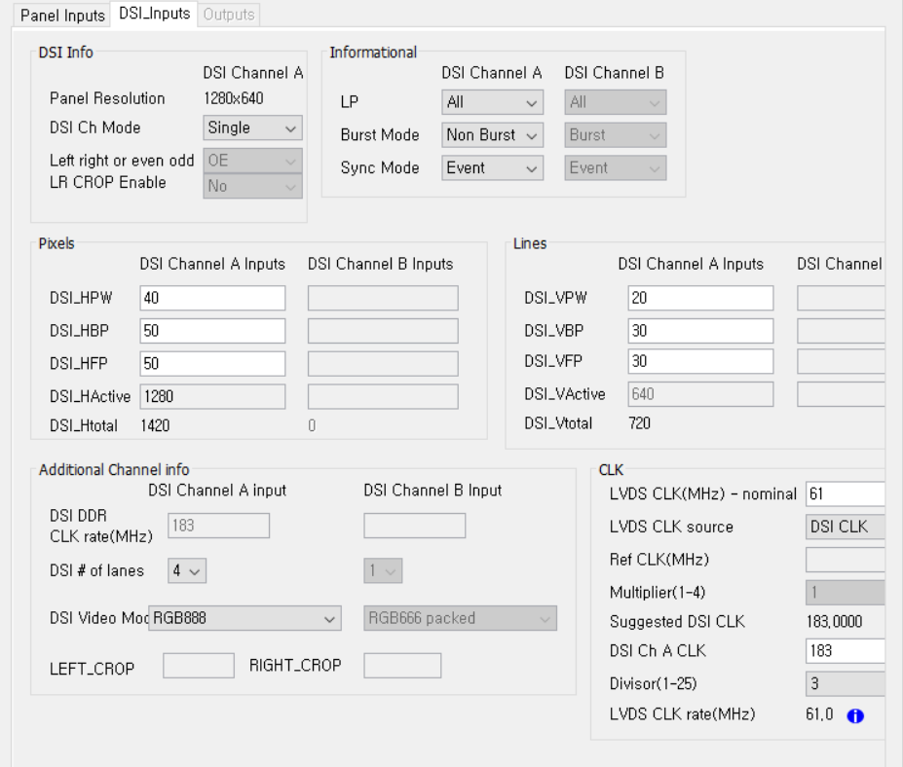
install DSI Tuner 2.0.exe
java -jar "DSI Tuner.jar"

Slide 3
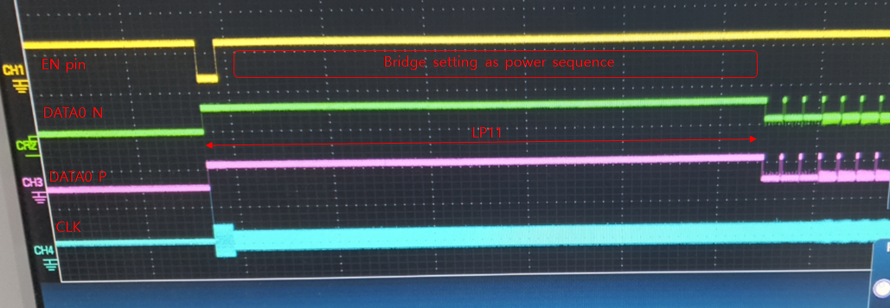
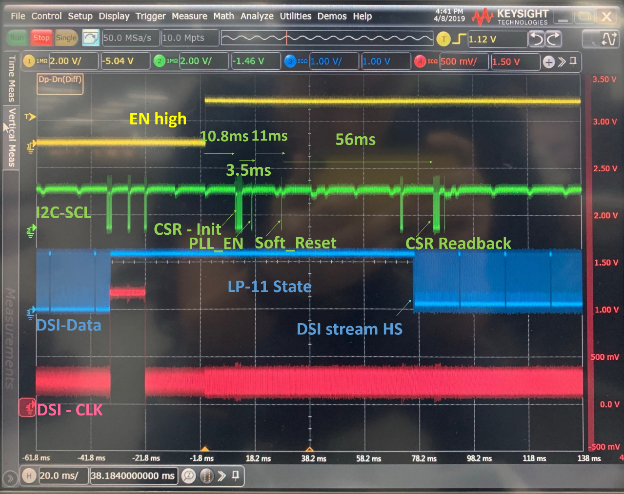
Install DSI Tuner 2.0.exe
- CSR configuration is done in LP11 state
- LG board -
-TI recommended sequence-

Slide 4
LVDS output timing for Normal CS NG
Parameters | Setting | Real Measured value
v_period | 720 | 720 | 720
v_pulse | 20 | 20 | 20
v_back_porch | 30 | 30 | 30
v_front_porch | 30 | 30 | 30
v_active_width | 640 | 640 | 640
h_period | 1420 | 1420 | 1420
h_pulse | 40 | 40 | 40
h_back_porch | 50 | 52 | 50
h_front_porch | 50 | 48 | 50
h_active_width | 1280 | 1280 | 1280
There is 2 pixel H timing variation between H-back porch and H-front porch in issue case

Slide 5
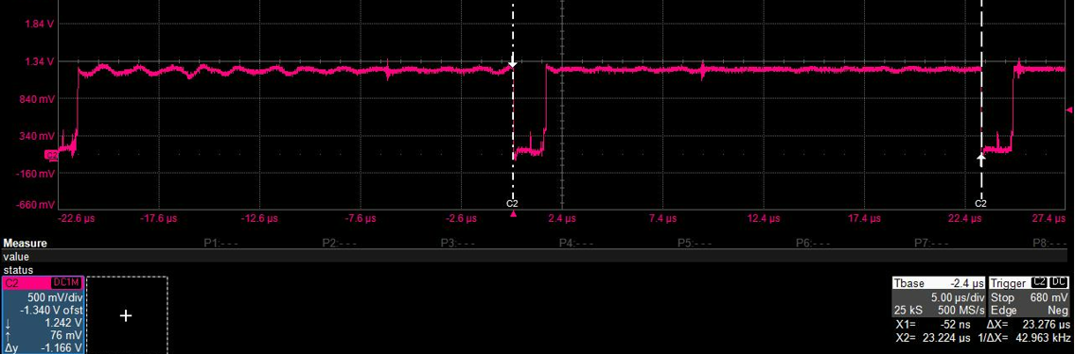
Line time in DSI analysis
    Calculation : 1420/61M(H_Total/PCLK) → 23.278us
    Measurement : 23.276us

