Slide 1
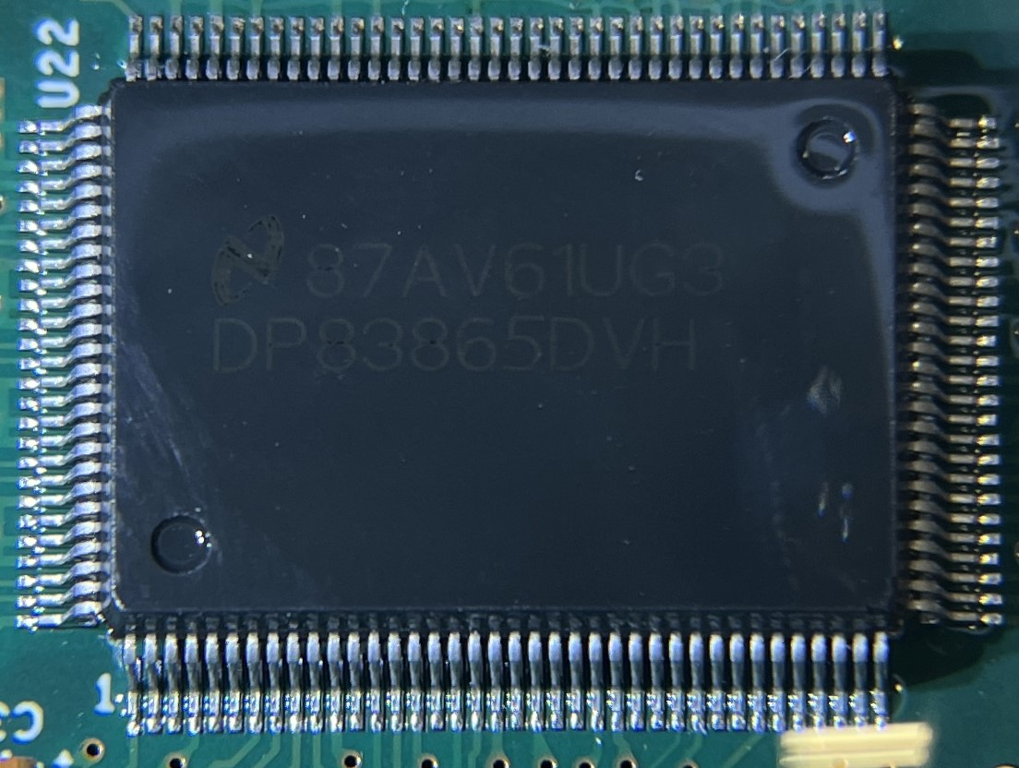
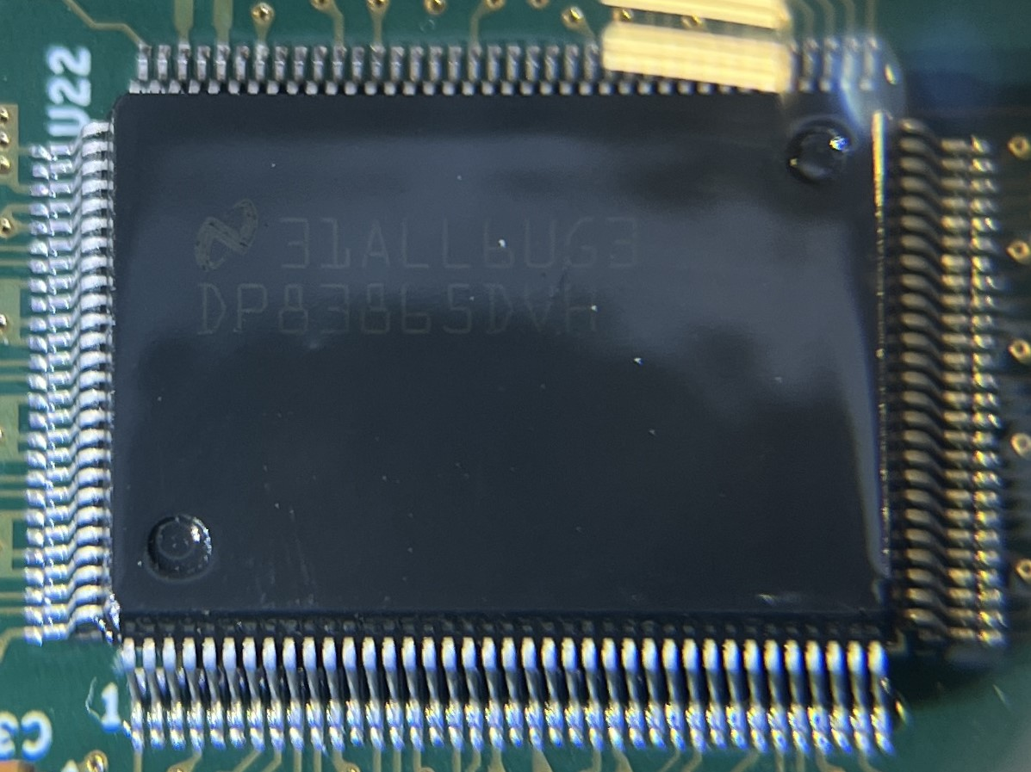
The location of the part marking is similar, but not exact.
Known Good Part
Suspect Part

Slide 2
The lot number of every component that I can see (some are covered with Mezz. cards) is the same, where as every known good component is vastly different.
Known Good Part
Suspect Part

Slide 3
The font used to print the manufacturer’s data is vastly different from a known good part to the suspect part.
Known Good Part
Suspect Part

