Slide 1
UART
Overview
High Speed Interface

Slide 2
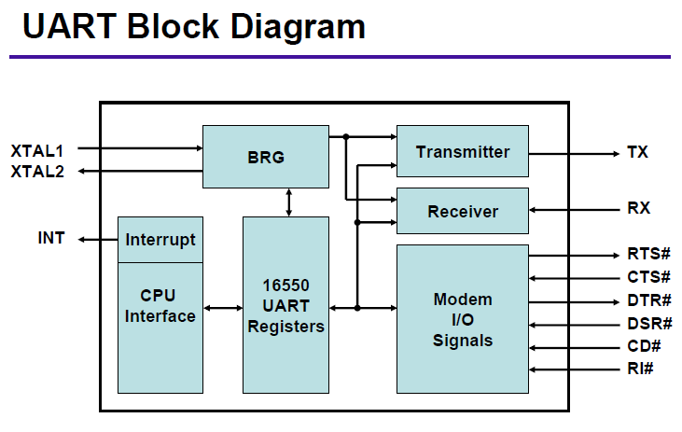
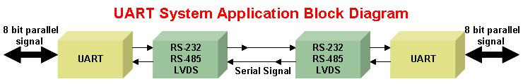
What is UART？
Universal Asynchronous Receiver/Transmitter
Parallel to Serial and Serial to Parallel Conversion
Buffering
Data Communication Baud Rate Generation
Communication Handshaking
Start/Stop Bits
Parity Generation
Why use UART
– Easy and low cost serial interface to connect
two computing systems
– Industry standard asynchronous communication
data interfaces
– More reliable for high-speed serial
communication
– Need less wires than parallel transmission
– Enable long distance serial communication
(RS232=50ft, RS485=4Kft)
XTAL1:Crystal or external clock input
XTAL2:Output of the crystal oscillator or buffered clock.
RTS: Request to send
CTS: Clear to send
DTR: Data terminal ready (active low)
DSR: Data set ready (active low).
CD: Carrier detect (active low)
RI: Ring indicator (active low).

Slide 3
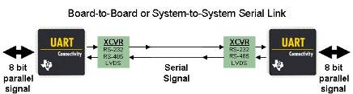
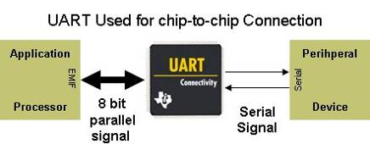
How are UARTS used?
End Equipments
Modem
Factory Automation and Process Control
Point of Sales Systems
Gaming Terminals
Network Management
System Management and Debug ports
Chip-to-chip parallel-to-serial and serial-to-parallel data conversion/transmission

Slide 4
Discrete UARTs VS integrated UARTs？
Faster baud rates – up to 5Mbps (good for Bluetooth)
Deeper FIFO Memmory
Low current consumption
Programmable UART baud rate with high resolution clock prescaler
Extra GPIO with change-of-state detectors for general-purpose or modem control
More Flexible interrupt system
Independent transmit and receive channel control
More Channels (1, 2, and 4)
Better Auto software and hardware flow controls – prevent loss of data
Better Auto multi-drop (RS-485) mode – prevent software overhead
Flexible character length format – 5 to 8 data, parity, 9-bit, and stop bits
Built-in IrDA interface circuitry – enable wireless links communication
Upgrade the UART for future interfaces without replacing the CPU/ ASIC

Slide 5
Application markets for UARTs
COMMUNICATIONS:
Telecommunications equipment used for transmission, control, and testing for quality, have been using discrete UARTs for serial communications.
Telecommunications equipment requires multiple channels, so UARTs with higher channel counts are required. Also, deeper FIFO devices are desirable for application designers in telecom.
– Telecom / networking : routers, servers, VoIP systems
COMPUTER:
Highly integrated: Most COM ports in the computer now are controlled by integrated ICs.
Further, most peripherals common in the computer market are parallel devices.
– POS systems : vending screen, banking terminal, gas station
– Remote access router : console, terminal, diagnostic, modem
CONSUMER:
Due to the growing number of applications requiring more computing power, the consumer market is a growing area for UARTs.
Relatively small, the consumer market is an area where significant integration occurs and the growing number of FPGAs and GPUs being used will be designed with the UART function integrated in.
– Portable Devices: GPS, digital cameras, smart phones, gaming and PDAs.
INDUSTRIAL:
Provide multiple opportunities in medical, process control, test equipment, and aerospace and military.
Use different channel count UARTs depending on how complex the design.
– Industrial control and Medical equipment
– Multi-drop industrial remote stations : display, sensor, meter
AUTOMOTIVE:
UARTs are used in conjunction with microcontrollers to communicate other subsystems through serial communications.
Navigation systems and other computer intensive functions.

Slide 6
UART Product Portfolio 1 Channel:
NO FIFO | 16 Byte FIFO | 64 Byte FIFO
TL16C450
5V, Max rate = 0.25Mbps
TL16C550C
3.3 or 5V, Max rate = 1Mbps
TL16C750
3.3V or 5V, Max rate = 3Mbps
TL16C451
5V, Max rate = 0.25Mbps, parallel port
TL16C550D
2.5, 3.3 or 5V, Max rate = 1.5Mbps
TL16PC564B
PCMCIA Interface w/ 64-Byte FIFOs
PC16550D
5V, Max rate = 1.5Mbps

Slide 7
UART Product Portfolio 2 Channels:
NO FIFO | 16 Byte FIFO | 64 Byte FIFO
 |  | High-Reliability product.
TL16C452
5V, Max rate = 0.25Mbps
TL16C552
5V, Max rate = 1Mbps, Parallel Port
TL16C752B
3.3 V, Max rate = 3Mbps
TL16C552AM
5V, Max rate = 1Mbps, Parallel Port
TL16C752B-EP
3.3 V, Max rate = 3Mbps
TL16C2550
1.8, 2.5, 3.V or 5V, Max rate = 1.5Mbps
TL16C752C
1.8, 2.5, 3.3 or 5V, Max rate = 3Mbps
TL16C2550-Q1
Automotive
1.8, 2.5, 3.V or 5V, Max rate = 1.5Mbps
TL16C2752
1.8, 2.5, 3.3 or 5V, Max rate = 3Mbps
TL16C2552
1.8, 2.5, 3.3 or 5V, Max rate = 1.5Mbps
NS16C2752
3.3 or 5V, Max rate = 5Mbps
NS16C2552
3.3 or 5V, Max rate = 5Mbps
TL28L92
3.3 or 5V, Max rate = 1Mbps
Intel & Motorola Interface
PC16552D
5V, Max rate = 1.5Mbps
TL16PIR552
Selectable IR and IEEE-1284 Modes

Slide 8
UART Product Portfolio 4 Channels:
NO FIFO | 16 Byte FIFO | 64 Byte FIFO
 | High-Reliability product.
TL16C554
5V, Max rate = 1Mbps
TL16C754B
3.3V or 5V, Max rate = 3Mbps
TL16C554A
3.3 or 5V, Max rate = 1Mbps
TL16C754C
1.8, 2.5, 3.3 or 5V, Max rate = 3Mbps

Slide 9
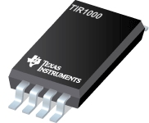
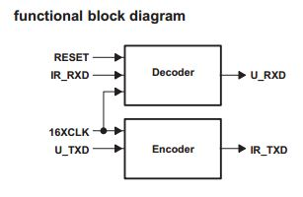
UART Product Portfolio IrDA™:
TIR1000
STANDALONE IrDA™ ENCODER AND DECODER
The TIR1000 serial infrared (SIR) encoder/
decoder is a CMOS device which encodes and decodes bit data in conformance with the IrDA specification.
Adds Infrared (IR) Port to Universal Asynchronous Receiver Transmitter (UART)
Compatible With Infrared Data Association (IrDA™) and Hewlett Packard Serial Infrared (HPSIR)
Provides 1200 bps to 115 kbps Data Rate
Operates From 2.7 V to 5.5 V
Provides Simple Interface With UART
Decodes Negative or Positive Pulses
Available in Two 8-Terminal Plastic Small Outline Packages (PSOP), PS Package Has Slightly Larger Dimensions Than PW Package

Slide 10
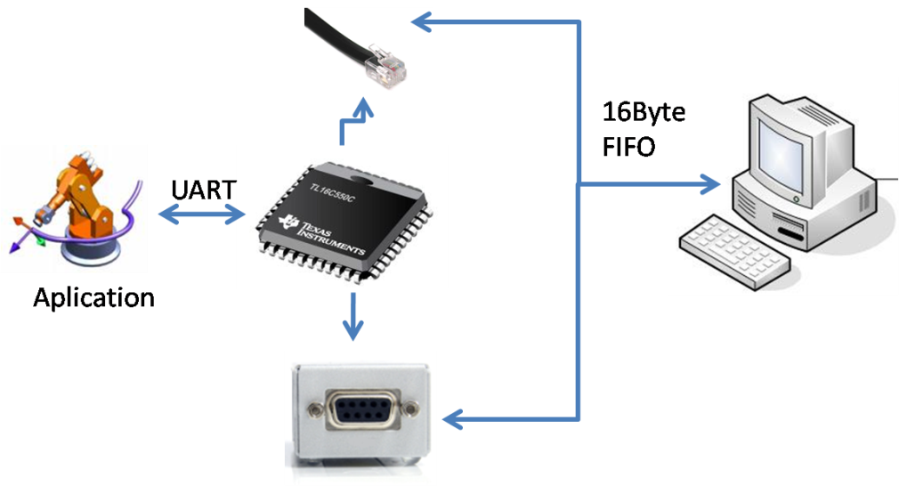
TL16C550C
Single UART with 16-Byte FIFOs and Auto Flow Control
16-Byte FIFO
Programmable Auto-RTS\ and Auto-CTS\
In Auto-CTS\ Mode, CTS\
Serial and Modem Control Outputs Drive a RJ11
Programmable Baud Rate Generator
5-V and 3.3-V Operation
Independent Receiver Clock Input
3-State Output TTL Drive Capabilities for
Bidirectional Data Bus and Control Bus
44 Pin PLCC & 48 Pin LQFP Packages
Capable of Running With All Existing TL16C450 Software
Up to 16-MHz Clock Rate
Internal Diagnostic Capabilities
Complete Status Reporting Capabilities
Factory automation
Industrial communications network
Ethernet Network Routers
Portable appliances
Serial modems
In System Debugging

Slide 11
TL16C750
Single Channel 64-byte FIFOs UART
Features
Benefits
Up to 1.0Mbps(5V) & 931kbps(3.3V)
44-pin PLCC and 64-pin QFP package options
TI Patented Programmable auto-RTS and auto-CTS
Programmable 16- or 64-Byte FIFOs Programmable baud rate generator
Independent clock for the receiver
Compatibility with high speed processors
P4P and functionally compatible to Industry Standard 16C750 function
Reduces software overload and increases system efficiency
64 byte FIFOs reduce CPU overhead
More functionality
64
Applications
Telecommunication routers
Mobile Computing
Handheld terminals
Factory Automation

Slide 12
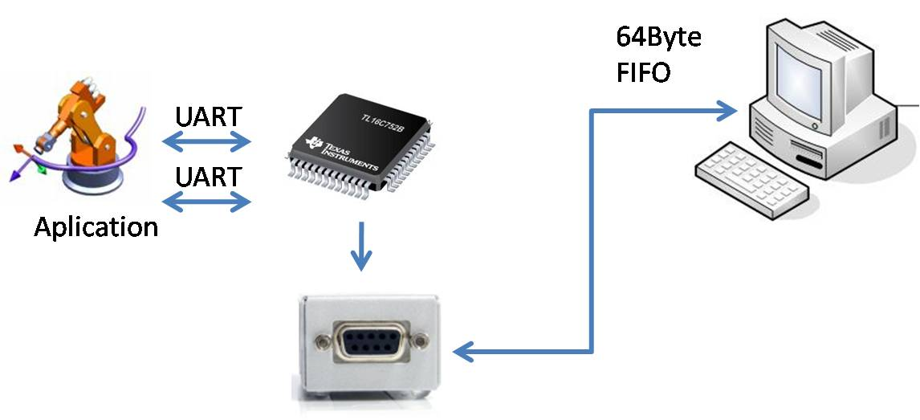
TL16C752B
Dual UART With 64-Byte FIFO

Slide 13
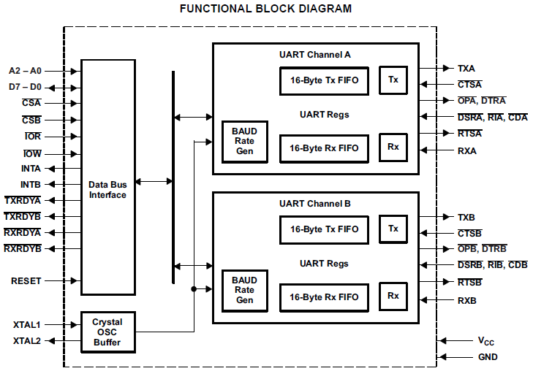
TL16C752C
Dual Channel 64-byte FIFOs UART
Features
Benefits
Up to 3Mbps(5V), 2Mbps(3.3V), 1.5Mbps (2.5V) and 1Mbps(1.8V)
TI Patented Programmable auto-RTS and auto-CTS
64-Byte FIFO
Programmable and selectable transmit and receive FIFO trigger levels
Xon/Xoff software flow control
Compatibility with high speed processors
Reduces software overload and increases system efficiency
64 byte FIFOs reduce CPU overhead
More functionality
Applications
Telecommunication routers
Factory Automation
Handheld terminals
Mobile Computing

Slide 14
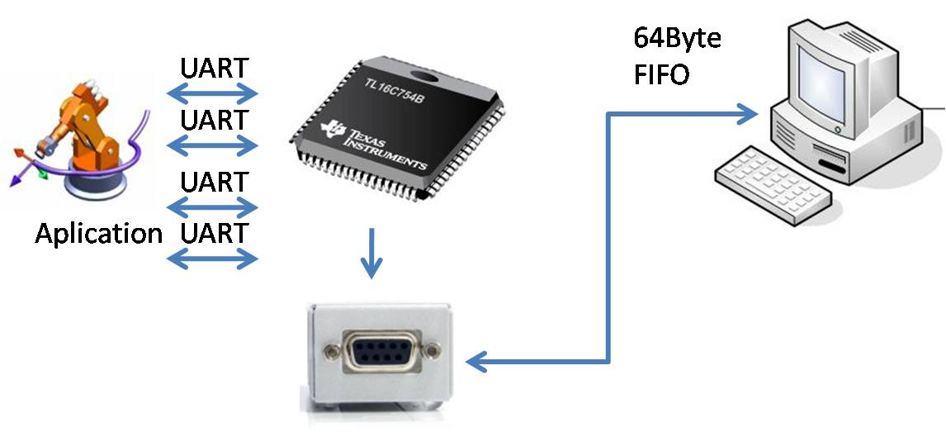
TL16C754B
Quad UART with 64-Byte FIFO
Supports Up To 48-MHz Oscillator Input Clock ( 3 Mbps) for 5-V Operation
Programmable Auto-RTS and Auto-CTS
64-Byte Transmit FIFO/Receive FIFO With Error Flags
Supports 3.3-V or 5-V Supply
Programmable and Selectable Transmit and Receive FIFO Trigger levels for DMA and Interrupt Generation
Available in 80-pin TQFP and 68-pin PLCC packages
Programmable Receive FIFO Trigger Levels for Software/Hardware Flow Control
Four UART Channels
Gets the status of TXRDY/RXRDY for all four ports in one access.
Programmable Sleep Mode
DMA Signalling Capability for Both Received and Transmitted Data
Factory automation
Industrial communications network
Ethernet Network Routers
Portable appliances
Serial modems
Cell data transfer

Slide 15
TL16C754C
Quad Channel 64-byte FIFOs UART
Features
Benefits
Up to 3Mbps(5V) and 2Mbps(3.3V) operation
RS-485 Mode Support
TI Patented Programmable auto-RTS and auto-CTS
64-Byte FIFO
Programmable and selectable transmit and receive FIFO trigger levels
Xon/Xoff software flow control
Compatibility with high speed processors
Reduces software overload and increases system efficiency
64 byte FIFOs reduce CPU overhead
More functionality
Applications
Telecommunication routers
Factory Automation
Point-of-Sale terminals
Data Concentrators

Slide 16
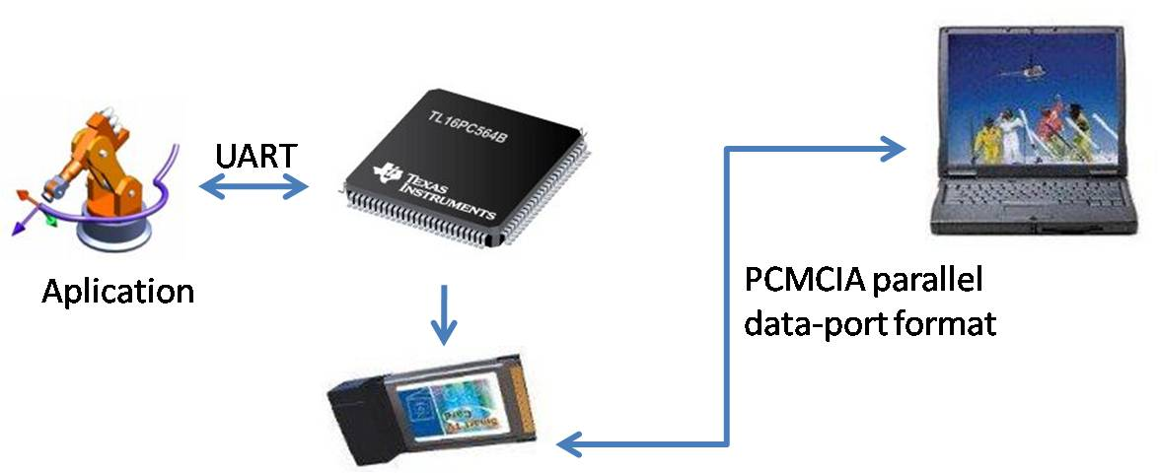
TL16PC564B
Single UART with 64-Byte FIFOs, PCMCIA Interface
Integrated Asynchronous Communications Element Compatible With PCMCIA PC Card Standard 2.01
Provides Common I-Bus/Z-Bus Microcontroller Inputs for Most Intel™ and Zilog™ Subsystems
Fully Programmable 256-Byte Card Information Structure (CIS) and 8-Byte Card Configuration Register (CCR)
Adds or deletes standard asynchronous communication Bits (Start, Stop and Parity) to or From Serial Data Stream
Independently Controlled Transmit, Receive, Line Status, and Data Set Interrupts
Subsystem Selectable Serial-Bypass Mode Provides Subsystem With Direct Parallel Access to the FIFOs
Fully Programmable Serial-Interface Characteristics
Fully Prioritized Interrupt System Controls
Modem Control Functions
Provides TL16C450 Mode at Reset Plus Selectable Normal TL16C550 Operation or Extended 64-Byte FIFO Mode
Selectable Auto-RTS\ Mode Deactivates RTS\ at 14 Bytes in 550 Mode and at 56 Bytes in Extended 550 Mode
Selectable Auto-CTS\ Mode Deactivates Serial Transfers When CTS\ is Inactive
UART to PCMCIA Applications
Factory automation
Industrial communications network
Ethernet Network Routers
Portable appliances
Serial modems

Slide 17
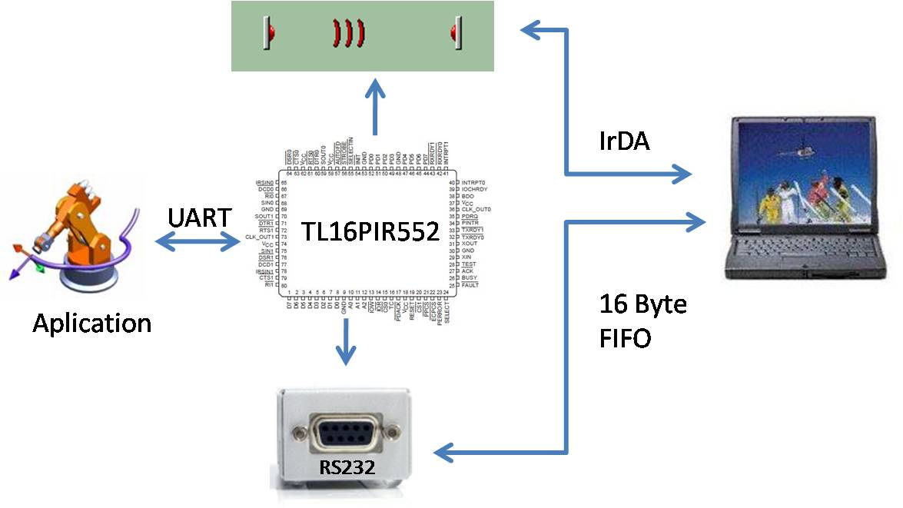
TL16PIR552
Dual UART with 16-Byte FIFOs, Selectable IR & 1284 Modes
Dual TL16C550C Universal Asynchronous Receiver/Transmitters (UARTs)
IEEE 1284 Bidirectional Parallel Data (PD) Port
Serial Ports Have IrDA Inputs and Outputs
1200 bps to 115.2 kbps Data Rate
16-Byte FIFOs Reduce CPU Interrupts
12 mA Drive Current for All 1284 Control Terminals and Parallel Port Data Terminals
Modem-Control Functions (CTS\, RTS\, DSR\, DTR\, RI\, and DCD\)
Available in 80-Pin QFP Package
Complete Status Reporting Capabilities
3-State Output TTL Drive Capabilities for Bidirectional Data Bus and Control Bus
Line Break Generation and Detection
Internal Diagnostic Capability
Fully Prioritized Interrupt System Controls
UART
Factory automation
Industrial communications network
Ethernet Network Routers
Portable appliances
Serial modems
Cellular data transfer

Slide 18



TL28L92
Dual Universal Asynchronous Receiver/Transmitter
Features
Benefits
Dual Full-Duplex independent asynchronous Receiver/Transmitters 16 Character FIFOs.
Pin Programming Selects 68xxx or 80xxx Bus (Motorola or Intel bus interface)
Programmable Data Format
  5 Data to 8 Data Bits Plus Parity
  Odd, Even, No Parity or Force Parity
  1 Stop, 1.5 Stop or 2 Stop Bits
  Programmable in 1/16-Bit Increments
  Programmable Baud Rate for Each Receiver and Transmitter
  Parity, Framing, and Overrun Error Detection
  False Start Bit Detection
  Programmable Channel Mode
  Industrial temperature range: -40°C to 85°C
  44 Pin QFP package
Operates with either the Motorola or Intel bus interface
SC28L92 Pin Compatible
Operates as either 8 Byte or 16 Byte FIFO’s
Versatile Interrupt System
Automatic Wake-Up mode for Multi-Drop applications
On-Chip Crystal Oscillator
Motorola
68xxx
BUS
8/16 Byte
FIFO
Applications
TL28L92
Telecommunication routers
Mobile Computing
Handheld terminals
Factory Automation
Intel
80xxx
BUS

Slide 19
TI UART Upgrade Conversion
Available Old Revisions |  | New Drop-in Replacement |  | New Version Enhancements | Comment
Generic PN | Orderable PN | Generic PN | Orderable PN
TL16C550C | TL16C550CIPT | TL16C550D | TL16C550DIPT | New process technology enables: the addition of lower voltage (2.5V) processor support Increasing the maximum baud rate achievavble at each supply voltage node Lower device AUP
 | TL16C550CIPTR |  | TL16C550DIPTR
 | TL16C550CPFB |  | TL16C550DPFB
 | TL16C550CPFBR |  | TL16C550DPFBR
 | TL16C550CPT |  | TL16C550DPT
 | TL16C550CPTR |  | TL16C550DPTR
 | TL16C550CFN |  | n/a |  | No New PLCC Development Planned
 | TL16C550CFNR |  | n/a |  | No New PLCC Development Planned
 | TL16C550CIFN |  | n/a |  | No New PLCC Development Planned
 | TL16C550CIFNR |  | n/a |  | No New PLCC Development Planned
TL16C552 | TL16C552FN | TL16C552A | TL16C552AFN | The TL16C552A fixes a timing errata item on the TL16C552.
 | TL16C552FNR |  | TL16C552AFNR
TL16C554 | TL16C554FN | TL16C554A | TL16C554AFN | The main functional difference between the TL16C554 and the TL16C554A is the addition of flow control in the TL16C554A.
 | TL16C554FNR |  | TL16C554AFNR
 | TL16C554IFN |  | n/a |  | No I-temp in FN Package
 | TL16C554IFNR |  | n/a |  | No I-temp in FN Package
 | TL16C554IPN |  | TL16C554AIPN
 | TL16C554PN |  | TL16C554APN
 | TL16C554PNR |  | TL16C554APNR
TL16C752B | TL16C752BPT | TL16C752C | TL16C752CPFB | the addition of lower voltage (1.8V & 2.5V) processor support changing the data bus timing from synchronous to asynchronous to better match the industry norm automatic RS-485 transceiver control per channel | PT = 1.4mm thick while PFB = 1mm thick
 | TL16C752BPTR |  | TL16C752CPFBR |  | PT = 1.4mm thick while PFB = 1mm thick
TL16C754B | TL16C754BFN | TL16C754C | n/a | the addition of lower voltage (1.8V & 2.5V) processor support changing the data bus timing from synchronous to asynchronous to better match the industry norm automatic RS-485 transceiver control per channel | No New PLCC Development Planned
 | TL16C754BPN |  | tbd |  | Potential Future Package release
 | TL16C754BPNR |  | tbd |  | Potential Future Package release

Slide 20
TL16C554A Competitive Overview
Code | Comp. | Device | Supp. Volt. (V) | Baud (Mbps) | Pin & Package | FIFOs | Tx/Rx FIFO INT Trig | Auto RTS/CTS | Bus Style | IrDa | Comments
 |  | TL16C554A | 3.3V 5.0V | 1.0 | 68PLCC 80LQFP | 16 | No / 4 Levels | Yes | Intel | No
Q | NXP | SC16C554 | 2.5V 3.3V 5.0V | 3.0 5.0 5.0 | 64-LQFP 68-PLCC 80-LQFP | 16 | No / 4 Levels | Yes | Intel or Motorola | Yes
Q | NXP | SC16C554B | 2.5V 3.3V 5.0V | 3.0 5.0 5.0 | 68-PLCC 48-HVQFN 64-LQFP 80-LQFP | 16 | No / 4 Levels | No | Intel or Motorola | No
Q | EPIC or Imp | Ei16C554 | 5.0V | 0.461 | 68-PLCC 64-TQFP | 16 | No / 4 Levels | No | Intel | No | Obsolete
P | Exar | ST16C554D | 3.3V 5V | 0.5 1.5 | PLCC-68 LQFP-64 | 16 | No / 4 Levels | No | Intel or Motorola | No | Pinout different, but Software Compatibl
P | Exar | ST68C554 | 3.3V 5V | 0.5 1.5 | PLCC-68 | 16 | No / 4 Levels | No | Motorola | No
P | NXP | SC16C554D | 2.5V 3.3V 5.0V | 3.0 5.0 5.0 | 68-PLCC 64-LQFP | 16 | No / 4 Levels | Yes | Intel or Motorola | Yes | Pinout different, but Software Compatible
P | NXP | SC16C554DB | 2.5V 3.3V 5.0V | 3.0 5.0 5.0 | 68-PLCC 64-LQFP | 16 | No / 4 Levels | No | Intel or Motorola | No | Pinout different, but Software Compatible
F | Exar | ST16C454 | 3.3V 5V | 0.5 1.5 | PLCC-68 | 1 | No / No | No | Intel or Motorola | No | "Q" cross only for Intel Mode 554A does NOT support IrDA
F | Exar | ST16C554 | 3.3V 5V | 0.5 1.5 | LQFP-64 PLCC-68 | 16 | No / 4 Levels | No | Intel or Motorola | No
F | NXP | SC28L194 | 3.3V 5.0V | 0.5 1.0 | 68-PLCC 80-LQFP | 16 | Multi / Multi | No | Intel or Motorola | No

Slide 21
Back Up

Slide 22
TI UART Products(1)
Part Number | Vcc | MAX Rate (Mbps) | CPU Interface | Number of Channels | FIFOs (bytes) | Packaging
TL16C450 | 5V | 0.256 | X86 | 1 | 0 | 44PLCC
TL16C451 | 5V | 0.256 | X86 | 1 | 0 | 68PLCC
TL16C550C | 3.3V & 5V | 1 | X86 | 1 | 16 | 48LQFP, 48TQFP, 44PLCC
TL16C550D | 2.5, 3.3 & 5V | 1.5 | X86 | 1 | 16 | 24BGA Microstar Junior, 32VQFN, 48TQFP, 48LQFP
PC16550D | 5V | 1.5 | X86 | 1 | 16 | 44PLCC, 40PDIP
TL16C750 | 3.3 & 5V | 1 | X86 | 1 | 64 | 64LQFP, 44PLCC
TL16PC564B | 3.3 & 5V | 1 | PCMCIA | 1 | 64 | 100LQFP
TL16C452 | 5V | 0.256 | X86 | 2 | 0 | 68PLCC
TL16C552 | 5V | 1 | X86 | 2 | 16 | 68PLCC
TL16C552AM High-Reliability product | 5V | 1 | X86 | 2 | 16 | 68CFP
TL16C2550 | 1.8, 2.5, 3.3 & 5V | 1.5 | X86 | 2 | 16 | 32VQFN, 48TQFP
TL16C2550-Q1 Automotive | 1.8, 2.5, 3.3 & 5V | 1.5 | X86 | 2 | 16 | 48TQFP
TL16C2552 | 1.8, 2.5, 3.3 & 5V | 1.5 | X86 | 2 | 16 | 44PLCC
NS16C2552 | 3.3 & 5V | 5 | X86 | 2 | 16 | 48TQFP, 44PLCC
TL28L92 | 3.3 & 5V | 1 | X86 or 68K | 2 | 16 | 44QFP
PC16552D | 5V | 1.5 | X86 | 2 | 16 | 44PLCC
TL16PIR552 Selectable IR and IEEE-1284 | 5V | 1 | X86 | 2 | 16 | 80QFP

Slide 23
TI UART Products(2)
Part Number | Vcc | MAX Rate (Mbps) | CPU Interface | Number of Channels | FIFOs (bytes) | Packaging
TL16C752B | 3.3V | 3 | X86 | 2 | 64 | 48LQFP
TL16C752B-EP High-Reliability product | 3.3V | 3 | X86 | 2 | 64 | 48LQFP
TL16C752C | 1.8, 2.5, 3.3 & 5V | 3 | X86 | 2 | 64 | 32VQFN, 48TQFP
TL16C2752 | 1.8, 2.5, 3.3 & 5V | 3 | X86 | 2 | 64 | 44PLCC
NS16C2752 | 3.3 & 5V | 5 | X86 | 2 | 64 | 48TQFP, 44PLCC
TL16C554 | 5V | 1 | X86 | 4 | 16 | 80LQFP, 68PLCC
TL16C554A High-Reliability product | 3.3 & 5V | 1 | X86 | 4 | 16 | 64LQFP, 80LQFP, 68PLCC
TL16C754B | 3.3 & 5V | 3 | X86 | 4 | 64 | 80LQFP, 68PLCC
TL16C754C | 1.8, 2.5, 3.3 & 5V | 3 | X86 | 4 | 64 | 64LQFP
TIR100 | 2.7 to 5.5V | 1200 bps to 115 kbps | IR to UART | 1 | 0 | 8SO, 8TSSOP

Slide 24

Thank You!

