Slide 1
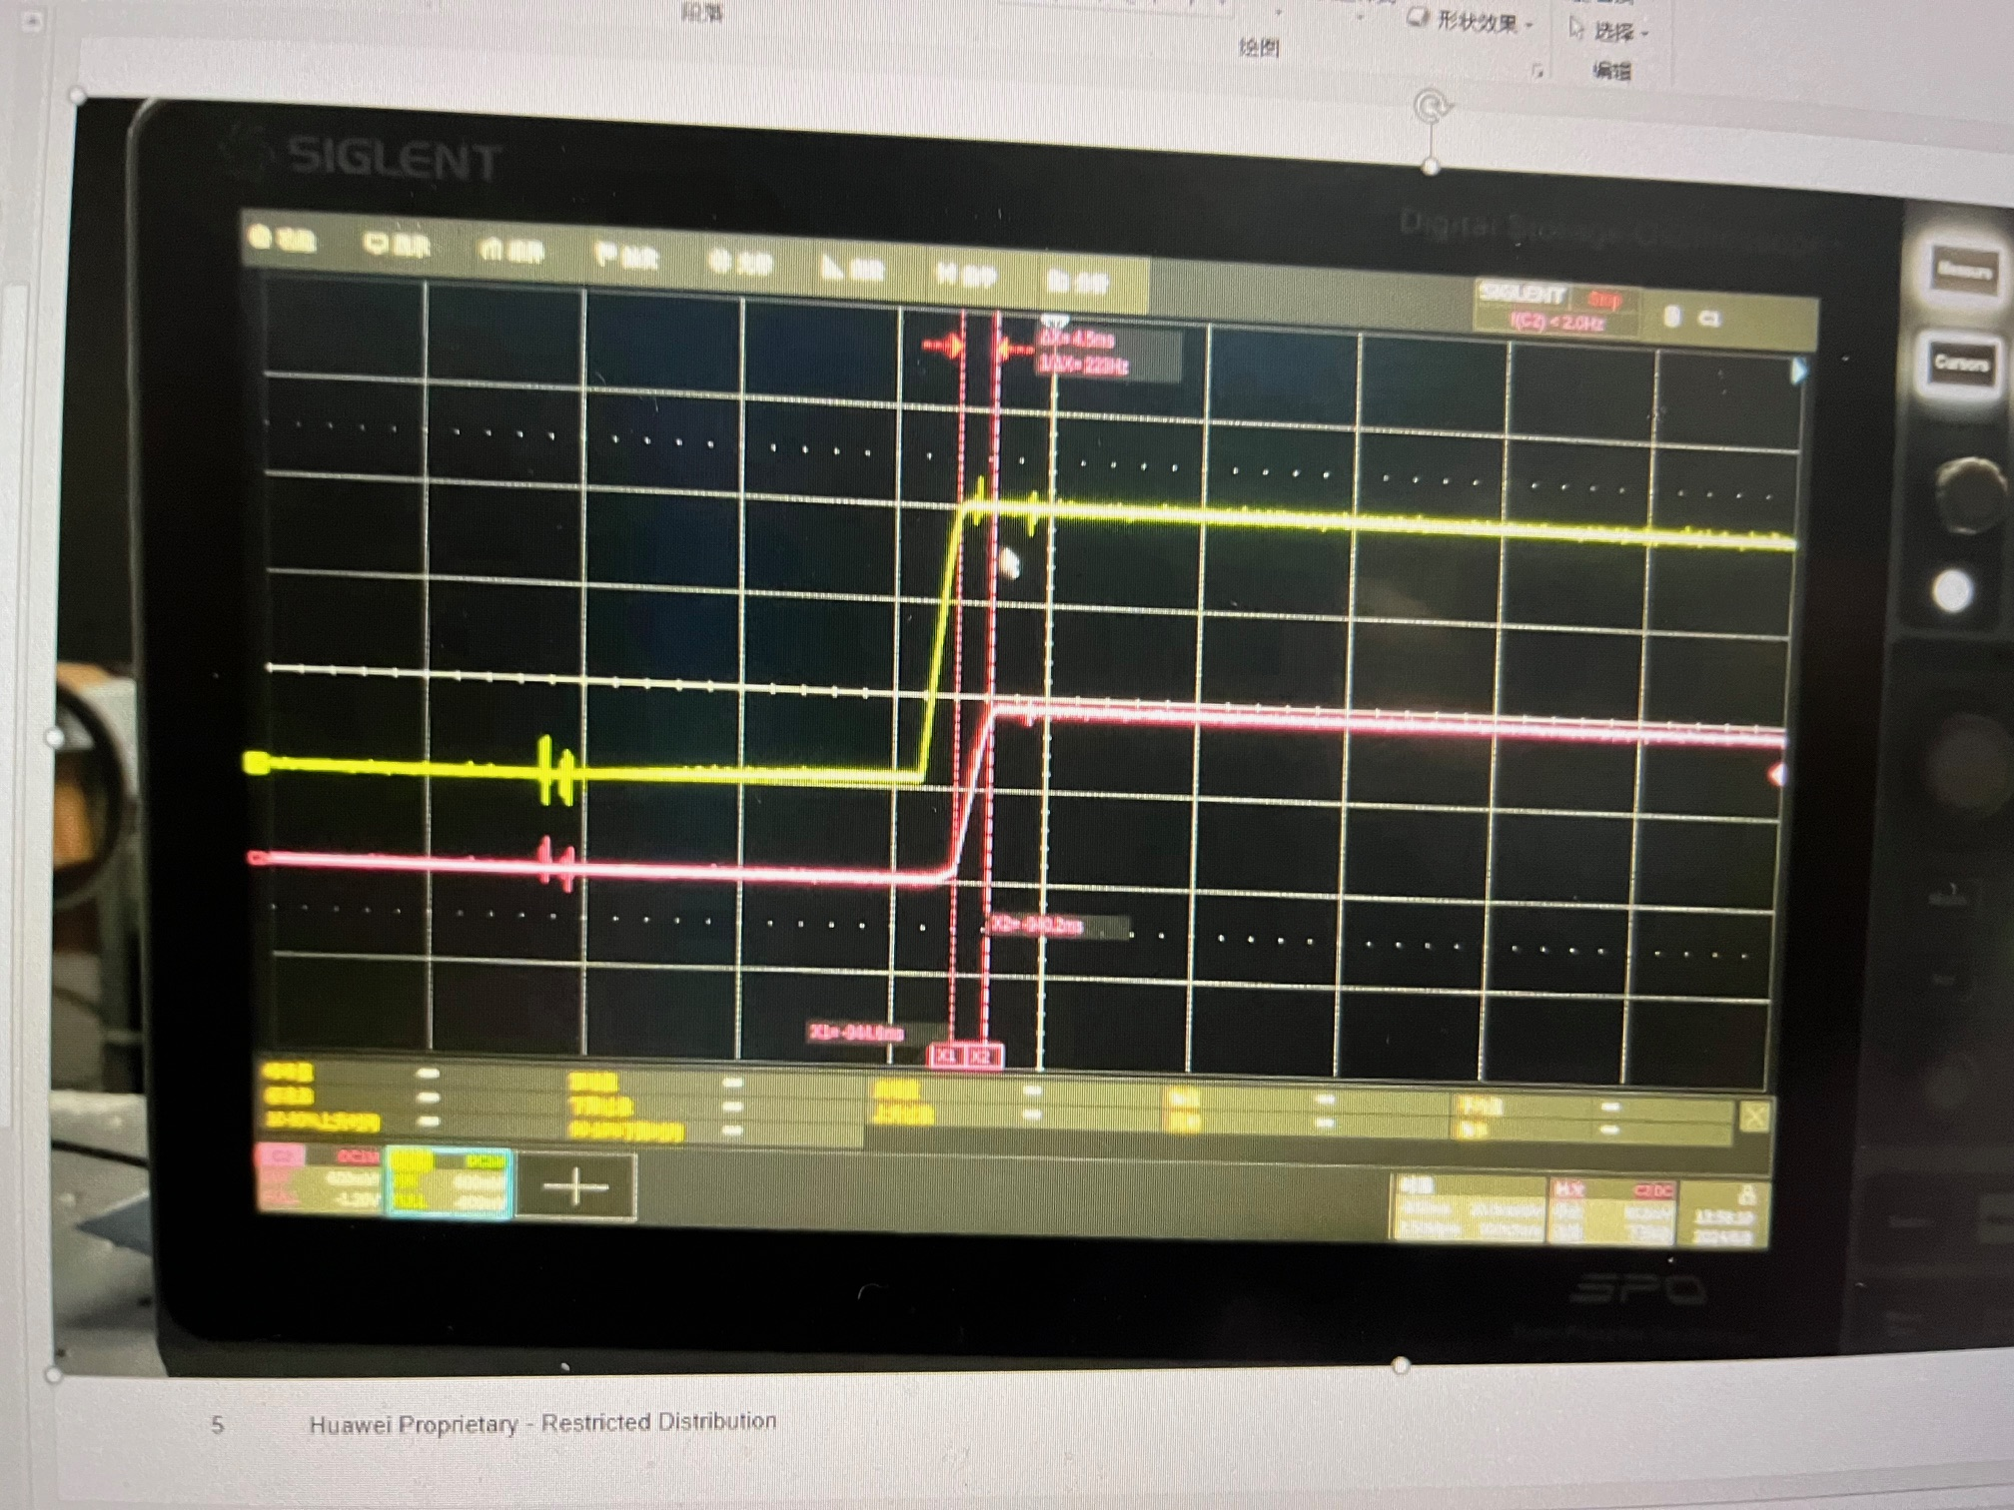
UB947 Yellow VDD18 vs. Pink VDD11
The only concern is VDD11 ramp up time is 4ms>1.5ms.
What impaction for this in theory?
NOTE: Their UB929 VDD11 ramp up time is also 4ms but didn’t show any AV mute issue like UB947. Huawei doubt this is not the key point of the problem.

Slide 2
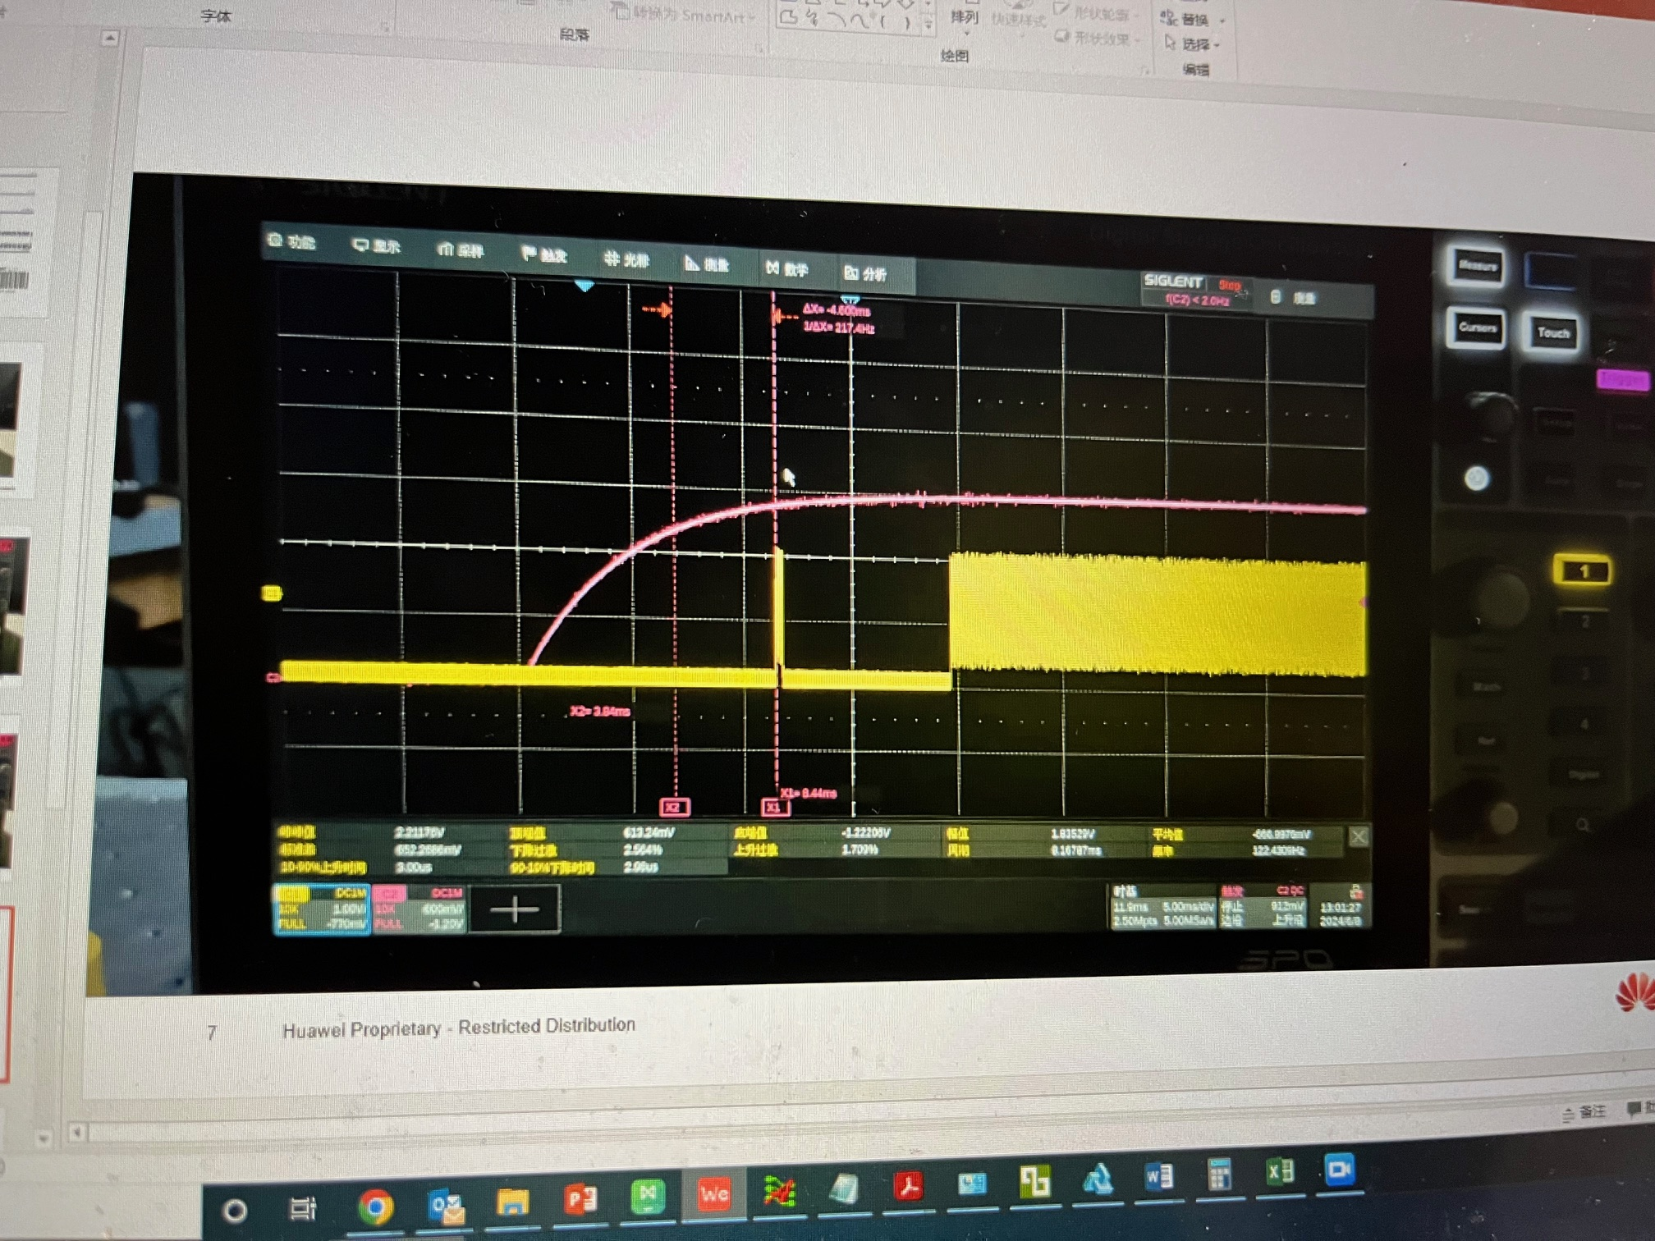
PDB vs. FPDlink

Slide 3
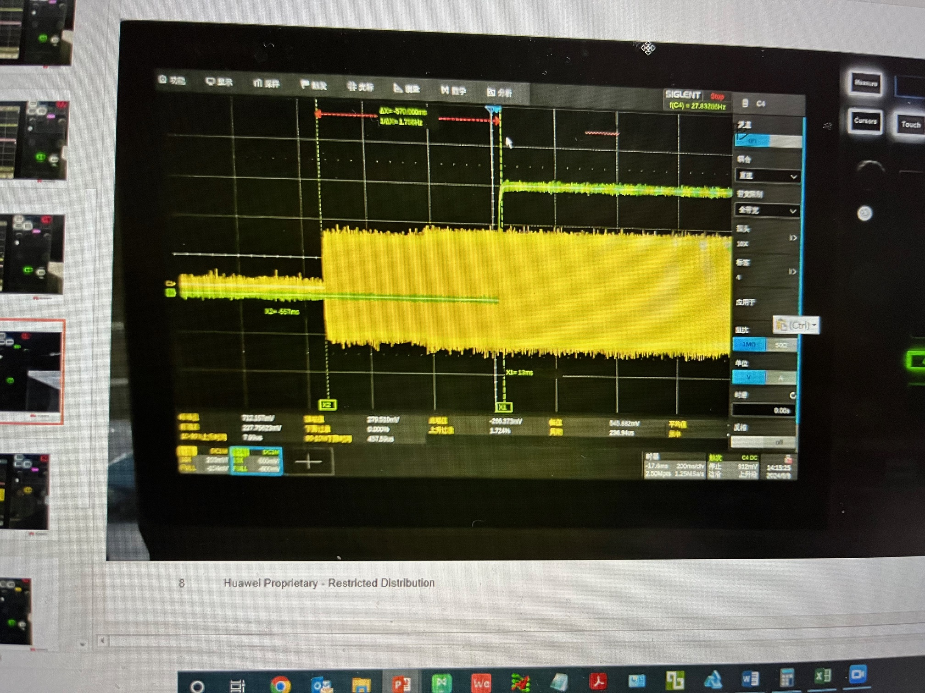
PDB vs. OLDI CLK

Slide 4
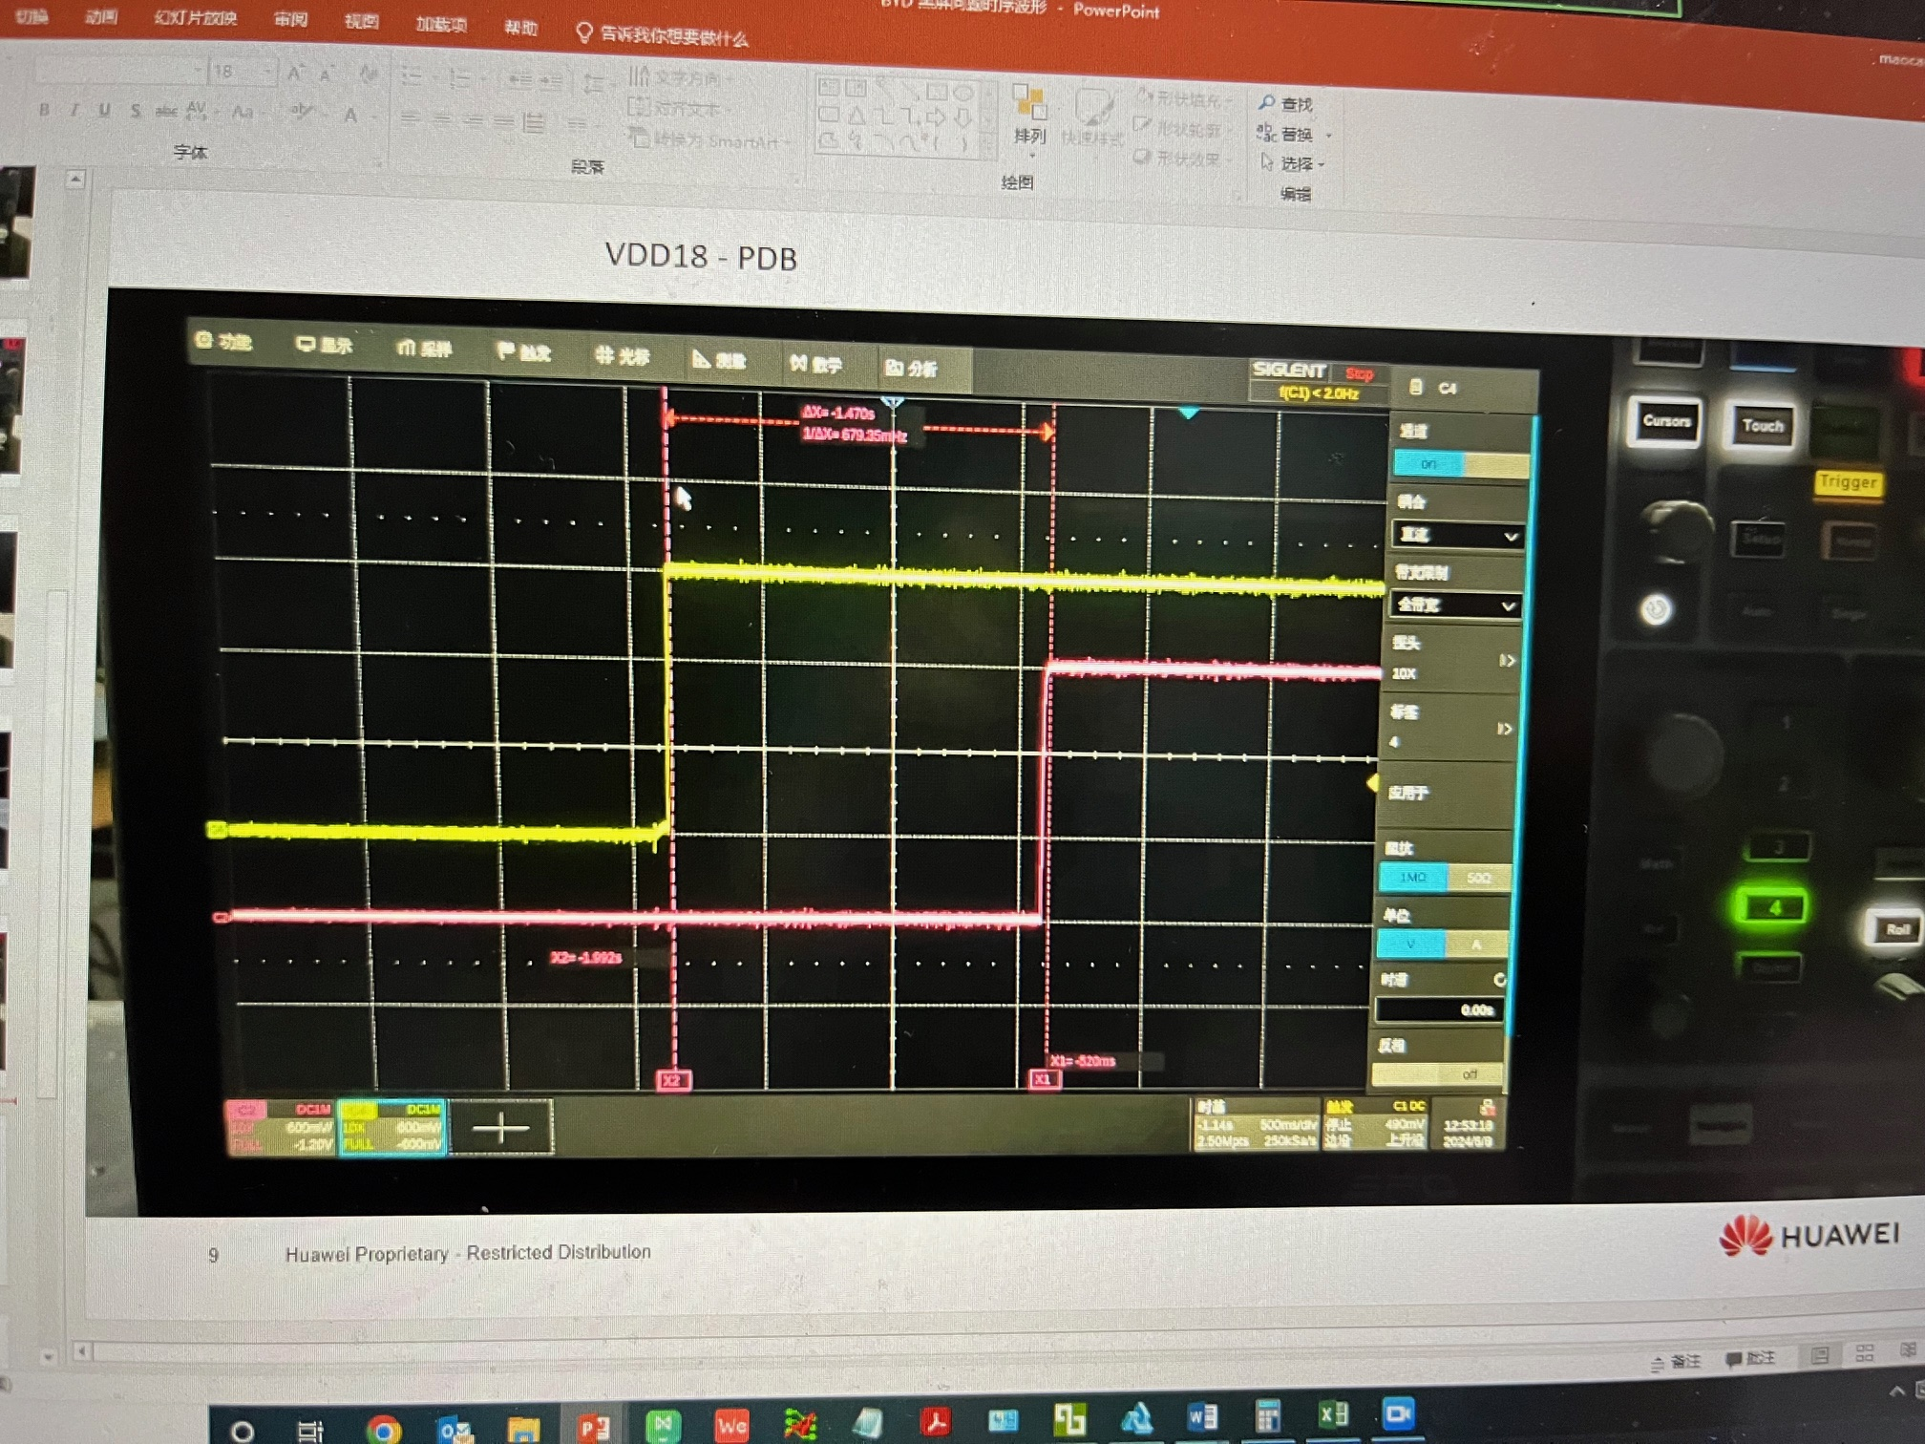
VDD18 vs. PDB

