Slide 1
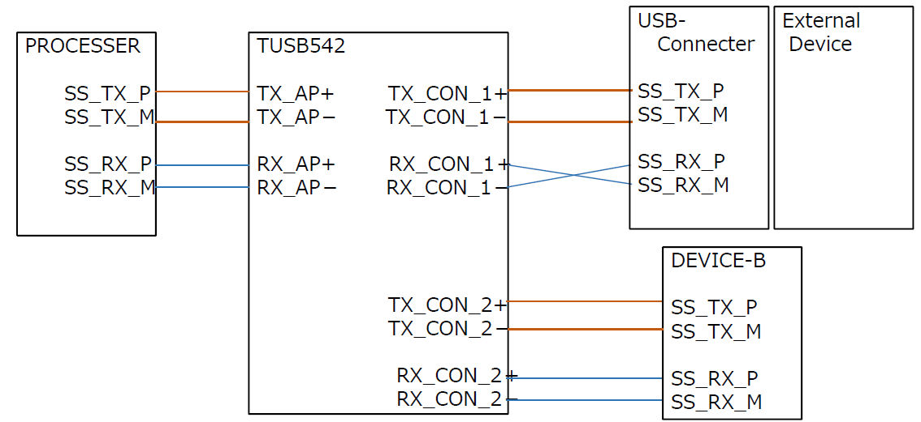
USB P / M connection in the case of using TUSB542
Case.1
*Capacitors and other components are omitted to illustrate the wiring.
Q.1) Does the TUSB542 reverse the polarity in the above wiring? If so, is the polarity reversed so that it does not affect the DEVICE-B side? Or is there no problem because the polarity is reversed in the External Device function?

Slide 2
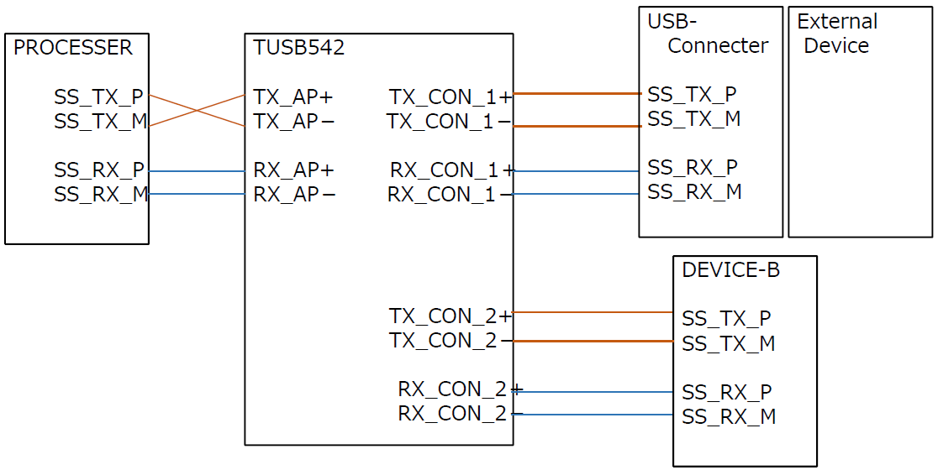
USB P / M connection in the case of using TUSB542
Case.2
*Capacitors and other components are omitted to illustrate the wiring.
Q.2) In this case, is there no problem because the Device's function reverses the polarity?

Slide 3
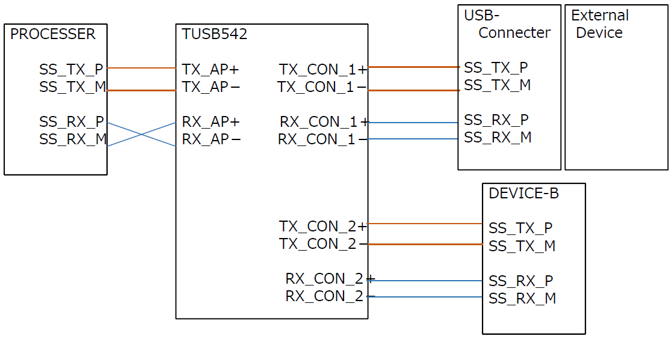
USB P / M connection in the case of using TUSB542
Case.3
*Capacitors and other components are omitted to illustrate the wiring.
Q.3) In this case, is there no problem because the Processer's function reverses the polarity?

