Slide 1
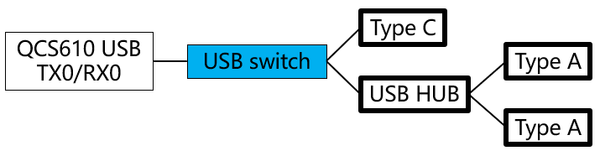
Description
When Epoch uses a USB 3.0 flash drive to transfer data for a long time, the transfer will be interrupted due to unknown reasons.
USB circuit block diagram:
USB Schematic:

Slide 2
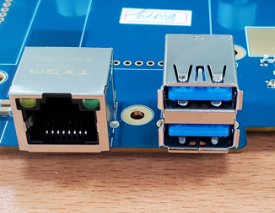
Data transmission test
@ Insert the USB 3.0 flash drive into port2(USB2)
Test1: No hardware modification(fail)
Test2: remove CMC3113, CMC3114 and shorted the pads (fail)
Test3: remove CMC3113, CMC3114 and shorted the pads, remove D3110 (fail)
Test4: remove CMC3113, CMC3114 and shorted the pads, remove D3110,
remove C3100~C3103 (fail)
Test5: only remove C3100~ C3103 (fail)
The above experiment is to remove the related components that may affect the eye diagram. Inferring from the results, it does not improve the USB transmission interruption problem.
@ Insert the USB 3.0 flash drive into port1(USB1)
Test6: only remove C3100~ C3103 (fail)
@ Insert two USB3.0 flash drives into port1 (USB1) and port2 (USB2) at the same time
Test7: only remove C3100~ C3103
1. One test for 120 hours (5 day) (pass)
2. One test for 96 hours (4 day) (pass)
3. 12 tests for 1 hour (pass)
@ Insert the USB 2.0 flash drive into port2(USB2)
Test8:
1. One test for 18 hours (pass)
2. 3 tests for 1 hour (pass)
@ Insert the flash drive into Type C
Test9:
1. One test for 18 hours (pass)
2. 4 tests for 1 hour (pass)
Port2:USB2
Port1:USB1

Slide 3
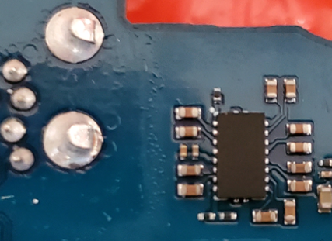
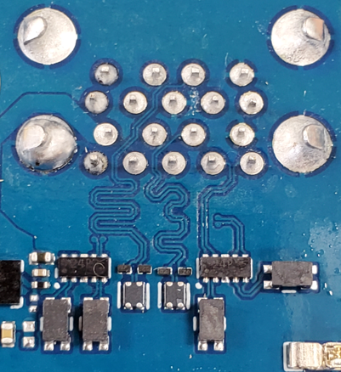
C3100
C3101
C3102
C3103
HUB
D3109
D3110
USB2
QCS610
USB1
CMC3114
CMC3113
Type C
CMC3111
CMC3112
Two ports generated by the HUB
Port1:USB1
Port2:USB2

Slide 4
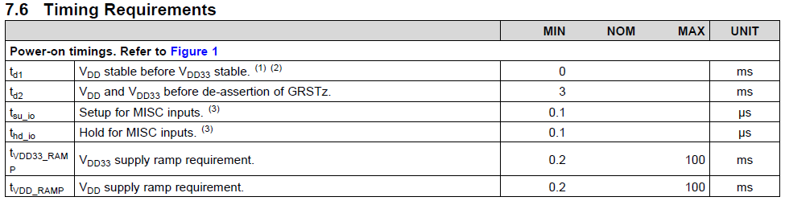
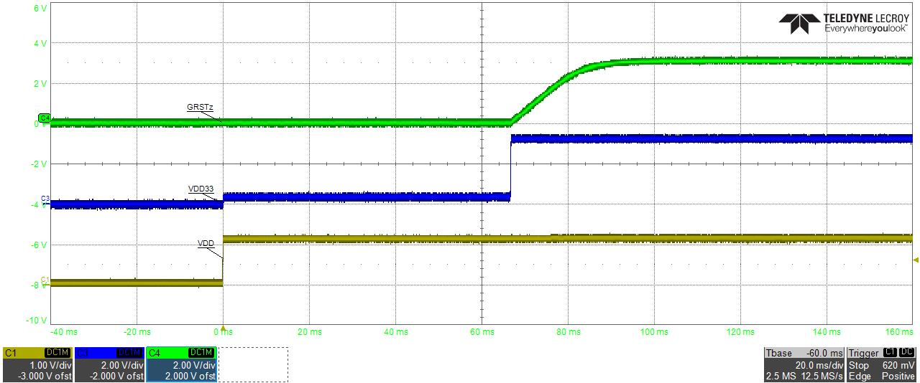
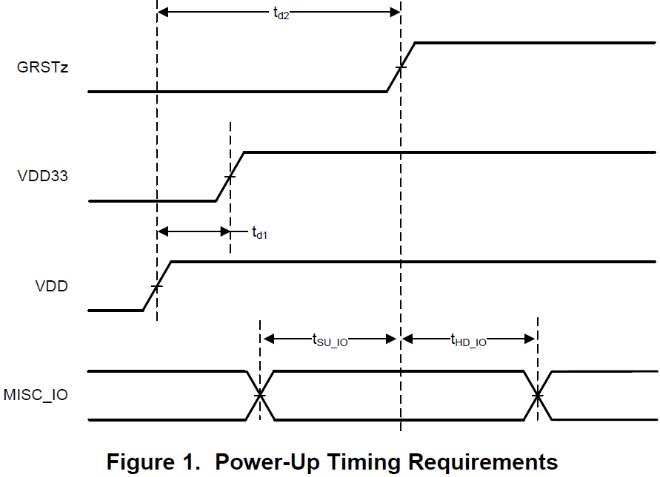
1. TUSB8043AI Power-Up Timing
The power-up timing complies with the specification.

Slide 5
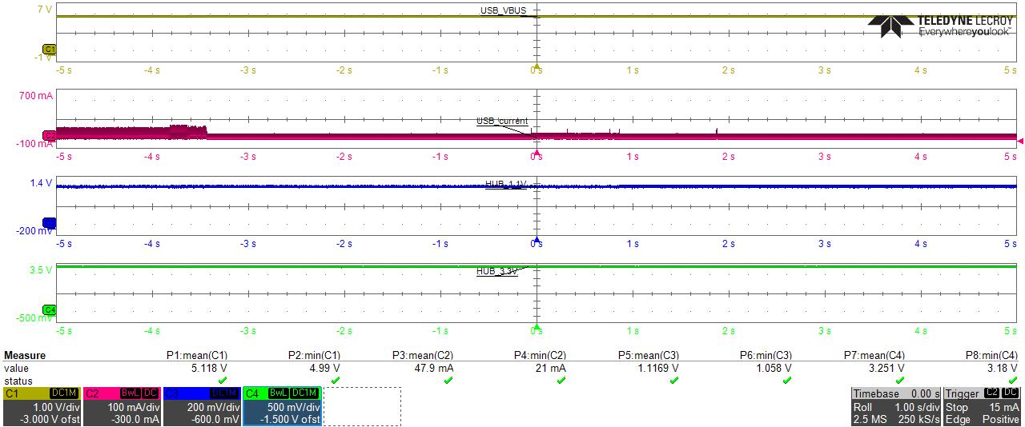
2. Power
USB HUB power(1.1V/3.3V):
When the data transmission is interrupted, the power(1.1V/3.3V) is normal.
USB Type A 5V(output power):
When the data transmission is interrupted, the output power is normal.
data transmission is interrupted

Slide 6
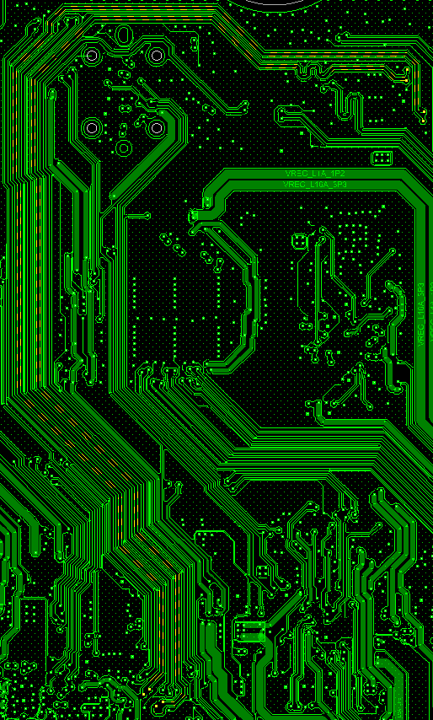
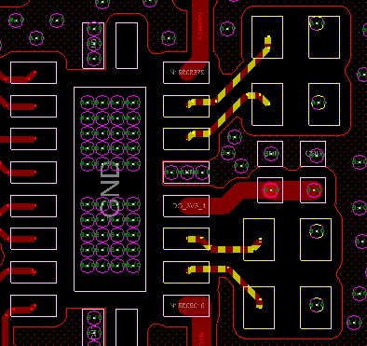
3. Layout
Diff Z0: 90ohm
Length:
Trace name | mil | Trace name | mil
USB0_SS_TX0_P | 3173.96 | USB0_SS_TX0_P_1 | 68.82
USB0_SS_TX0_M | 3150 | USB0_SS_TX0_M_1 | 61.1
USB0_SS_RX0_P | 3210.24 | USB0_SS_RX0_P_1 | 48.14
USB0_SS_RX0_M | 3209.46 | USB0_SS_RX0_M_1 | 56.04
Layer5: GND
Layer6: trace
Layer7: GND
Layer1: trace
Layer2: GND

Slide 7
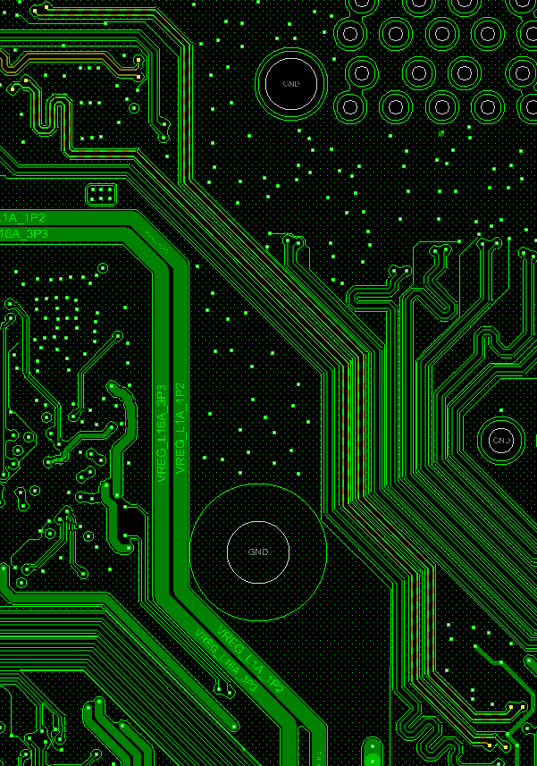
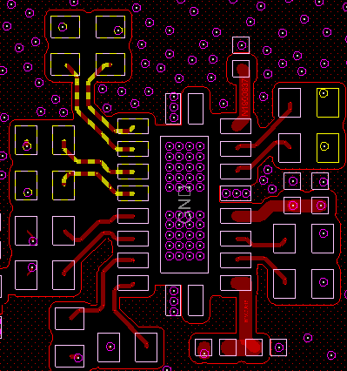
3. Layout
Diff Z0: 90ohm
Length:
Trace name | mil | Trace name | mil
USB0_SS_TX0_P_B | 98.12 | USB0_SS_TX0_P_B_1 | 1819.21
USB0_SS_TX0_M_B | 108 | USB0_SS_TX0_M_B_1 | 1809.54
USB0_SS_RX0_P_B | 77.19 | USB0_SS_RX0_P_B_1 | 1841.24
USB0_SS_RX0_M_B | 76.24 | USB0_SS_RX0_M_B_1 | 1839.16
Layer5: GND
Layer6: trace
Layer7: GND
Layer1: trace
Layer2: GND

Slide 8
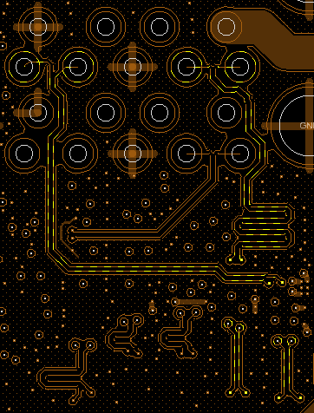
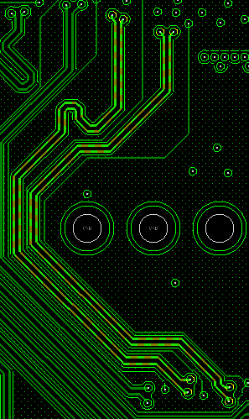
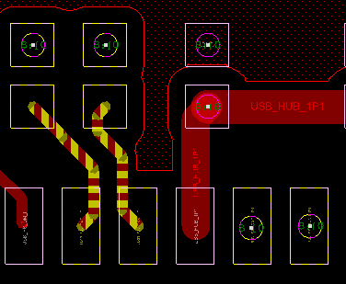
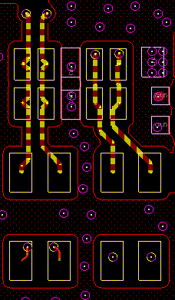
3. Layout
Diff Z0: 90ohm
Length:
Layer7: GND
Layer8: trace
Layer9: GND
Layer5: GND
Layer6: trace
Layer7: GND
Layer1: trace
Layer2: GND
Trace name | mil | Trace name | mil | Trace name | mil
USB_SS_RXP1_P1 | 1015.71 | USB_SS_RXP1_P1_1 | 780.31
USB_SS_RXN1_P1 | 1016.36 | USB_SS_RXN1_P1_1 | 781.87
USB_SS_TXP1_P1 | 51.54 | USB_SS_TXP1_P1_1 | 1013.62 | USB_SS_TXP1_P1_2 | 781.36
USB_SS_TXN1_P1 | 48.2 | USB_SS_TXN1_P1_1 | 1013.41 | USB_SS_TXN1_P1_2 | 779.02

Slide 9
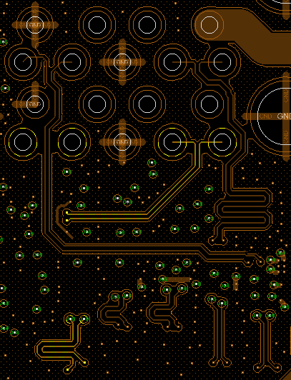
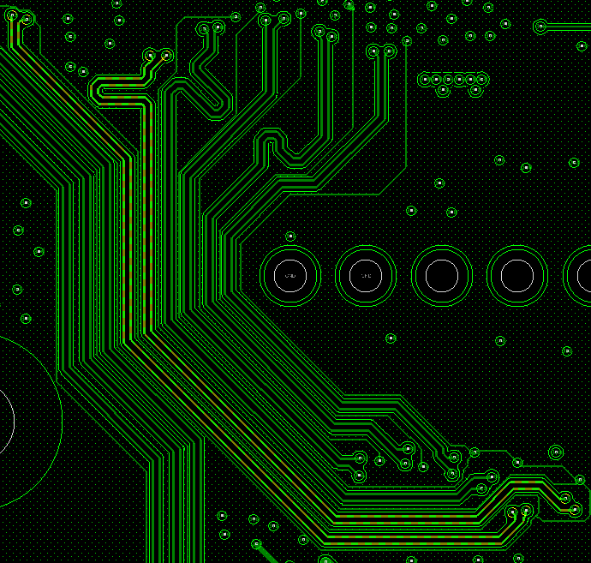
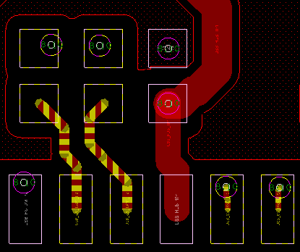
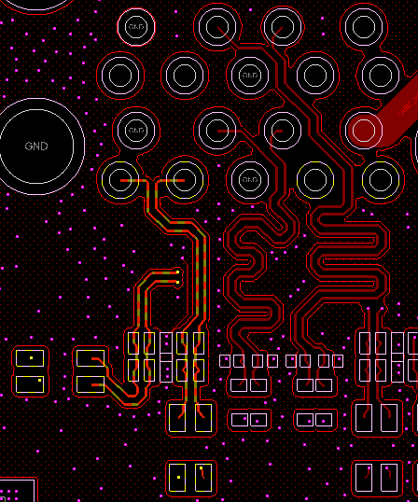
3. Layout
Diff Z0: 90ohm
Length:
Layer7: GND
Layer8: trace
Layer9: GND
Layer5: GND
Layer6: trace
Layer7: GND
Layer1: trace
Layer2: GND
Trace name | mil | Trace name | mil | Trace name | mil
USB_SS_RXP1_P2 | 1423.55 | USB_SS_RXP1_P2_1 | 372.09
USB_SS_RXN1_P2 | 1419.41 | USB_SS_RXN1_P2_1 | 376.75
USB_SS_TXP1_P2 | 47.029 | USB_SS_TXP1_P2_1 | 1210.14 | USB_SS_TXP1_P2_2 | 578.38
USB_SS_TXN1_P2 | 49.61 | USB_SS_TXN1_P2_1 | 1215.61 | USB_SS_TXN1_P2_2 | 579.84

Slide 10
4. USB3.0 TX test report
Our product is a linux system, and we haven’t found a way to test the eye diagram of USB HUB Type A, so we want to use Type C to look at the eye diagram first.
We removed the EMI filter and shorted the pads and removed the TVS. This architecture is similar to connecting the CPU to the HUB, the eye diagram is pass.
USB test report
short
EMI filter
TVS
Type C
QCS610 USB TX0/RX0
USB switch
EMI filter
TVS
Type A
USB HUB
EMI filter
TVS
Type A

