Slide 1
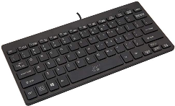
Tablet
BLE+BT
Speaker
Amp
USB-C
USB-C
USB-C enumerated
up to 20V or 45W
5V 1A
USB-C
USB-C
USB-C
60W
or
or
or
or
USB-C charger

