Slide 1
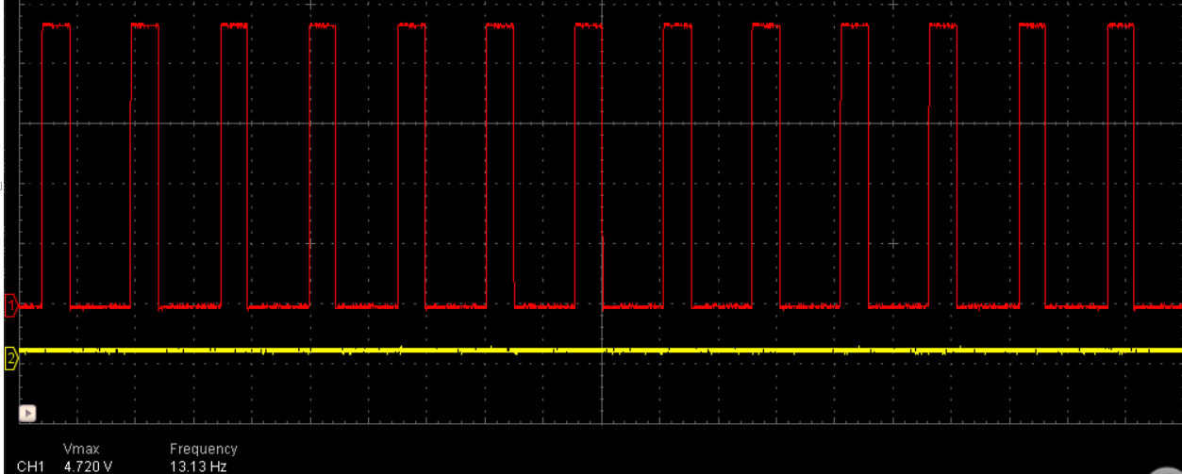
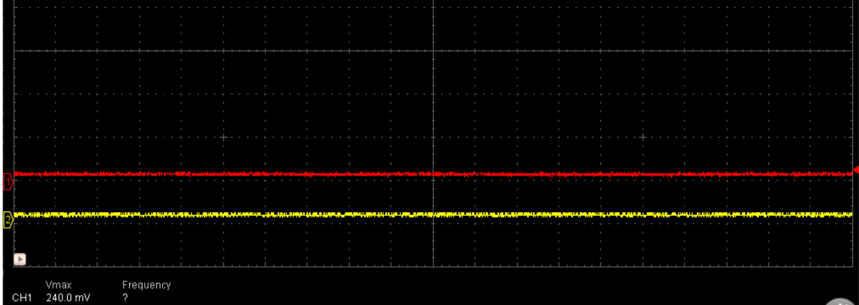
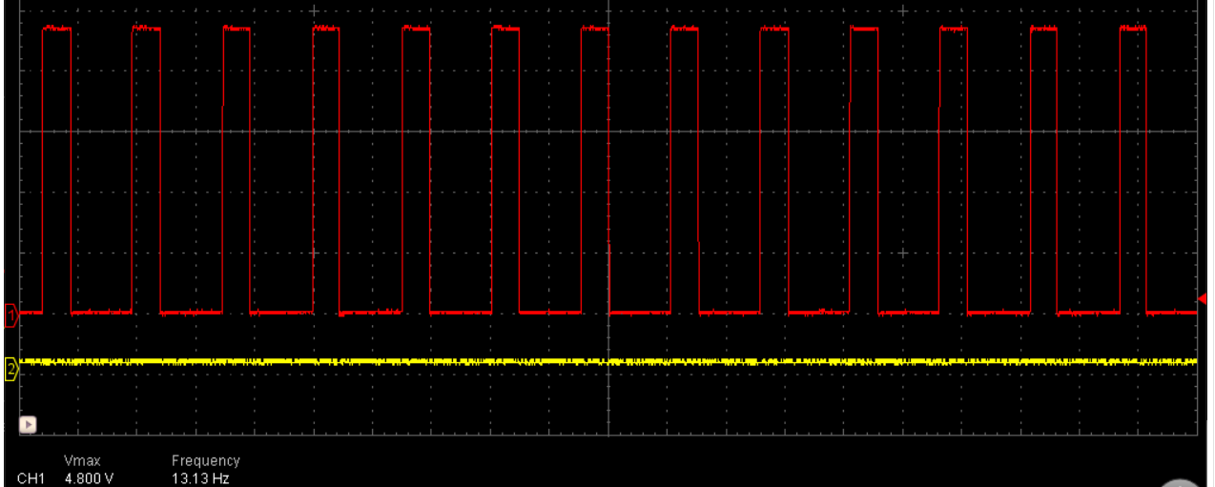
CC1 pin
After Power ON
No cable connection
0xA[7:0] = 0x00
CC1 pin is toggling
Set 0x1 to TERM_DISABLE
No cable connection
0xA[7:0] = 0x01
Stopped toggling
CC1 pin
Set 0x1 to MODE_SELECT
No cable connection
0xA[7:0] = 0x11
Stoppped toggling
CC1 pin
Set 0x0 to TERM_DISABLE
No cable connection
0xA[7:0] = 0x10
Started toggling
Unexpected VBUS detect happens when
TypeA cable is connected

