Slide 1
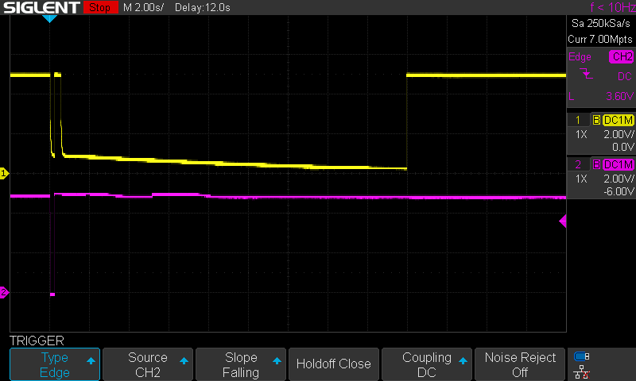
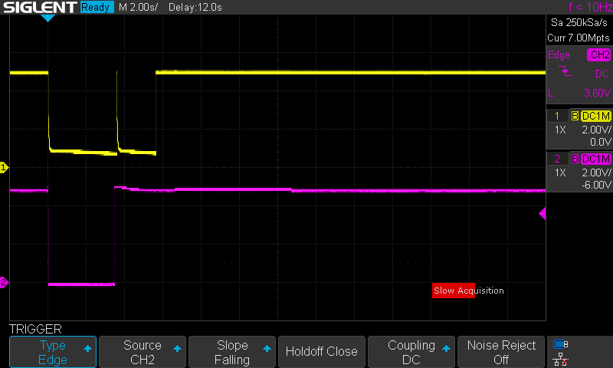
Memory
No
Cable
TUSB8041
Type-C
Tablet
Terminations Toggle Correctly = USB3
Terminations Fail = USB2
DFP - VBUS
DFP - VBUS
UFP - VBUS
UFP - VBUS
Attach Cable (Type-C)
“Reset” Tablet
Remove Cable (Type-C)

