Slide 1
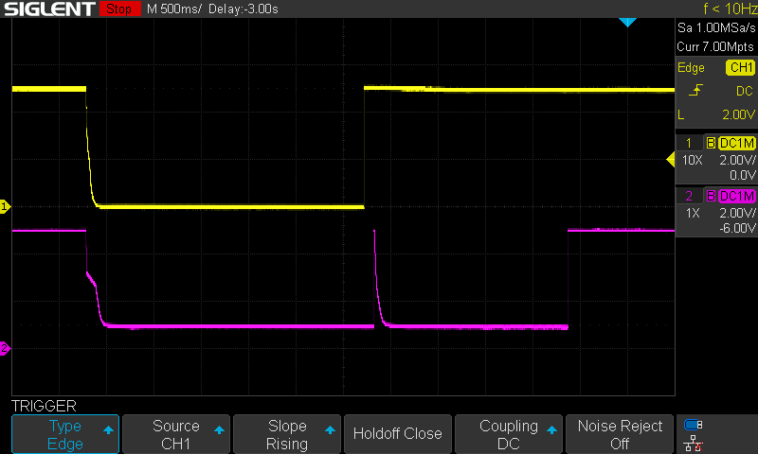
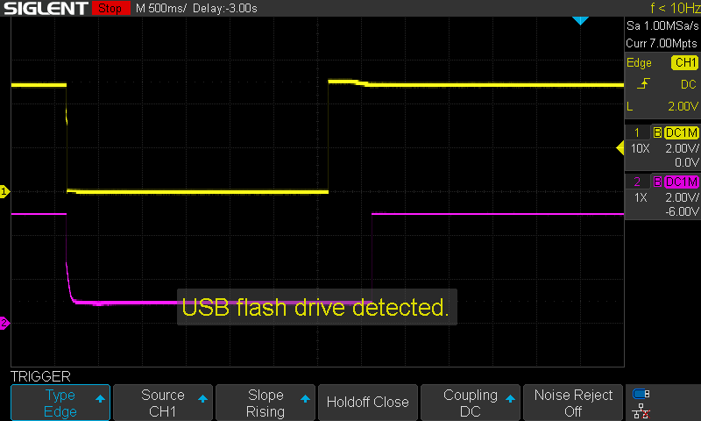
Power Cycle and VBUS
Samsung
iPad Air 4th
Yellow：VBUS for TypeC (Goes to TUSB8041’s USB_VBUS via Resistor Divider)
Purple：VBUS for TypeA (On/Off toggled by power-switch controlled by TUSB8041’s PWRCTLx pin)

Slide 2
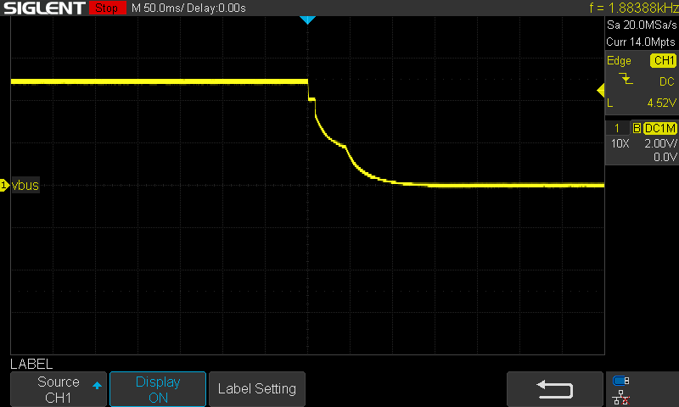
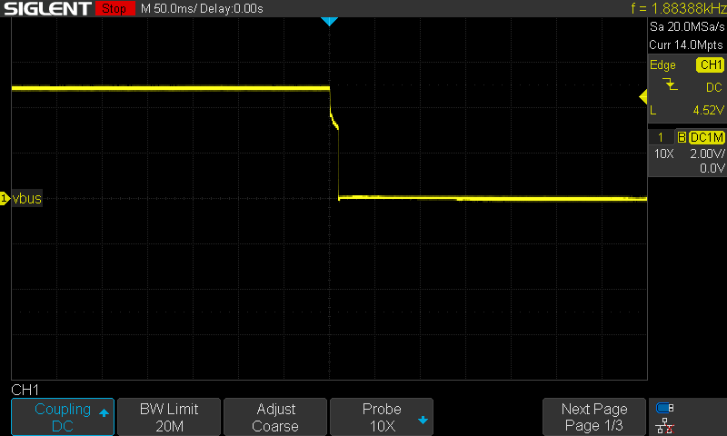
TypeC-side VBUS at Power Down (50ms/div)
Samsung
iPad Air 4th

Slide 3
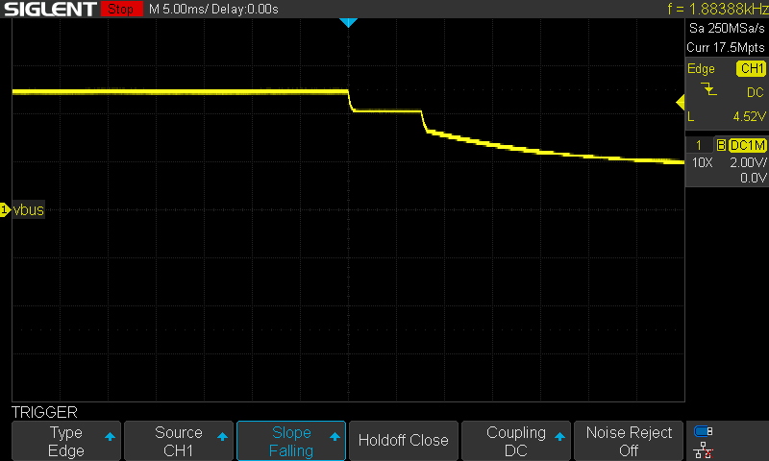
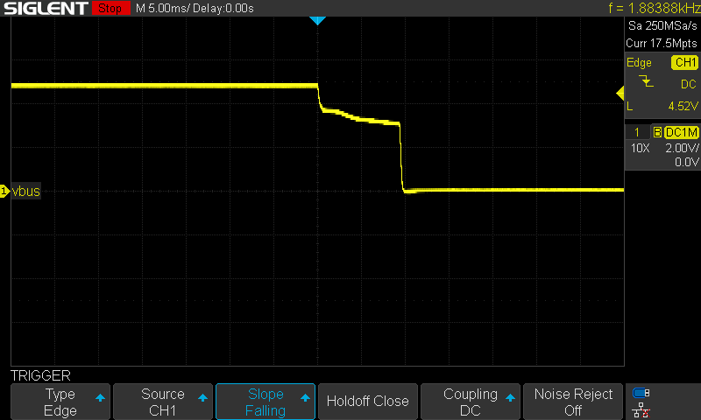
TypeC-side VBUS at Power Down (5ms/div)
Samsung
iPad Air 4th

