Slide 1
Visionary Daughter Card Review
FPD-Link Applications
02/21/2024

Slide 2
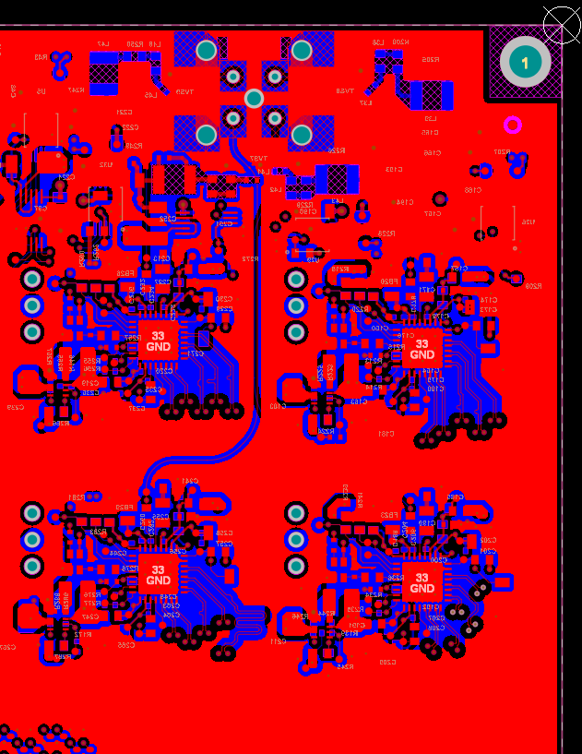
Scope
4x UB953 serializer layout will be reviewed
Focus on CSI layout, and FPD layout checking for issues could have negative impact on signal integrity

Slide 3
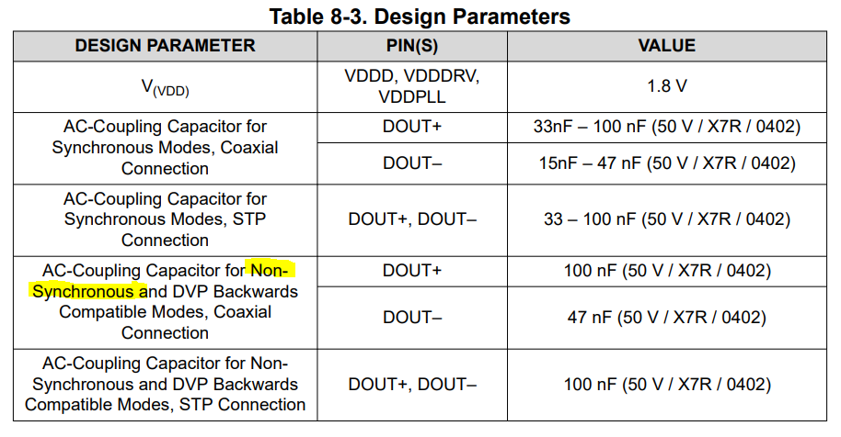
Schematic comments
AC coupling capacitors should be 0402 package size & should match partner deserializer
If async mode is used with external clk_in provided, AC coupling caps must be updated based on datasheet (100nF & 47nF as shown below)
ESD diode here used has 7V reverse standoff with 9.8V breakdown, PoC network is present here, assuming these would be conflict here

Slide 4
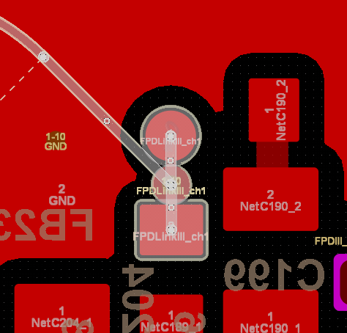
General layout comments
Is the PoC network routed with 50 ohm impedance to the final inductor?
Test point should not be placed on DOUT+ trace as it creates a stub
Rosenberger connector: Rosenberger gives layout recommendations for these connectors, has this been reviewed?
Could ground pours be added between CSI traces for isolation from neighboring differential pairs?

Slide 5
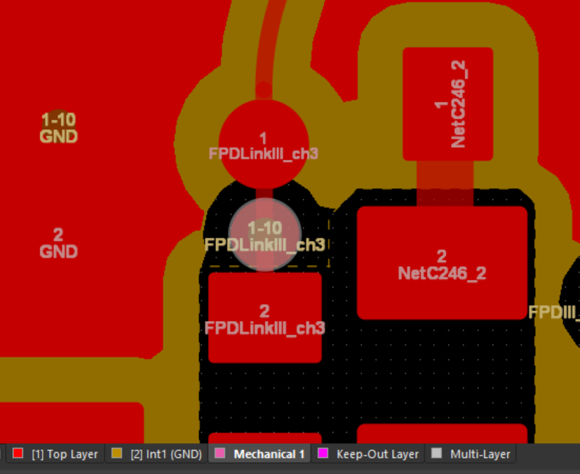
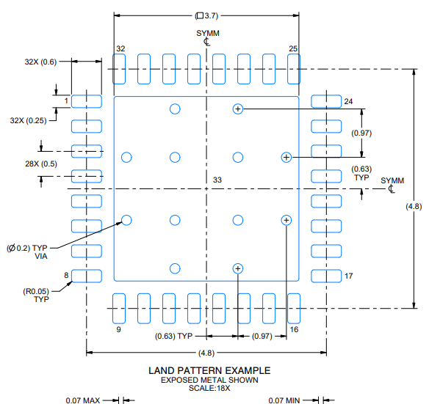
FPD-Link Layout comments
Stub on quad connector as trace on L1 attaches to the connector rather than L10 for FPDLink CH3
VIA added on serializer side which is not used, this will damage signal integrity. Also impacting FPDLink CH3
VIAs missing from landing pattern of UB953, please match
PoC network anti-pad extends through all PCB layers rather just 1-2 layers. We still need a gnd reference for these components. Also confirm anti pad on AC coupling caps is correct

Slide 6
Important notice and disclaimer
TI PROVIDES TECHNICAL AND RELIABILITY DATA (INCLUDING DATASHEETS), DESIGN RESOURCES (INCLUDING REFERENCE DESIGNS), APPLICATION OR OTHER DESIGN ADVICE, WEB TOOLS, SAFETY INFORMATION, AND OTHER RESOURCES “AS IS” AND WITH ALL FAULTS, AND DISCLAIMS ALL WARRANTIES, EXPRESS AND IMPLIED, INCLUDING WITHOUT LIMITATION ANY IMPLIED WARRANTIES OF MERCHANTABILITY, FITNESS FOR A PARTICULAR PURPOSE OR NON-INFRINGEMENT OF THIRD PARTY INTELLECTUAL PROPERTY RIGHTS.
These resources are intended for skilled developers designing with TI products. You are solely responsible for (1) selecting the appropriate TI products for your application, (2) designing, validating and testing your application, and (3) ensuring your application meets applicable standards, and any other safety, security, or other requirements.
These resources are subject to change without notice. TI grants you permission to use these resources only for development of an application that uses the TI products described in the resource. Other reproduction and display of these resources is prohibited. No license is granted to any other TI intellectual property right or to any third party intellectual property right. TI disclaims responsibility for, and you will fully indemnify TI and its representatives against, any claims, damages, costs, losses, and liabilities arising out of your use of these resources.
TI’s products are provided subject to TI’s Terms of Sale or other applicable terms available either on ti.com or provided in conjunction with such TI products. TI’s provision of these resources does not expand or otherwise alter TI’s applicable warranties or warranty disclaimers for TI products.

