Slide 1
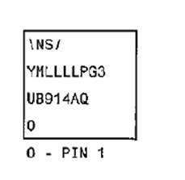
DS90UB914ATRHSJQ1
Please let me know about the marking code meaning
I understood below.
Y： Year Code（0～9）
M： Month Code(1～9、A、B、C）
L： Lot Trace Code
What is the meaning of “PG3”.
Does this code fixed or variable?
⇒'P' is the primary assembly site code and 'G3' is the ECAT (environmental category).

Slide 2
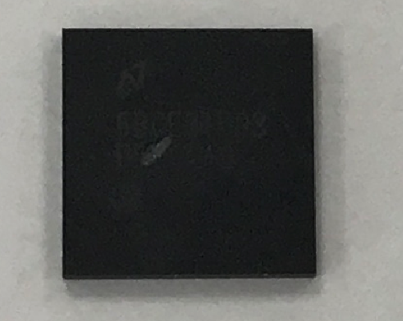
Our device marking
NS/
6BCE3TUG3
UB914AQ

