Slide 1
TUSB8020 Schematic review

Slide 2
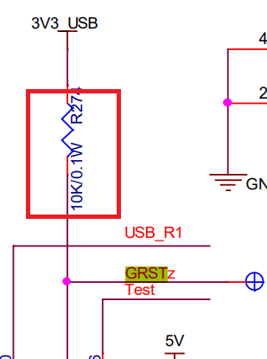
TUSB8020 review
1: remove R274 on GRSTz

Slide 3
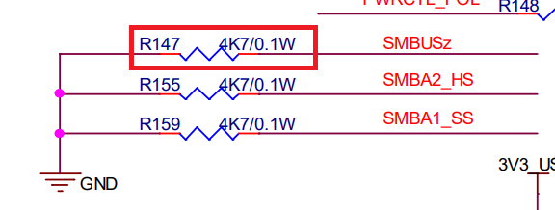
TUSB8020 review
1: remove R147 on SMBUSz if you don’t plan to change configuration with SMBUS

Slide 4
TUSB8020 review
Change to it’s full name on pin 35/36

Slide 5
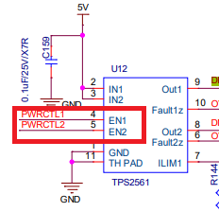
TUSB8020 review
For TUSb8020B, 1 is active low for PWRCTL_POL, if you pullup, means active low for PWRCTL ,but TPS2561 is EN high to enable the switch

Slide 6
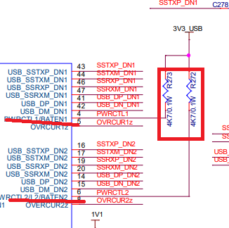
TUSB8020 review
If PWRCTL_BATEN is pulled up, it mean battery charging is enabled, is this what you want?

