Slide 1
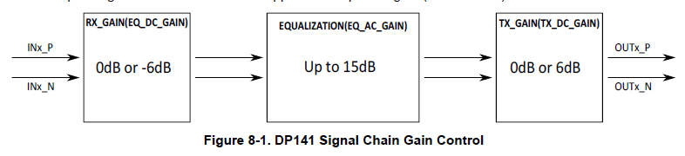
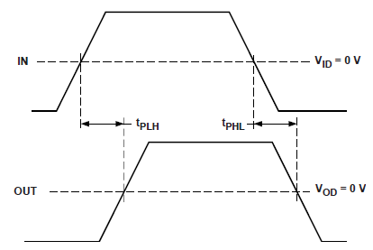
Vin_amp.
Vout_amp.
Can SN65DP141 support Vout_amp.=Vin_amp*Gain (Gain>1)?
Vin_amp. : input signal amplitude across input pins (INX_P-INX_N)
Vout_amp: output signal amplitude across output pins(OUTX_P-OUTX_N)

