Slide 1
Connection between PC(host),502B and EZ USB(device)
Redriver is used for self powered and same as EZ USB.
USB3.0 CABLE
3.3V
PC
(host)
connector
connector
VBUS
connector
connector
EZ USB
(device)
Device Tx1+
Host Rx1+
502B
Host Rx1-
Device Tx1-
GND
Host Tx2+
GND
Device Rx2+
Device Rx2-
Host Tx2-
DM
DP
Although PC was not connected to USB3.0,
it was established
Rx termination at
Device Rx side.
please see next page
USB2.0 CABLE
Measurement point
If it was connected directly,
USB2.0 was not identified.

Slide 2
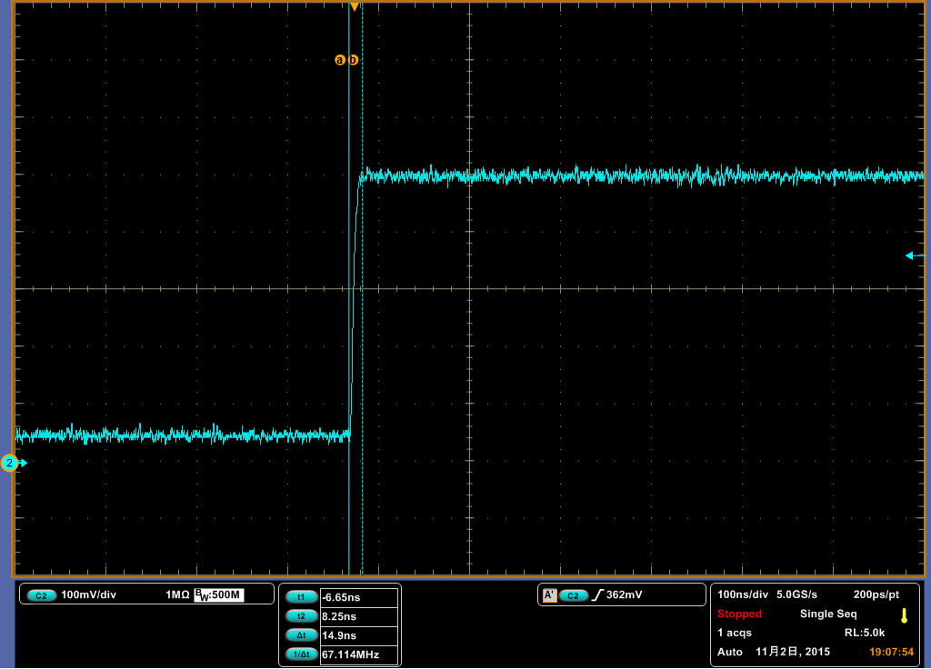
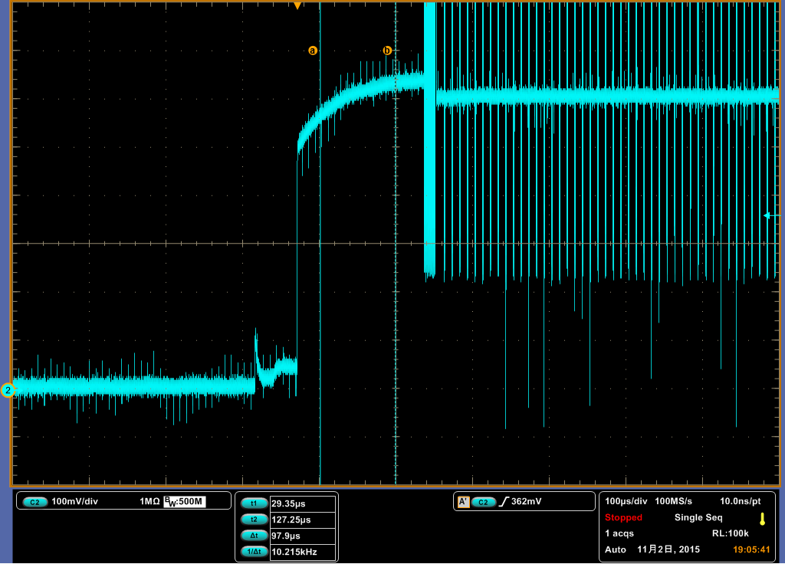
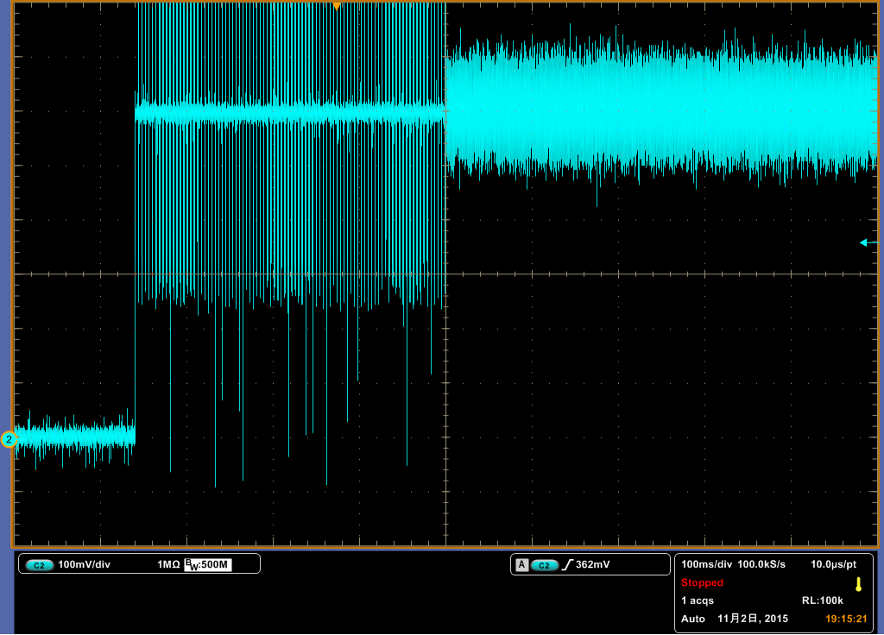
Waveform of Device Rx pin at powering up
100ns/div
100us/div
100ms/div

