Slide 1
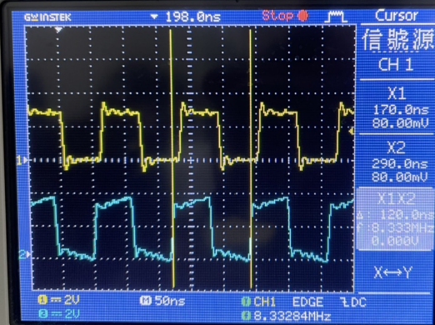
CH1 intact, CH2 drift
→ The two sides of TX/RX are not locked, the TX will not drop the message if
there is transmission, and the RX will drop the message
CH1 @925 PCLK
CH2 @926 PCLK Drifting and flickering

Slide 2
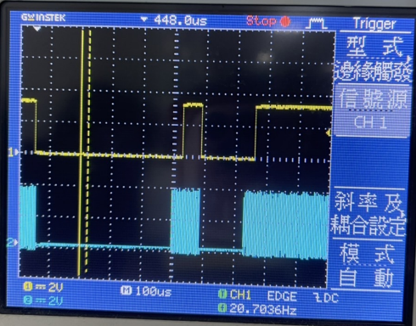
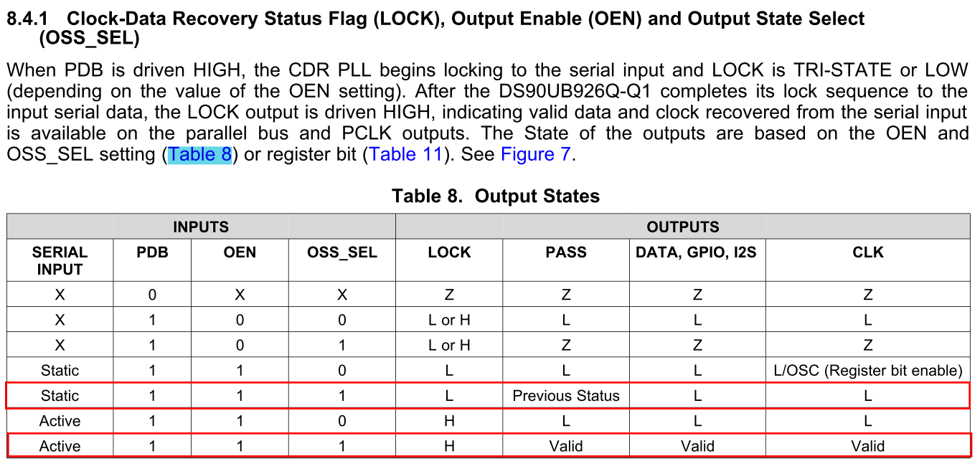
2. Check RX LOCK@926
→ input ：
PDB V(1), OEN V(1), OSS_SEL V(1)
→ output：
PASS V(1), LOCK/PCLKAs shown on
the right
CH1 @926 LOCK
CH2 @926 PCLK
tDDLT=44us

Slide 3
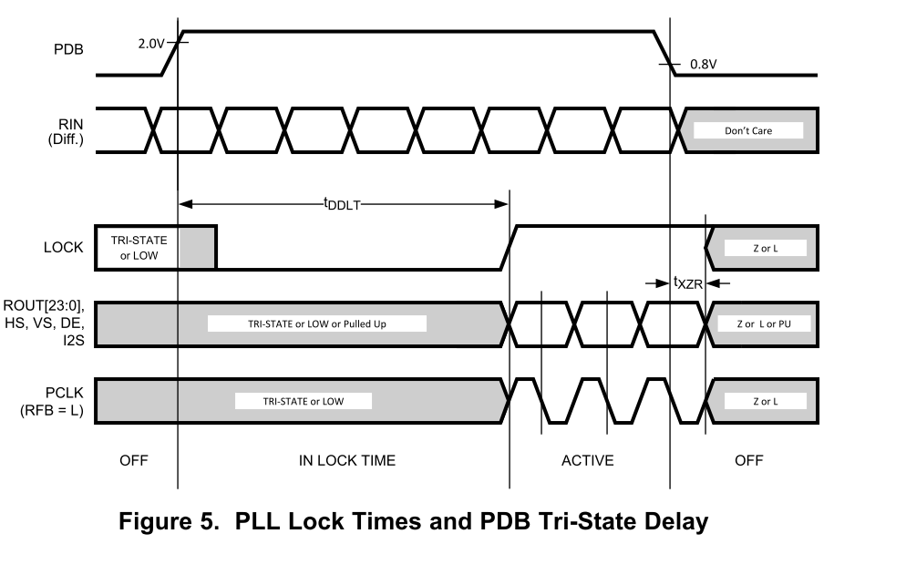
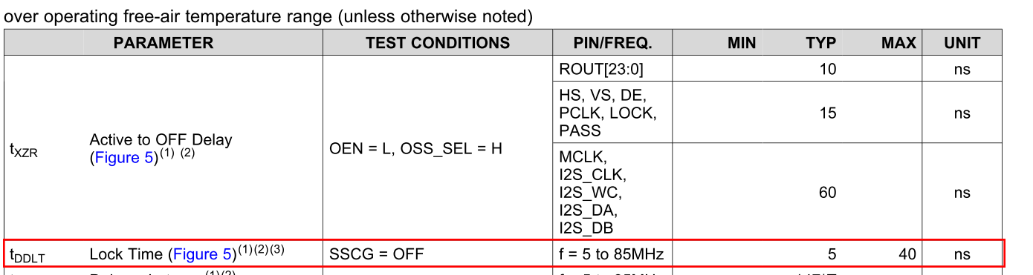
2. The time of tDDLT that PCLK needs to stabilize before checking LOCK
→The oscilloscope measures about 44us, which meet the SPEC.

Slide 4
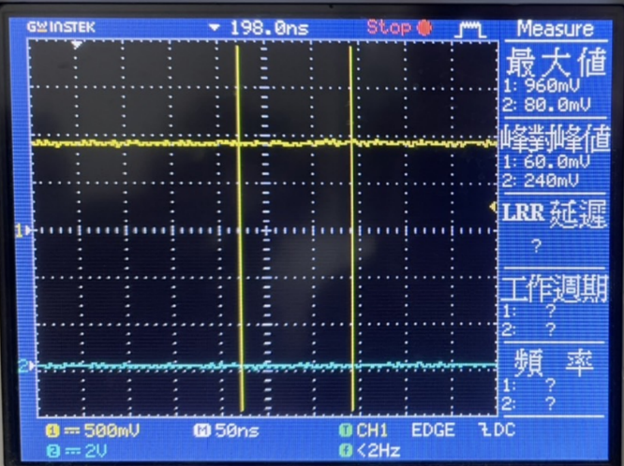
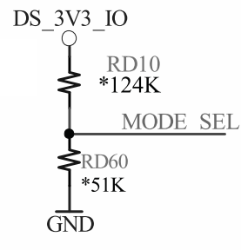
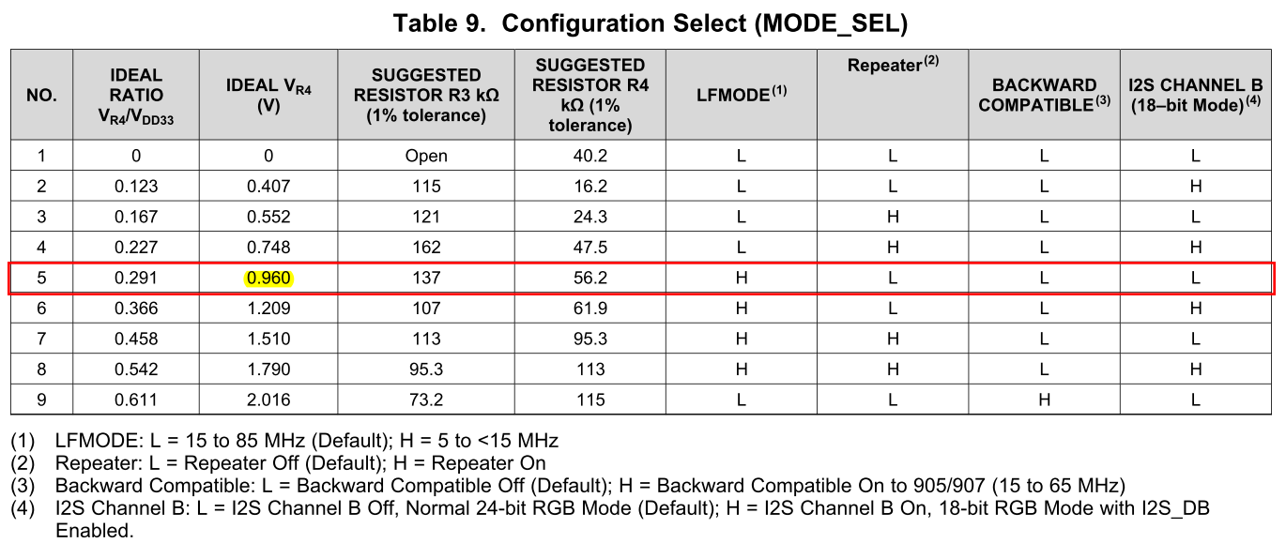
0.96V

