Slide 1
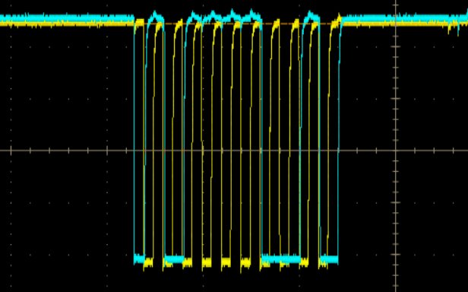
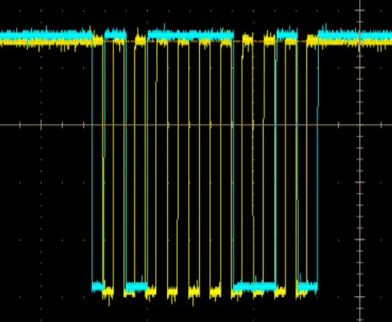
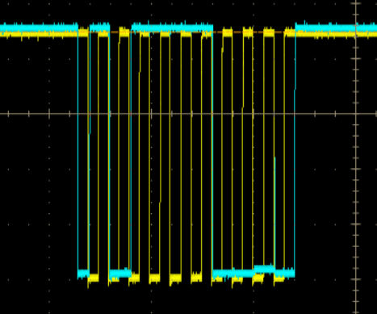
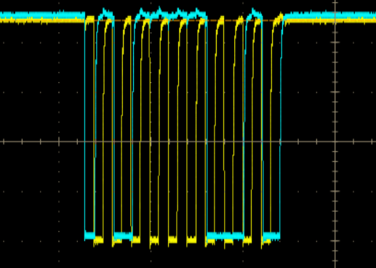
Expander1
Middle-plane
U26
Master
A
B
Expander2
Slave
U27
A
B
Slave expander2 receive
the slave address
and send ACK to U27 port-A
U27 port-B should direct output slave ACK signal,
but U27 port-B send
out the NACK, what happen in U27?

