Slide 1
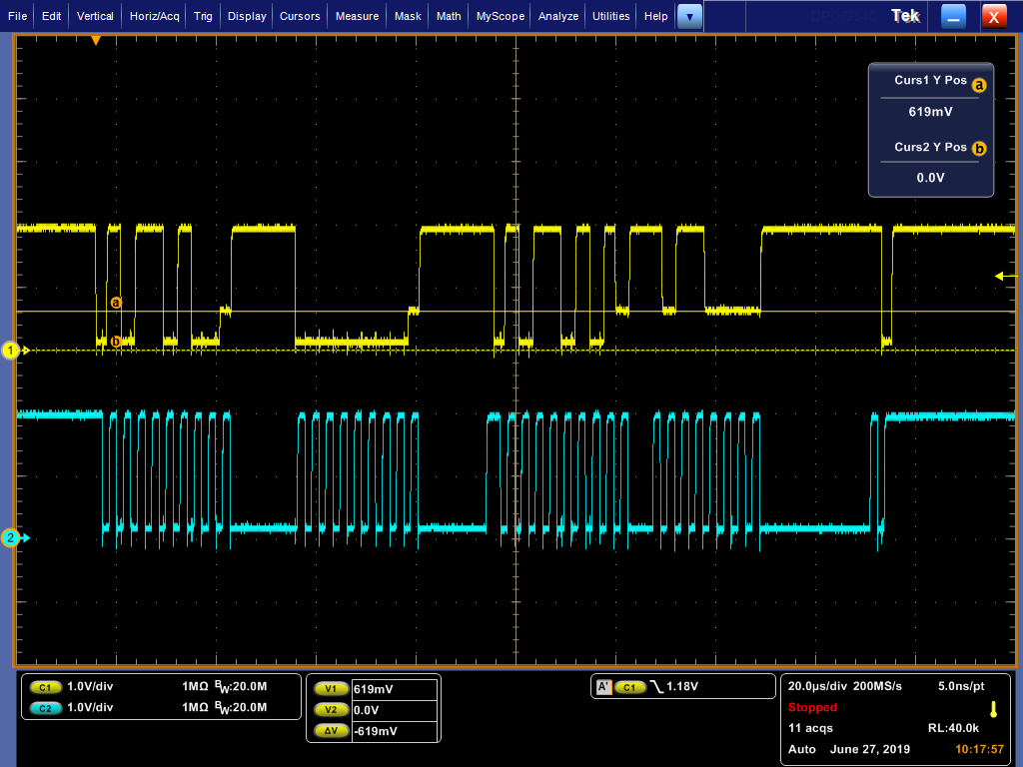
I2C host in Serializer side
SDA Vol over spec waveform

Slide 2
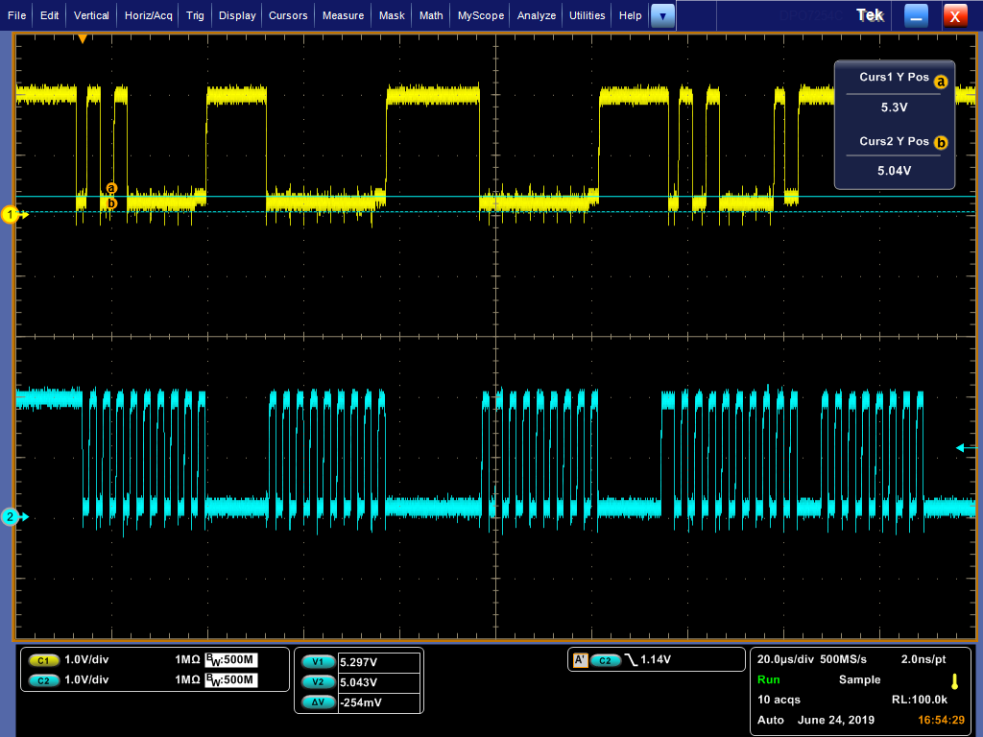
I2C host in De-serializer side
SDA Vol meet spec waveform

