Slide 1
SBOM（9548-475）

Slide 2
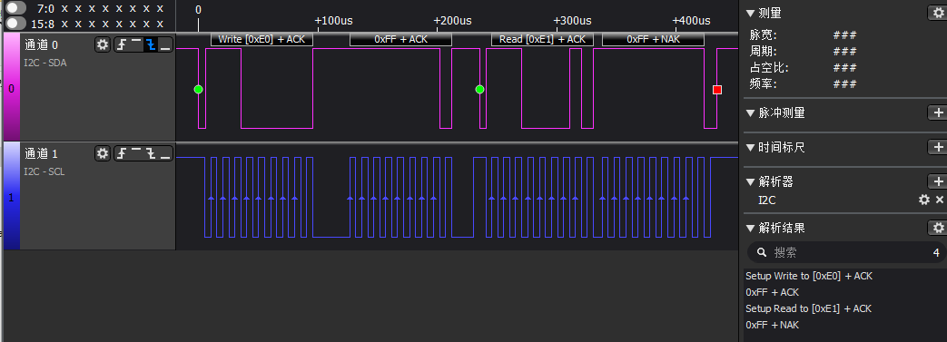
Solution 1, IPMI.kvdat: set pca9548 to 0xff and then repeate read without stop, but customer can’t find any device after PCA9548.

Slide 3
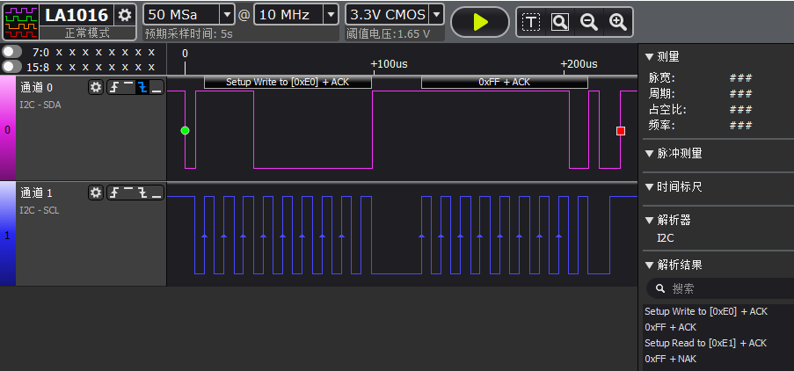
Solution 2, PIC3.kvdat: set pca9548 to 0xff and then stop, and all device after PCA9548 can be found.

