Slide 1
LVPECL to LVDS transform with SN65LVDS179
Date: May.12,2023

Slide 2
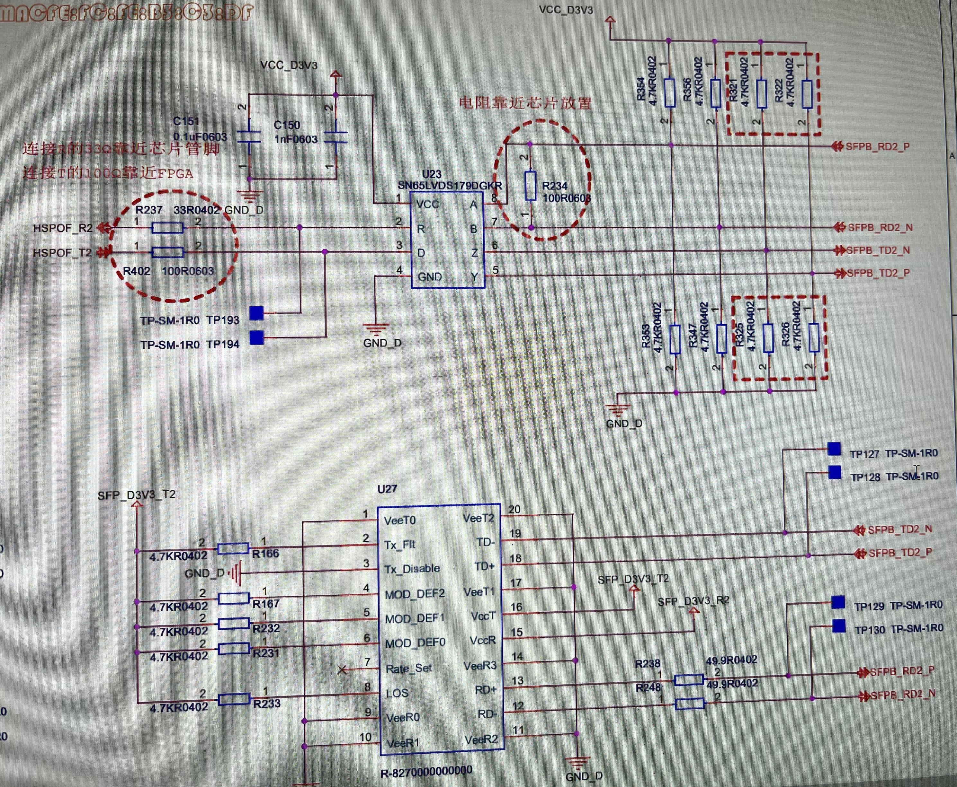
Schematic
SOC
LVDS_drive
LVDS Receive
LVDS Transceiver
LVDS179
LVPECL
SFP Transceiver
(optical module)
R-827000
SFP: Small Form-factor Pluggable
Support needs:
1.To realize LVDS and LVPECL communication,
If the schematic is good? if not, any suggestion
Notes:
Small Form-factor Pluggables

Slide 3
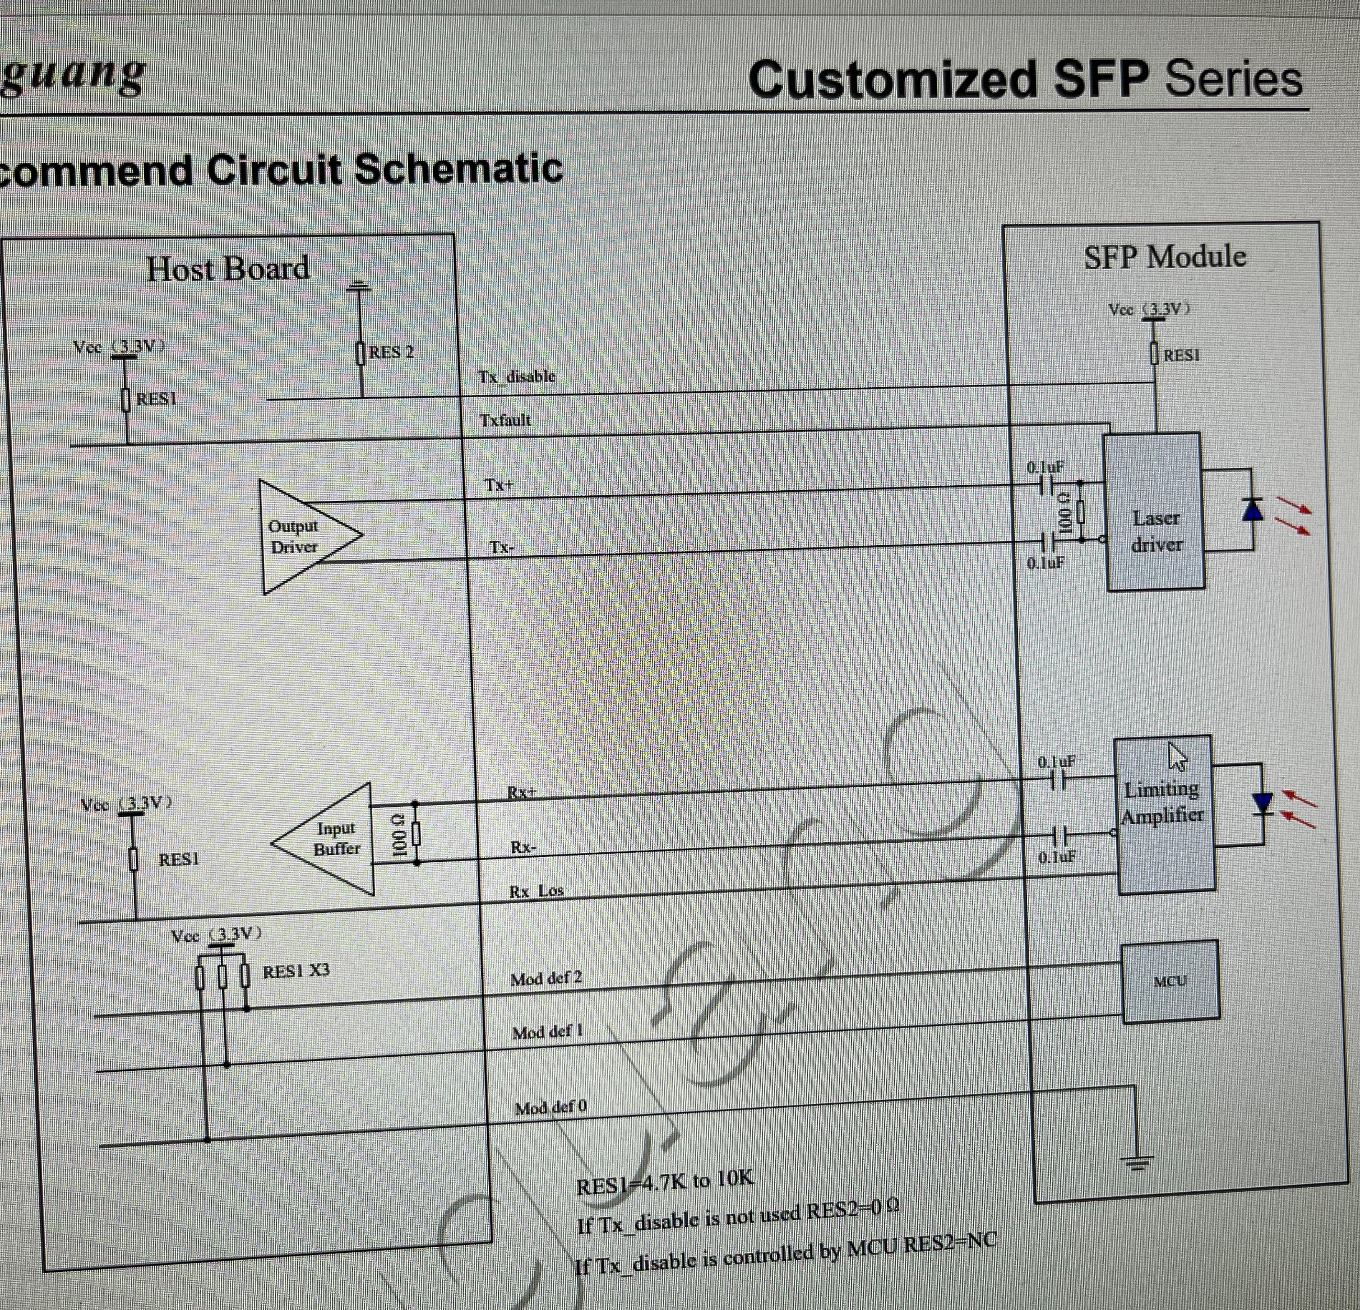
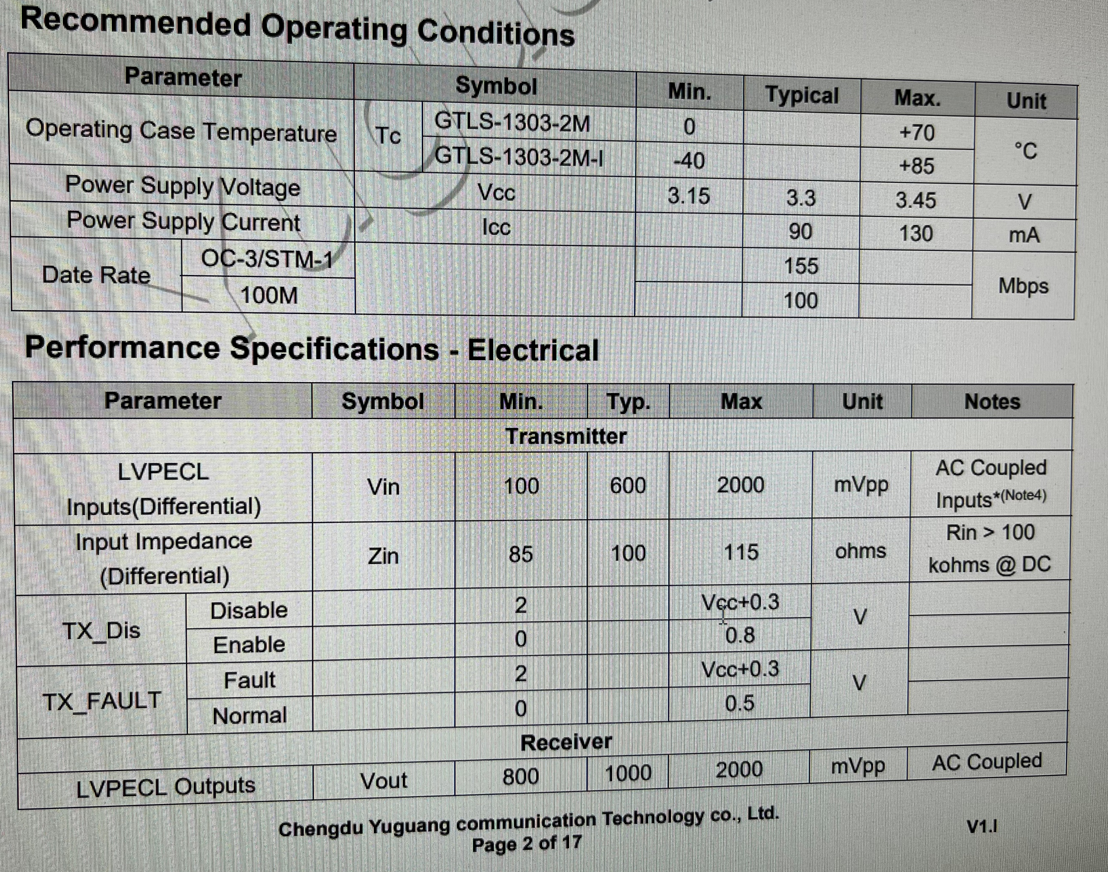
SFP module
SPF block diagram
SPF block diagram
Notes:
Small Form-factor Pluggables

