Slide 1
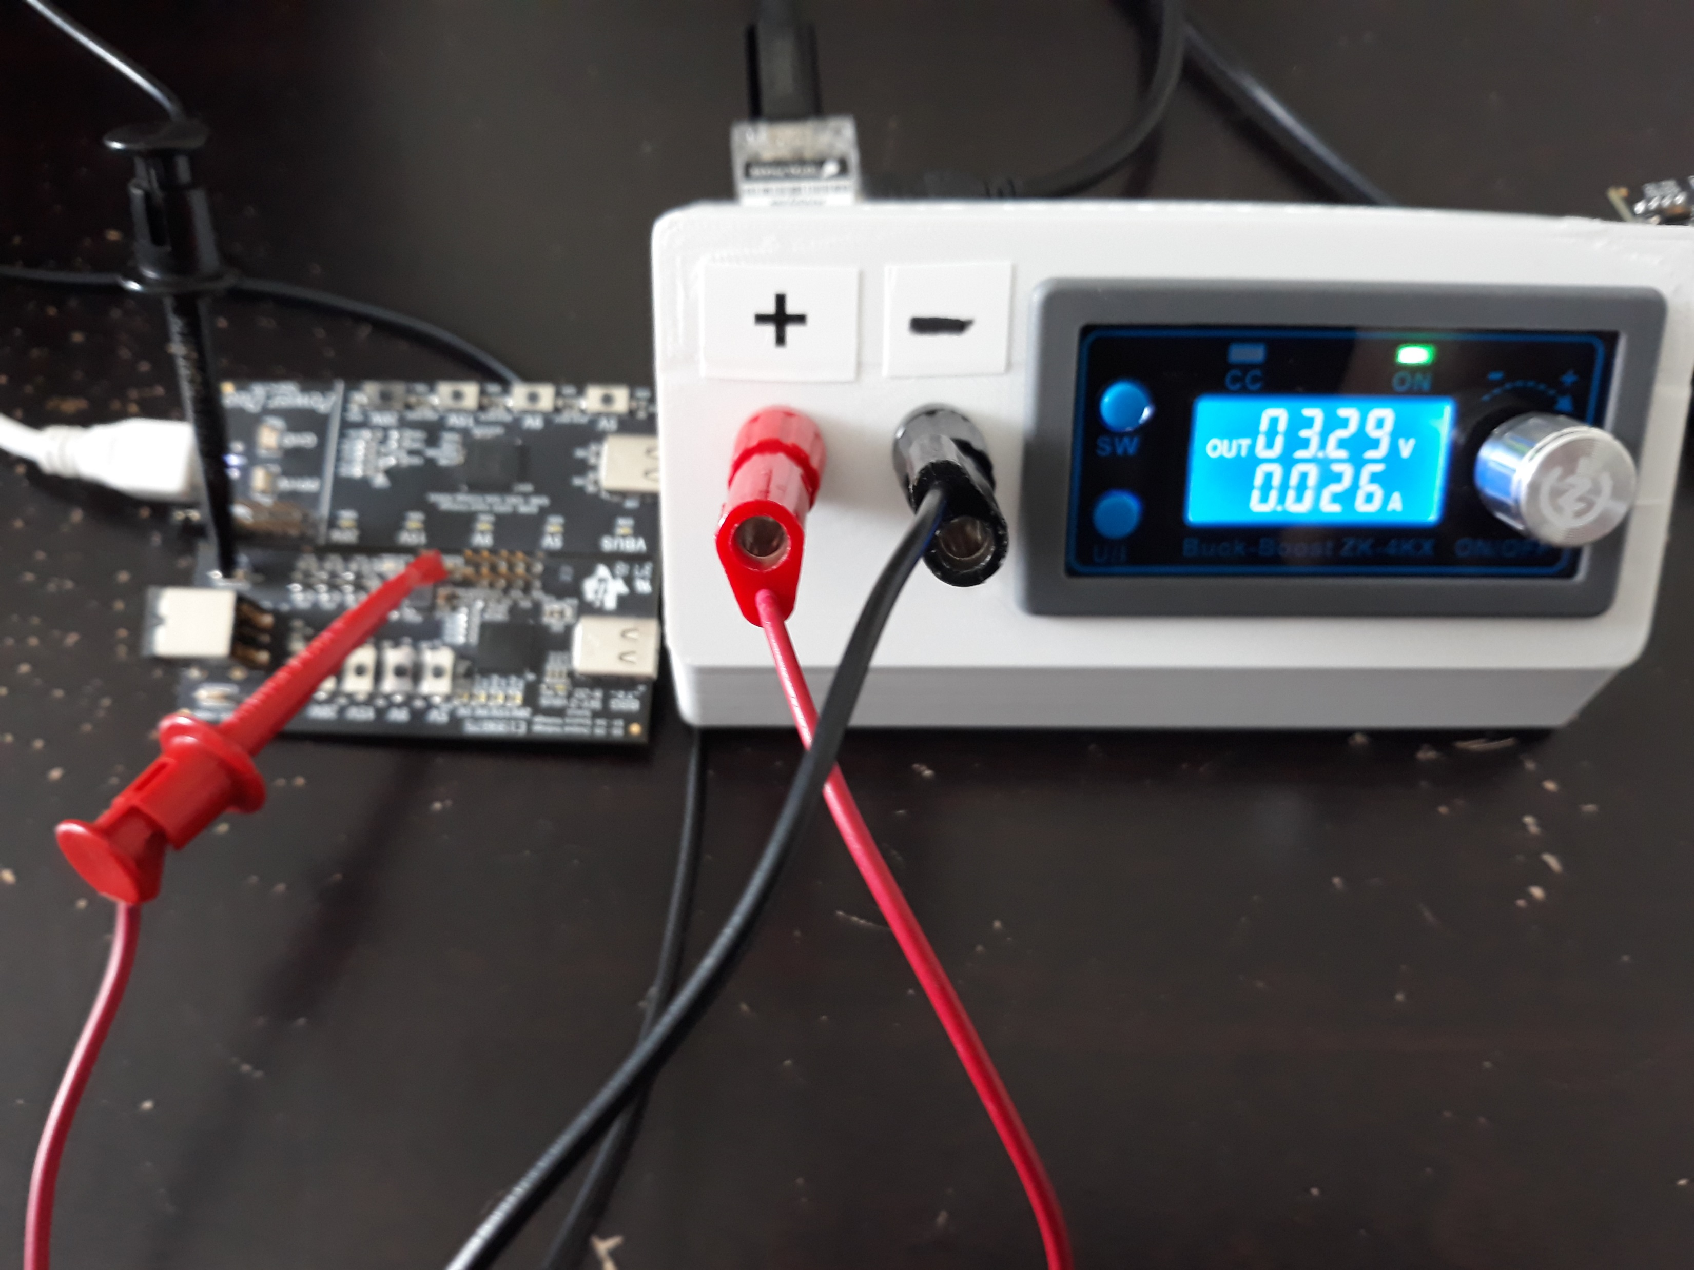
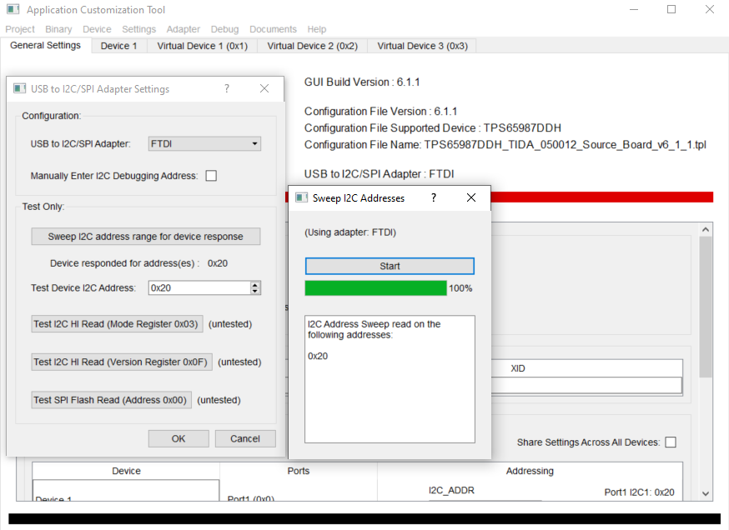
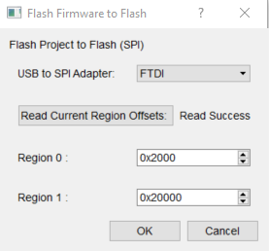
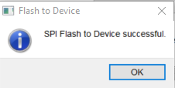
Program source board with external 3.3V
Set J202 to SRC
Force 3.3V on TP3
Load the TIDA_050012 SRC binary
Set adapter to FTDI and sweep I2C address, close and hit OK when t’s done
Go to Binary tab and select “flash from current project”
Select FTDI and click OK, click OK on successful flashing message
Recycle source side power
1
2
5
3
6
4

Slide 2
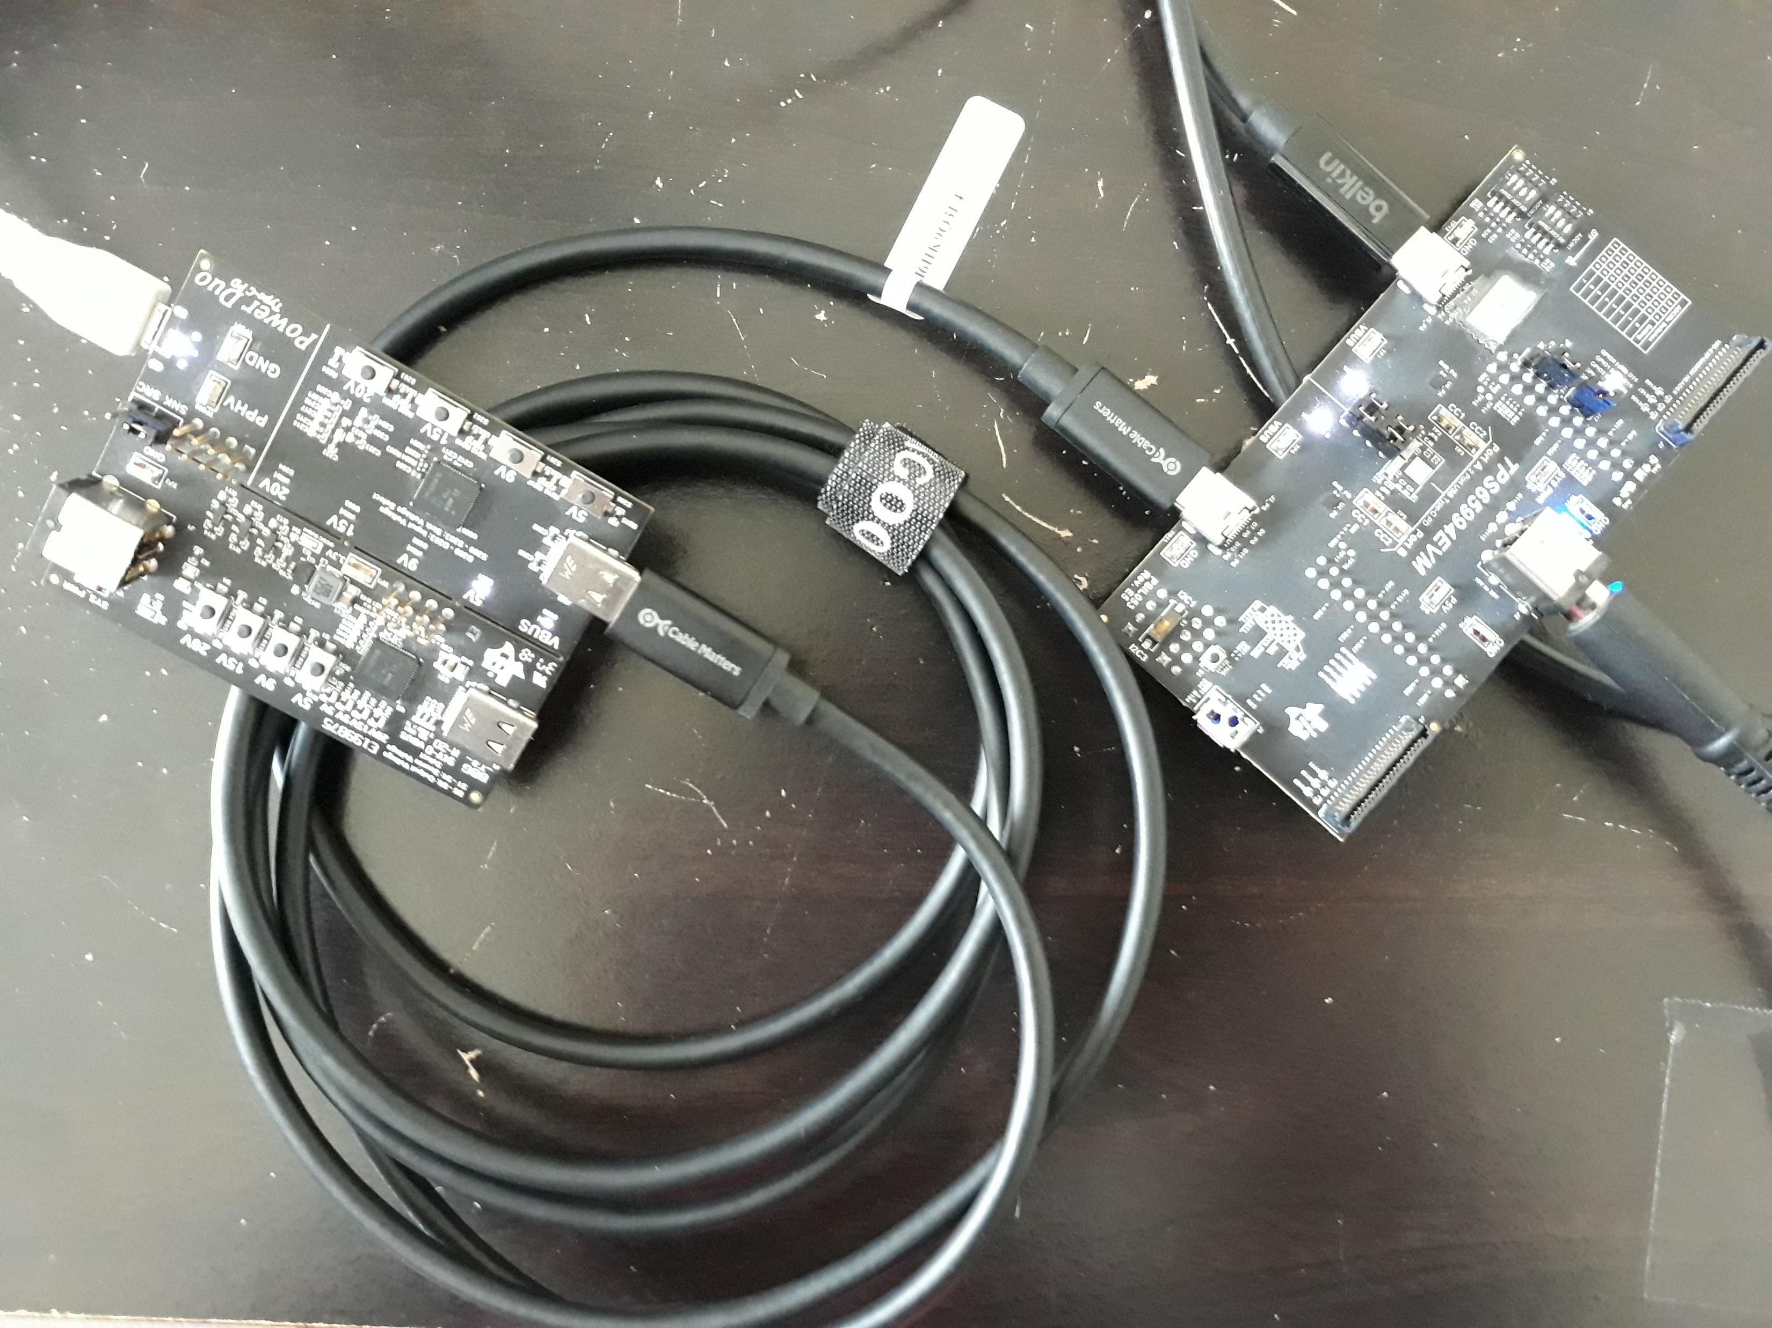
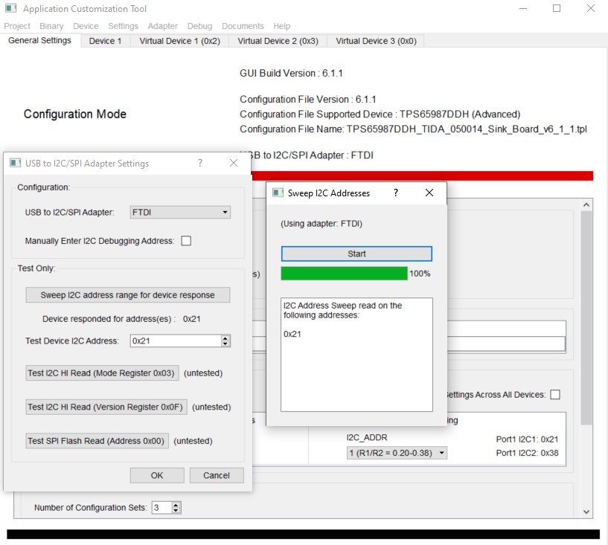
Program sink board independently
Set J202 to SNK
Connect external Type C to sink board type C connector
Load the TIDA_050012 SNK binary
Set adapter to FTDI and sweep I2C address, close and hit OK when t’s done
Go to Binary tab and select “flash from current project”
Select FTDI and click OK, click OK on successful flashing message
Recycle sink side power
2
1
5
3
4
6

