Slide 1
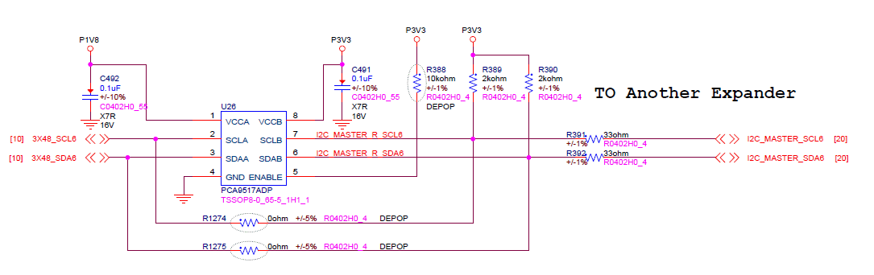
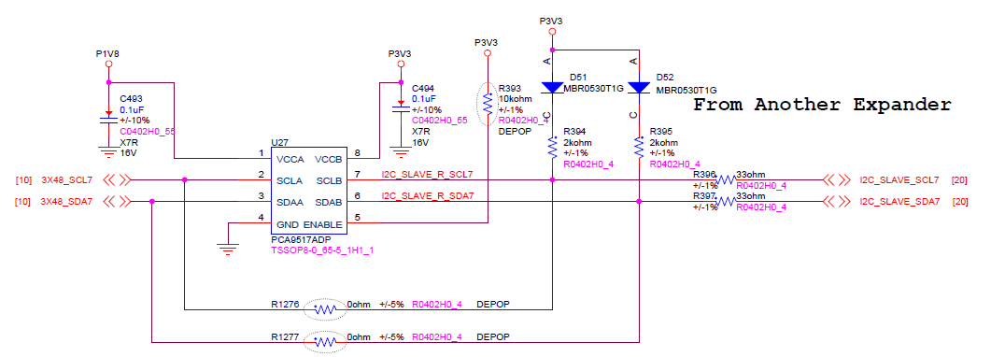
Sorry ,All of them are 9517 only.
All these are point out which side is which side.
The picture below is the same the 1st time picture I copy- paste to you
You will see U26 is Master side. Direction is from A--> B, U27 is slave side from B-->A
The Master and Slave both are LSISAS3x48 in the different I2C location with cascade.
VCCA on the both end are 1.8V, VCCB on both side are 3.3V The 9th CLK should be NACK on the Master side ( A,B),

