Slide 1
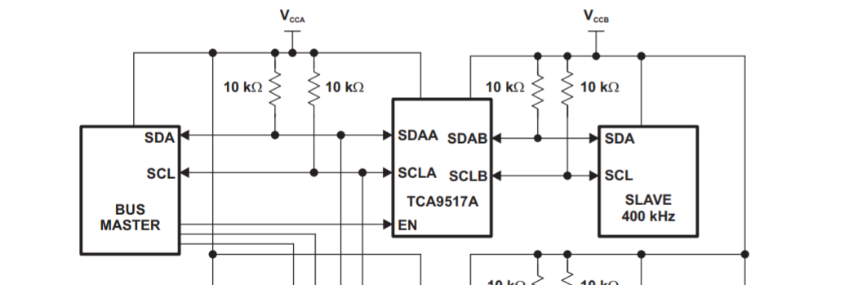
When the data is sent from Slave to master
Vol of the slave needs to be less than 0.45V.
For example, 0.4V
Vol of TCA9517A needs to be 0.47V(=0.4V + 0.07V)
=1.8V
=3.3V

Slide 2
When the data is sent from master to slave
Vol of the master needs to be less than 0.45V.
For example, 0.4V
Vol of TCA9517A needs to be 0.47V(=0.4V + 0.07V)
=1.8V
=3.3V

