Slide 1
TLV3491 application circuit
1. P1 is photo resistor, base impedance is 200k in dark. If lighting, the impedance will
Change to <100k.
2. R5 connect to MCU.
3. In DARK, TLV3491 will output 1. in Lighting, P1 < 100k, TLV3491 output 0.

Slide 2
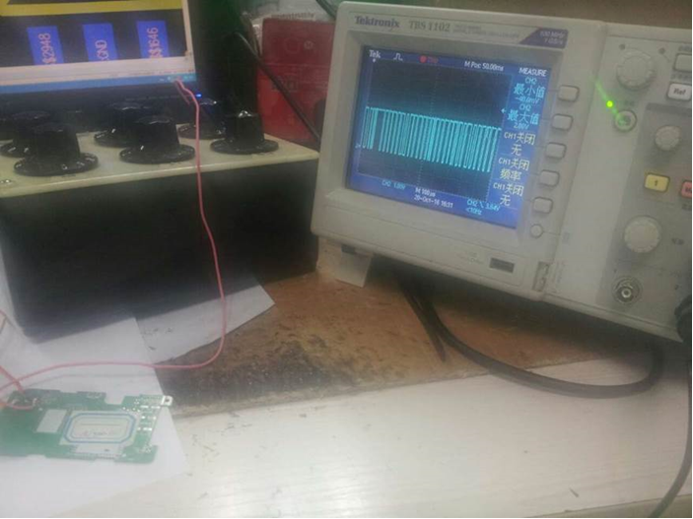
The problem
When using discrete resistor to simulate opto resistors, when using 200kohm, TLV3491
Output will be oscillator, as below, pls help check why?

