Slide 1
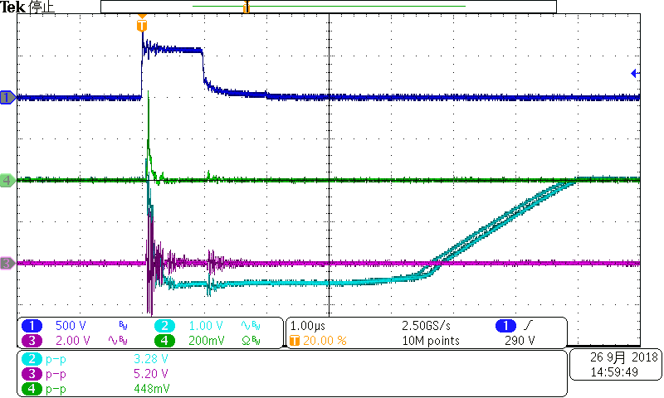
Ch1:impulse Noise
C4: IN+ to IN-
Differential probe
Ch3:-IN
Ch2:Vout

Slide 2
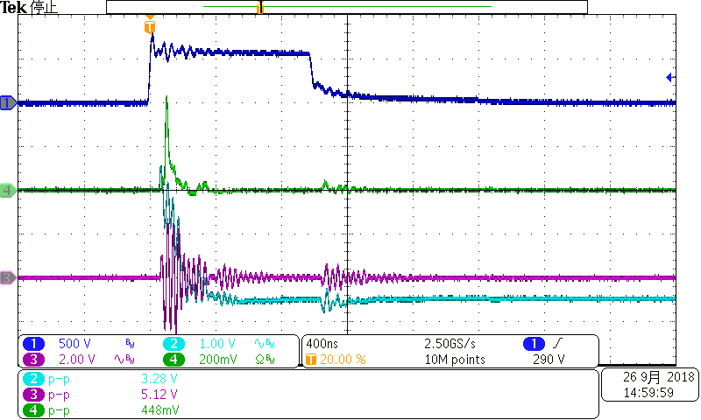
Ch1:impulse Noise
C4: IN+ to IN-
Differential probe
Ch3:-IN
Ch2:Vout

