Slide 1
OPA1632 Stability Analysis
Zak Kaye
Precision Amplifiers Applications
January 31, 2017

Slide 2
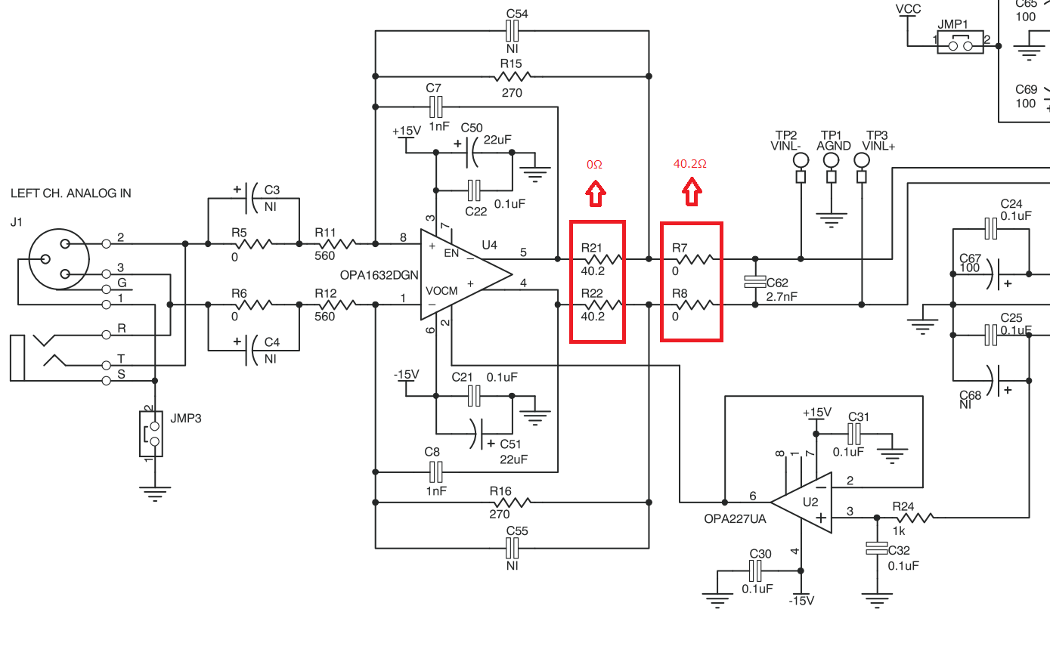
Design

Slide 3
Analysis

Slide 4
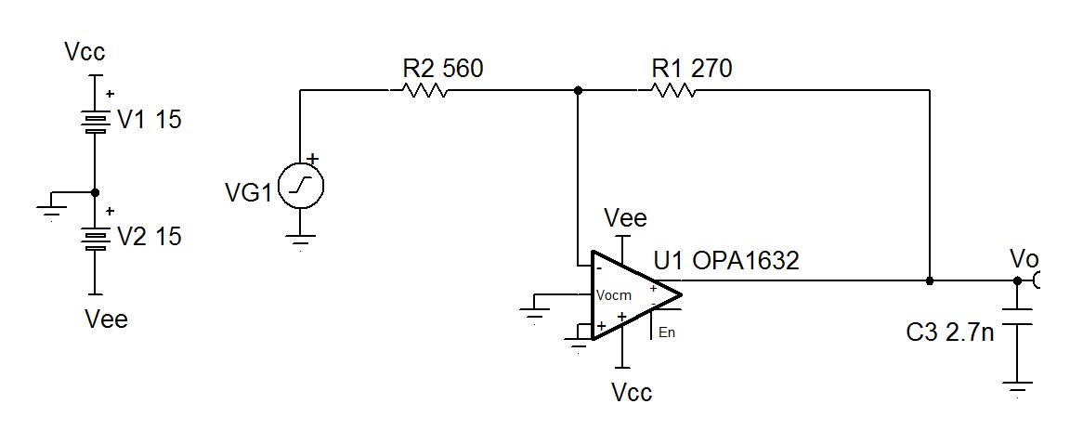
Single Sided Analysis
Simplify the schematic to a single sided representation for the fully differential amplifier. It now looks like a classic inverting op-amp.

Slide 5
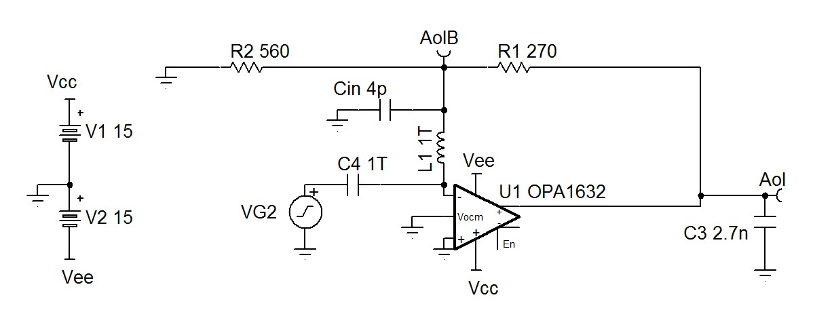
Set Up Open Loop Simulation

Slide 6
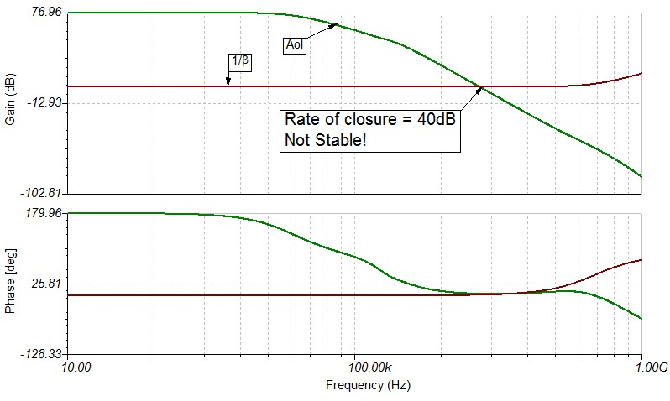
Simulate Open Loop Gain and 1/β

Slide 7
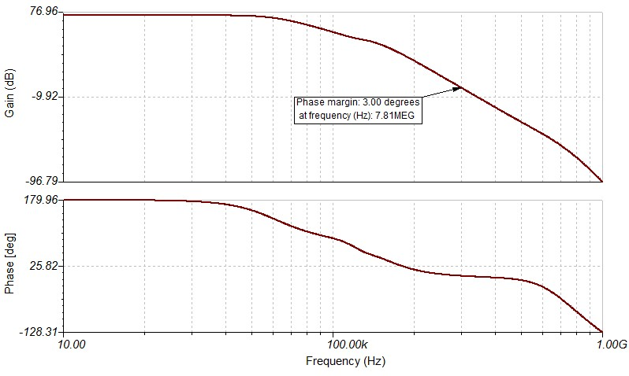
Loop Gain - Aolβ

Slide 8
What Next?
All signs point towards severe instability
You need to make the 1/β curve intersect the Aol curve with a lower rate of closure. A capacitor in the feedback network will only help if you have a lot of gain to manipulate.
Solution: Riso + Dual Feedback

Slide 9
Riso + Dual Feedback

Slide 10
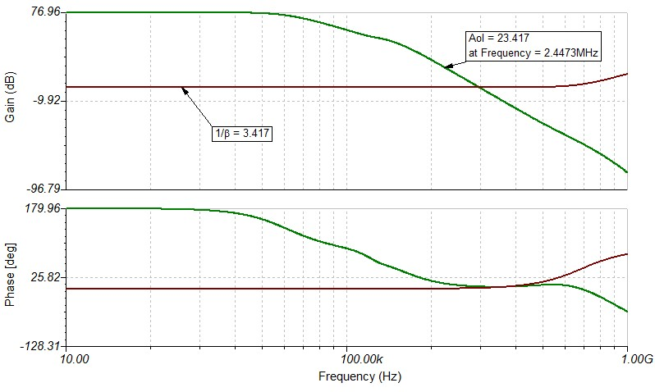
Riso + Dual Feedback
Riso adds a zero to cancel the pole in the capacitively loaded Aol curve
Find the frequency, f_{ZERO} where the magnitude of Aol – 1/β = 20dB
Calculate the value of Riso to set the zero at f_{ZERO}
R_{ISO} Equation:
$$R_{iso}=\frac{1}{2∗π∗f_{ZERO}∗C_{LOAD}}$$
$$R_{iso}=\frac{1}{2∗π∗2.4473MHz∗2.7nF}$$
$$R_{iso}=24Ω$$

Slide 11
Riso + Dual Feedback
Set feedback resistor, R1 ≥ 100*Riso
Set the feedback cap, Cf such that $\frac{6∗R_{ISO}∗C_{LOAD}}{R_{F}}≤C_{F}≤\frac{10∗R_{ISO}∗C_{LOAD}}{R_{F}}$
lower values of C_{F} = faster settling, higher overshoot
Rule 4 ensures that the two feedback paths will never create a resonance that would cause instability
R1 ≥ 2.4kΩ
$$\frac{6∗24Ω∗2.7nF}{270}≤C_{F}≤\frac{10∗24Ω∗2.7nF}{270}$$
1.44nF ≤ Cf ≤ 2.4nF

Slide 12
Compensated Design

Slide 13
Compensated Open Loop

Slide 14
Compensated Loop gain- Aolβ

Slide 15
Appendix: Op Amp Stability Reference
For detailed, definition-by-example of 10 different ways to stabilize
op amps driving capacitive loads, and additional technical information
on solving op amp stability problems, visit the Texas Instruments
E2E Forum at:
http://e2e.ti.com/support/amplifiers/precision_amplifiers/w/design_notes/2645.solving-op-amp-stability-issues.aspx
Download Part 1, Part 2, Part 3, and Part 4.
For more in-depth learning about op amps and op amp stability
look at TI Precision Labs at:
www.ti.com/precisionlabs
Analog Engineer’s Pocket Reference
A “must-have” for every Board/System Design Engineer
Download: http://www.ti.com/lsds/ti/amplifiers-linear/precision-amplifier-support-community.page#pocketref
Buy Hardcopy: https://store.ti.com/Search.aspx?k=pocket+reference&pt=-1
All Embedded Schematics in this presentation can be run in the Free TINA_TI SPICE simulator available at:
http://www.ti.com/tool/tina-ti

Slide 16
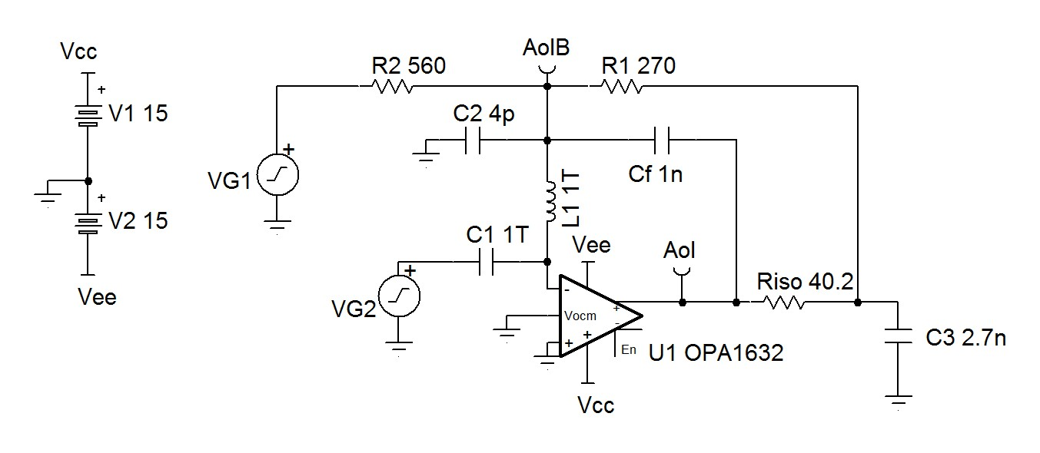
PCM4222 Evaluation Module Simulation

Slide 17
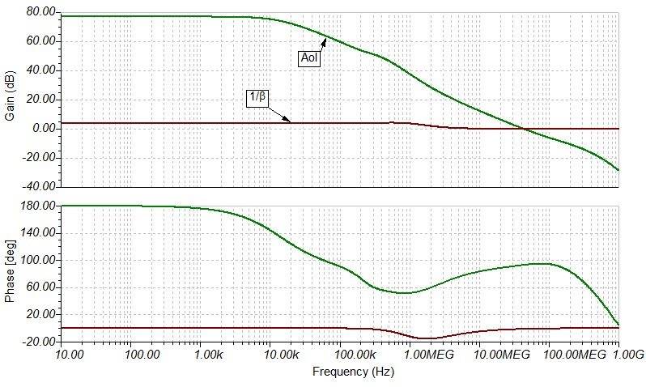
Open Loop with Riso + Dual Feedback

Slide 18
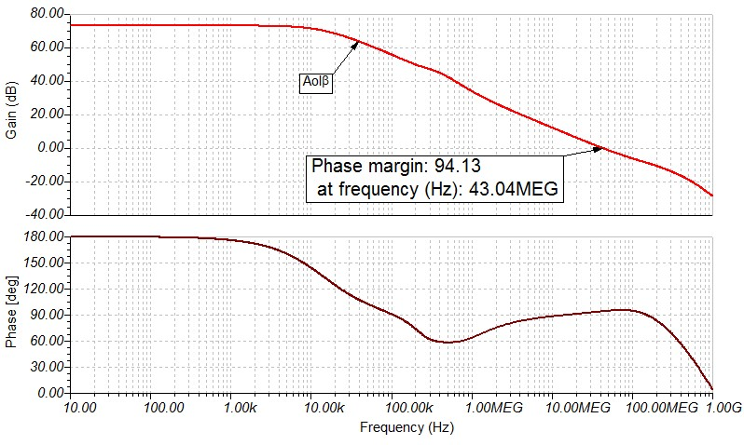
Loop Gain with Riso + Dual Feedback

Slide 19
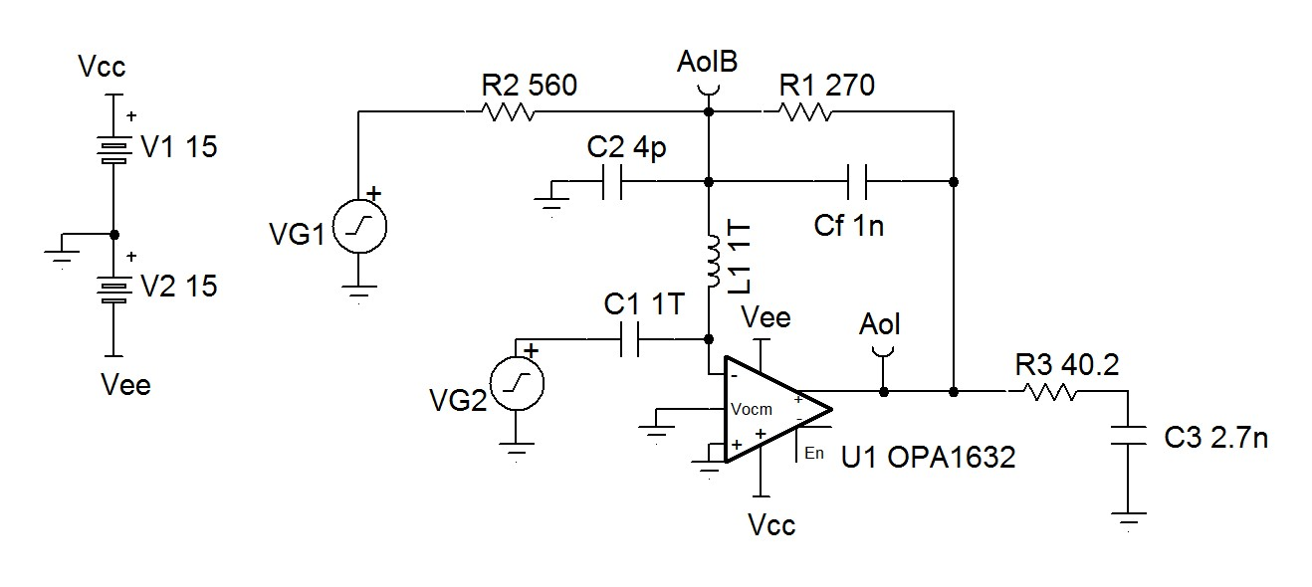
Riso

Slide 20
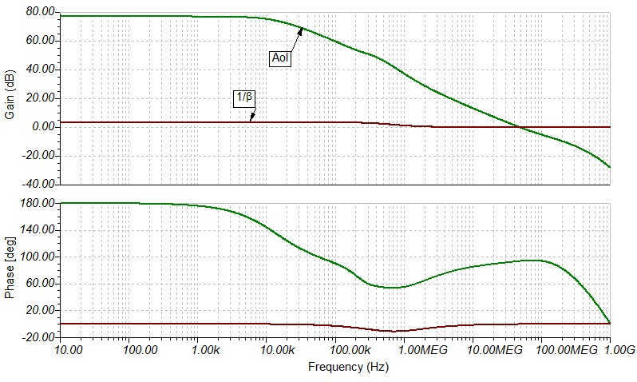
Open Loop with Riso

Slide 21
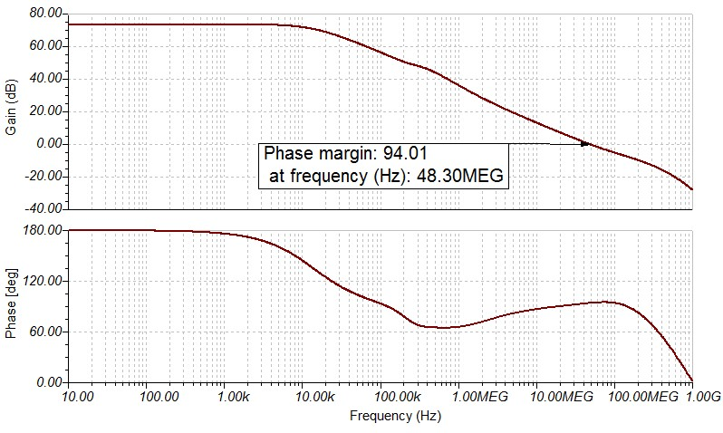
Loop Gain with Riso

