Slide 1
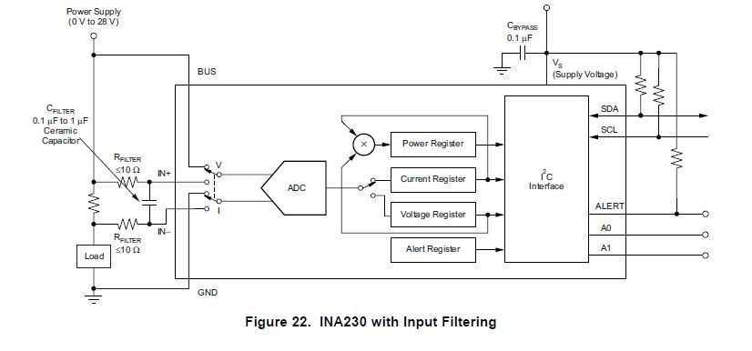
15V
Vs=3.3V
A: 1000pF
9.1Ω
0.27Ω
1uF
B: 1000pF
9.1Ω

Slide 2
Voltage Sensing(I2C)
15V
14V
1V
0V
Voltage shift
RF off
RF on

Slide 3
Current Sensing(I2C)
0.3A
0.25A
Current shift
0A
RF off
RF on

