Slide 1
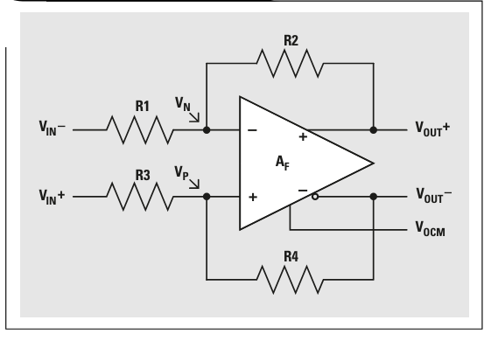
FDA Example
Texas Instruments

Slide 2
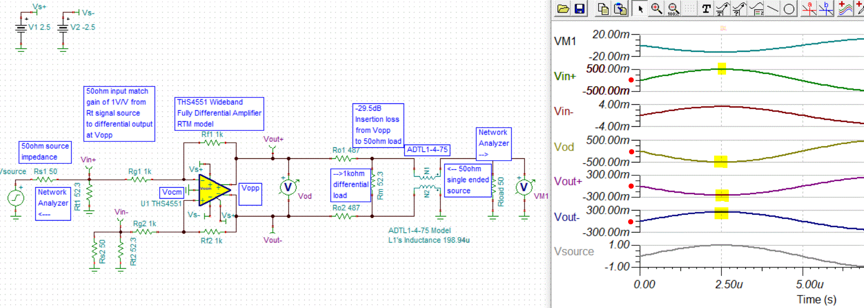
Single Ended Input, Vocm = 0V and no VIN Offset
Vout+ = (V_{N}*(R_{f}+R_{g})/(R_{g})) – (Vin-*(R_{f})/(R_{g}))
Vout- = (V_{P}*(R_{f}+R_{g})/(R_{g})) – (Vin+*(R_{f})/(R_{g}))
Vod = Vout+ - Vout-

Slide 3
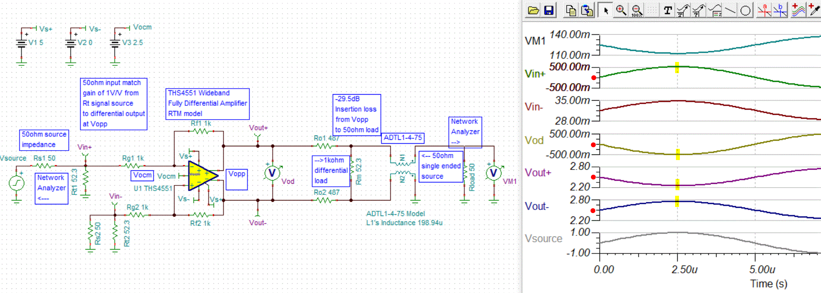
Single Ended Input, Vocm = 2.5V and no VIN Offset
Vout+ = (V_{N}*(R_{f}+R_{g})/(R_{g})) – (Vin-*(R_{f})/(R_{g}))
Vout- = (V_{P}*(R_{f}+R_{g})/(R_{g})) – (Vin+*(R_{f})/(R_{g}))
Vod = Vout+ - Vout-

Slide 4
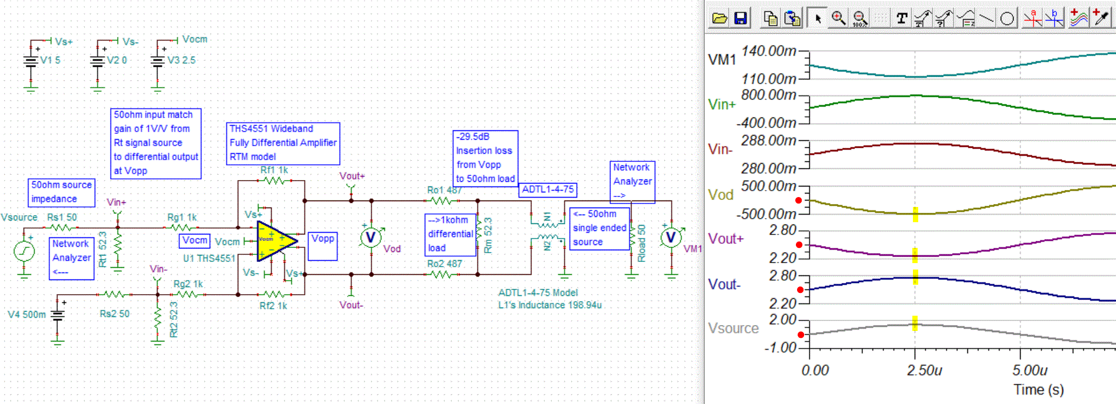
Single Ended Input, Vocm = 2.5V and 0.5V Offset
Vout+ = (V_{N}*(R_{f}+R_{g})/(R_{g})) – (Vin-*(R_{f})/(R_{g}))
Vout- = (V_{P}*(R_{f}+R_{g})/(R_{g})) – (Vin+*(R_{f})/(R_{g}))
Vod = Vout+ - Vout-

Slide 5
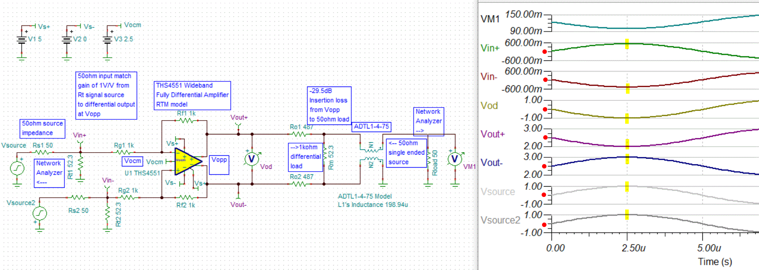
Same Value, Differential Input, Vocm = 2.5V and No Offset
Vout+ = (V_{N}*(R_{f}+R_{g})/(R_{g})) – (Vin-*(R_{f})/(R_{g}))
Vout- = (V_{P}*(R_{f}+R_{g})/(R_{g})) – (Vin+*(R_{f})/(R_{g}))
Vod = Vout+ - Vout-

Slide 6
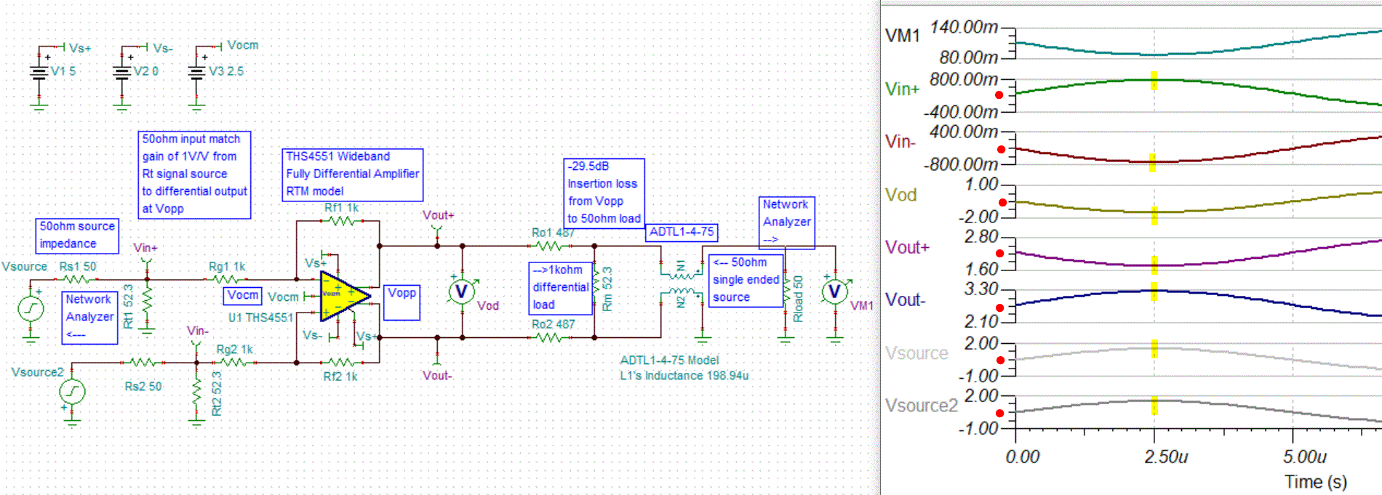
Same Value, Differential Input, Vocm = 2.5V and 0.5V Offset
Vout+ = (V_{N}*(R_{f}+R_{g})/(R_{g})) – (Vin-*(R_{f})/(R_{g}))
Vout- = (V_{P}*(R_{f}+R_{g})/(R_{g})) – (Vin+*(R_{f})/(R_{g}))
Vod = Vout+ - Vout-

Slide 7
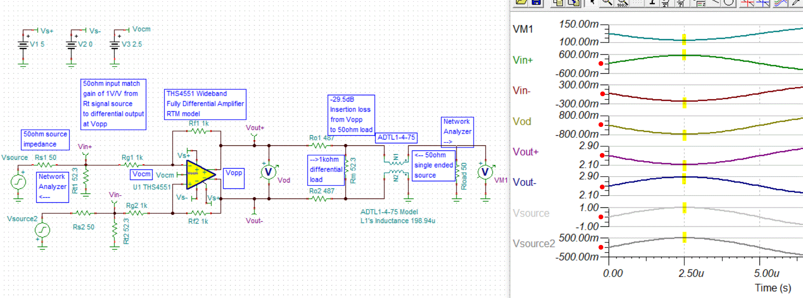
Different Value, Differential Input, Vocm = 2.5V and No Offset
Vout+ = (V_{N}*(R_{f}+R_{g})/(R_{g})) – (Vin-*(R_{f})/(R_{g}))
Vout- = (V_{P}*(R_{f}+R_{g})/(R_{g})) – (Vin+*(R_{f})/(R_{g}))
Vod = Vout+ - Vout-

Slide 8
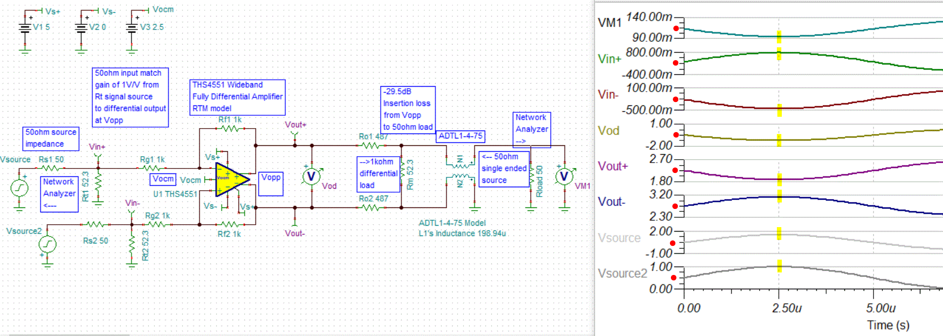
Different Value, Differential Input, Vocm = 2.5V and 0.5V Offset
Vout+ = (V_{N}*(R_{f}+R_{g})/(R_{g})) – (Vin-*(R_{f})/(R_{g}))
Vout- = (V_{P}*(R_{f}+R_{g})/(R_{g})) – (Vin+*(R_{f})/(R_{g}))
Vod = Vout+ - Vout-

