Slide 1
4 to 20 mA receiver
Notes:
Hello and welcome to the TI precision labs session on

Slide 2
Dual supply

Slide 3
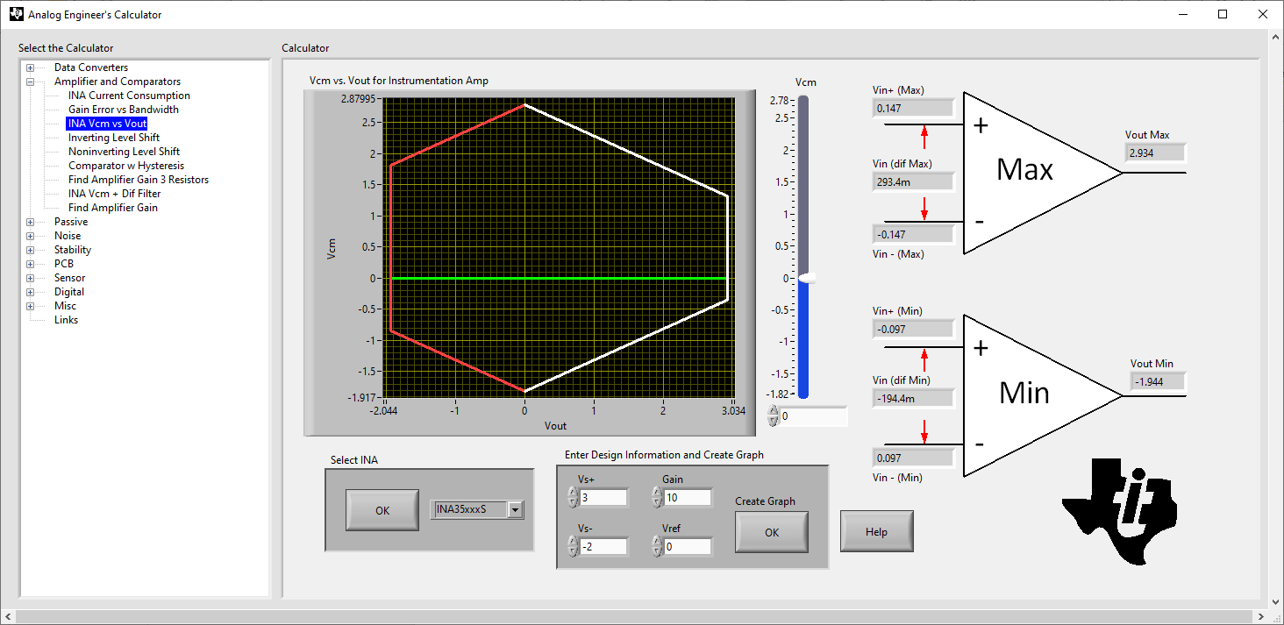
Dual supply diamond plot

Slide 4
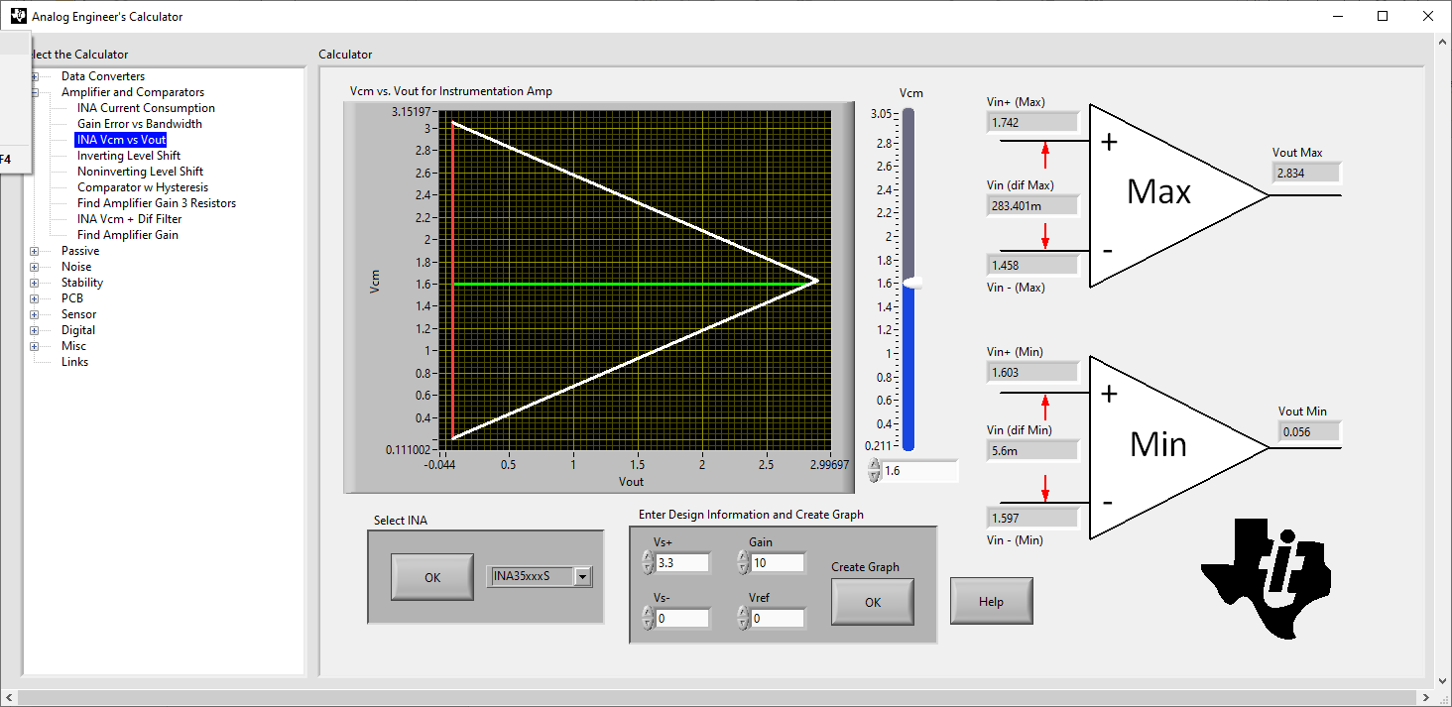
Single supply challenge
When used in single supply output is limited for larger output signal. Best range is for common mode equal to 1.6V

Slide 5
Single supply solution
Use a common mode resistor.
Vcm = (Va + Vb)/2 +Vb.
At 20mA, Vcm = (20mA*85Ω+20mA*75Ω)/2=1.6V
At 20mA, Vout = 20mA*10*10= 2V, This gives a lot of margin in output vs common mode

Slide 6
Single supply solution
The output range common mode margin is circled in blue

Slide 7
SPICE Files

