Slide 1
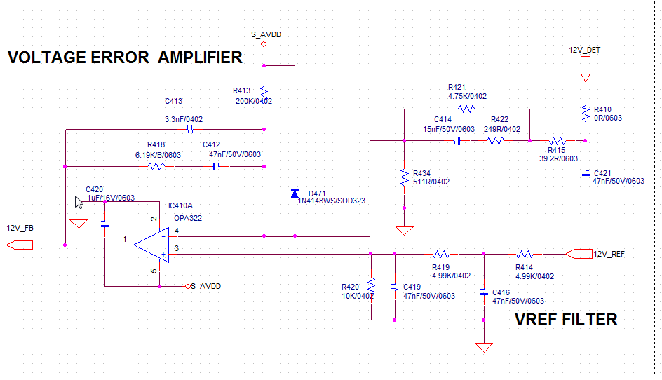
≈1.1Vdc
To Digital Controller
From Digital Controller
≈2.2Vdc
≈1.1Vdc

Slide 2
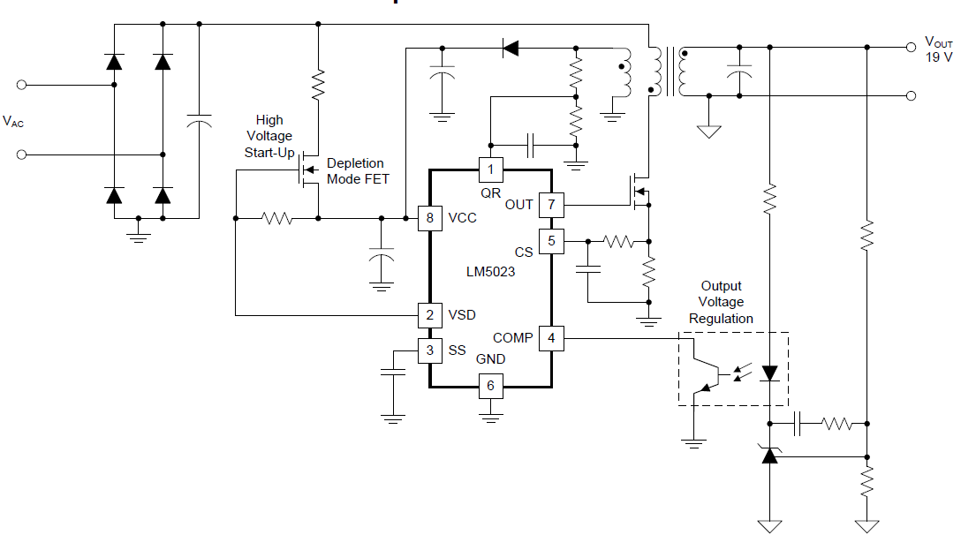
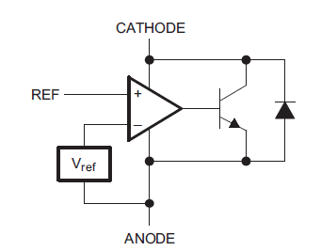
Feedback circuit
Loop
compensation
TL431
Using OPA322 instead of TL431
TL431 Equivalent Schematic

