Slide 1
OPA549
Improved Howland Current Pump Stability Analysis
Tim Green, MGTS
Precision Op Amp Applications Manager
April 10, 2018

Slide 2
Summary
OPA549 Web SPICE macromodel does not properly model the real silicon Zo.
An external Zo block is used to match real silicon for stability analysis and small signal transient analysis ONLY.
Customer original circuit is analyzed to be marginally stable with 14 degrees of loop gain phase margin.
A proposed compensation scheme for robust and stable operation is implemented and analyzed with 85 degrees of loop gain phase margin.
Note: ANY deviation from values of components shown in the proposed compensation scheme will require re-analysis for guaranteed stable operation.
Note: All TINA-TI simulations can be run on the embedded schematics in this presentation by downloading the free TI SPICE simulator, TINA-TI, at:
http://www.ti.com/tool/tina-ti

Slide 3
Loop Gain Uncompensated Circuit

Slide 4
Uncompensated Aol and 1/Beta
Rate-of-Closure at fcl = 40dB/decade→ Unstable

Slide 5
Uncompensated Loop Gain
Loop Gain Phase Margin at fcl where loop gain = 0dB is 13.7degrees.
Minimum acceptable phase margin is >45degrees.

Slide 6
Uncompensated Transient Analysis

Slide 7
Uncompensated Transient Analysis

Slide 8
Uncompensated Transient Analysis
fosc of 32.54kHz in Transient Analysis correlates to 13.7 degrees of phase margin at fcl (about 32khz)

Slide 9
Desired 1/Beta modification for stability
Beta+ feedback path will be modified to yield a Desired Modified 1/Beta shown above so that at fcl rate-of-closure = 20dB/decade for stale operation.

Slide 10
Desired 1/Beta modification for stability
C4 interacts with RF add a pole to Beta- feedback path to counteract Beta+ feedback path zero. R1 sets the flat portion of the Desired Modified 1/Beta curve at higher frequencies.

Slide 11
Desired 1/Beta modification for stability

Slide 12
Desired 1/Beta modification for stability Loop Gain
Loop Gain Phase Margin at fcl where loop gain = 0dB is 86 degrees. Want 45 degrees of phase margin or greater for robust and stable design.

Slide 13
Desired 1/Beta modification Transient Analysis

Slide 14
Desired 1/Beta modification Transient Analysis
Fast response to transients and quick settle → stable and robust design.

Slide 15
Desired 1/Beta modification AC Closed Loop Transfer

Slide 16
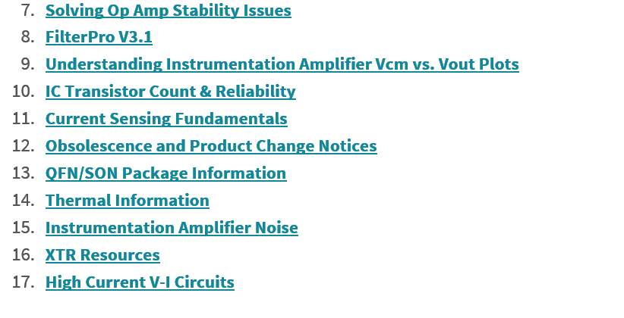
Op Amp Stability Reference
For on solving op amp stability problems visit the Texas Instruments
E2E Forum at:
https://e2e.ti.com/support/amplifiers/precision_amplifiers/w/design_notes
Download all parts of the following presentations:

