Slide 1
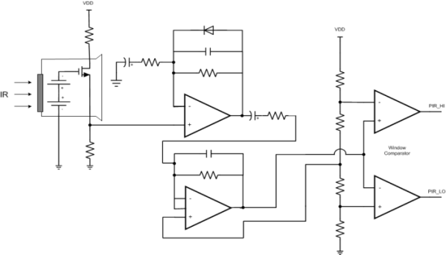
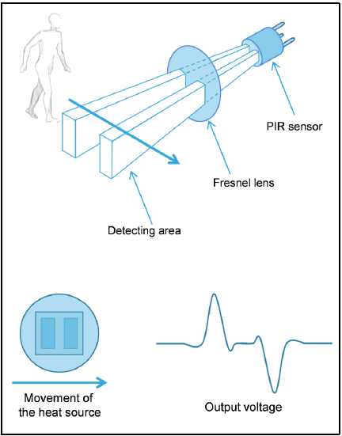
PRAMPS in PIR Motion Sensing Summary of Implementations and Needs
Passive / Pyroelectric infrared
Sensor BW: 10 Hz
Gain needed: ≥500V/V
Slow to start up → always on
3 Implementations
AFE: Dual op amp & window comparator
Mixed: Dual op amp and ADC (in micro)
Digital: Digital PIR sensor module
Key Op Amp Parameters
Wireless & Bus
GBW
>5 kHz
IQ
Lower is better
Wireless systems use batteries → longer battery life
Bus-powered → more nodes per bus / hub
Wired
Cost
Package
Most op amps have the same pinout → customer preference leads / no-leads
Hero Products:
OPA/TLV2369
TLV8812
1. PIR Sensor
2. Filtering &
Amplification
3. Threshold
Detection
10 Hz BW
AFE Implementation

Slide 2
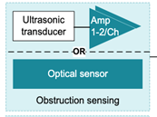
PRAMPS in Smoke and Heat Detector
Application: Smoke detector
EE | Type | Key specs | GPN’s
Smoke detector | With ionization | Very low power Low offset voltage Low drift | LPV821 LPV811 LPV812
Smoke detector | with thermistor | Very low power Low offset voltage | OPA369, TLV369 LPV811, LPV812
CO sensor (toxic gas) | Vref | Low power Low output impedance | OPA369, OPA348, TLV369
CO sensor (toxic gas) | Potentiostat | Low power Low Ib | LPV821 LPV811, LPV812
Ultrasonic transducer | Optical sensor | Low power Low Ib RRIO | TLV6003
Ultrasonic transducer | Obstruction sensor | Low power Low Ib Wide BW | TLV9061
Requirements
Solution
TI Value
Battery life longevity (low power)
Accurate measurement (low Vos)
I-V conversion (low Ib)
Very low power, precision CMOS
Hero products: LPV821, LPV812, OPA369
Broad low power product offerings
Wide selection of micro and nano power amplifiers
Notes:
2

