Slide 1
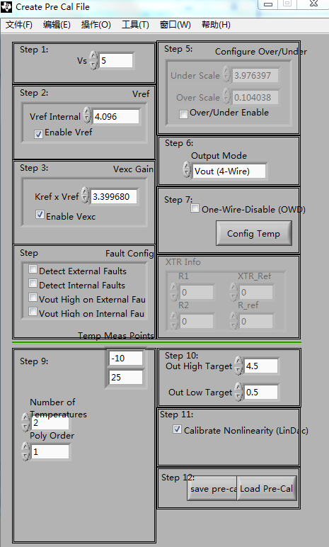
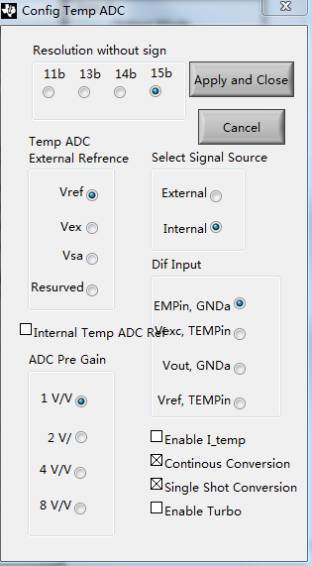
PGA309EVM-USB
Load Pre-Cal File
Click “Create Model File Emulator File”;
Click “Create Pre Cal File”;
The Config Temp ADC and Pre Cal File
menu have the following settings.
Click “save pre-Cal”,save file as “test.txt”;

Slide 2
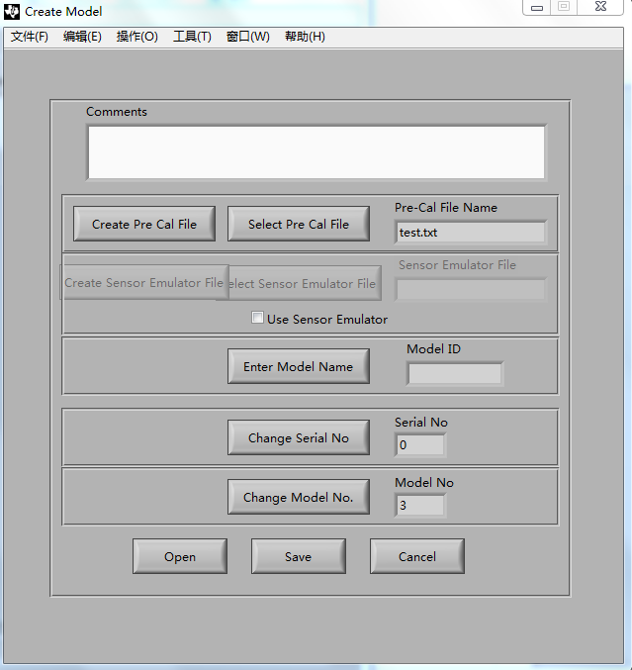
PGA309EVM-USB
Loading the Model File
Click “Select Pre Cal File”
Load “test.txt”
Click Save button
Save file as “test.txt”
Close window

Slide 3
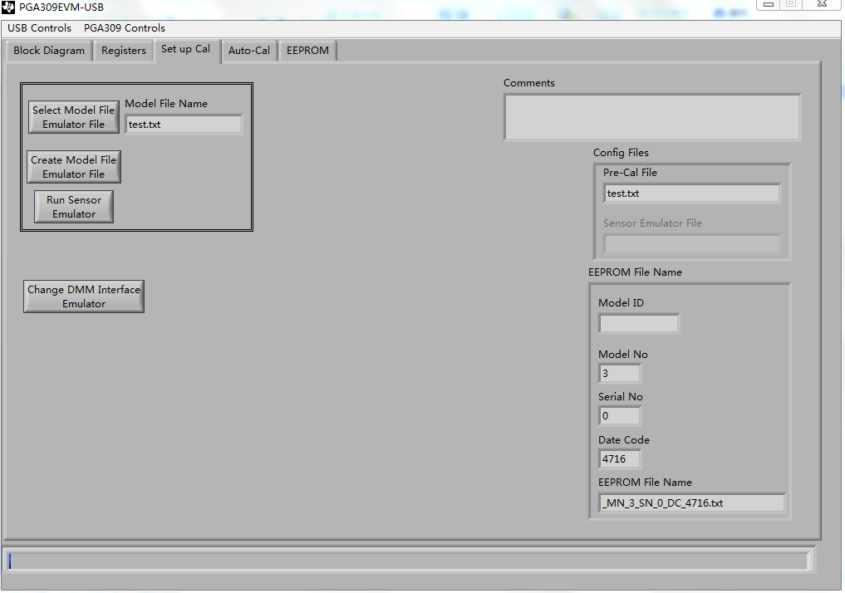
PGA309EVM-USB
Loading the Model File
Click “Select Model File Emulator File”
Load “test.txt”

Slide 4
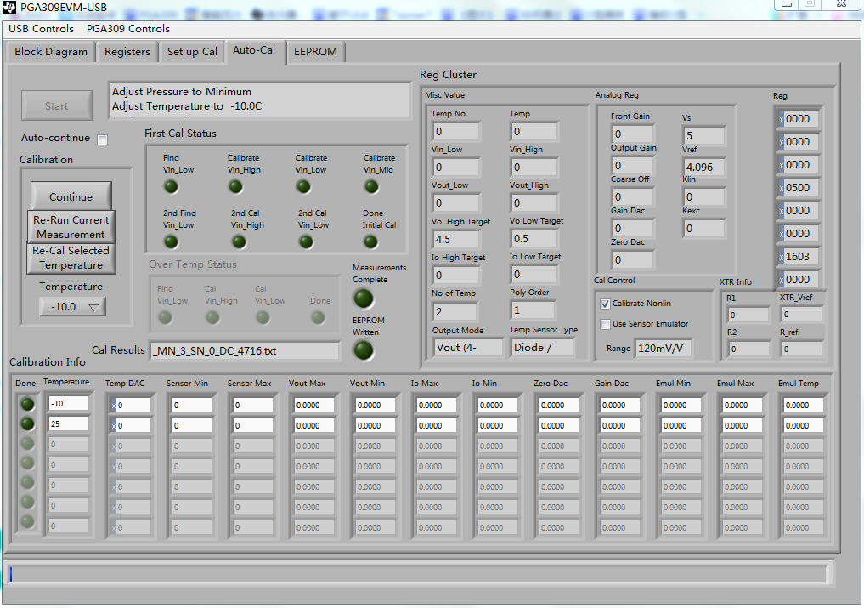
PGA309EVM-USB
Calibration
Click “Start” to initiate calibration
Set the temperature and pressure according to the prompt;

Slide 5
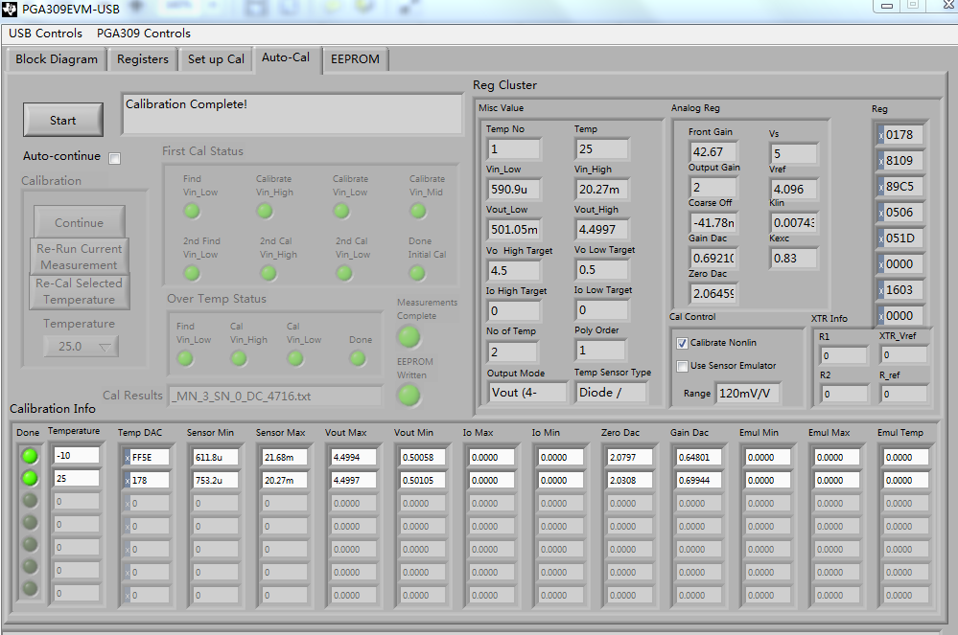
PGA309EVM-USB
Calibration
Calibration is completed, calibration info have the following values.

Slide 6
PGA309EVM-USB
output
When temperature is 25℃, the output voltage with different pressure is as follows:

Slide 7
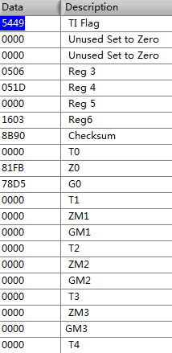
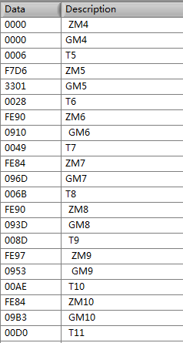
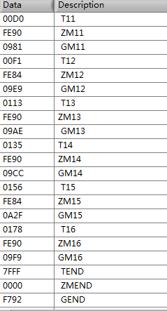
PGA309EVM-USB
EEPROM Data
Screen-shot EEPROM results

