Slide 1
Automatic Power Control (APC) in Laser
- Anant Sinha

Slide 2
Automatic Power Control (APC) in Laser
Automatic power control (APC) in laser drive systems, ensures stable and efficient laser operation by continuously regulating optical output power of the Laser. Fluctuations in temperature, ageing effects, and variations in external conditions can cause instability in laser performance. APC employs feedback mechanisms to dynamically adjust the laser's drive current based on feedback from a photodiode, maintaining a consistent optical output. This enhances reliability and optimizes performance in applications which require precise control of the optical output.
In our setup, we have used a laser diode (PLT5 518FB_P) which has an integrated back facet photodiode as well for feedback.A back facet diode typically refers to a photodiode or integrated sensor that monitors light emitted from the back facet of a laser diode. In most edge-emitting laser diodes, the primary optical output is deliberately extracted from the front facet, while the back facet—which is usually highly reflective—is not used for the main beam output. However, a small fraction of light escapes (or is purposefully tapped) from the back facet.
This light is sampled by the back facet diode (which is basically a photodiode), and generates current proportional to the optical output of the laser. This current is then sensed and then sent as feedback to the laser driver to control the laser performance.

Slide 3
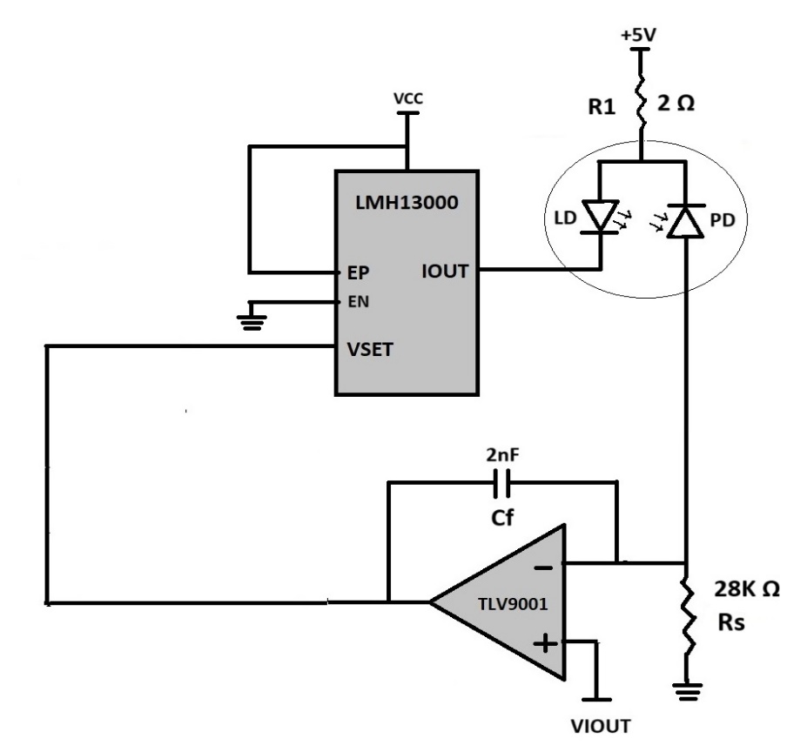
APC loop working for DC operation
To set a desired optical output, first we need to know the transfer function of Laser optical output vs the photodiode current of the back facet diode.
With this knowledge we can set the desired value of the at VIOUT (non-inverting input of the error amplifier). This voltage acts as the reference voltage for the error amplifier.
  VIOUT(set)= Rs x Ipd(at desired optical output)
The feedback voltage, Vsense (= Ipd x Rs) is then compared to the reference voltage (VIOUT) to set the correct voltage at the output of the error amplifier, this is then fed as a bias to the VSET pin of the LMH13000.
The LMH13000 sets the Laser current proportional to the VSET (refer to the LMH13000 datasheet for IOUT vs VSET transfer function). The value of this current will be such that the optical output of the laser results in Ipd= VIOUT(set)/Rs
If for any reason the optical output deviates from the set value, the feedback voltage will change, resulting in the error signal to increase. The error amplifier will then try to correct the error by adjusting its output voltage (VSET) which will cause the IOUT and hence the optical output of the laser to change. The adjustment in laser output will be such that it brings the Ipd back to the set value. This feedback mechanism to adjust the laser's drive current maintaining a consistent optical output.
PLT5 518FB_P
Ipd
Vsense
Error Amplifier

Slide 4
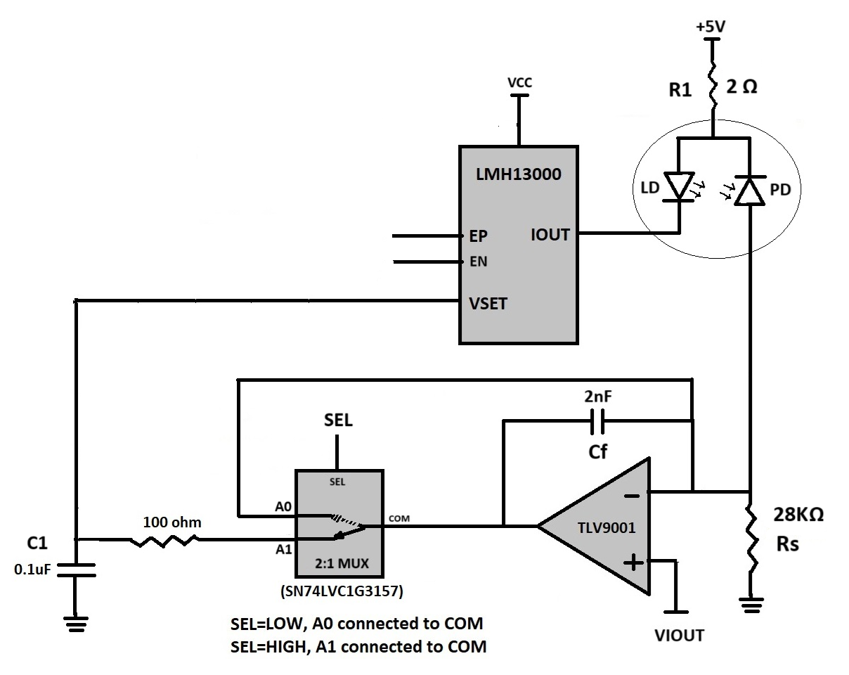
APC loop for Pulsed Laser Operation
For pulsed Laser operation also, the current adjustment is done when the loop is closed but pulsing is done in open loop condition only. This is to ensure that the APC loop does not try to correct for the current during the off period of the pulse signal when the current is zero.
To realize this, a switch and a capacitor are added in the loop between the error amplifier output and the LMH13000 VSET pin.
VLD
To set the required peak pulse optical output power of the laser, the Switch S1 is closed and EP is pulled high to enable the LMH13000 output. During this time the system works as a standard APC loop as discussed in the previous section and the Capacitor C1 gets charged to the required VSET voltage, and the system is ready for pulsed operation.
To enable the pulse operation, open the Switch S1 and start the pulse signal at EP/EN pin. Opening the switch S1 breaks the loop and it no longer tries to correct for any deviation in the set current during the off period of the pulse.
The peak current during this time is decided by the voltage across the capacitor C1 which holds the charge during the off state of the switch S1 and hence provides the required VSET voltage.
This process is repeated to keep monitoring and controlling the peak optical power of the Laser
Ipd
S1
Vsense

Slide 5
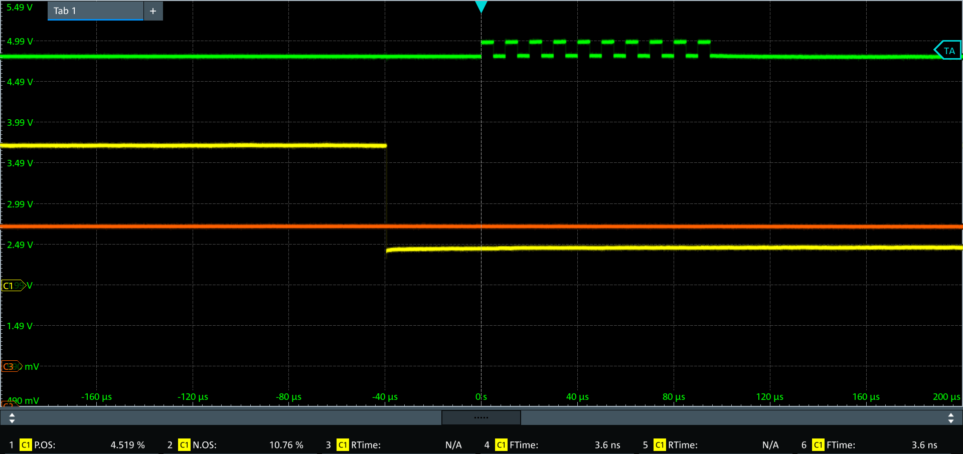
Waveform
(IOUT= 85mA, VIOUT= 70mV, LMH13000 MODE= 0)
VLD
5V
4.83V
SEL
Current pulse (85mA peak)
3.5V
VSET
171mV
1V
Loop Closed
Loop Open

