Slide 1
Electrostatic Discharge (ESD)
TIPL 1401
TI Precision Labs – Op Amps
Presented by Marek Lis
Notes:
Hello, and welcome to the video for the TI Precision Lab discussing electrostatic discharge, or ESD. In this video we’ll explain how ESD can damage semiconductor components. We will also give detail on internal ESD protection circuits that are included in semiconductor devices. Finally, we will explain how ESD performance is characterized so that the robustness of the device is understood.

Slide 2
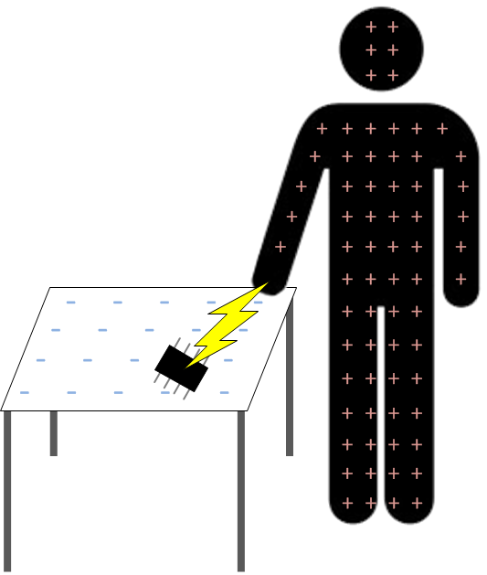
Electrostatic Discharge (ESD)
Large potential difference (kV) causes static discharge
Insulators allow for
large static buildup
Notes:
Many common items can develop a static electrical charge. Insulators are especially prone to developing large static charges. Some materials tend to become positively charged and others become negatively charged. Whenever two items with a charge imbalance are brought in close proximity, you can have a sudden flow of electricity between the two objects, called an electrostatic discharge, ESD. ESD can show up as a visible spark and often has voltage levels in the thousands of volts. From a semiconductor perspective, ESD is the most common way that devices are damaged.

Slide 3
ESD Generation vs. Relative Humidity (RH)
Source: ESD Association
ESD Generation vs. Human Awareness
Some ICs can be damaged at <10V !
You will not even feel the ESD !
Source: http://emp.byui.edu/fisherr/esd/esd_control_handbook.pdf
Notes:
The table at the top of this slide lists some materials that generate significant static charges. Also notice that the static charge is dependent on the relative humidity. Lower relative humidity generates more static charge.
The table at the bottom of the slide shows ESD discharge voltages vs. human awareness. Notice that when you can see an ESD “spark” the voltage is very large, at 8000V or more.

Slide 4
Typical IC Device Sensitivity Thresholds
Source: http://emp.byui.edu/fisherr/esd/esd_control_handbook.pdf
Notes:
Different device types are susceptible to different levels of ESD voltage. Some devices, such as MOSFETs, are susceptible at very low voltages. We will see later that ESD protection circuits are used inside most semiconductor devices to enhance ESD robustness. The ESD robustness of a MOSFET can be improved from only ten volts to thousands of volts with additional ESD protection circuits.

Slide 5
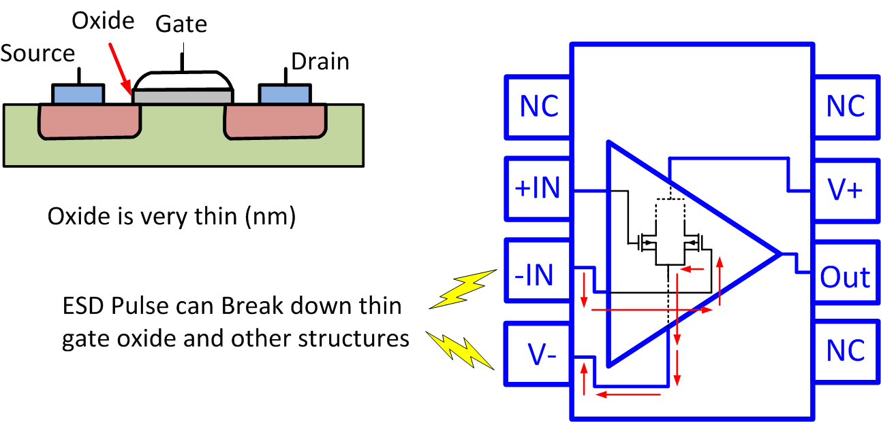
ESD Can Damage Semiconductors
Oxide
Gate
Source
Drain
Oxide is very thin (nm)
ESD pulse can break down thin
gate oxide and other structures
Notes:
Let’s look more closely at the typical way in which semiconductor devices are damaged by ESD. Consider a large ESD potential, or voltage, which is applied between the inverting input and negative supply pin of an op amp. This places a large voltage from the gate to the source of one of the input MOSFETs, which can cause damage to the device. Keep in mind that the thickness of the MOSFET gate oxide may only be a few nanometers, making it very susceptible to this kind of damage.

Slide 6
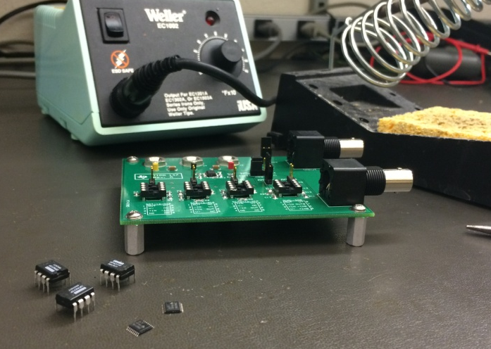
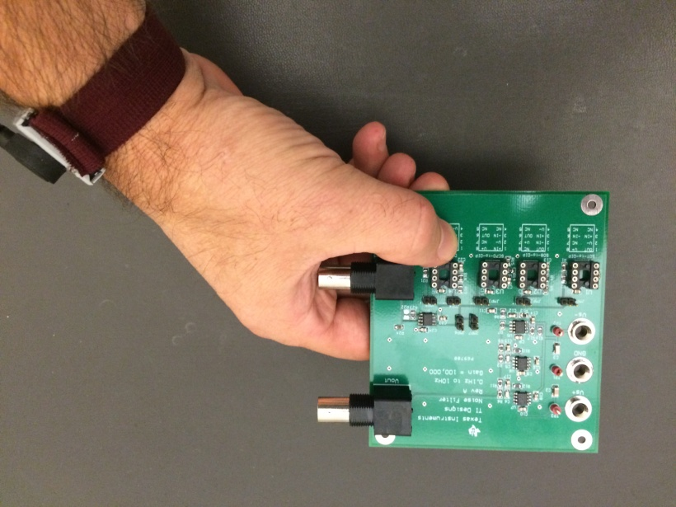
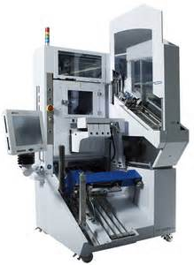
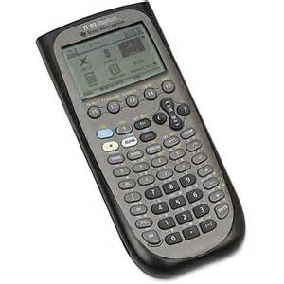
Out-of-Circuit vs. In-Circuit
PCB assembly
Fully-assembled PCB
Factory test
End product
Note: ESD robustness depends on device and environment
Note: ESD robustness depends on system design, packaging, and device
Notes:
There are two main categories of ESD events for semiconductor devices. An “out of circuit” ESD event can occur to a loose device; that is, a device before it is soldered to a printed circuit board. Out of circuit events can happen during manufacturing, factory test, or the assembly process. In general, factory test and manufacturing processes are designed to minimize exposure to ESD.
An “in-circuit” ESD event refers to damage caused on a fully assembled PCB, or end product. In this case the product packaging, product design, and the device’s own robustness determine the ESD susceptibility of the product.
The ESD protection circuits that are included in the device are intended to protect against out-of-circuit events.

Slide 7
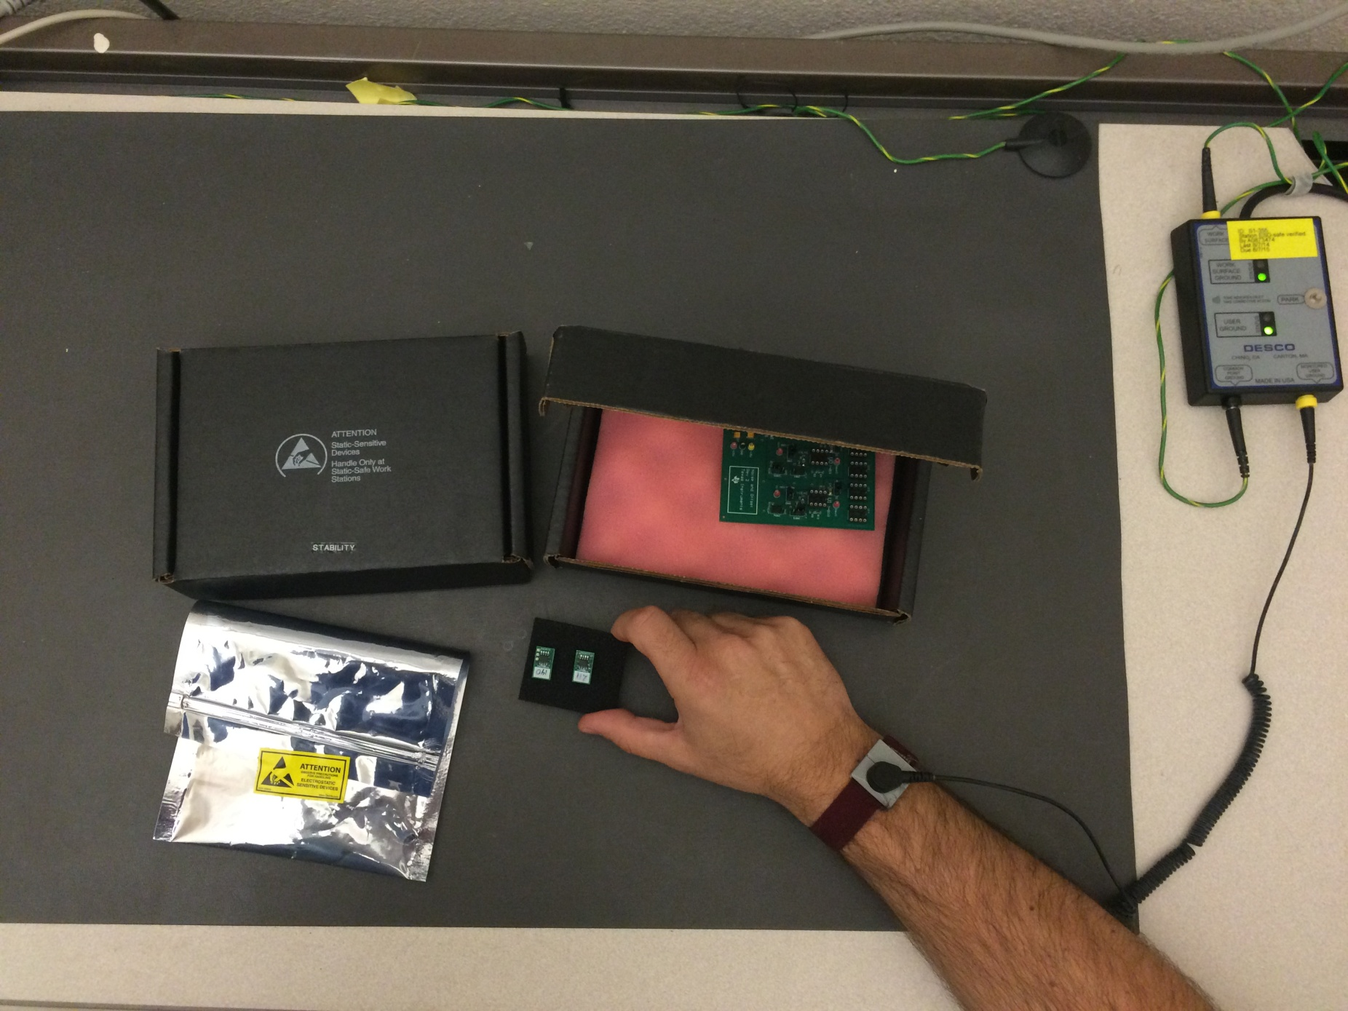
ESD Handling and Protection
Anti-Static Work Surface
Anti-Static Box
Anti-Static Wrist Strap
Anti-Static Bag
Notes:
There are some general precautions that can be followed to minimize ESD damage to devices and assembled products. In general, these precautions use resistive materials to dissipate charge. For example, the anti-static wrist strap shown in the picture allows a controlled discharge of static electricity to ground. Typically the impedance of antistatic materials is in the mega ohms. Note that the anti-static bag, box, and work surface also contain resistive materials that are intended to slowly neutralize charge.

Slide 8
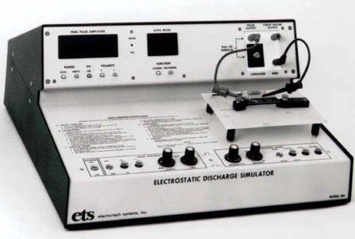
Characterization of Device ESD Robustness
Comprehensive test of device
Using automated equipment
Most specified parameters tested
Apply ESD Pulse
Simulator generates repeatable pulses
Different levels are applied, 1kV, 2kV…
Different pin combinations are tested
ESD Simulator
Repeat Comprehensive Test
Look for failures
ESD specification set by highest pulse
that doesn’t damage device
Notes:
During the initial development of a semiconductor product the ESD robustness is characterized. First, a statistically significant sample of devices is fully tested using automatic test equipment. Generally, most of the data sheet parameters are measured during this automated test.
Second, a specialized ESD test system is used to apply a simulated ESD pulse to the device. The specific characteristics of the ESD pulse are controlled by the test hardware. For example, the amplitude and ESD model can be selected. Various ESD models will be discussed later, but in short the ESD model sets the capacitance, inductance and charge of the ESD pulse to simulate a real world ESD event. During the test the ESD pulse is applied to many different combinations of device pins for a significant sample of devices. Also, different levels of ESD pulses are applied to the device; for example, 1kV, 2kV, 3kV, and so on.
Finally, the comprehensive test is repeated on the devices. The ESD rating of the device is determined by the highest ESD level that all devices in the sample pass. This ESD rating is listed in the absolute maximum rating table of the data sheet.

Slide 9
Types of ESD Simulator Pulses
Human Body Model (HBM)
Machine Model (MM)
Charged Device Model (CDM)
Notes:
3 different models are used to generate controlled ESD pulses. The “Human Body Model,” or HBM, is first and the most common model developed for ESD emulation. This model attempts to emulate the ESD discharge that could occur when a human touches an microelectronic device. Typical HBM voltage levels range from 1kV to 5kV.
The “Machine Model,” or MM, is also called the zero ohm model because it simulates a very low impedance discharge of static charge to ground. The MM is meant to simulate a static discharge in a metal handler or automatic assembly equipment. The Machine Model has in most cases been replaced by the Charged Device Model.
The “Charged Device Model,” or CDM, is designed to accurately simulate the test and assembly environment, for example, the static charge developed when a device slides down shipping tubes. CDM voltages are typically in the hundreds to thousands of volts. CDM currents are higher than HBM currents because the current limiting resistance is much smaller.

Slide 10
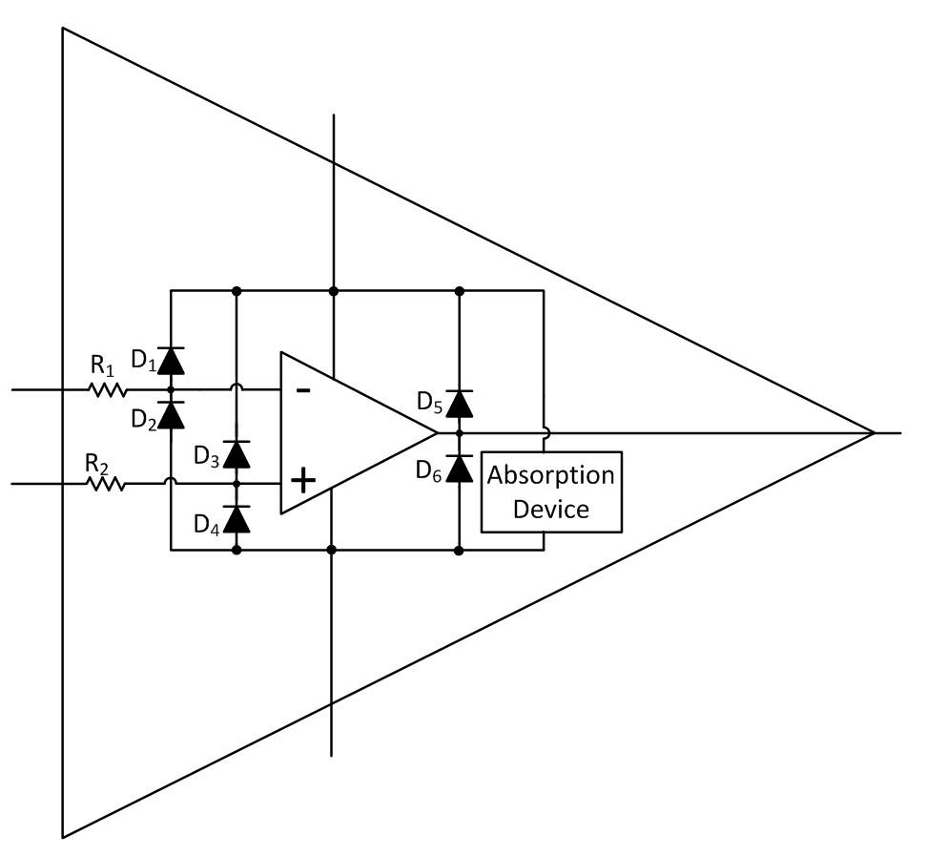
ESD Protection Inside an IC
Series Resistance
Steering Diodes
Absorption Device
Notes:
Here we illustrate the ESD protection circuits commonly used on semiconductor devices. In this case an op-amp is shown, but similar ESD protection is used on other types of devices.
Remember that this type of ESD protection is intended to protect the device from an “out of circuit” ESD event. In other words, these structures are intended to protect the device during the test, assembly, and manufacturing process. They are also effective for ESD protection in unpowered systems, but they may actually cause issues such as latch-up in powered systems. The video series on electrical overstress will cover this topic in much more detail.
Three common structures used in ESD protection are the series resistance, steering diodes, and absorption device. The steering diodes turn on and direct the ESD pulse away from the sensitive circuit elements to the absorption device. The absorption device absorbs the energy of the ESD pulse and limits the voltage level to prevent damage. The series resistance limits the input or output current. Note that a larger series resistance offers more protection but often degrades other key parameters such as noise or maximum output current. This practical limitation on resistance may affect the ESD robustness of some devices.

Slide 11
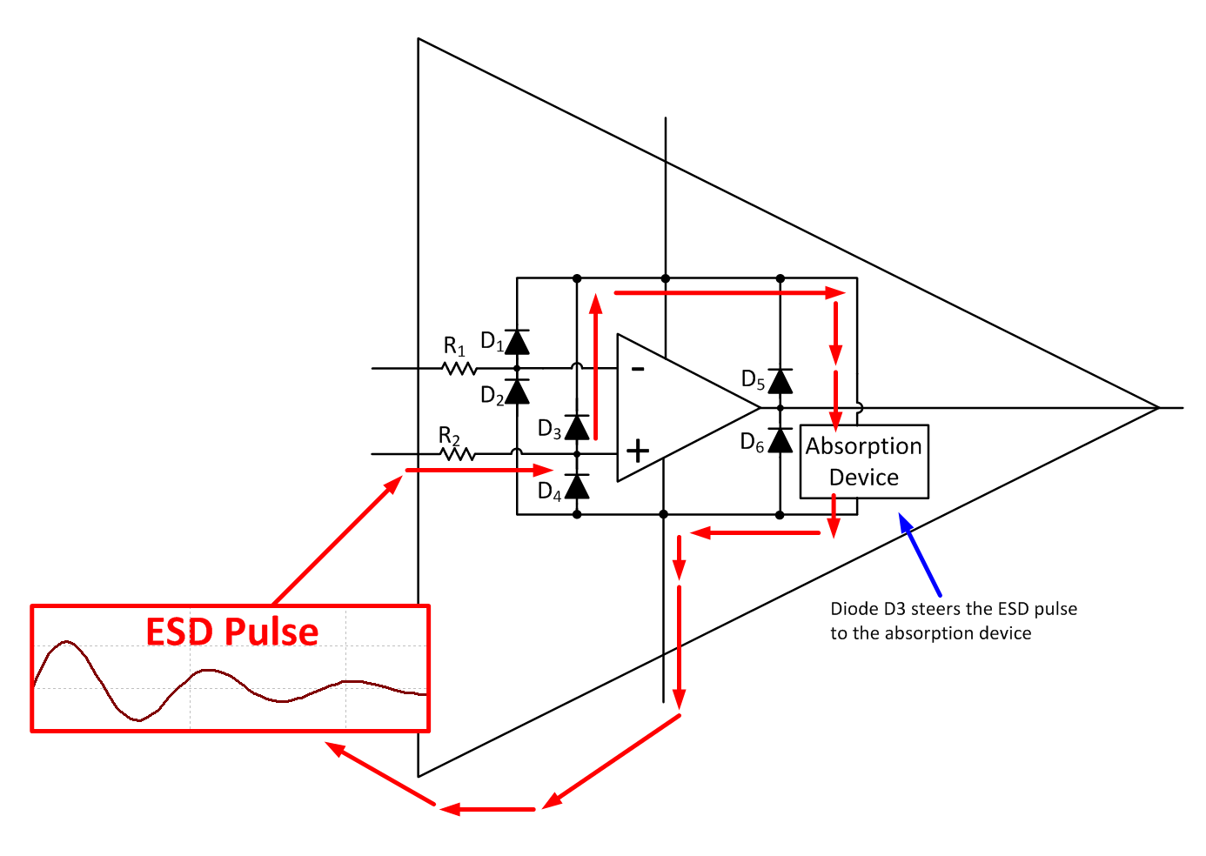
ESD Protection with Pulse Applied
Diode D3 guides the ESD
pulse to the absorption device
Notes:
Let’s examine how the ESD protection structures work. In this example, an ESD pulse is applied between the non-inverting input pin and the negative power supply. In the real world this could happen by improper handling of the device; for example, assembling a PCB on a non-static safe work surface. Notice, for this example that diode D3 becomes forward biased and “steers” the ESD pulse to the absorption device. The absorption device is designed to limit the voltage and absorb the energy of the ESD pulse. Note that if the ESD pulse were applied to different pins, different diodes would turn on and steer the pulse to the absorption device. Also, notice that the input resistance R2 limits the input current from the ESD pulse. A larger value of R2 will make the circuit more robust, but may introduce errors from bias current and noise, and may also affect frequency response.

Slide 12
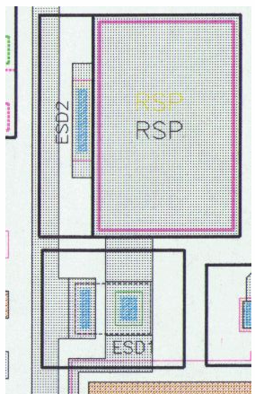
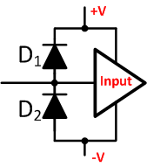
ESD Diode Specifications
Input Connection Pad
Specification | Typical Value
Diode Drop (250mA) | 0.7 V
Diode Drop (2A) | 1 V
Pulse Current | A (for ns)
Continuous Current | 10 mA
Leakage Current | 0.5 pA (25°C, typical) 500 pA (125°C, typical)
Parasitic Capacitance | 1 pF to 2 pF
ESD diodes
Notes:
These specifications are meant to give a general idea of the ESD diode’s performance. Actual diodes will very depending on the device design and the process used. One key thing to notice is that the diode drop is about 0.7V with significant current. This diode is designed to take amps of pulse currents for only a few nanoseconds, as is typical with ESD pulses. However, they are rated for only 10mA of continuous current. These diodes also have a reverse leakage current that may be less then a pico-amp at room temperature, but could be hundreds of pico-amps at high temperatures. In fact, leakage current from ESD diodes makes up the majority of the “bias current” of CMOS devices. Finally, it should be noted that the ESD diodes have parasitic capacitance in the low pico-farads.

Slide 13
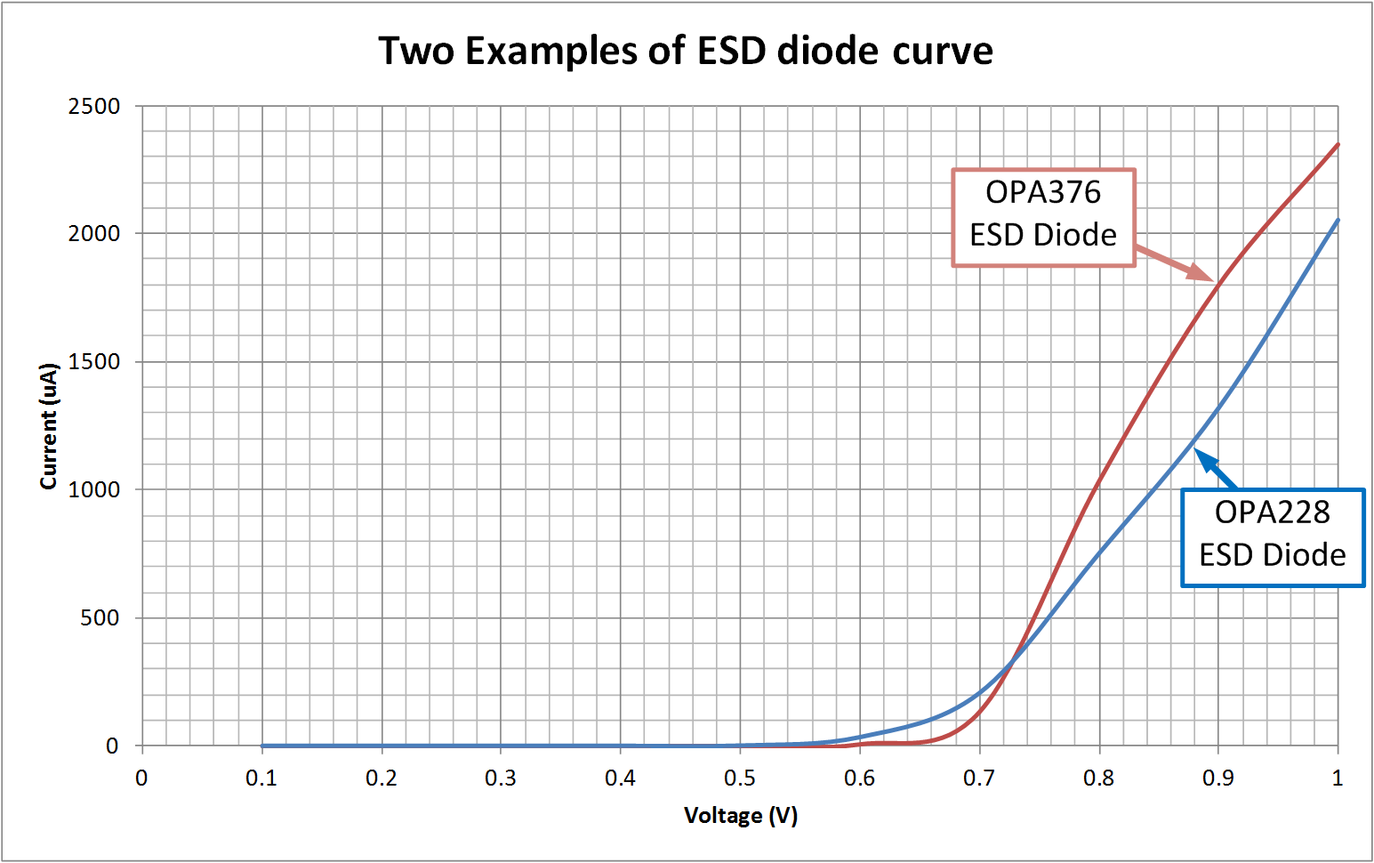
ESD Diode Curve Examples
Notes:
Here we take a look at the I-V characteristic for the ESD diodes in two different op amp ICs. Notice that at low currents, the forward drop is about 0.7 V and at high current the drop increases to about 1V. Understanding the ESD diode characteristics will become useful when investigating electrical overstress issues in later videos.

Slide 14
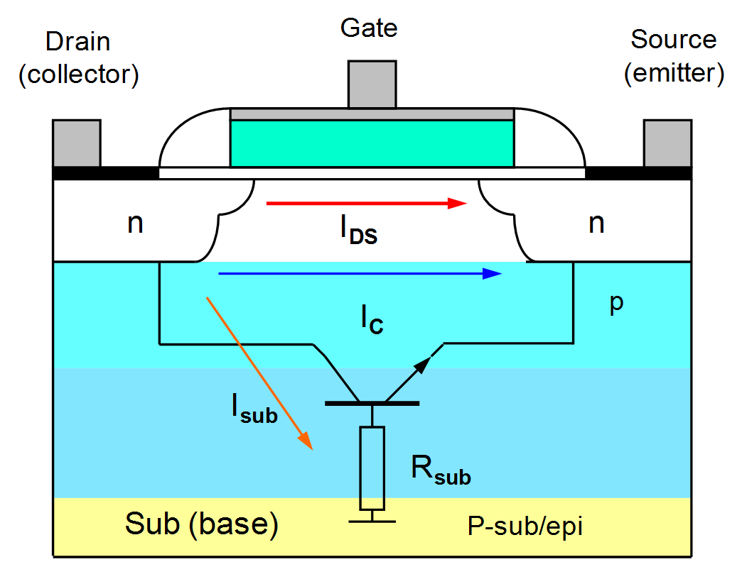
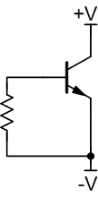
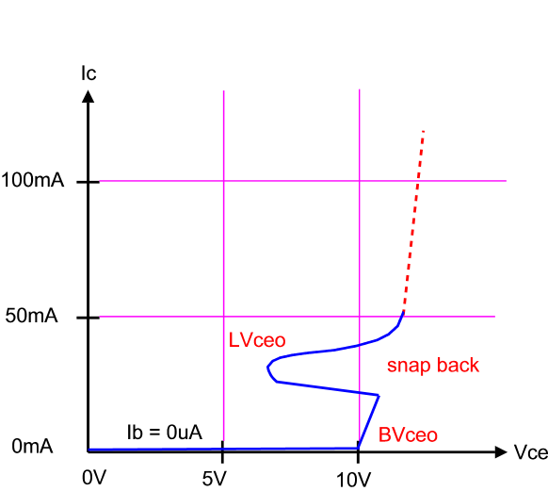
Absorption Device
Notes:
We previously discussed the absorption device only in a very general sense. The absorption device is a parasitic bipolar device that is formed vertically with regards to the substrate. Normally, this device is reverse biased so that no base current flows. As the voltage across the device increases, the Collector-to-Emitter reverse breakdown is approached. Increasing the voltage beyond the breakdown level causes a rapid increase in current. Collector current will increase until a point where a “snap back” takes place. Beyond the snap region, current again begins to rapidly increase. If there isn’t another source of resistance in the transistor’s path to limit the current, it can increase to the point where the thermal generation results in excessively high temperatures and transistor melt down. Usually the emitter ends up spiking through the base and shorting to the collector forming a permanent short circuit.
The absorption device is designed to clamp the supply voltage during an out-of-circuit ESD event to prevent damage. Once the event ends, typically after a few nano-seconds, the absorption device turns off since there is no power supply connected to the device. On the other hand, if the absorption device turns on for an in-circuit event, it will remain on and in a low impedance state until power is removed from the circuit. Thus, it is imperative that the absorption device is not allowed to turn on during in-circuit electrical overstress events. This topic is the focus of the next video series.

Slide 15
Absolute Maximum Ratings
 |  |  | VALUE | UNIT
Supply voltage |  |  | ±20 (+40, single supply) | V
Signal input terminals | Voltage | Common-mode | (V-) - 0.5 to (V+) + 0.5 | V
 |  | Differential | (V+) - (V-) + 0.2 | V
 | Current |  | ±10 | mA
Output short circuit |  |  | Continuous | mA
Operating temperature |  |  | -55 to +150 | °C
Storage temperature |  |  | -55 to +150 | °C
Junction temperature |  |  | +150 | °C
Electrostatic discharge (ESD) ratings | Human Body Model (HBM) |  | 4 | kV
 | Charged device model (CDM) |  | 1 | kV
Notes:
The absolute maximum ratings given in a device data sheet describe the worst case conditions that can be applied to a device before damage occurs. Maximum supply voltage, input voltage, input current, and temperature are given. Notice that the maximum input current is given as ±10mA. This is the limit for most devices and is based on the maximum continuous current that the ESD diodes can sustain. Also notice that the ESD ratings for the device are given in the maximum ratings table. In this example, the rating is 4kV for human body model and 1kV for charged device model. Different devices will achieve different ratings based on their performance during characterization.

Slide 16
Multiple-Choice Quiz
ESD voltage as low as _________can cause damage to some semiconductor devices.
a) 10V
b) 50V
c) 100V
d) 1000V
Humans can just feel ESD at_________.
a) 3500V
b) 2000V
c) 1000V
d) 100V
(T/F) The absolute maximum input current is determined by the ESD diodes and is generally set to 10mA.
a) True
b) False

Slide 17
Multiple-Choice Quiz
Exceeding the __________ will cause damage to the device.
a) Specified power supply range
b) Absolute maximum power supply range
c) Pulsed power specification
d) Over-current protection specification
Internal Op Amp ESD cells are designed to_________.
a) Protect against all EOS events once assembled in a PCB
b) Provide latch-up-free operation under all EOS events
c) Prevent ESD damage from out-of-circuit events
d) Discharge any nearby lightning strikes

Slide 18
Multiple-Choice Quiz
(T/F) ESD protective devices such as an ESD work surface or ESD wrist straps use very low resistance (0Ω) to quickly discharge ESD charge to ground.
a) True
b) False
The absorption device is designed to _________.
a) Turn on and limit the supply voltage during an electrical overstress event
b) Turn on and limit the supply voltage during an ESD event
c) Turn on and limit the input current during an ESD event.
d) Turn on and limit the supply current during an ESD event.

Slide 19
Electrical Overstress – 1
TIPL 1411
TI Precision Labs – Op Amps
Presented by Marek Lis
Notes:
Hello, and welcome to the video for the TI Precision Lab discussing electrical overstress, or EOS, part 1. In this video we’ll discuss the causes of electrical overstress and introduce several methods that can be used to improve circuit robustness against electrical overstress. All of the examples in this video show op-amp circuits, but the methods used could be applied to other devices as well. Follow up videos will give additional details showing how to select component values as well as test methods used to confirm electrical overstress robustness.

Slide 20
ESD vs. EOS – What’s the Difference?
ESD
EOS
Electrostatic discharge
Short duration event (1-100ns)
High voltage (kV)
Fast edges
Both “in-circuit” and “out-of-circuit”
Electrical overstress
Longer duration event
  Milliseconds or more
  Can be continuous
Lower voltage
  May be just beyond absolute maximum ratings
“In-circuit” event only
Notes:
First, lets compare ESD and EOS. We discussed ESD in detail in TIPL 1401. ESD or electrostatic discharge is the sudden flow or discharge of static charge between two oppositely charged objects. ESD is a very short event; typically in the nano-seconds. The voltage of an ESD event can be quite high, in the kilo-volts, and the pulses can have very vast edges. ESD damage can happen both in-circuit and out-of-circuit.
EOS or electrical overstress happens when a voltage is applied that exceeds the absolute maximum rating of the device. An EOS event can be a long duration event. It may be milliseconds, seconds, or even a continuously applied overstress voltage. The voltage level is typically lower than an ESD voltage. In fact, it may be just over the absolute maximum of the device. For example, applying 10V to a device with a absolute maximum rating of 7V will cause EOS damage.

Slide 21
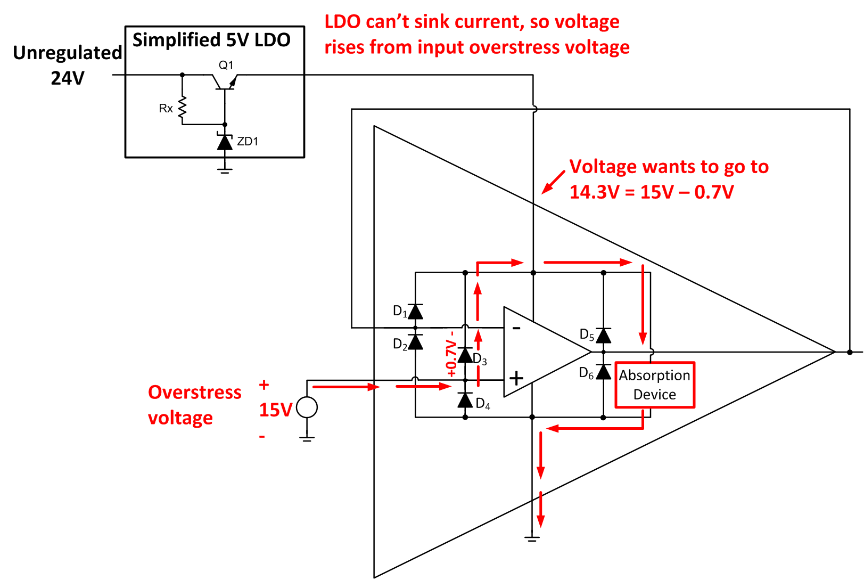
EOS Event – Overvoltage Input
LDO can’t sink current, so voltage rises from input overstress voltage
Supply voltage rises to
14.3 V = 15 V – 0.7 V
Overstress
voltage
Notes:
Let’s look at an example of an EOS event on an op-amp. The example op-amp circuit is in a 5V single supply configuration. Notice that power is supplied by a 5V low dropout voltage regulator, or LDO. The maximum power supply voltage for this circuit is 5V, but the input of this circuit is connected to a 15V overstress voltage. This EOS voltage causes diode D3 to turn on and direct the current to the power supply pin and the absorption device.
This causes the power supply voltage to rise to 14.3 V, which happens because the LDO cannot sink current and can therefore no longer regulate its output voltage. Effectively, the LDO acts like an open circuit under these circumstances. The power supply voltage of 14.3 V is above the absolute maximum rating for the op-amp, which causes the absorption device to turn on in an attempt to clamp the supply voltage.

Slide 22
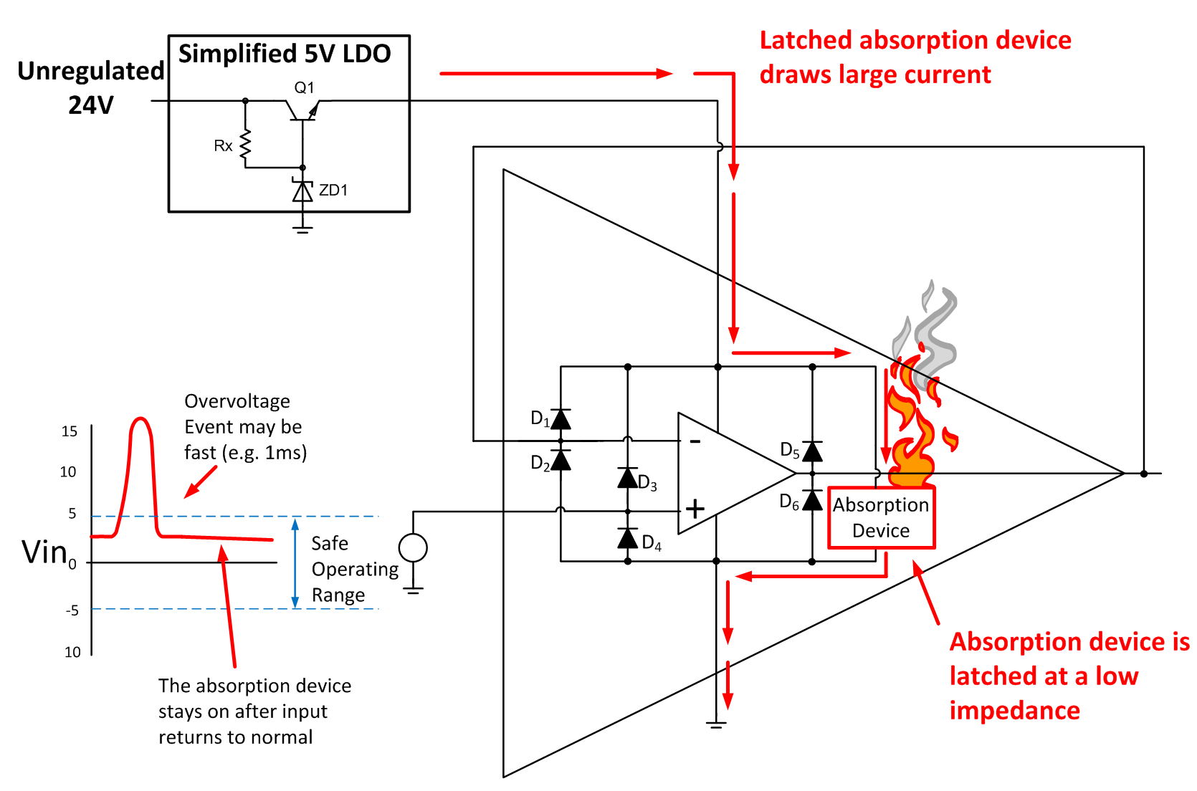
Absorption Device Latches
Latched absorption device
draws large current
Absorption device is
latched at low impedance
Notes:
Once the absorption device is on, it will remain on until power for the circuit is cycled. In this mode, the absorption device has a very low impedance and draws excessive current from the LDO. This high current generates a great deal of heat which often destroys the device.
It is important to remember that the absorption device was designed to protect the integrated circuit from “out-of-circuit” ESD events, and is not intended to protect against this kind of electrical overstress event. In fact, it is very important to design EOS protection circuits that prevent the absorption device from ever turning on during an EOS event.

Slide 23
Transient Voltage Suppressor (TVS) Diode
Notes:
One of the most common devices used to protect circuits from EOS damage is the transient voltage suppressor diode, or TVS diode. A TVS diode is similar to a Zener diode, but is designed for fast turn on and large transient power dissipation.
The plot on the bottom-right shows the I-V curve for the TVS diode and points out key locations on the curve. On the right side of the curve the forward voltage, Vf, is defined at forward current If. On the left side of the curve, the reverse standoff voltage, Vr, is shown with its associated reverse leakage, Ir. The reverse standoff voltage is the maximum voltage which can be applied across the TVS diode for it to maintain a low leakage current. This is the “off” state for the TVS diode. The reverse breakdown voltage, Vbr, is the point at which the TVS diode starts to breakdown and limit, or clamp, the voltage. Finally, the clamping voltage, Vc , is the voltage across the TVS diode when the peak pulse current, or Ipp, is flowing.

Slide 24
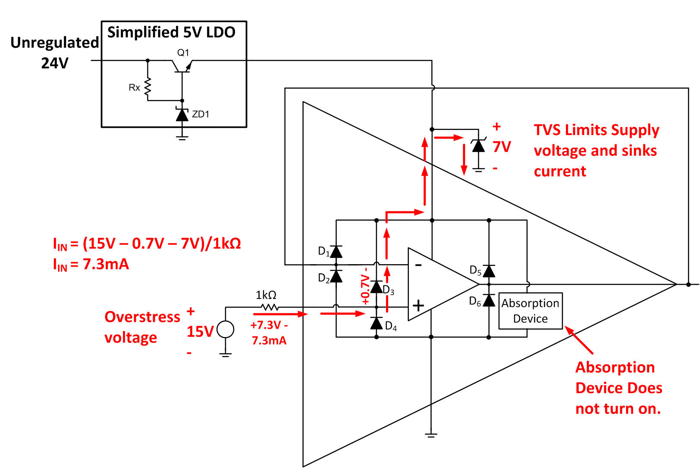
TVS Diode and Series Resistance
TVS limits supply
voltage and sinks
current
I_{IN} = (15 V – 0.7 V – 7V)/1kΩ
I_{IN} = 7.3 mA
Overstress
voltage
Absorption device
does not turn on
Notes:
Here we show the same circuit and EOS event from before, but now a TVS diode on the power supply and a series resistance at the input have been added to protect the amplifier from EOS damage. In this case, the 15V EOS voltage is applied to the input and now the ESD diode D3 directs the overvoltage pulse to the TVS diode. The TVS diode limits the supply voltage to 7V, which is below the voltage needed to turn on the absorption device. Also, notice that the series 1kΩ resistor limits the current to less than 10mA to prevent damage. Remember that 10mA is the absolute maximum rating for signal input current. This method of EOS protection is the most common way to protect semiconductor devices.

Slide 25
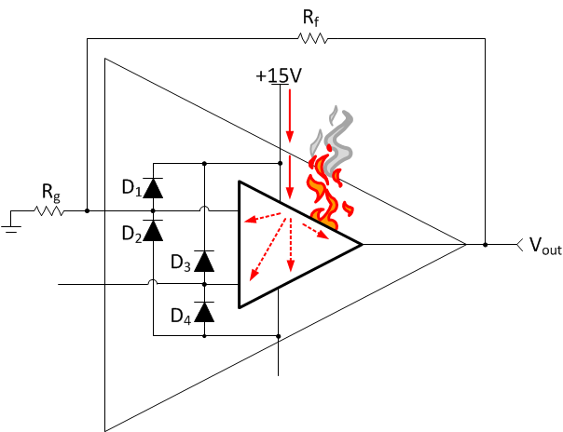
Power Supply Sequencing
High impedance from
previous stage
Current finds internal paths –
abnormal operation!
Floating pin
Notes:
In some cases, power supply sequencing can actually cause device damage. This example shows a dual supply power amplifier in the process of powering up. In this system the power supply sequence turns on the +15V supply first and the -15V supply second. At this moment in time, the +15V supply is on but the -15V supply has not yet turned on and is floating. There is no proper current path from the positive supply to the negative supply, so the current finds parasitic paths inside the op amp. This can potentially put the device into an abnormal mode, where the device draws excessive current and has unexpected operation.

Slide 26
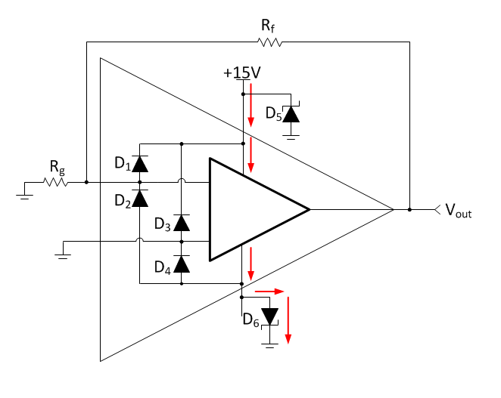
Power Supply Sequencing
Current flows from positive to
negative supply via TVS diode
Notes:
Let’s connect TVS diodes across both the positive and negative power supplies. Normally, the TVS diode D6 is reverse biased. However, during power up the TVS diode will become forward biased, providing a direct path for current from the positive to negative supply. This prevents the device from going into an abnormal state. Once the negative supply turns on, D6 becomes reverse biased and the device behaves normally.

Slide 27
Schottky Diodes – Input Protection
Connected to
outside world
Internal
connection
Notes:
Another useful technique which is used to protect the input of a device is to add external protection diodes in parallel with the internal ESD diodes. Ideally, the forward bias voltage drop of the external ESD diodes should be lower than the internal ESD diodes so that the majority of the EOS current flows through the external diodes. For this reason, Schottky diodes are often used as their forward drop is about 0.3V. Unfortunately, Schottky diodes also have very high leakage current, in some cases as high as micro-amps. Thus, it is not always practical to use Schottky diodes and so other silicon signal diodes may be used.
Notice that this example only requires input protection because only the input side is connected to the outside world. The op amp output is connected to an internal circuit on the PCB. For example, the input may connect to a remotely located sensor and the output may connect to an A/D converter or another amplifier stage. In general, external connections are much more susceptible to EOS damage that internal connections. For example, long sensor leads may develop a significant charge that causes an EOS event. Improperly wired external connections and other large induced voltages can also cause EOS damage.

Slide 28
Schottky Diodes – Output Protection
R_{p} = 10 to 20 Ω
to minimize impact
on output swing
Internal
connection
Connected to
outside world
Notes:
The same Schottky protection circuit can also be used on an amplifier’s output, if the output is connected to the outside world. One key point with output protection is that a large series resistance, Rp, will significantly limit the op amp’s output swing. This limitation is dependent on the amount of current that the output needs to deliver, so higher power amplifiers will require lower values of Rp. Rp values of 10 to 20 Ω are common for many op amp circuits.
Notice that Rp is inside the feedback loop. This allows an accurate output voltage to be maintained despite the voltage dropped across Rp. Finally, notice that very low current will flow through Rf to the input of the circuit as the value of Rf is generally much larger than Rp.

Slide 29
Multiple-Choice Quiz
EOS damage occurs when you exceed ______.
a) The specified minimum voltage level.
b) Two times the maximum specified voltage level.
c) The absolute maximum voltage rating.
d) The maximum allowable frequency for input signals.
(T/F) EOS events are typically longer in duration than ESD events.
a) True
b) False

Slide 30
Multiple-Choice Quiz
A TVS diode is ___________.
a) A crystal diode used to minimize RF interference.
b) A Zener diode optimized for fast turn on time and large power dissipation.
c) A diode with a low forward voltage that is placed in parallel with ESD diodes.
d) A specialized diode that minimizes leakage over temperature.
Positive LDO (low-drop-out) linear voltage regulators can _________.
a) Sink but not source current
b) Source and sink current equally
c) Source but not sink current

Slide 31
Multiple-Choice Quiz
The goal of the TVS diode is to _________.
a) Limit the input current to less than 10mA during EOS events
b) Limit the supply voltage to less than the absolute maximum during EOS
c) Direct EOS energy to an absorption device.
d) Maintain the temperature of the device during EOS
What generally limits the resistance which can be connected to the output of an amplifier?
a) The amplifier bandwidth.
b) The amplifier output swing
c) The amplifier slew rate
d) The amplifier offset drift.

Slide 32
Multiple-Choice Quiz
(T/F) Applying an overstress voltage to a device input can cause the absorption device to latch on and draw excessive current.
a) True
b) False
Assume than an EOS event turns on the absorption device while the IC is powered on. Once the EOS event ends, the absorption device _____________.
a) Will return to normal operation
b) Will return to normal operation with degraded performance
c) Will continue to draw excessive current until power is cycled.

Slide 33
Thanks for your time!

