Slide 1
Comparator Test Buffer
Tim Green, MGTS
Precision Op Amp Applications Manager
November 1, 2018

Slide 2
Key Additional Resources
Note: All TINA-TI simulations can be run on the embedded schematics in this presentation by downloading the free TI SPICE simulator, TINA-TI, at: http://www.ti.com/tool/tina-ti
Note: Op Amp Stability tutorial at:
https://e2e.ti.com/support/amplifiers/f/14/t/735210?tisearch=e2e-sitesearch&keymatch=faq%3Atrue

Slide 3
TI Analysis

Slide 4
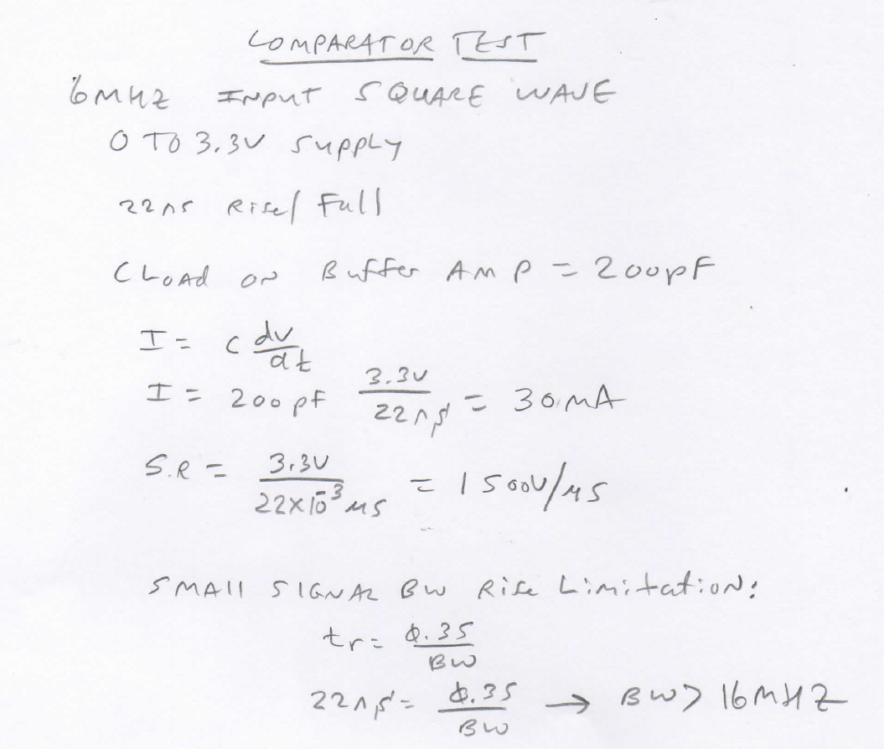
Hand Calculations

Slide 5
Loop Gain FB#1

Slide 6
Loop Gain FB#1

Slide 7
Final Loop

Slide 8
Final Loop

Slide 9
Transient Analysis

Slide 10
Transient Analysis

