Slide 1


TAS6684Q1 Training
AAA – Automotive Audio Amplifier

Slide 2
Agenda
Basic Introduction
DSP Features
Schematic & Layout Guidance
PPC3 Application Guidance
Software Process Flow

Slide 3
Basic Introduction

Slide 4

One Page: TAS6684-Q1
45V​​​, 13A Digital Input 4-Channel Automotive Class-D Audio Amplifier
with Real-time Diagnostics and Current Sense
Features
Benefits
4.5 – 45V Supply Voltage operation, 56V transient protection
4-Channel amplifier, Digital I2S / TDM16 Input
0.03% THD+N (8 Ω, 1 W, 1 kHz) flat frequency response out to 40kHz
111dB SNR with 85uV@ 45V BD mode
<2-W idle power loss at 14.4 V, <8-uA max VBAT+PVDD shutdown loss
Output Power per channel:
  400VA / Peak Power / 4Ω / 45V
  118 W_{AVG} / <1% THD / 8Ω / 45V
  215 W_{AVG} / <1% THD / 4Ω / 45V
Up to 13A of output current in BTL
384 kHz - 2 MHz output switching frequency, 2.1MHz Fsw supports up to PVDD 35V
I²C DC Load Diagnostics (Shorts, Open), AC Diagnostics
Class-H supply voltage control
Current Sense / Real-time Diagnostics by channel
Thermal fold-back and PVDD fold-back gain control
<100us signal path @96kHz with more DSP features supported
Automotive EMI Performance (CISPR25 L5), Spread Spectrum
I2C interface supports 1MHz bitrate for programing
8 levels of temp sensing for each channel
Excellent fidelity at high power
Enables a smaller 4 or more channel solution size
Support up to 16 channels from a single TDM line
Get more power where you need it, less loss in idle and shutdown
Increased immunity to system noise
Integrated diagnostic monitoring with no audible artifacts during standby and audio playback
Protects against harsh automotive transients
Supports automotive cold/crank & start stop
Reduce noise cancellation signal delay without increasing sample rate to 96kHz/192kHz or increasing MIPS (2-4 times)
Easily tuning for thermal control on each channel
Support more DSP processes to run simultaneously at 96k sample rate
More flexible spread spectrum configuration to easily pass the EMI test
4.5 - 45V
PVDD / VBAT
1.8V / 3.3V
DVDD
TAS6684-Q1
CH1
SoC /
DSP
I2C
CH2
Applications
Automotive external amplifier
Automotive head unit
CH3
I2S / TDM
CH4

Slide 5
Comparison between TAS6584Q1 and TAS6684Q1
Feature | TAS6584-Q1 | TAS6684-Q1
100us low latency path @96k Fs | Not supported | Support
Channel temp sensing | 3 level over temp warning (OTW) and OTSD. Can be read by I2C | Support 3 bit / 8 level temp monitoring and readout by I2C reg and TDM, easily tune the thermal control on each channel.
DSP process @96kHz Fs | DC-Block, Thermal Gain Foldback, Clip Detect | 100us Low Latency, DC-Block, Thermal Gain Foldback, Current Sense, Clip Detect. Optional selection for Real Time Load Diagnostic(Open Load-Short Load)/Hybrid. Optional selection for FIR/IIR filter for audio path.
Device ID (Read in reg 0x70) | 0x84 | 0x88

Slide 6
Comparison between TAS6584Q1 and TAS6684Q1
Performance Parameter | TAS6584-Q1 | TAS6684-Q1
OTSD threshold (Local Channel) | 170 Deg C (typ) | 180 DegC (typ)
OC level min-max range | 10 ~16.9A | 13 ~ 16.9A
THD + N improvement | 0.2% (45V PVDD/4Ω load/BD/BTL/480kHz Fsw/20Hz-20kHz) | <0.15% (45V PVDD/4Ω/BD/BTL/480kHz Fsw/20Hz-20kHz)
Noise improvement @ BD mode | 100uV(A-wt) @ 45V/4ohm/BD/BTL/480kHz Fsw | <85uV(A-wt) @ 45V/4ohm/BD/BTL/480kHz Fsw
DC offset @ BD mode | >10mV | 7mV (typical)
Spread spectrum | Triangle + Random spread spectrum | Dynamic period triangle + Triangle + Random spread spectrum

Slide 7
DSP Features

Slide 8
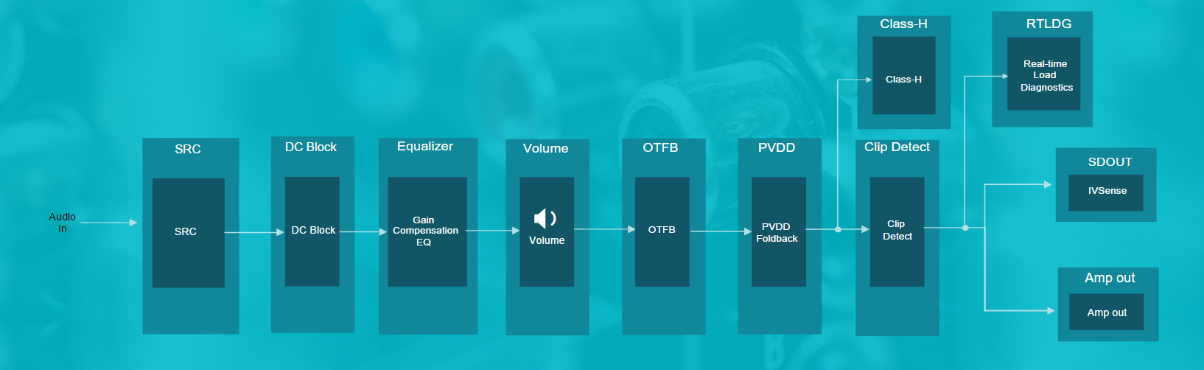
DSP Features – Typical Process Flow

Slide 9
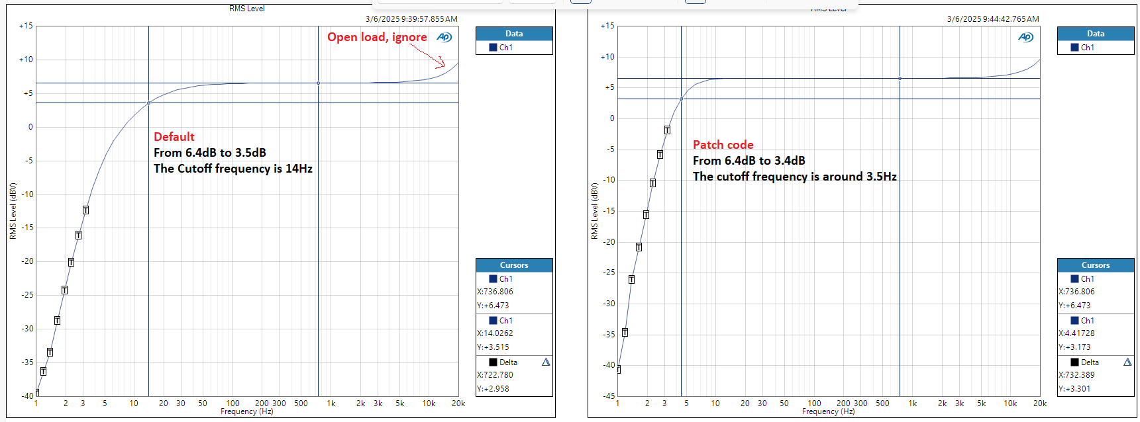
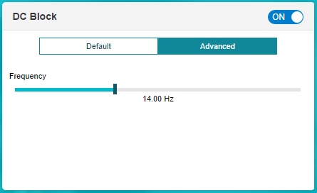
DSP Features – DC Block
DC Detect
  The internal circuit measures the DC offset continuously at the output of the amplifier during normal operation. If the DC offset exceeds the DCFAULT threshold, that channel triggers a DC Fault Event and is placed in the FAULT state and the output stage is set to high impedance.
DC Block
  DC Block is a high pass filter which can protect speakers connected to the TAS6684-Q1. The DC blocking high pass filter is build into the audio processing path. This filter is turned on by default and be configured in bit 0 of DSP_CTRL1 Register (Address = 0x39) [Reset = 0x00]

Slide 10
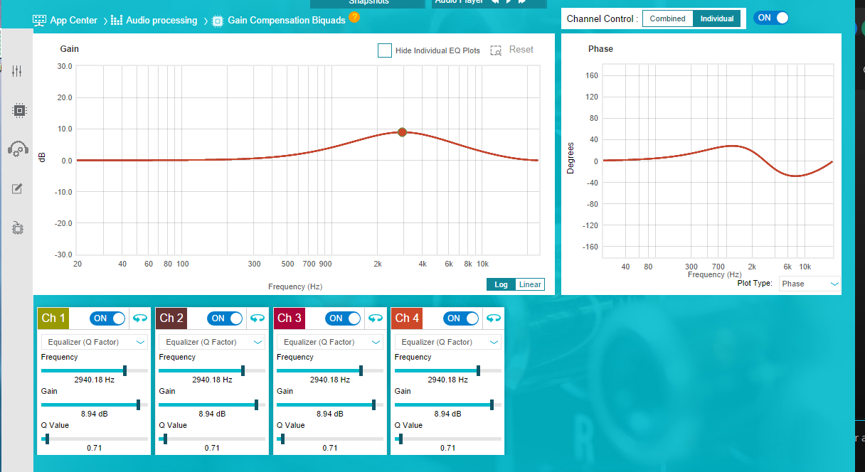
DSP Features – Gain Compensation Biquads
Gain Compensation Biquads
  The modulator and output LC filter of the Class-D amplifier can have an undesired influence on frequency response linearity causing frequency drop/peaking. To help compensate for this effect and achieve a flat response, TAS6684-Q1 offers integrated and channel-based gain compensation biquads. The biquad is configurable by channel and is disabled by default. To enable the desired tuning, the respective coefficients need to be written to the DSP memory.
1
Can select four channels combined or individual
A variety of digital filter types are available
2

Slide 11
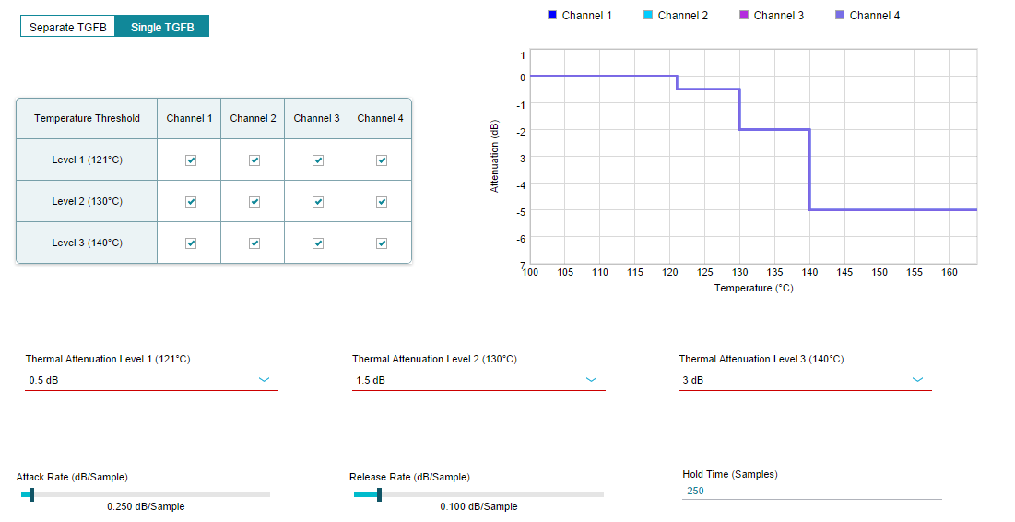
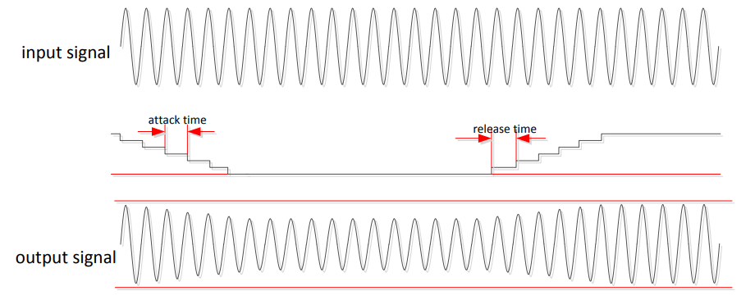
DSP Features – Thermal Foldback
Thermal Gain Foldback
  Thermal Gain Foldback (TGFB) is a power limiting feature to protect the TAS6684-Q1 from excessive die temperature while maintaining audio output. The main purpose of foldback power limiting is to keep the output stage within its safe power dissipation limit to avoid unexpected Overtemperature Shutdown. The feature provides a smooth audio response and allows for uninterrupted music playback when temperature limits are crossed.
Thermal Foldback Attack and Release

Slide 12
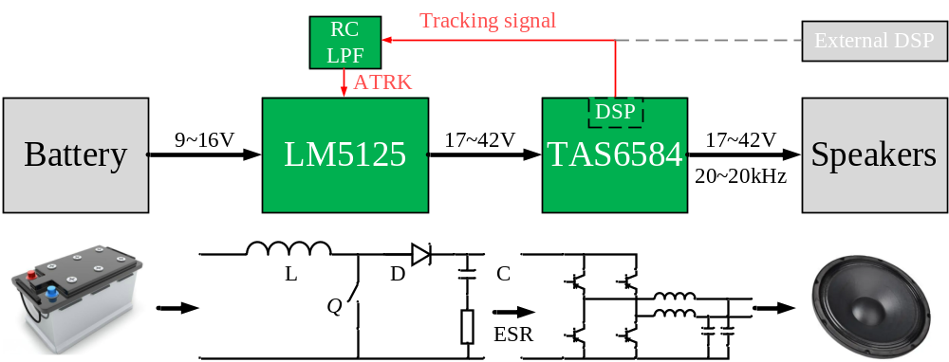
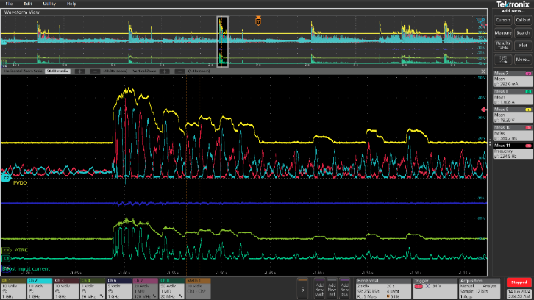
DSP Features – Class-H
Class-H
  The AMP’s internal DSP processes the input audio data and then output the tracking signal through GPIO to control the boost output voltage(PVDD).
  Compared with external DSP solution, TI helps customers save development costs and a DSP.
Benefits of Class-H Feature
Improving Audio System Efficiency
  Smaller and lighter heat sinks
  Lower idle current and power consumption
Better EMC performance because of the lower dv/dt
Typical Class-H System

Slide 13
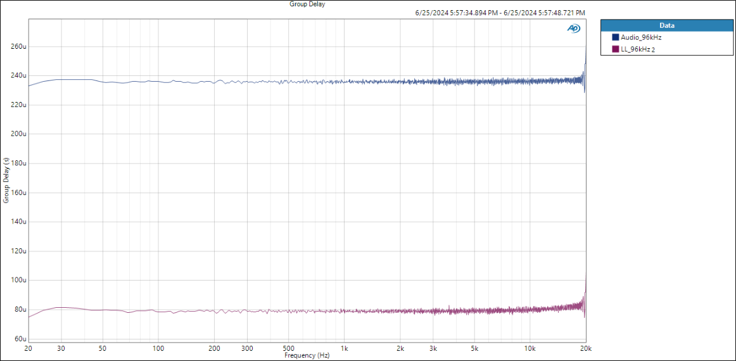
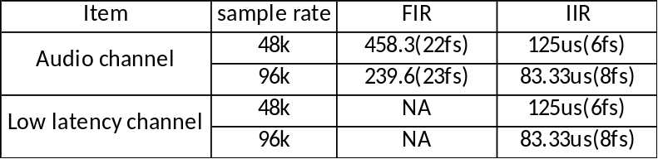
DSP Features – Low Latency Mode
Low Latency
  For time-sensitive audio signals that require a minimal processing delay, such as active noise cancellation (ANC) or road noise cancellation (RNC), TAS6684-Q1 offers a low latency signal path. At 48kHz sampling frequency, this path reduces the signal delay by more than 70% between the input and output of the amplifier by minimizing the internal signal processing. At 96kHz sampling rate, this path can support the delay time less than 100us.

Slide 14
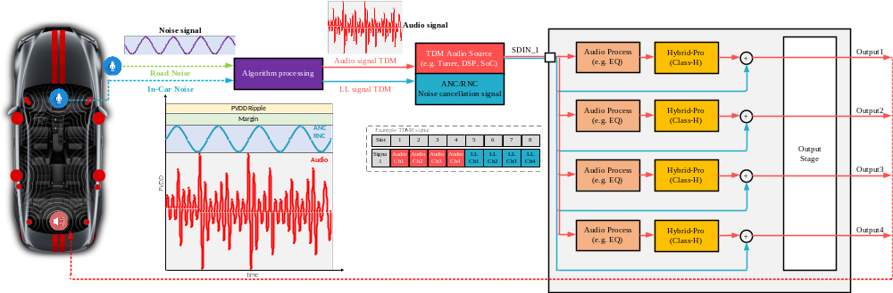
DSP Features – Low Latency Mode
Class-H + Low Latency
  Class-H feature will not influence the delay of low latency signal.
  When use Class-H and ANC/RNC(Low Latency) features together, it’s necessary to ensure that the margin of PVDD can meet the amplitude requirements of ANC/RNC.

Slide 15
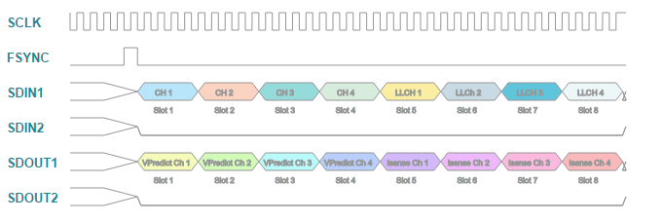
DSP Features – IV Sense
IV Sense
  TAS6584-Q1 can support the output current measurement and voltage predict of each channel simultaneously. The measured current and voltage data is provided through SDOUT pin. The following data groups can be transmitted through SDOUT:
    Isense Ch1-4 - Current Sense feedback by channel;
    Vpredict Ch1-4 - Output voltage estimate based on supply voltage and input signal by channel. Vpredict data is only available at 48 kHz sampling frequency and not supported at 96 kHz or 192 kHz.
    Aux Ch1-4 - Auxiliary data channels. Support Aux1 and Aux2 on TDM16 mode.
  Because SODUT pin is a tri-state(0,1,Hi-Z) output pin, the multiple SDOUT pins can be tied together directly.

Slide 16
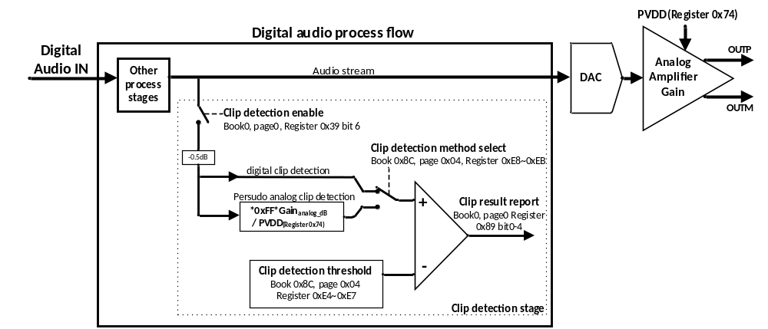
DSP Features – Clip Detect
Clip Detect
  The DSP monitors the audio signal of each channel individually and compares the magnitude of the audio signal at the input to the interpolation filters to a configurable threshold. If the audio signal exceeds the threshold, a Clip Detect Warning Event is triggered.

Slide 17
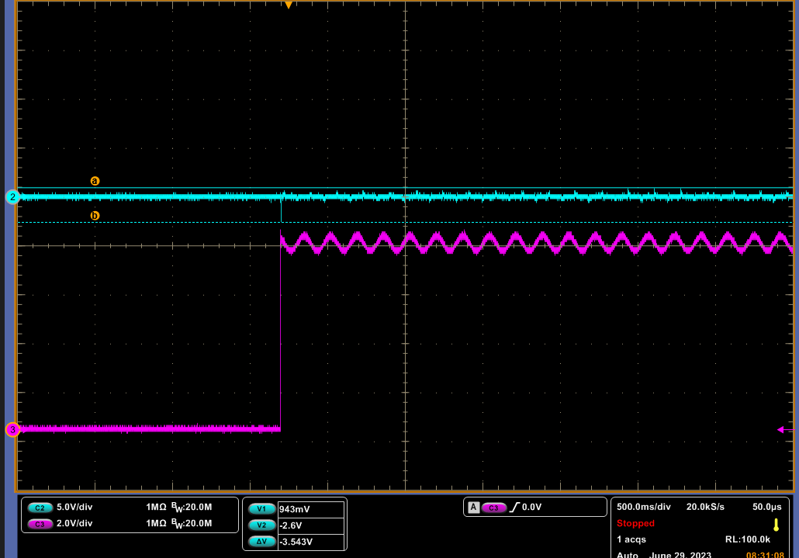
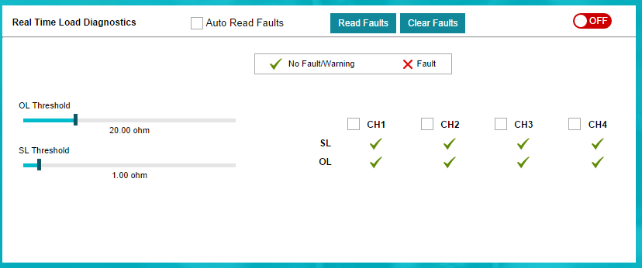
DSP Features – Real-Time Load DIAG
Real-Time Load DIAG
  Real-Time Load Diagnostics (RTLDG) allows the detection of shorted load (SL), open load (OL) conditions during audio operation of the amplifier. To monitor the load impedance while in PLAY state state TAS6684-Q1 uses its integrated current sense to measure the output impedance by channel and compare it with configurable thresholds. An internally generated pilot tone ensures the continuous detection of the output impedance, regardless if an external audio input signal is present. The configurable pilot tone is by default a 6 Hz, -36 dBFs signal.
6Hz Pilot Tone
OUT_P

Slide 18
Schematic & Layout Guidance

Slide 19
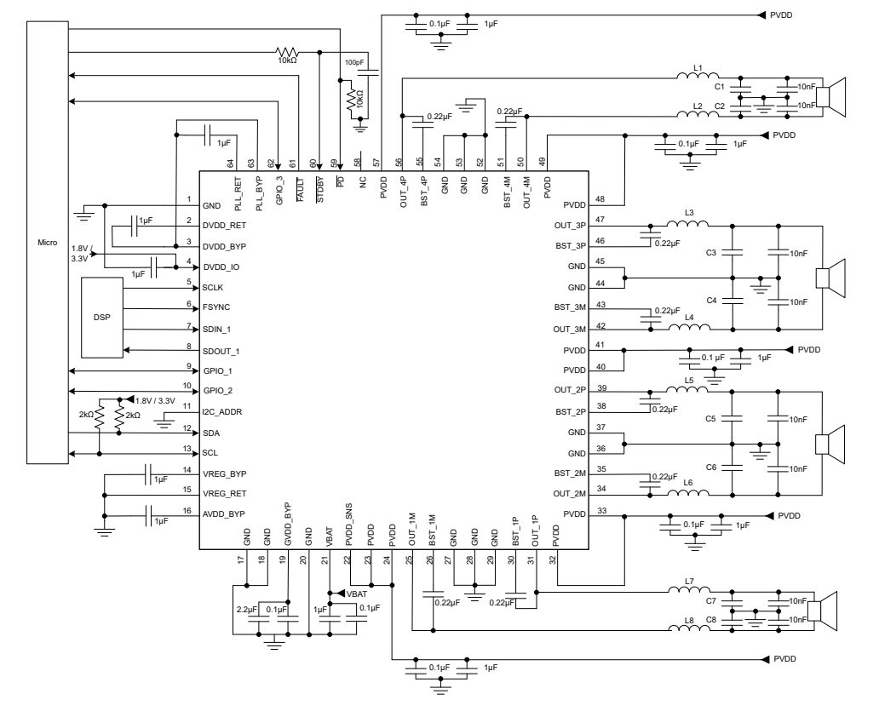
Schematic
① PDN&STBY
Schematic Check list
  1. PDN&STBY
    Increase RC and grounding resistance to ensure good filtering effect
  2. Digital decoupling
    Floating ground to avoid affecting DGND
  3. PVDD decoupling
    Make sure to place a 0.1uF capacitor on each PVDD pin (at least 5 in total)
  4. Output LC filter
    BTL: 10uF+2.2uF (48kHz, 480kHz Fsw, 4Ohm)
    Find the LC filter designer tool in ti.com http://www.ti.com/tool/LCFILTER-CALC-TOOL
  5. Capacitor beside connector
② Digital decoupling
④ Output LC filter
⑤ Capacitor beside connector
③ PVDD decoupling

Slide 20
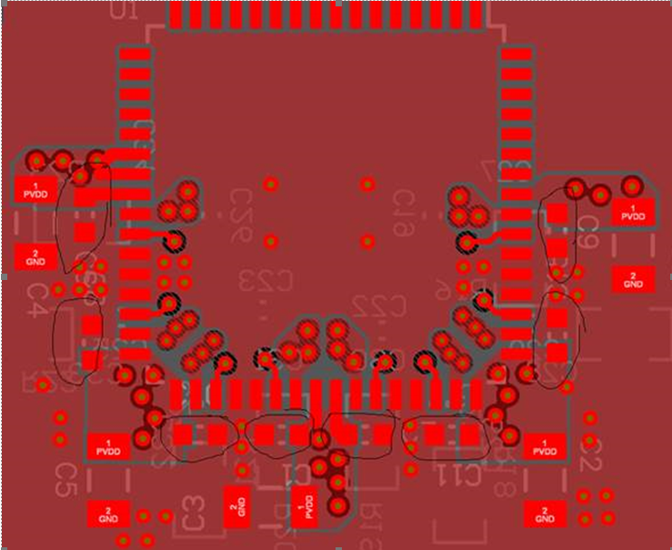
Layout – PVDD Decoupling
PVDD pins need low value decoupling capacitors nearby at the same layer as device.
  Put the caps on same layer as device, will avoid the via’s parasitic L/R, which is very important to enable good PVDD decoupling. Put both the low value cap and high value cap on same layer as device is preferred.

Slide 21
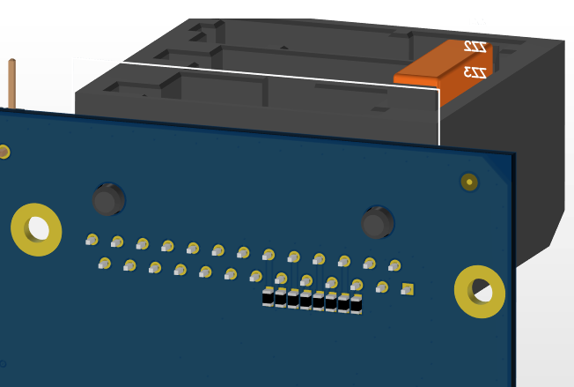
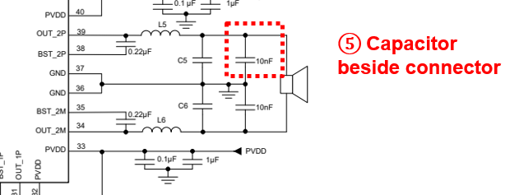
Layout – Capacitor beside connector
Place 10nF capacitor at each pins of connector, as close as possible.
  Low impedance capacitor is preferred. (Impedance-frequency characteristic)
  The 10nF capacitance could be adjusted according to EMI measurement result.
Place multiple GND via nearby, enable good grounding of these capacitors.
10nF capacitor beside connector
Multiple GND via placed

Slide 22
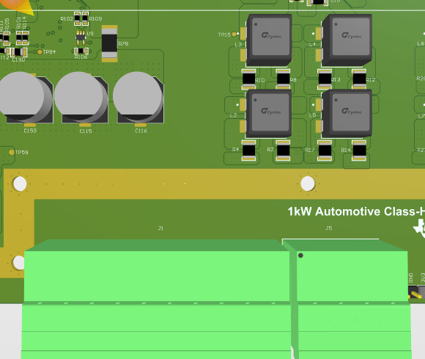
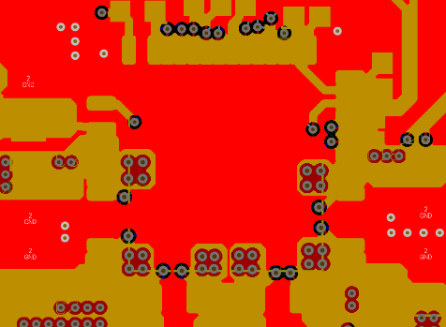
Layout – Check Points
Output inductor
  Place it as far away from the power connector as possible.
  Crosstalk: The larger the spacing between inductors the better, or use a ‘W’ shape arrangement
GND Plane
  Clean and intact GND plane at both Top and second layer.
  Do Not cut the GND layer.
Internal Power Supply Decoupling
  Internal power supply decoupling cap, as datasheet listed PLL_BYP, VR_DIG_BYP, VR_DIG_RET, AVDD_BYP, AVDD_RET, VREG_BYP,VREG_RET, GVDD_BYP, DVDD. All suggested to put at the same layer of IC, and close to IC’s pins, for the best audio and EMC performance.

Slide 23
PPC3 Application Guidance

Slide 24
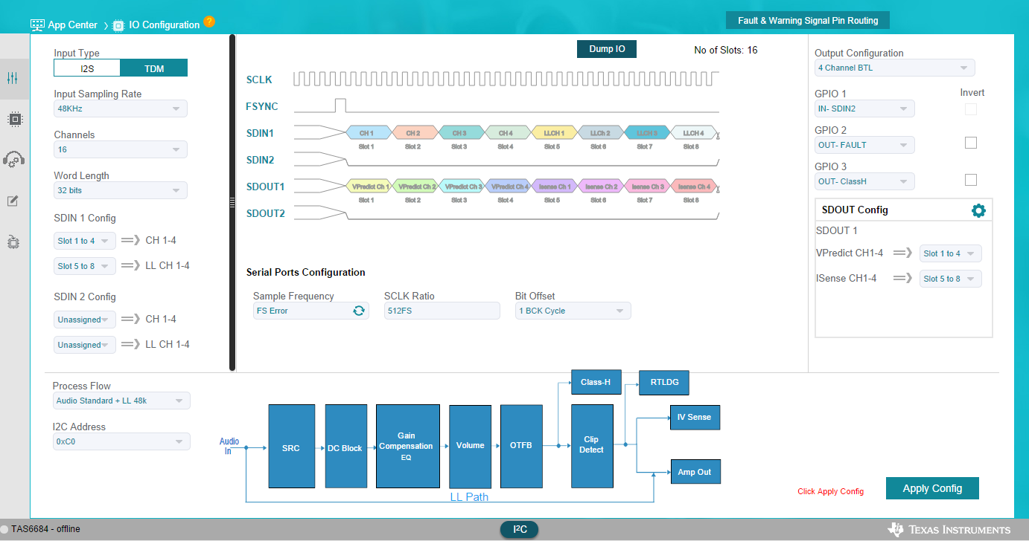
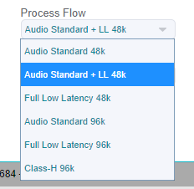
IO Configuration
After the setting is completed, you can dump the configuration script
Set the GPIO function
Set the input audio format
Select the required flow

Slide 25
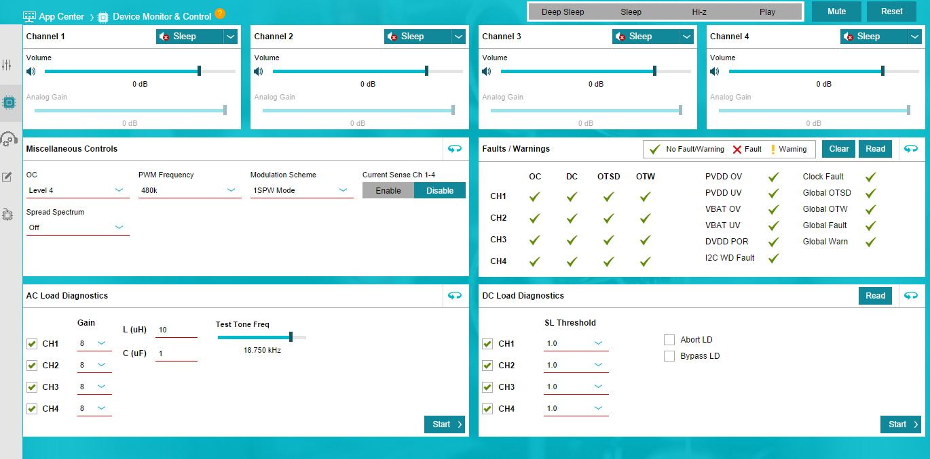
Device Monitor & Control

Slide 26
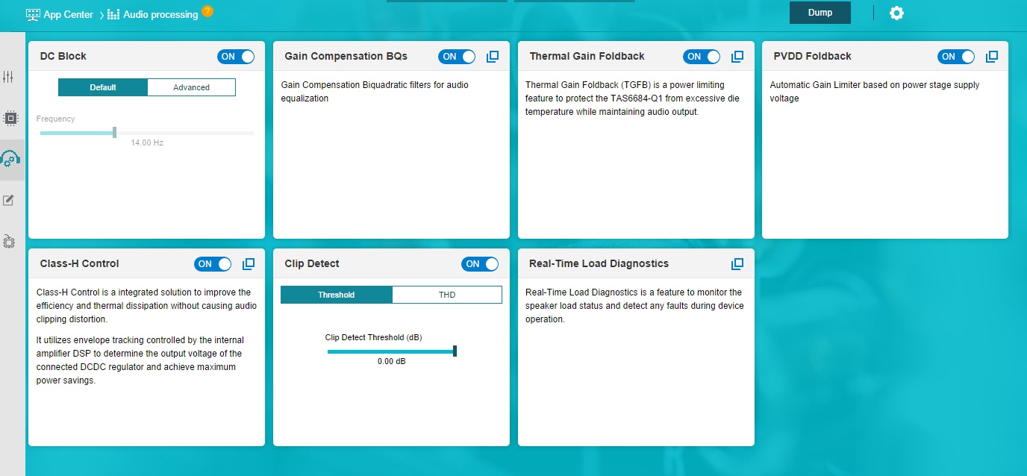
Audio Processing
After the setting is completed, you can dump the configuration script

Slide 27
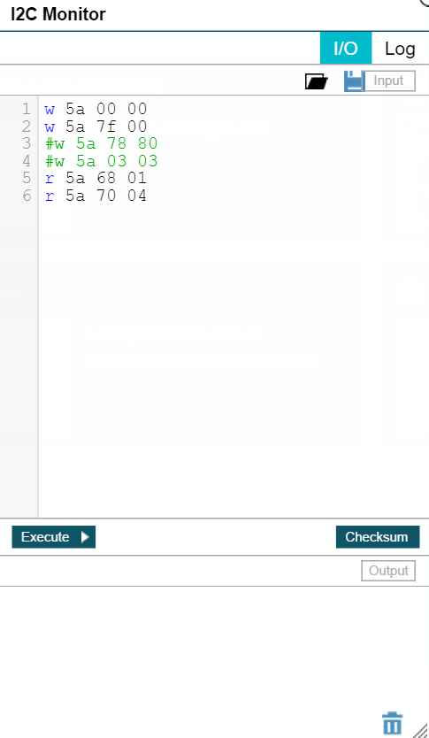
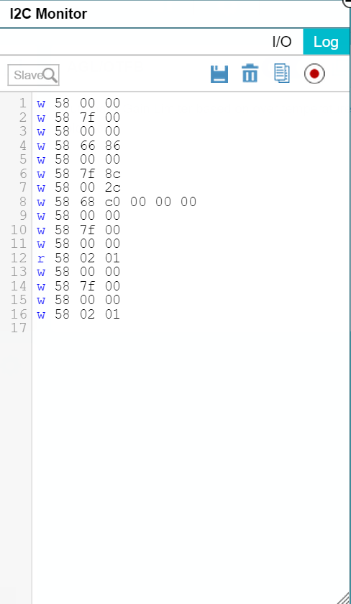
I2C Control
I/O Operation
Direct access to read/write operation
Support multiple command script
Log Monitor
Record front-end operation in GUI
Interpret it into I2C commands

Slide 28
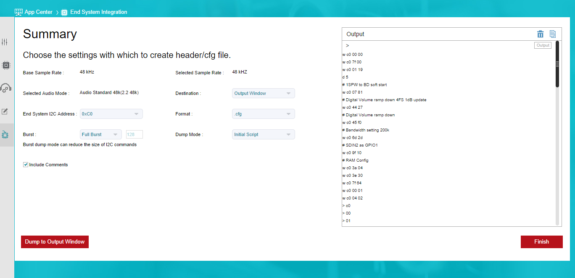
End System Integration

Slide 29
Software Process Flow

Slide 30
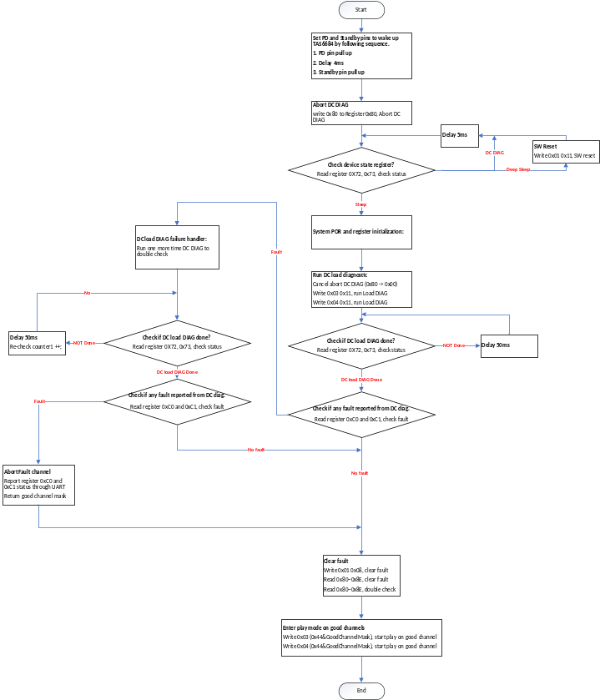
Initialization

Slide 31
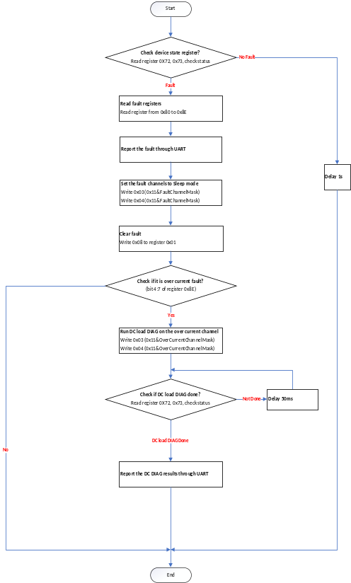
Runtime Routine

Slide 32
Thanks!

Slide 33
Backup

Slide 34
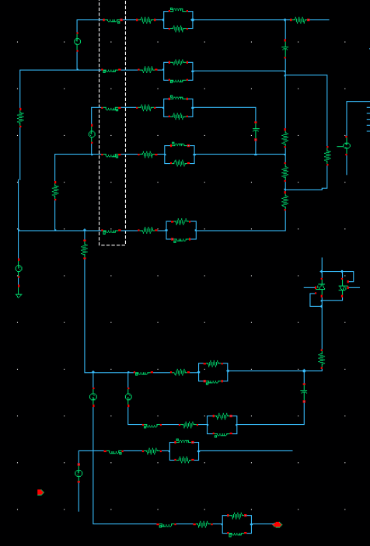
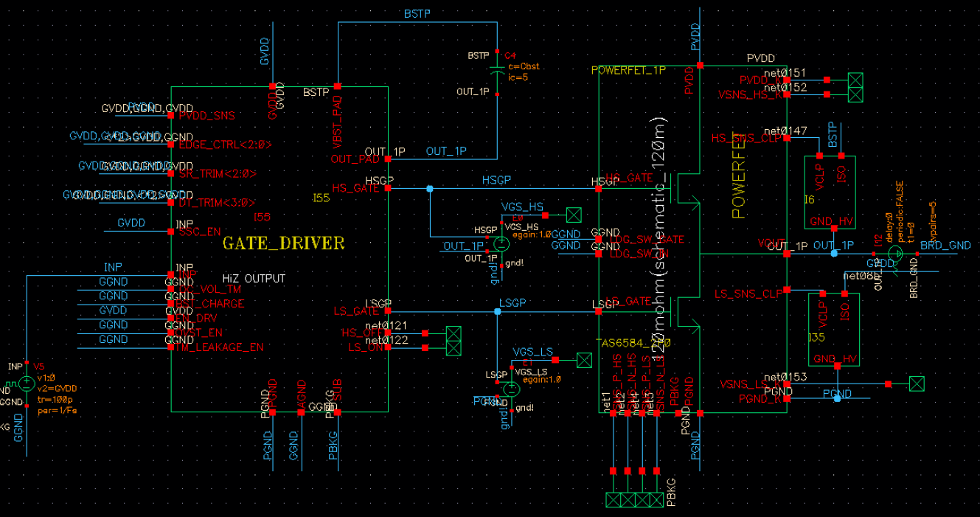
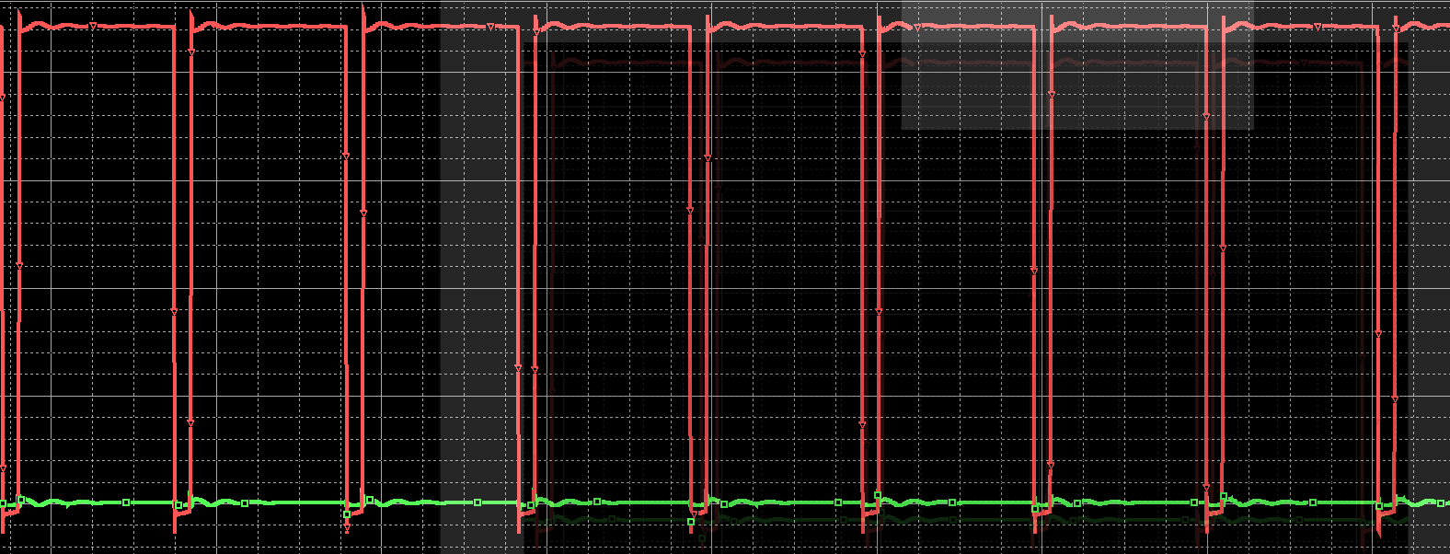
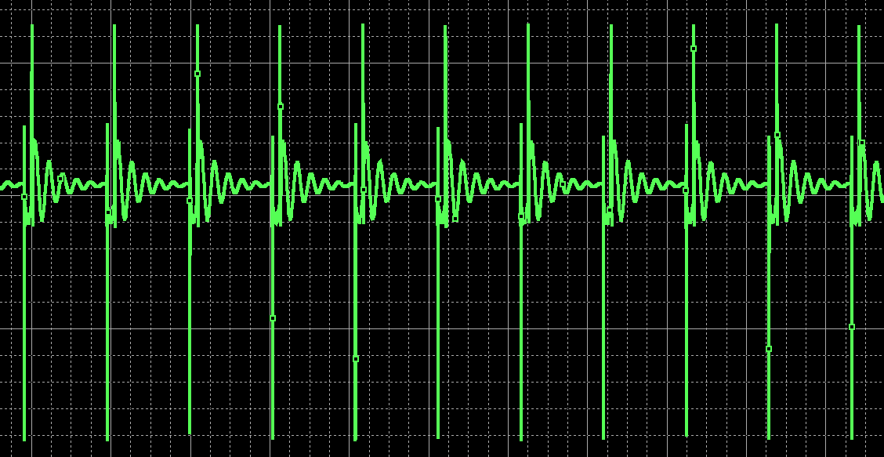
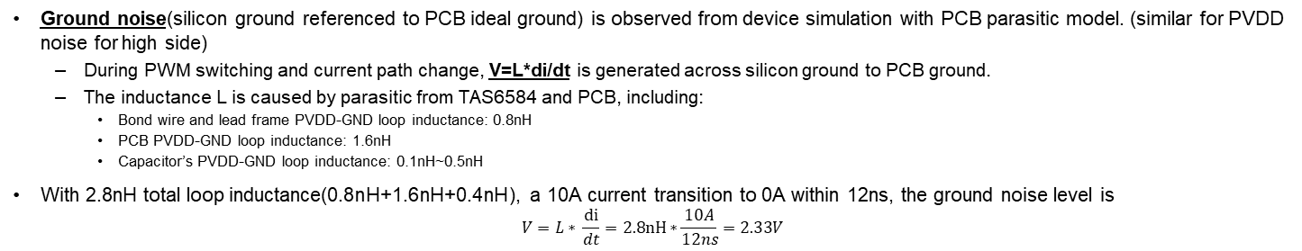
Where the noise is from
Ground noise(silicon ground referenced to PCB ideal ground) is observed from device simulation with PCB parasitic model. (similar for PVDD noise for high side)
  During PWM switching and current path change, V=L*di/dt is generated across silicon ground to PCB ground.
  The inductance L is caused by parasitic from TAS6584 and PCB, including:
    Bond wire and lead frame PVDD-GND loop inductance: 0.8nH
    PCB PVDD-GND loop inductance: 1.6nH
    Capacitor’s PVDD-GND loop inductance: 0.1nH~0.5nH
With 2.8nH total loop inductance(0.8nH+1.6nH+0.4nH), a 10A current transition to 0A within 12ns, the ground noise level is
$$V=L∗ \frac{di}{dt}=2.8nH∗\frac{10A}{12ns}=2.33V$$
PWM
Ground noise
0V GND
Parasitic Network
Die GND
(noisy)
Simulation bench condition: PVDD=42V, Slew rate=3.5V/ns

Slide 35

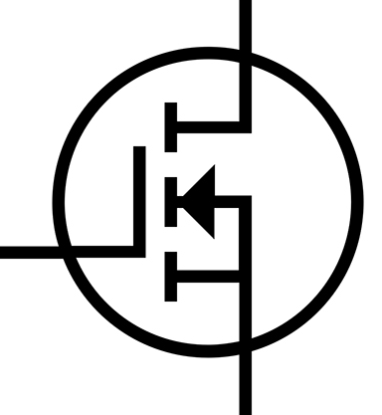

How Schottky diode improves noise
Schottky diode shares current during current switching, which avoid the high di/dt current flow through parasitic inductance of GND or PVDD
  Without Schottky diode, all current flows through the red arrow below, and generator noise L*di/dt
  With Schottky diode, partial current flows through green arrow below, which helps reduce high frequency current flow into red arrow, so reduces internal noise.
Please note is internal silicon ground, is board level ground.
GVDD
PVDD
BST
Parasitic L of PVDD
i
H FET
Digital
Core
DAC
&
Modulator
Pulse width
Control
PWM_P
H gate driver
…
Shutdown
PWM_N
OUT+
L FET
i
L gate driver
Speaker
Load
Parasitic L of GND
i
OC shutdown
Diff
Amp
OR
H FET
Diff
Amp
OUT-
OC Threshold
OC detection
L FET

Slide 36
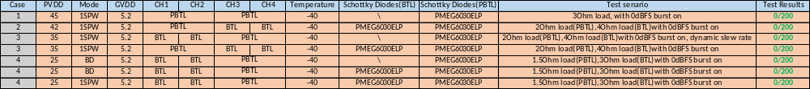
Recommend Application Scenario
Case1: 2*PBTL mode
  Must: Add all 16 Schottky diodes, 1spw mode
Case2: PBTL+2*BTL mode, 42V PVDD
  Must: Add all 16 Schottky diodes, 1spw mode
Case3: PBTL+2*BTL mode, 35V PVDD
  Must1: Add 8 Schottky diodes for PBTL channel, 1spw mode, Dynamic slew rate change
  Must2: Add all 16 Schottky diodes, 1spw mode
Case4: PBTL+2*BTL mode, 25V PVDD
  Must1: Add all 16 Schottky diodes, 1spw/BD/Hybrid mode
  Must2: Add 8 Schottky diodes for PBTL channel, BD mode

Slide 37
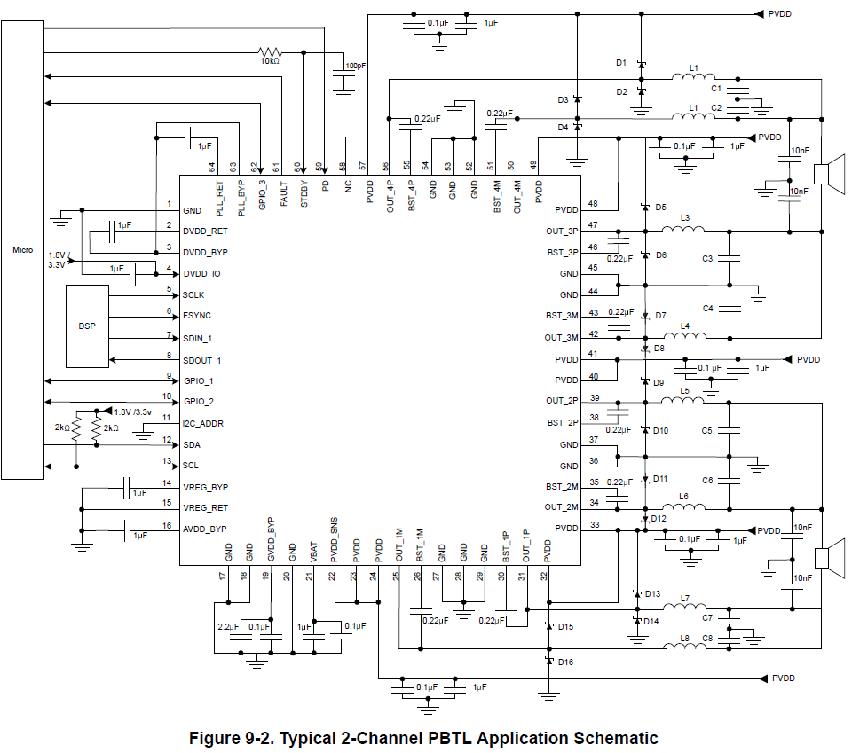
Schottky Diode Selection Guide
The use of Schottky diodes on PBTL channels is required under the following conditions:
  Operational voltages that exceed 14.4 V
  Or switching frequencies higher than 480 kHz
Schottky diode is to eliminate switching noise by conduct current during moment of switching current flow through body diode of FET. It improve device functional robustness and avoid false trigger of protection circuit (clock fault typically)
Current spec of diode should be taken care:
  Leakage current spec: <1mA to avoid impact to TAS6684 DC diagnostic function (need to guarantee full work temperature range)
  Forward voltage spec (at -40 degree and 3A forward current point): 0.7V or smaller (the smaller the better)
  Customers need to choose the appropriate Schottky model based on the actual situation of the board.

