Slide 1
PSPICE for TI
A short overview
2/22/2022
Art Kay
Notes:
Hello, and welcome to the TI Precision Lab introducing SAR ADC Power Scaling.
Overall, this section will cover the basic ideas of power consumption for the SAR data converter and ways to minimize it.
In this video, we will define and explain analog supply power, digital supply power, and front-end driver power.

Slide 2
Thanks for support on this
JC Zhu
Sean Cashin
Carolina Gomez
Cynthia Sosa
Keith Nicholas
Collin Wells
István Eperjesi (Design Soft)
Dr Michael Koltai (Design Soft)
And many others...
Thanks!

Slide 3
Table of contents (click link to jump to section)
Getting and Installing PSPICE for TI
New Project
Adding components
Adding simulation profile & Running a Simulation
Adding plots and curves
Post processing
Using Cursors
DC Sweep
AC Sweep and Noise analysis
Parameter Stepping
Monte Carlo Analysis
Using multiple schematics and simulation profiles
Getting professional PSPICE
Uploading a Model to the web and PSPICE TI library

Slide 4
Getting and Installing PSPICE for TI
Visit https://www.ti.com/tool/PSPICE-FOR-TI to make the request.
Make sure your myTI information is complete, all required fields (marked with “*”) are filled in.
An email will be sent to the registered email address containing a download link and an access key.
Click the download link to get the installer. Run the installer, enter the registered email and the access key when prompted.
Notes:
Slide 5: This slide is for the 5 slide abstract ONLY

Slide 5
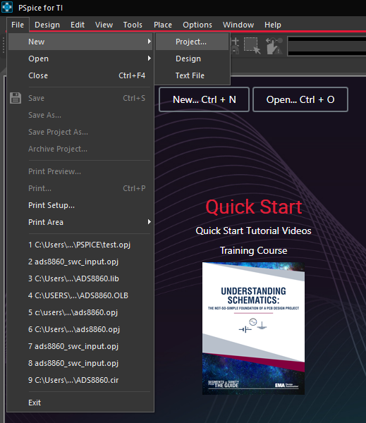
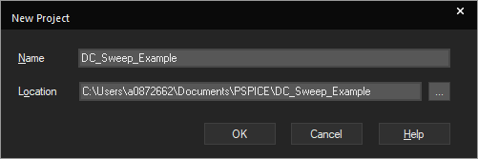
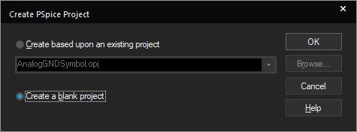
New project
Select File>New>Project
Choose project name and location. You may want to create a unique folder for each project. The project contains a *.opj, *.png, *.dsn, and a separate folder with the net lists, simulation profiles, and other support files. If you put everything in one folder you will “mix-up” files for all your projects”
Select “create a blank project”
Create a unique folder for each example. Press three dots and press “New Folder” to create a folder then select it.

Slide 6
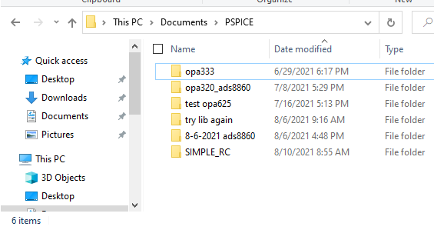
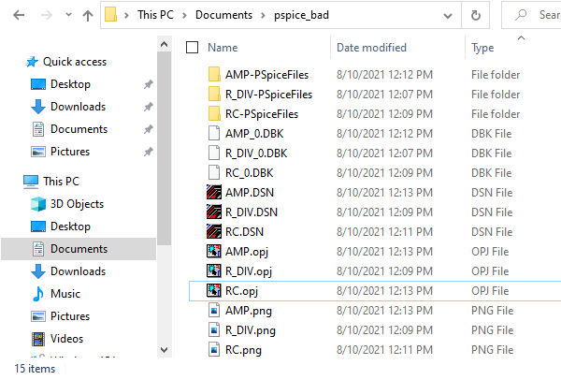
Bad vs Good structure
Good Structure
Manually created new folder for each project.
Each project folder contained in PSPICE main folder
Files don’t get mixed together
Bad Structure
All files mixed together
All the PSPICE files in one folder.
No project specific folder created automatically

Slide 7
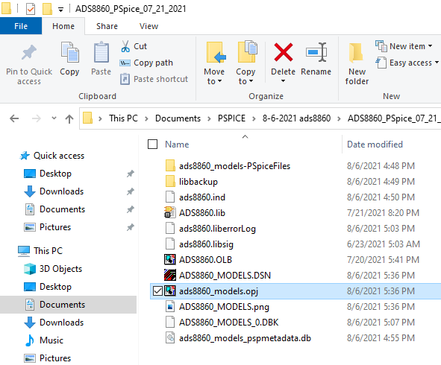
Launch PSPICE from file explorer
If you already have a project and want to just launch form windows explorer, click on the OPJ file. This is the project file.

Slide 8
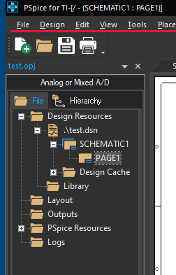
Find the Schematic
Project name
Folder containing all schematic pages. You can rename this
“PAGE1” is the editable first page of the schematic

Slide 9
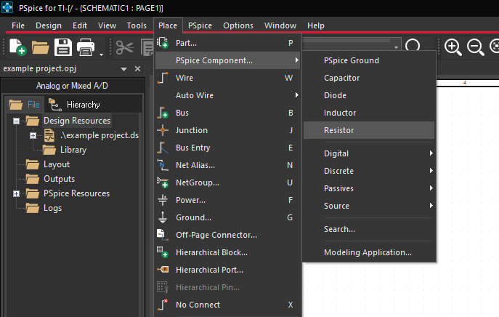
Adding passive components
Select resistor, capacitor inductor.

Slide 10
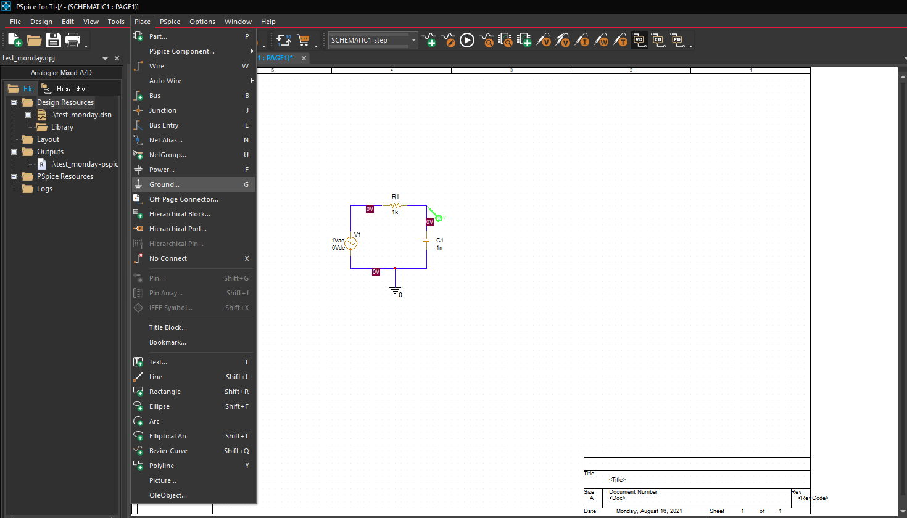
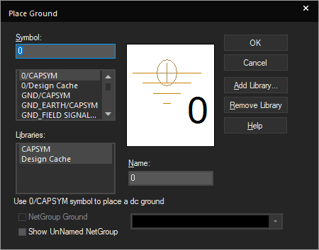
Adding GND symbol
One way to get access to a GND symbol. There are a few different locations to access this.
It is very important that you use the GND symbol with the “0” on it. Other GND symbols are really just reference points and not the 0V system reference.

Slide 11
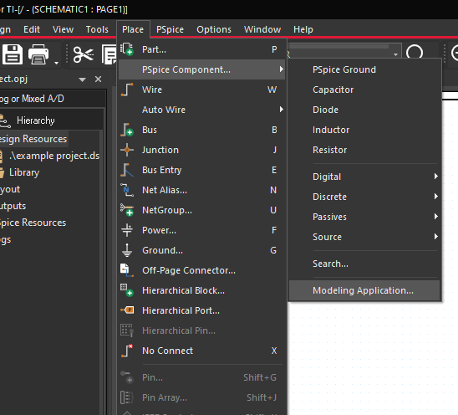
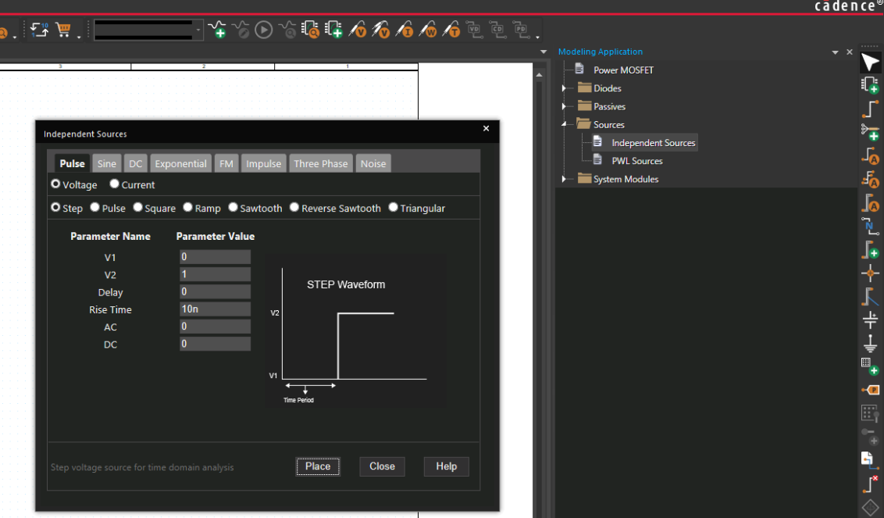
Adding sources for transient analysis
Select “Modeling Applications”
A menu will appear at the side. Choose “independent sources” for typical sources needed for transient analysis.

Slide 12
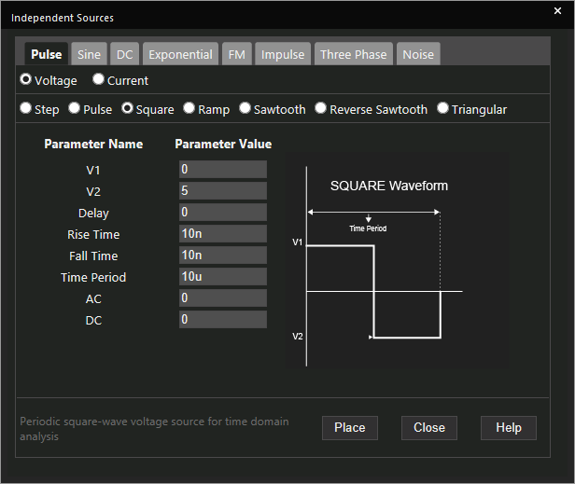
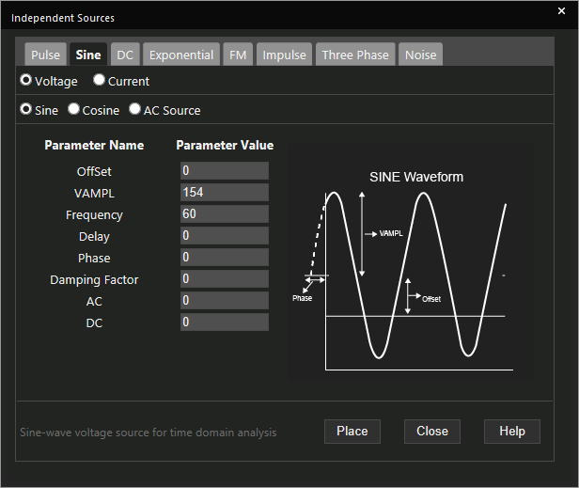
Adding sources continued
Some common signal types
Note that “pulse” includes square, ramp and other types

Slide 13
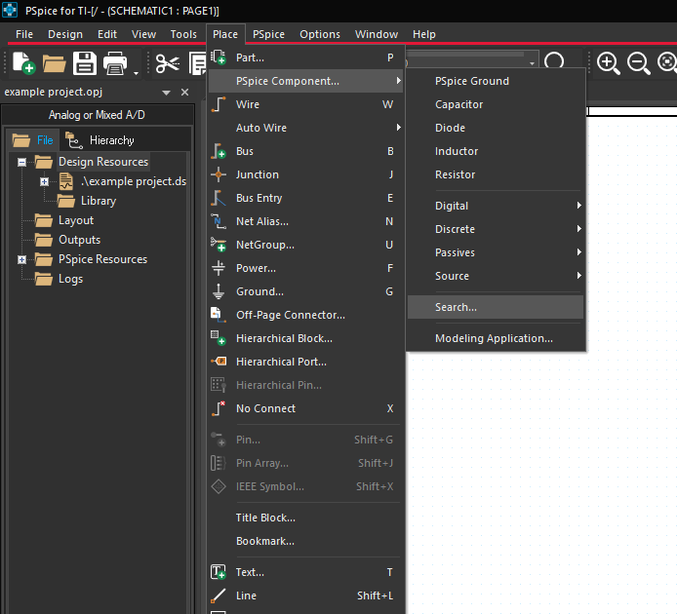
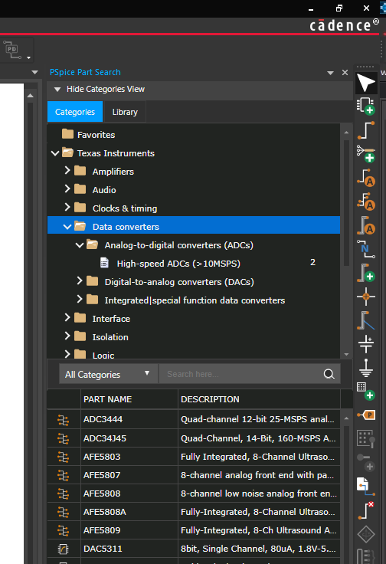
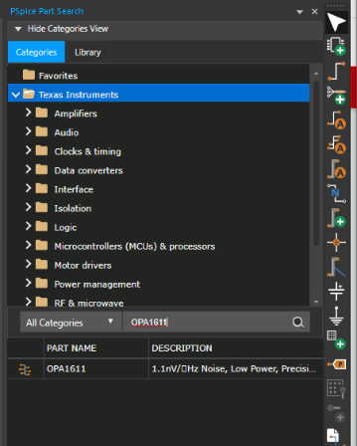
Find TI components
Select “Place>Pspice Component > Search”
A menu will appear at the side. Find “Texas instruments” and navigate to subcategory “Data converters”
Alternatively, search for a part in the search window.

Slide 14
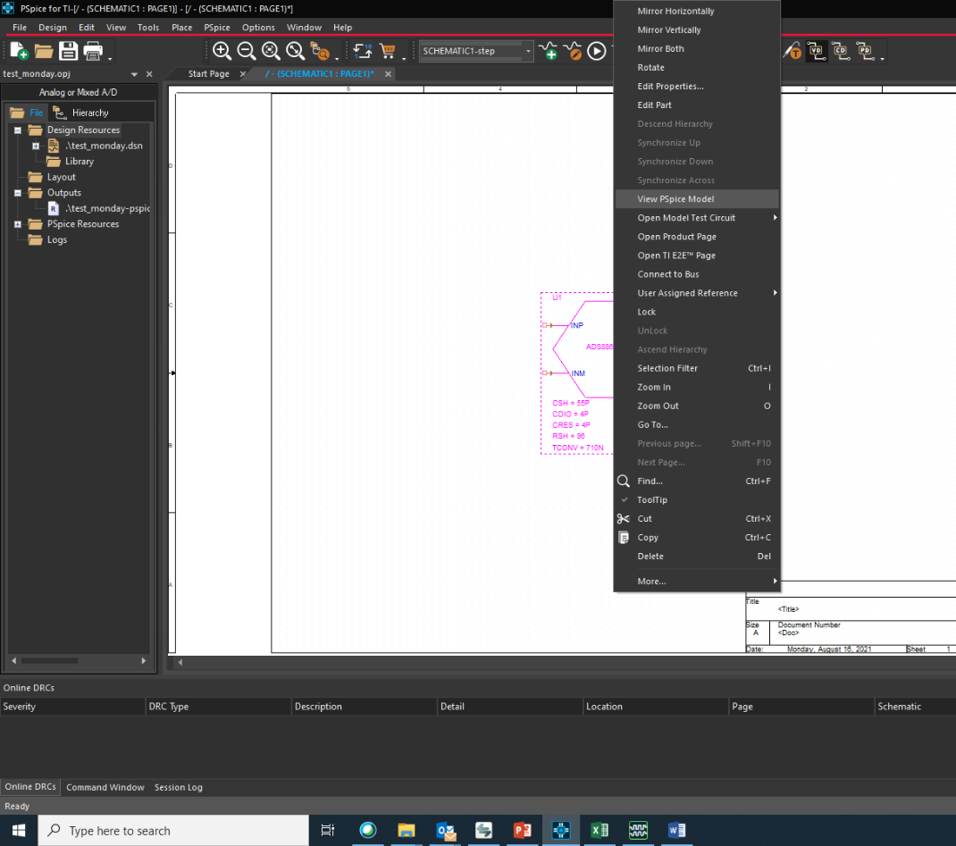
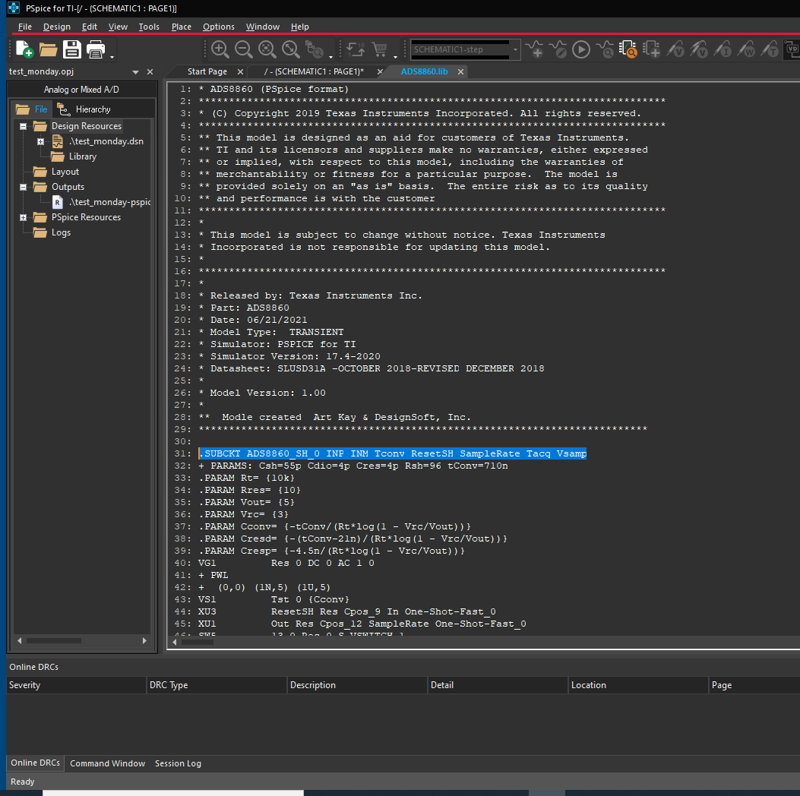
View PSPICE model
Right click on model and select “View Pspice model”

Slide 15
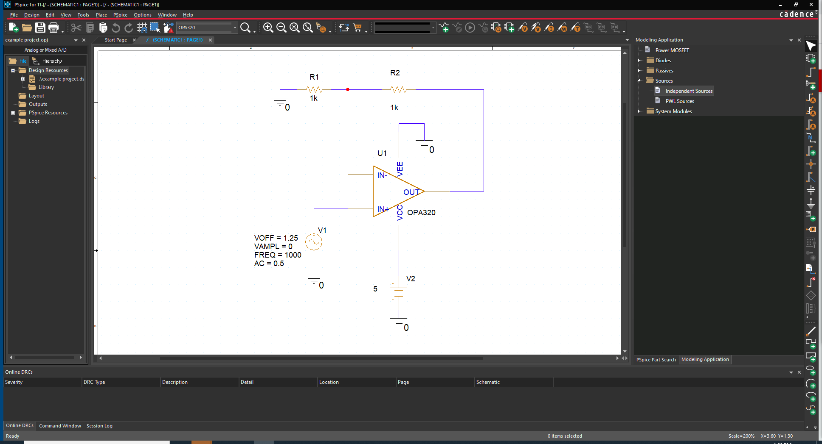
Use shortcut “w” to wire

Slide 16
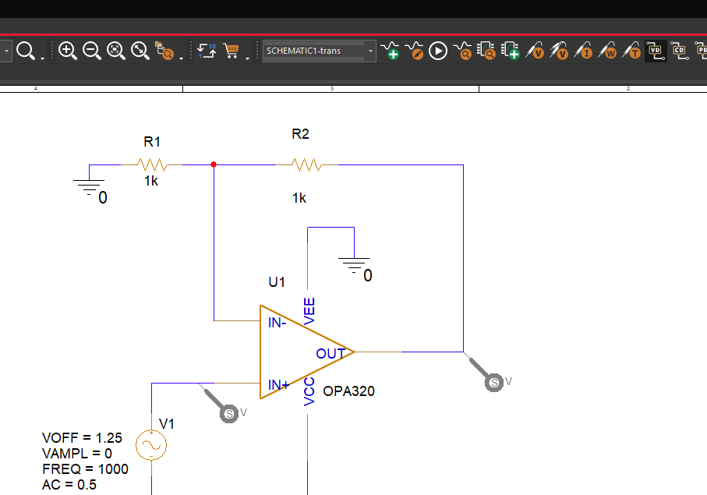
Add probes (voltage markers) to input and output
A probe will automatically generate an output plot at the selected node.

Slide 17
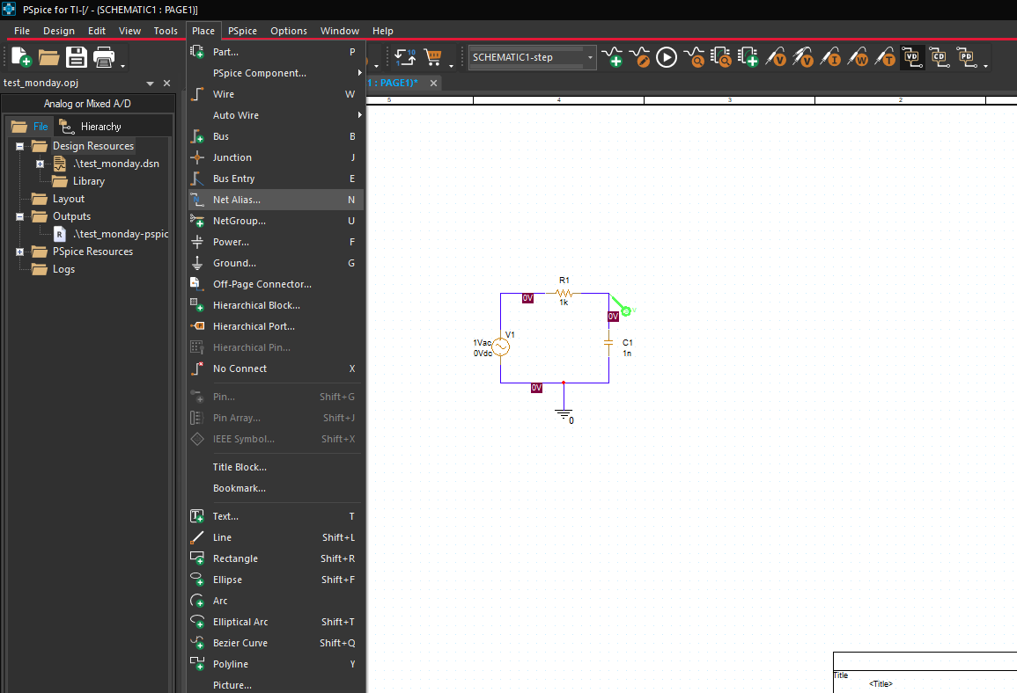
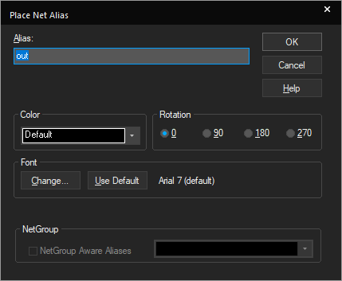
Add net alias label
Select “Place > Net Alias”.
Enter the Alias and click on the net you want to label
You will need a “net alias” to do many of the different simulation types in PSPICE

Slide 18
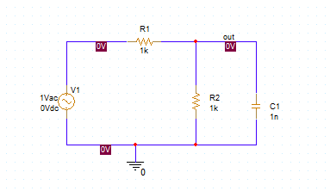
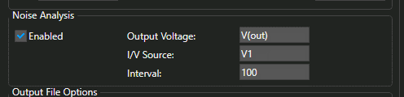
The net alias is very important.
When referring to the “out” node you will use V(out), or I(out) to indicate that you want to plot voltage or current of this node.

Slide 19
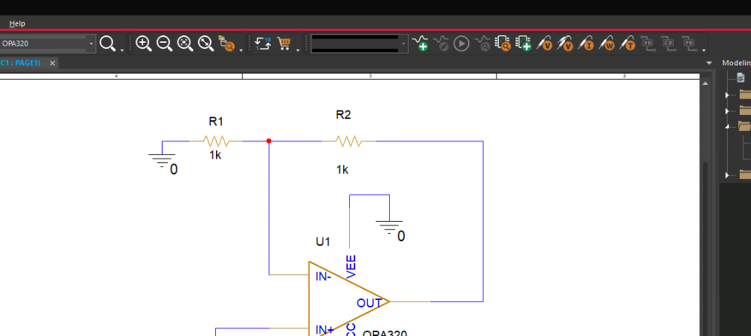
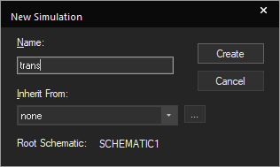
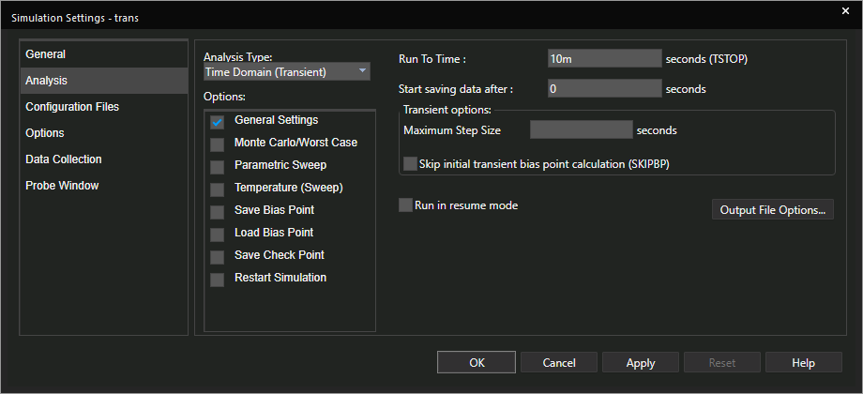
Add “simulation profile” - transient
1. Click on the green “+” sign to get a new simulation profile
3. This example shows a transient simulation profile.
2. Choose a name for the simulation profile. You can save multiple simulation profiles if you want to quickly re-do your simulations.

Slide 20
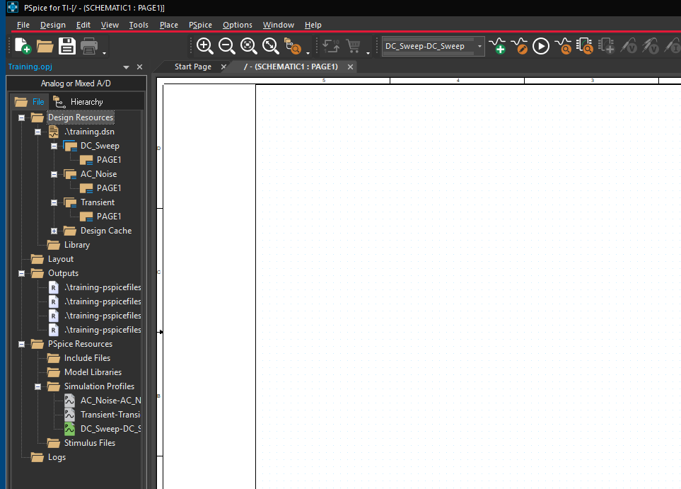

Simulation profiles
New simulation profile
Edit currently selected existing profile.
Run currently selected profile.
Simulation profiles

Slide 21
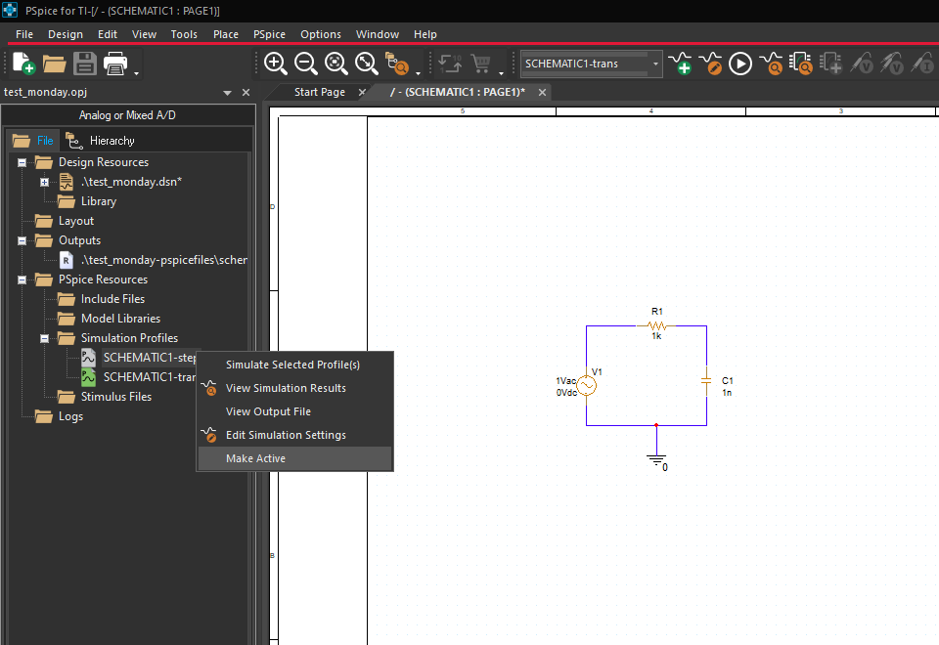

Running simulation
2. Once your simulation profile is selected press the run button
If you have multiple simulation profiles, select the one you want to run by right clicking and choosing “make active”. This is not necessary if you only use one simulation profile.

Slide 22
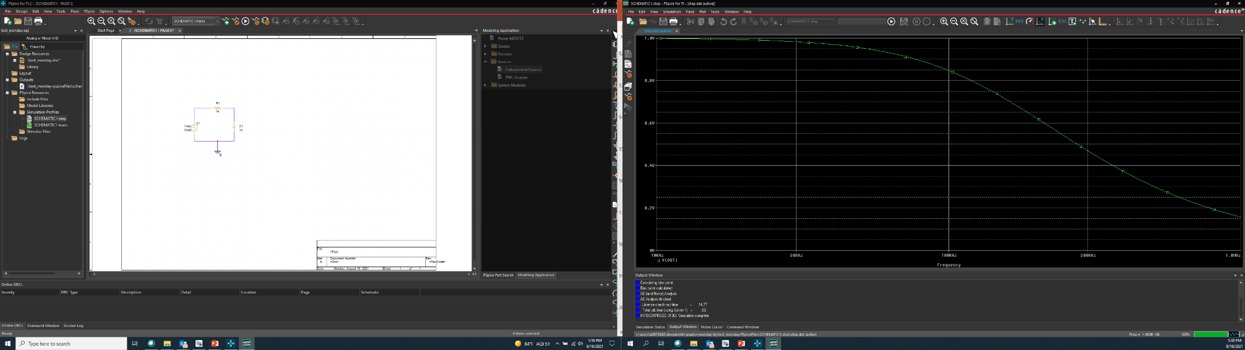

Results
Schematic entry and project control on one screen
Simulation results on the other screen.

Slide 23
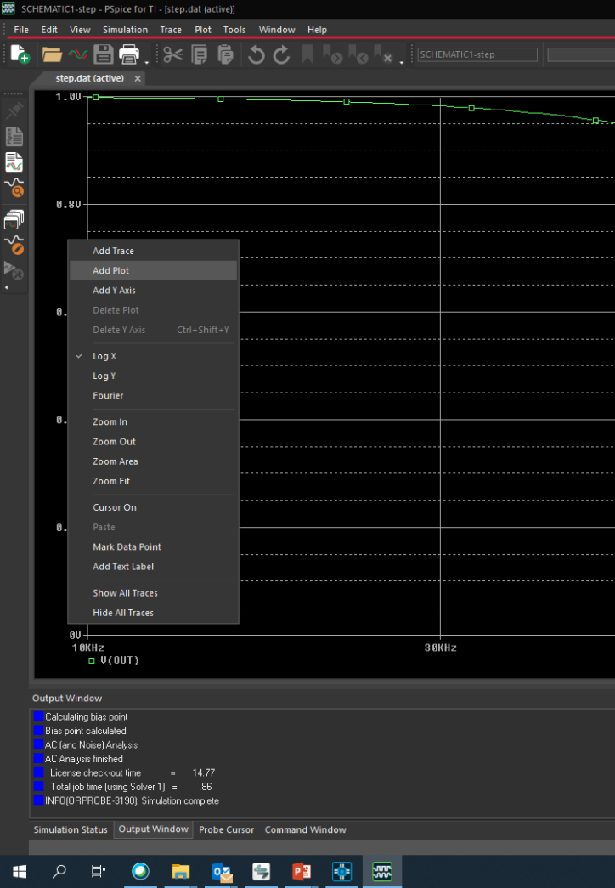
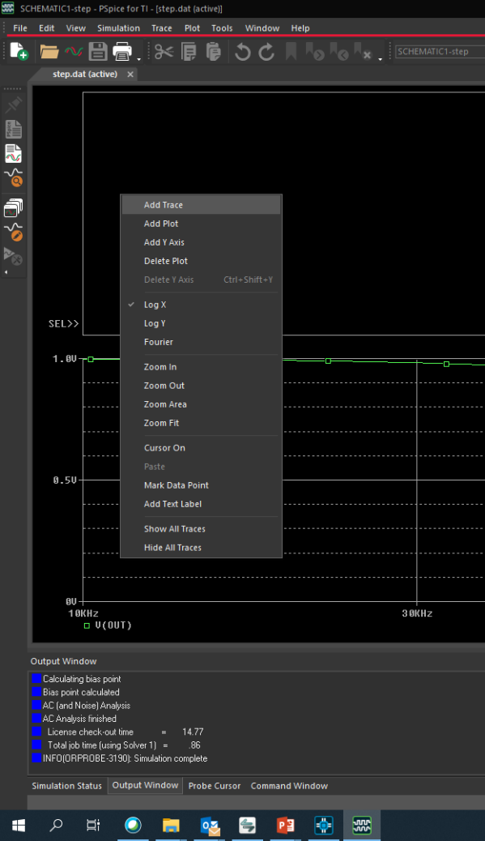
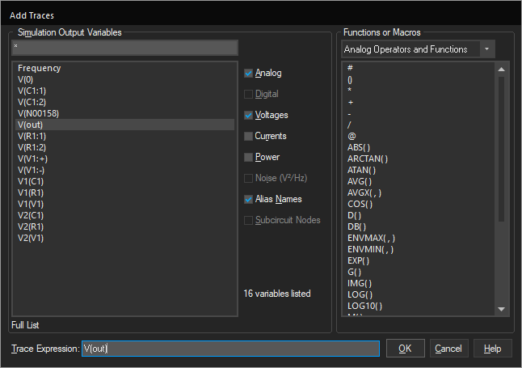
Adding plots and curves
2. Right click on the blank plot area and select “Add trace”.
3. Select the trace you want to plot. You may want to uncheck some categories like current and power to make the list easier to sort through.
Right click on the blank area to left of y-axis and select “add plot”
4. Press “ok” and the trace will be added to the selected plot.

Slide 24
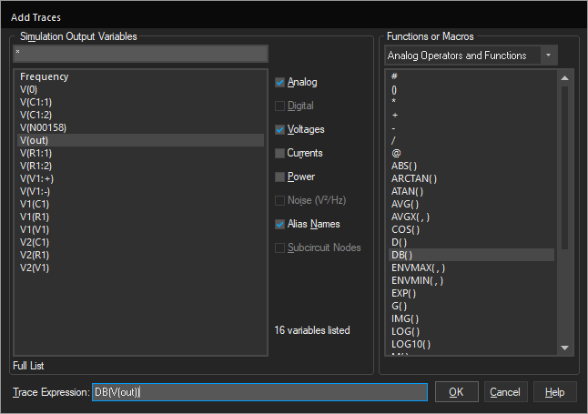
Post processing
You may want to perform a mathematical operation on the waveform. You can select the math function here. DB() converts the voltage plot to decibels.
First press the math operation
Second select the signal
In this example: DB(V(out)) will plot V(out) in decibels.

Slide 25
Post processing functions
ABS(x) |x|
SGN(x) +1 (if x > 0), 0 (if x = 0), -1 (if x < 0)
SQRT(x) x^{½}
EXP(x) e^{x}
LOG(x) ln(x) (log base e)
LOG10(x) log(x) (log base 10)
M(x) magnitude of x
P(x)phase of x (result of degrees)
R(x) real part of x
IMG(x) imaginary part of x
G(x) group delay of x (result in seconds)
PWR(x,y) x^{y}
SIN(x) sin(x) (x in radians)
COS(x) cos(x) (x in radians)
TAN(x) tan(x) (x in radians)
ATAN(x) tan⁻¹(x) (result in radians)
ARCTAN(x) tan⁻¹(x) (result in radians)
d(x) derivative of x with respect to the X axis variable.
s(x) integral of x over the range of the X axis variable.
AVG(x) running average of x over the range of the X axis variable.
AVGX(x,d) running average of X (from x-d to x) over the range of the X axis variable.
RMS(x) running RMS average of x over the range of the X axis variable.
DB(x) magnitude in decibels of x.
MIN(x) minimum of the real part of x.
MAX(x) maximum of the real part of x.

Slide 26
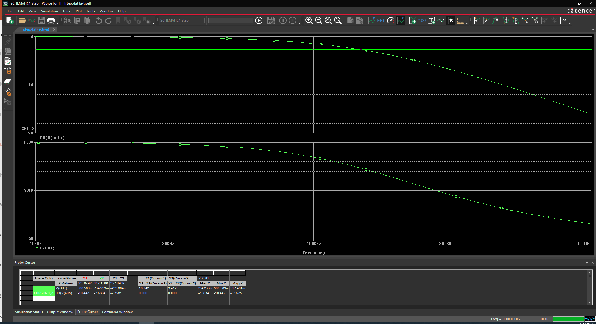

Using cursors
Press “toggle cursor”
2. Right click mouse for green cursor and left click for red cursor.
3. Cursor x/y values and delta cursor given here.

Slide 27
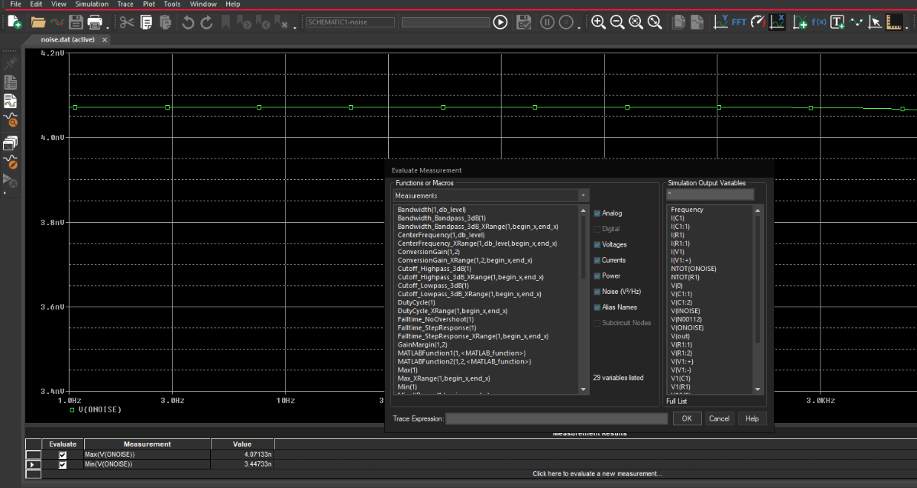

Adding Measurements
Press “toggle measurement result window”
Choose measurement (e.g. Bandwidth, Max, Min, rise time…)
Select output variable
Results displayed here.

Slide 28
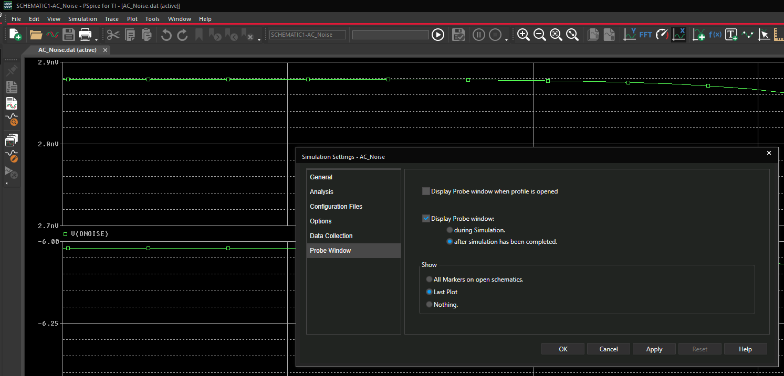
Remember plot window setup in simulation profile
This is very helpful to retain all the different plots, and calculations in a simulation profile.
Click on edit simulation profile button.
Select probe window
Choose “last plot”

Slide 29
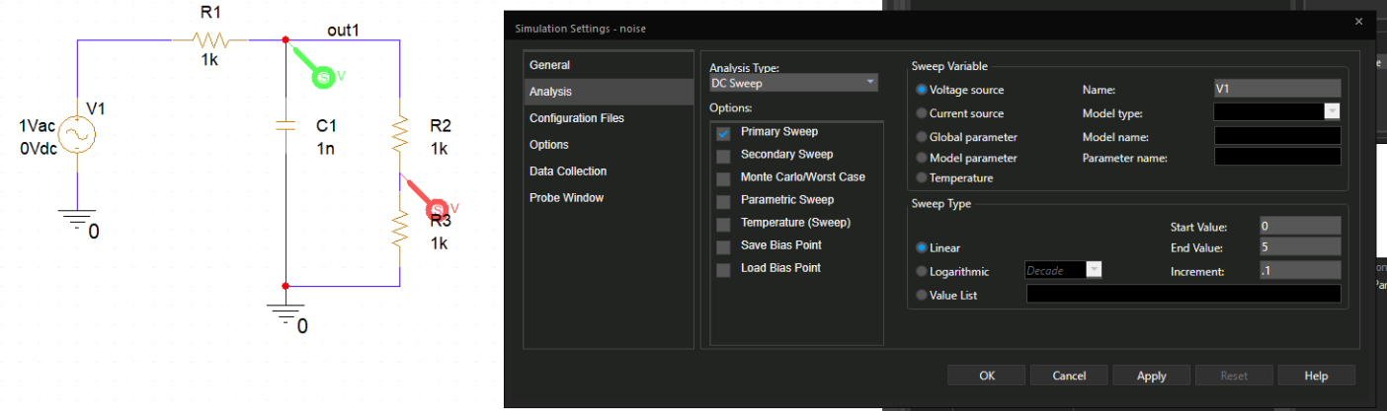
DC sweep
For DC sweep: specify the voltage source you want to sweep (V1 in this example). Specify the sweep type and range.

Slide 30
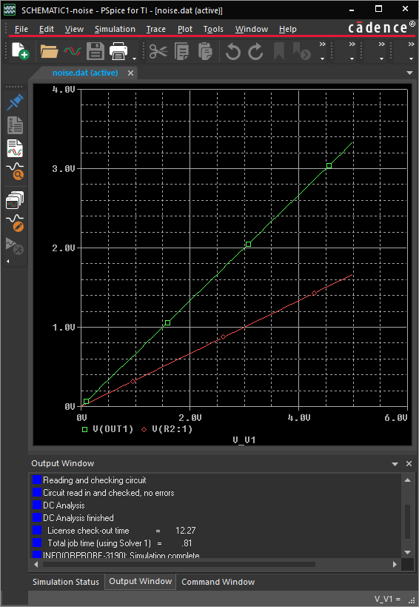
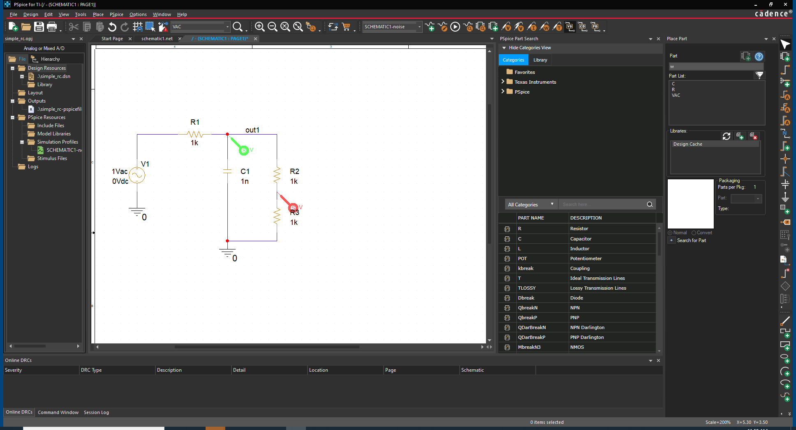
DC Sweep
This shows the example results for DC sweep where two probes measure the outputs.

Slide 31
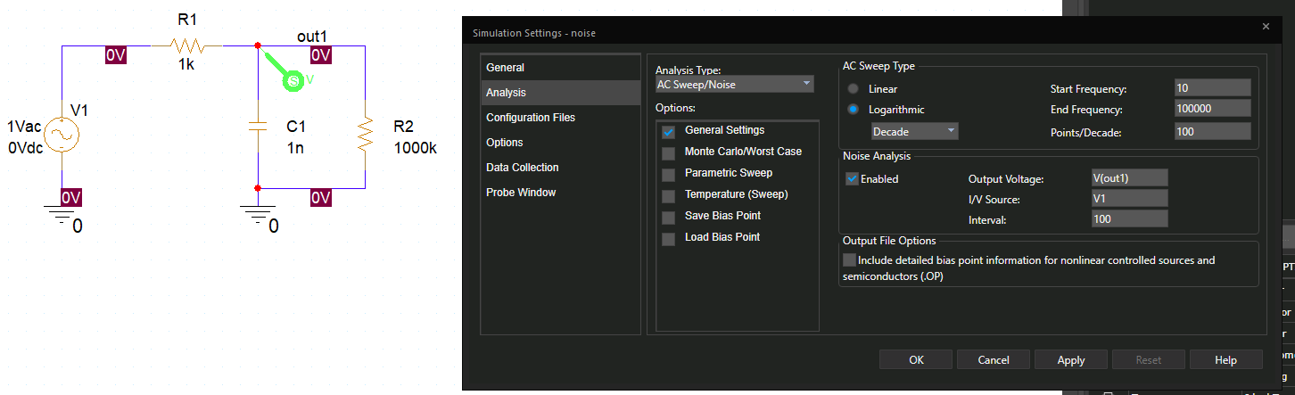
AC Sweep and Noise analysis
Where Output voltage: V(net_name) is used to plot voltage noise for net_name. In this case the net name is out1
V/I Source: source_name – In this example the source name is V1

Slide 32
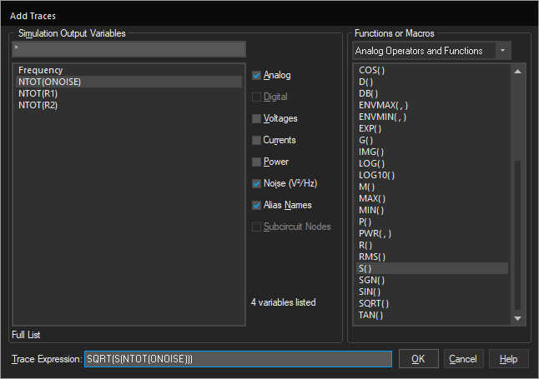
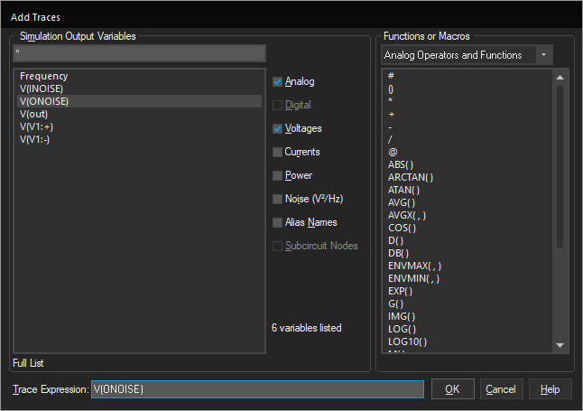
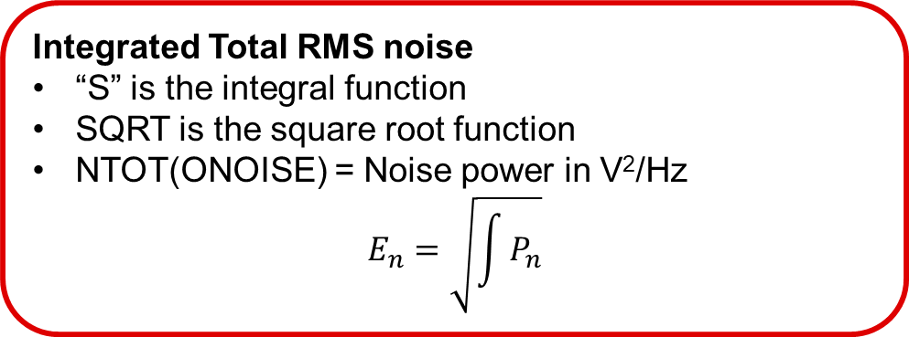
Noise analysis
Integrated Total RMS noise
“S” is the integral function
SQRT is the square root function
NTOT(ONOISE) = Noise power in V²/Hz
$$E_{n}=\sqrt{\int{P_{n}}}$$
Voltage Noise Spectral Density
V(ONOISE) is the noise density in V/rtHz at the output
V(INOISE) is the input noise density
Note: the “Noise” check box will give noise power in V²/Hz

Slide 33
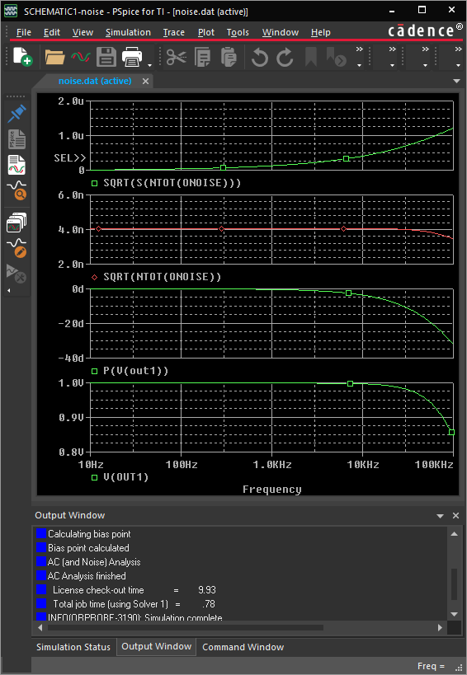
Noise analysis
Integrated noise
Voltage Noise density
This slide shows the two traces for noise density and integrated noise match TINA. By default PSPICE plots noise power which isn’t very useful

Slide 34
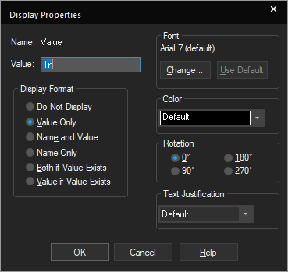
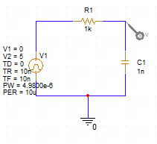
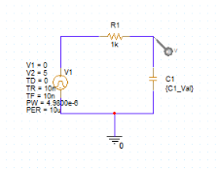
Parameter Stepping: Edit schematic value
Double click on the value “1n”. Change it to {C1_Val}
Draw circuit schematic. For this example, use 100kHz (10us period) square wave.

Slide 35
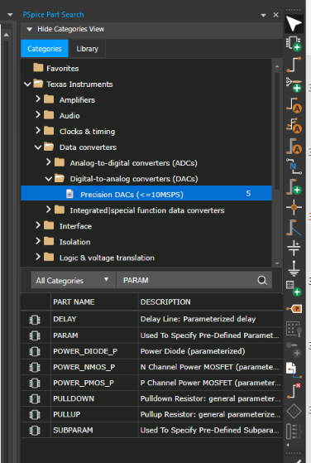
Parameter Stepping: Find PARAM
4. In the search window type “PARAM” and press the seach magnifying glass.
3. Select “Place > Pspice Component > Search” This will bring up the PSPICE search utility that you typically use to find TI components.
Double click on “PARAM” and drag it onto your schematic.

Slide 36


Parameter Stepping: Edit PARAM
6. Double click the parameter to edit.
Press the “New Property” button.
Enter the “Name” to match the name in the braces: {C1_Val}
Enter a good value (e.g. 1n) and press ok.

Slide 37



Parameter Stepping: Display value
Right click and select “Display” to display the value on the schematic.
Select “Name and Value” and press “ok”
12. Schematic after displaying the value.

Slide 38


Parameter Stepping: Set up analysis profile
14. Under “Parametric Sweep”, select:
  Parameter name
  Sweep type (Linear in this example)
  Start value, end value, and increment
13. Choose a transient analysis for 20us under “general settings”

Slide 39


Parameter Stepping: Example Results
15. Select “all” and press “ok”
16. Parameter step results.

Slide 40



Monte Carlo Analysis
1. Note: the full version of Cadence allows assigning tolerances to all components using “assign tolerance” option. If you did a complex design and wanted to compare 0.1% tolerance to 1% tolerance results this would be a useful option. This is not available on PSPICE for TI.
2. Choose tolerance for each component by double clicking on the “tolerance” parameter. In this example the resistor is set to 1% and capacitor is set to 5%.

Slide 41


Monte Carlo Analysis
Select Monte Carlo Worst Case
Choose the output variable (use the net name). In this case the net name is “out”, so V(out) plots the voltage for the “out” net.
Enter the “number of runs” (100 used in this example)
3. Choose analysis type for “General Settings”. In this example we use an AC sweep type.

Slide 42


Monte Carlo Analysis
7. Run the simulation. When the simulation is complete you will get a list of available results. Select all and press ok.
8. This shows a typical Monte Carlo result. 100 different simulation curves are displayed.

Slide 43


Monte Carlo Analysis
8. Choose performance analysis then press ok for the pop-up.

Slide 44


Monte Carlo Analysis
Press “add trace” on the new plot.
Select the function you want to apply then the output variable. In this case the function is “Cutoff_lowpass_3dB” and the variable is V(out).

Slide 45

Monte Carlo Analysis
This shows the distribution for the -3dB point Monte Carlo analysis for 100 simulation runs.

Slide 46

Using multiple schematics and simulation profiles
This shows a project with two schematics added and two simulation profiles. This approach can be useful if you want to do variations on different types of simulations. For example, a transient simulation requires a square wave source, and an AC simulation requires an AC source. You can build two slightly different schematics and develop simulation profiles for each schematic.

Slide 47


Using multiple schematics and simulation profiles
Right click on project and select “New Schematic”
Choose a name for the schematic

Slide 48


Using multiple schematics and simulation profiles
Add a page to the schematic
To create a simulation profile for this schematic select “Make Root”

Slide 49

Using multiple schematics and simulation profiles
Create a simulation profile for the current root schematic. Not that in this example it is “DC Sweep”
Select the page, and enter the schematic.

Slide 50




Using multiple schematics and simulation profiles
Once the simulation profiles are set up you can select them by right clicking and choosing “make active”, and “RunPspice”
Note: the simulation profile includes the schematic name, so there is no need to select the schematic when running a particular profile.

Slide 51



Using multiple schematics and simulation profiles
Click on the imbedded file above.
Open the file.
Drag the training folder to the location where you keep you PSPICE projects.
Click on “training.opj” to start the project

Slide 52

Using multiple schematics and simulation profiles
This is what the example project should look like once opened.
Select the different schematics under “training.dsn”
Choose the different simulation profiles and run them under “simulation profiles”

Slide 53
Getting professional PSPICE
Confluence instructions for installing full PSPICE from JC Zhu
Why you may want the full version
You need to run Non-TI models. If this is the case, the PSPICE for TI is very limited (three probes)
If you are developing your own models, or if you are working with a developer (e.g. design soft).
If you want access to the PCB development tools. Since we use Altium this may not be too useful but I suppose if you had a customer design this may be helpful.
Why you may not want the full version
It is very large and takes a long time to install
PSPICE for TI works well if you aren’t using non-ti models. You can do all analysis types (e.g. montecarlo). The only limit happens when you us non-TI models. In this case you can only monitor three signals.

Slide 54


Uploading a Model to the web and PSPICE TI library
“.lib” file – library file contains net list for your device.
“.olb” file – contains the schematic symbol and connections to “.lib” file.
Note that the .lib file has the SUBCKT netlist. Also note that the name of the SUBCKT matches the name of the .lib file and the .olb file.

Slide 55

Uploading a Model to the web and PSPICE TI library
bitbucket repository for ADC model files
Confluance Bit Bucket Tutorial
Select the appropriate repository. These have been pre-populated for all device names. If you need to make a custom model name press the “+” sign to add a new reparatory.

Slide 56



Create a folder in bit bucket
5. Click on New File
6. Name the file:
Development-TINA/junk.txt
To get the folder “Development-TINA”
7. Press Commit

Slide 57


Uploading model to BitBucket
8. Press
“upload”
9. Click on “choose your files” and select your ZIP file to upload.

Slide 58



Deleting the junk file from new folder
12. Select delete. Note: you can’t delete until after you copy a file into the folder as Bitbucket will not allow empty subfolders
11. Double click “junk.txt”
10. Press “Commit”

Slide 59


Uploading a Model to the web and PSPICE TI library
13. Once you have uploaded your files. Click on the appropriate reparatory
14. Copy the link for your Jira ticket (intake form).

Slide 60


Uploading a Model to the web and PSPICE TI library
Confluence Model Intake Form makes Jira ticket
Example of completed Jira Ticket
Click on the link to start your Jira ticket for model creation.
The form questions are mostly self explanatory. At one point in the form you will need to past in the bit bucket repository link from the previous slide.
A few hours after the files are uploaded, a signed copy of your files will automatically be uploaded back to the bit bucket repository. You can copy these to your computer and this will enable you to use PSPICE for TI without limitations. If the .lib is not signed, PSPICE for TI considers the model to be non-TI and limits you to three probes. See signed library below:

Slide 61

Uploading a Model to the web and PSPICE TI library
18. You will get Jira emails regarding the status. Press the buttons at the top to change the status.

Slide 62

Uploading a Model to the web and PSPICE TI library
19. Use comments to send messages to key people involved in model release. Note that “DCIT Jenkins” is an automated response. JC Zhu’s team is a good contact for issues. Also launch marketing (e.g. Mindy Mitchel) is also a good contact.

Slide 63
Entry form for TINA

Slide 64

Model intake form: https://confluence.itg.ti.com/display/MODEL/Model+Request+Intake+Form

Slide 65

Model intake form: https://confluence.itg.ti.com/display/MODEL/Model+Request+Intake+Form

Slide 66

Model intake form: https://confluence.itg.ti.com/display/MODEL/Model+Request+Intake+Form

Slide 67
Thanks for your time!
Notes:
That concludes the hands-on experiment. I hope this was useful to you. Thanks for your time.

Slide 68


Slide 69


Slide 70


