Slide 1
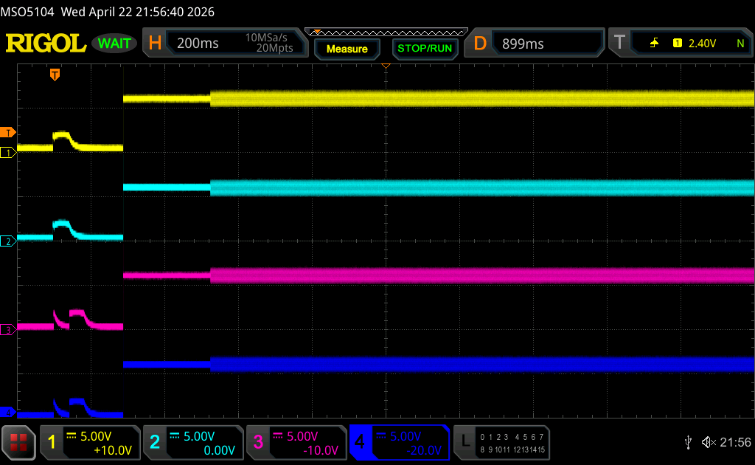
Behavior at low temperature(-40 degree)
OK pattern
OK pattern shows the diag at startup is correctly working, then play sound
Amp condition
Power supply: 12V
Temperature : -40 degree at thermostatic chamber

Slide 2
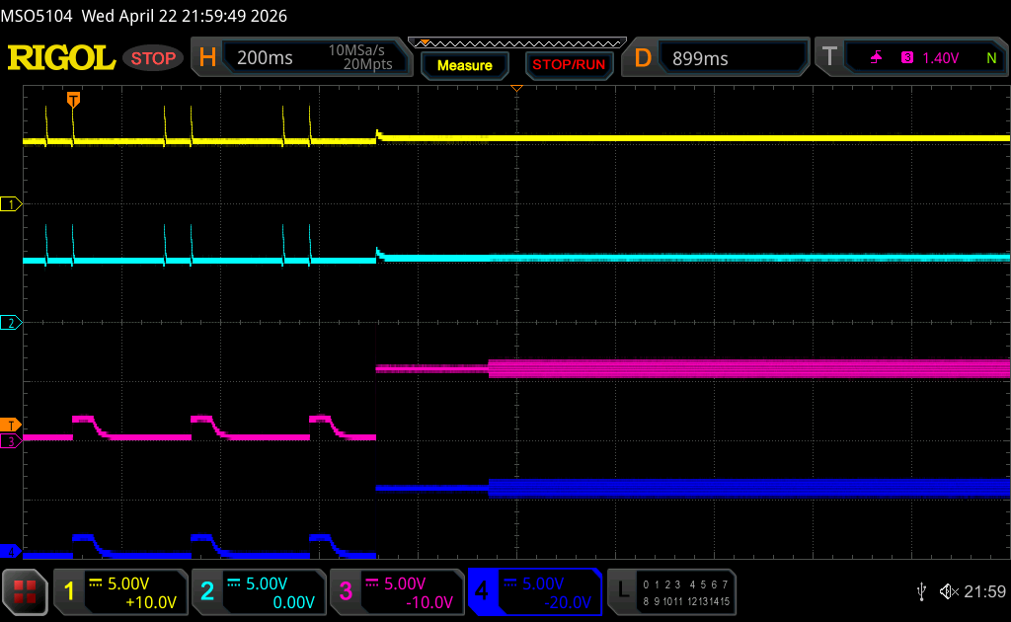
Behavior at low temperature(-40 degree)
NG pattern
NG pattern shows the diag at startup is not correctly working, and the
Amp condition
Power supply: 12V
Temperature : -40 degree at thermostatic chamber

Slide 3
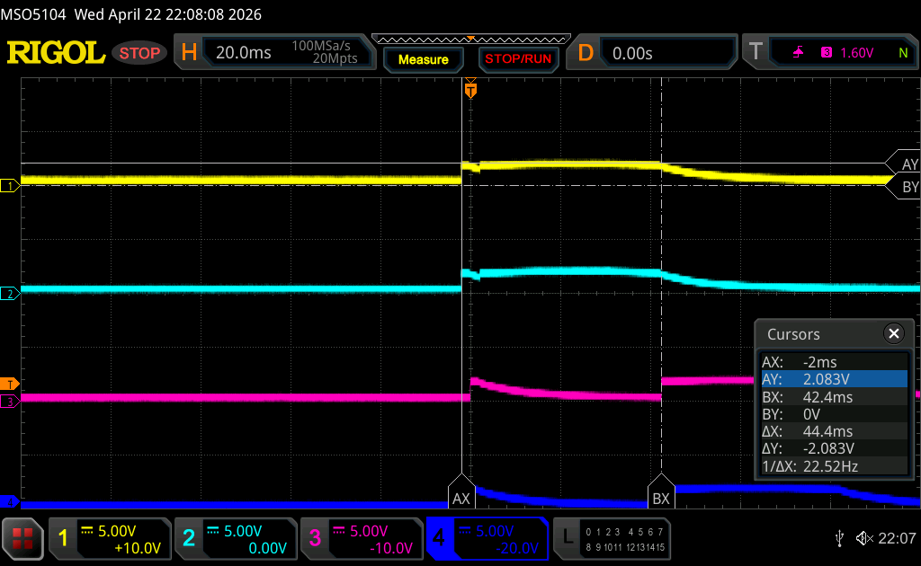
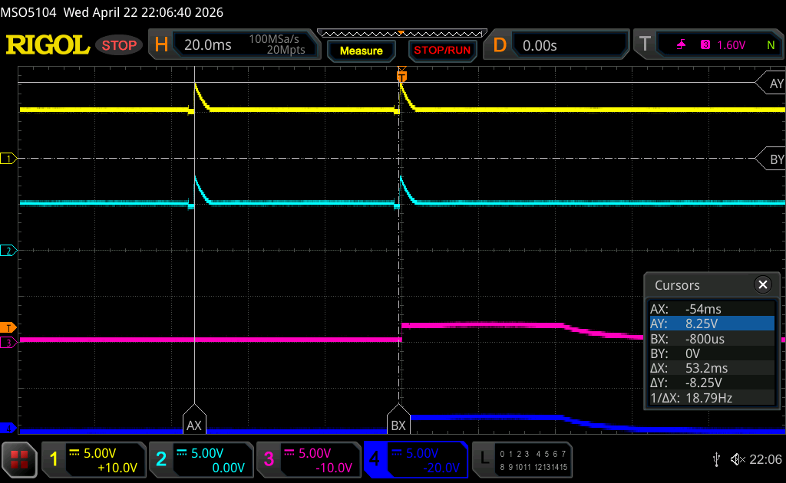
Compare the OK and NG pattern
OK pattern shows the diag waveform as expected.
NG pattern shows the spike waveform(around 8.1V) when start the diag, can you guess some insight from this?
OK pattern
NG pattern

