Slide 1
Board Modification
SO8 (OPA827)
VSSO8 (OPA827)
SO8 (OPA827)
VSSO8 (OPA827)
(OPA827)
Reserved Socket
(INA223)
Red : Active BPF
Blue: DUT
Reserved Socket

Slide 2
This DUT is correlated
well
Power supplies for INA223 from voltage divider
Input : V_{CM} plus V_{DIFF} or GND
I2C for mode configuration
Dedicated Power Supplies for INA223

Slide 3
2 Layers Board
Top Layer
Bottom Layer

Slide 4
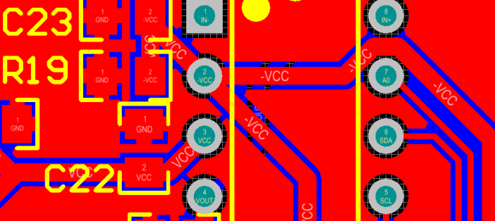
The Next Revision
To lower impedance
Top Layer
GND is relief pouring
Without placing vias (current return on top layer)
Decoupling capacitor is close to INA223 but the power supply to the decoupling capacitor is high impedance
Charging current to decoupling cap_ Path 1
Charging current to
decoupling cap_ Path 2

Slide 5
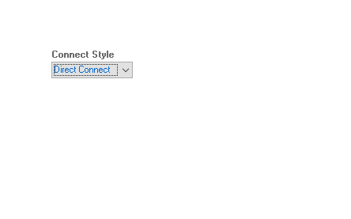
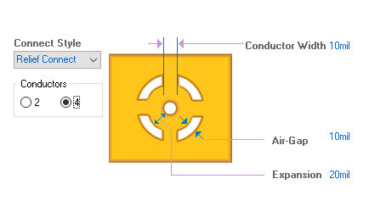
Action
GND Pouring : Relief → Direct
GND vias: low impedance for current return
Compact board : Physically close
Socket removal and mounted INA223 on the board directly to avoid possible connectivity issue
4 layers board : Clearly routing plan for power / analog / GND

