Slide 1
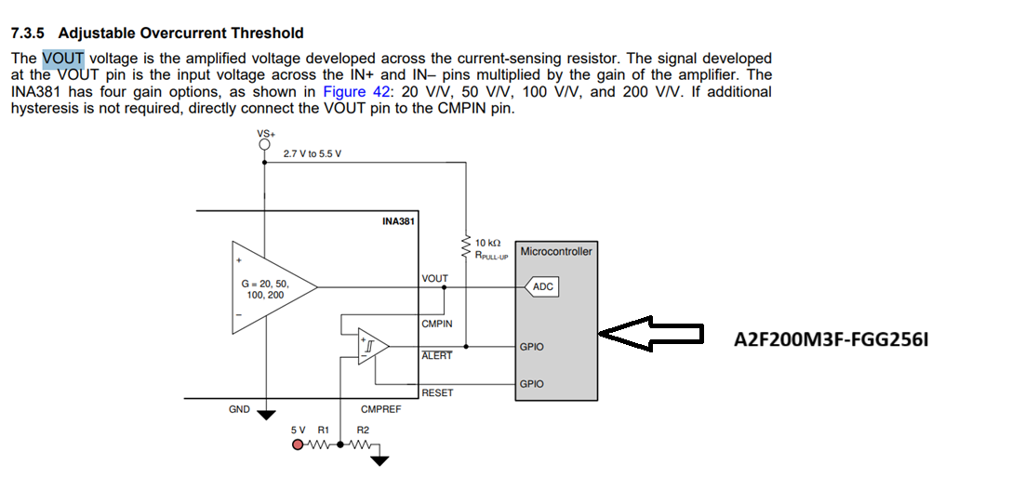

Slide 2
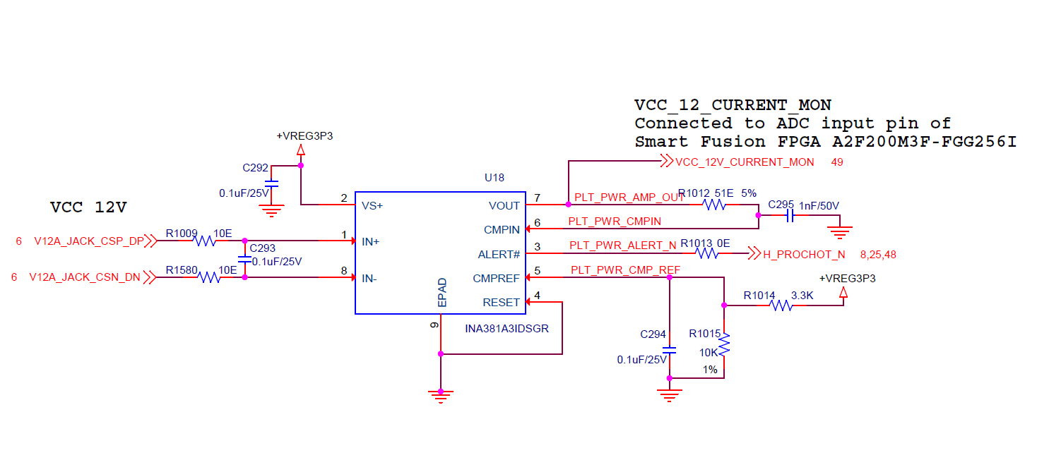
Current Sensor Schematics Reference

Slide 3
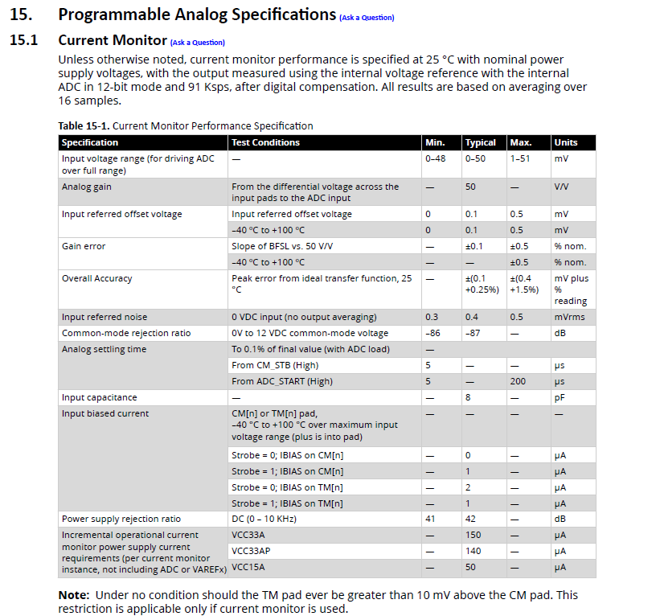
FPGA Current Monitor Specification

Slide 4
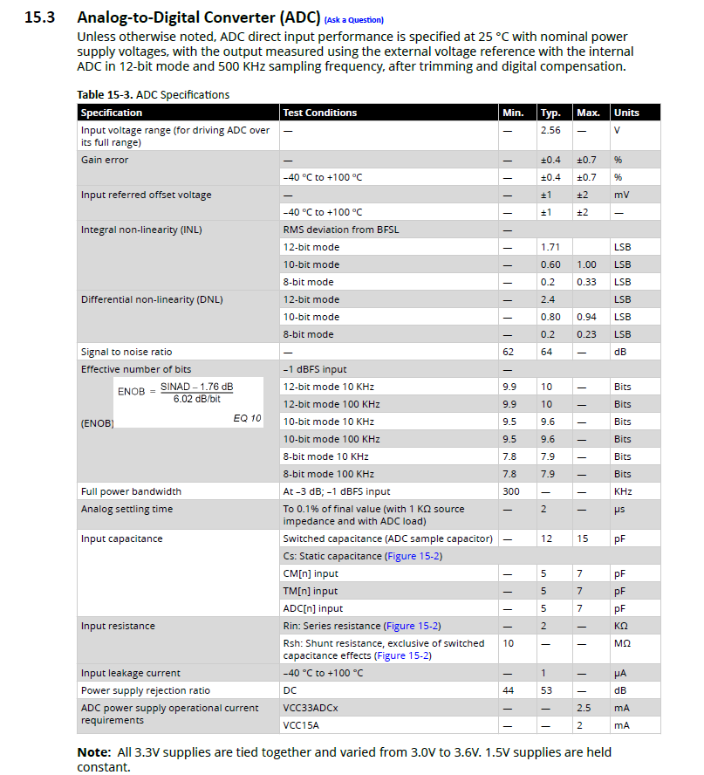
FPGA Current Monitor Specification

