Slide 1
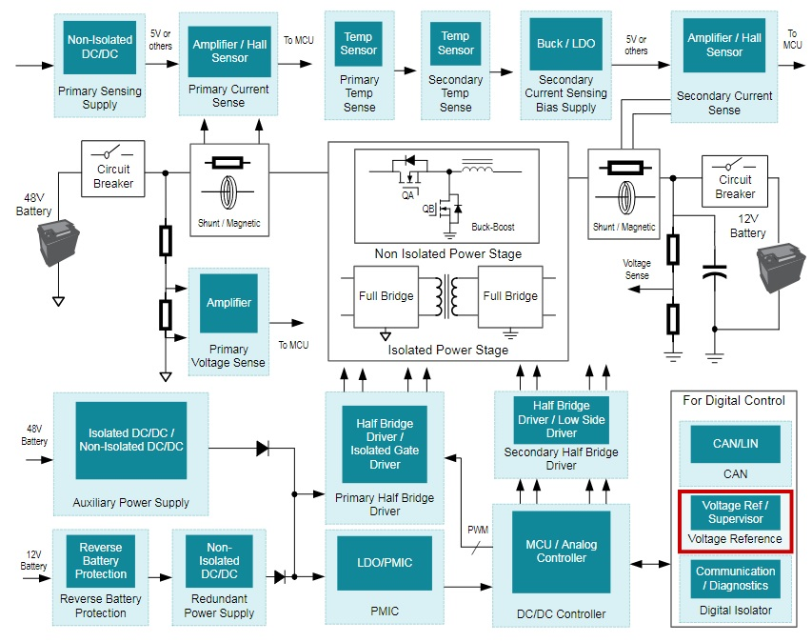
Precision Amplifiers for DC-DC Converters
Leading Spec
Subsystem: Bidirectional converter
Key amplifier specs and hero parts
Current/Voltage sensing
Device Dual Channel | Supply Range | Channel Count | GBW (MHz) | Slew Rate (V/µs) | Vos (mV) (max) | Cost (1ku) (single)
TLVx197-Q1 Texas Instruments | 4.5V – 36V | 1,2,4 | 2 | 3.4 | .6 | $0.468
OPAx388-Q1 Texas Instruments | 2.5V – 5.5V | 1,2 | 10 | 5 | .005 | $1.119
AD862x Analog Devices | 2.7V – 5.5V | 1,2,4 | 2.5 | 1 | .005 | $0.960
TSX71x ST Micro | 2.7V – 16V | 1,2 | 2.7 | 1.3 | .2 | $0.527
Key specs for current/voltage/temp. sensing
Temperature sensing
Reference Designs / Collateral
Use of high switching frequencies requires higher speed amplifiers with fast settling times
Avoid extensive calibration using high precision amplifiers with low voltage offset and offset drift
Dual/Quad channel amps in small form factors save board space
Device | Supply Range | GBW (MHz) | Slew Rate (V/µs) | Vos (mV) (max) | Vos Drift (typ) (uV/ºC) | I_{Q} (mA) (typ)
OPAx333-Q1 Texas Instruments | 1.8V – 5.5V | .35 | .16 | .01 | .02 | .017
OPAx317-Q1 Texas Instruments | 1.8V – 5.5V | .35 | .15 | .09 | .05 | .021
NCVx333 On Semi | 1.8V – 5.5V | .3 | .1 | .03 | .03 | .021
PRAMPS automotive contacts
Systems engineer – Kartik Sinha Marketing engineer – Jacob Fattakhov
TI Confidential - NDA Restrictions

Slide 2
EE: DC-DC Converters
What is it?
A DC/DC converter from high voltage (hundreds of volts) to 12 or 48V is required for powering low-voltage end-equipment’s such as infotainment, power steering, ABS, A/C and lots of others.
This voltage rail not only energizes legacy 12-V devices but also simplifies the design for various low-power EEs because basic isolation is not needed.
Identified EE Subsystems for PRAMPS
Primary and Secondary Current/Voltage Sense
It is important to measure input/output voltage and current to maintain the control loop stable and provide basic set of diagnostics and safety.
Hero Devices and Cookbook Circuits
INA148-Q1: +-200V Common-Mode Voltage Difference Amplifier
OPA197-Q1: 36-V, Precision, Rail-to-Rail Input Output, Low Offset Voltage
OPA376-Q1 Precision, Low Noise, Low Iq Operational Amplifier
OPAx188-Q1: 36-V, 0.03µV/C, Low Noise, Rail-to-Rail Output, Zero-Drift Op Amp

Slide 3
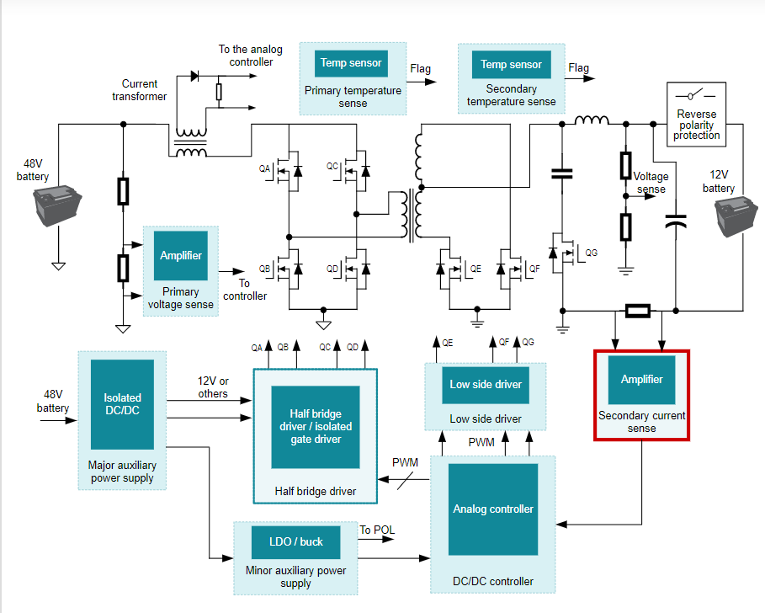
LAMPs in HEV/EV – DC/DC Unidirectional
Hero parts
Current/Voltage Sense
Function |  | Key LAMP requirement | Devices
Low side current sense on primary and secondary sides |  | Fast settling OPAMP to account for high switching frequencies | OPA607-Q1, OPA365-Q1, TLVx197-Q1
 |  | Budget conscious | TLV9062/4-Q1, TLV9352-Q1
Battery voltage measurements post resistor divider |  | Fast settling OPAMP to account for high switching frequencies | OPA365-Q1, TLVx197-Q1
 |  | Budget conscious | TLV9062/4-Q1, TLV9352-Q1
Post magnetic sensor signal conditioning |  | Budget conscious | TLV9002/4-Q1
OC & OV fault detect with comparators |  | Low offset, fast response, precision integrated reference | TLV9022-Q1, LM2903B-Q1, TLV4011-Q1, TLV6703-Q1
Temperature Sense
Function |  | Key LAMP requirement | Devices
Buffer OPAMP for NTC |  | Budget conscious | TLV9002/4-Q1, LM290xLV-Q1, LM2904B-Q1
 |  | High precision | OPA333-Q1
Thermocouple, 3-wire RTD front end |  | Low power instrumentation amplifier | INA333-Q1
Thermal switch (COMP) |  | Low power, low offset, integrated hysteresis | TLV7041-Q1, TL331B-Q1, LM2903B-Q1
Reference Designs / Collateral
Discovery Questions:
Most common switching frequencies used? High speed OPAMPs needed?
Is Isolation leakage measurement done in this system?
Correlation between battery bus voltage measurement error and system efficiency?

Slide 4
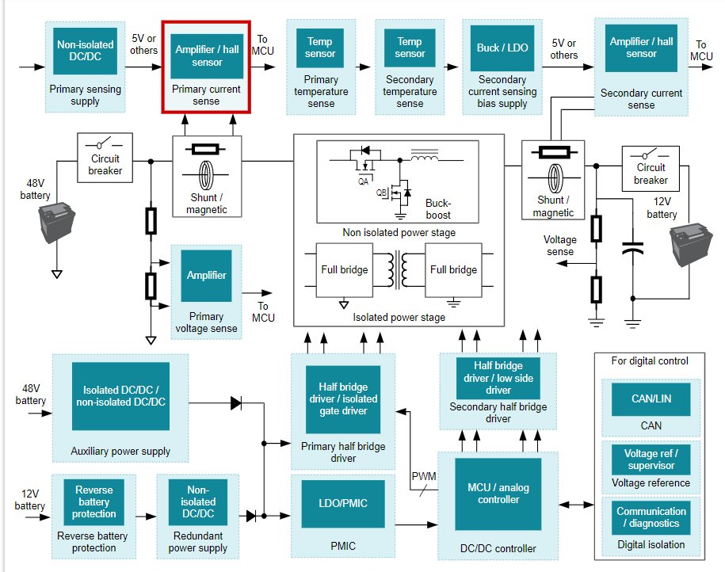
LAMPs in HEV/EV – DC/DC Bidirectional
Hero parts
Current/Voltage Sense
Function |  | Key LAMP requirement | Devices
Low side current sense on primary and secondary sides |  | Fast settling OPAMP to account for high switching frequencies | OPA607-Q1, OPA365-Q1, TLVx197-Q1, OPA388-Q1
 |  | Budget conscious | TLV9062/4-Q1, TLV9352-Q1
Battery voltage measurements post resistor divider |  | Fast settling OPAMP to account for high switching frequencies | OPA365-Q1, TLVx197-Q1
 |  | Budget conscious | TLV9062/4-Q1, TLV9352-Q1
Post magnetic sensor signal conditioning |  | Budget conscious | TLV9002/4-Q1
OC & OV fault detect with comparators |  | Low offset, fast response, precision integrated reference | TLV9022-Q1, LM2903B-Q1, TLV4011-Q1, TLV6703-Q1
v
Temperature Sense
Function |  | Key LAMP requirement | Devices
Buffer OPAMP for NTC |  | Budget conscious | TLV9002/4-Q1, LM290xLV-Q1, LM2904B-Q1
 |  | High precision | OPA333-Q1
Thermocouple, 3-wire RTD front end |  | Low power instrumentation amplifier | INA333-Q1
Thermal switch (COMP) |  | Low power, low offset, integrated hysteresis | TLV7041-Q1, TL331B-Q1, LM2903B-Q1
Reference Designs / Collateral
Discovery Questions:
Most common switching frequencies used? High speed OPAMPs needed?
Is Isolation leakage measurement done in this system?
Correlation between battery bus voltage measurement error and system efficiency?

