Slide 1
Gentec: 12 Bit Driver for TMS320F2837xD Delfino MCU
November 7, 2016
Errol Leon

Slide 2
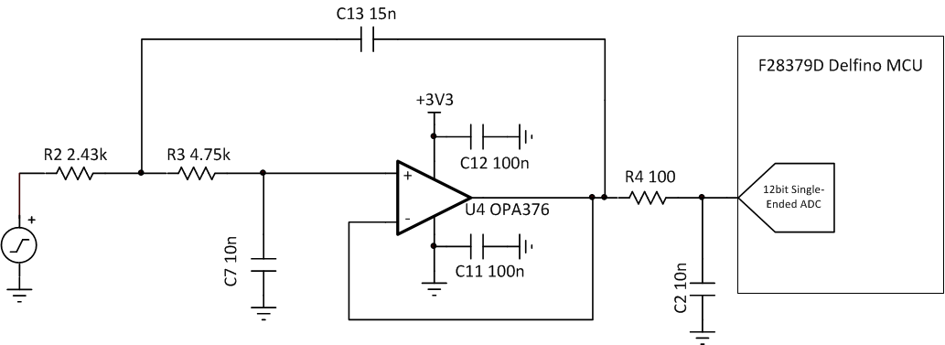
TMS320F2837xD Delfino Single-Ended 12 bit Driver
Sallen-Key topology with passive RC charge-bucket filter recommendations
Issues with Components
OPA376 does not have the bandwidth to drive a 12bit ADC with an acquisition time of 100ns.
From calculations GBW of the Op amp needs to be at least 38MHz.
Current device will not settle with ½ LSB within the acquisition time.

Slide 3
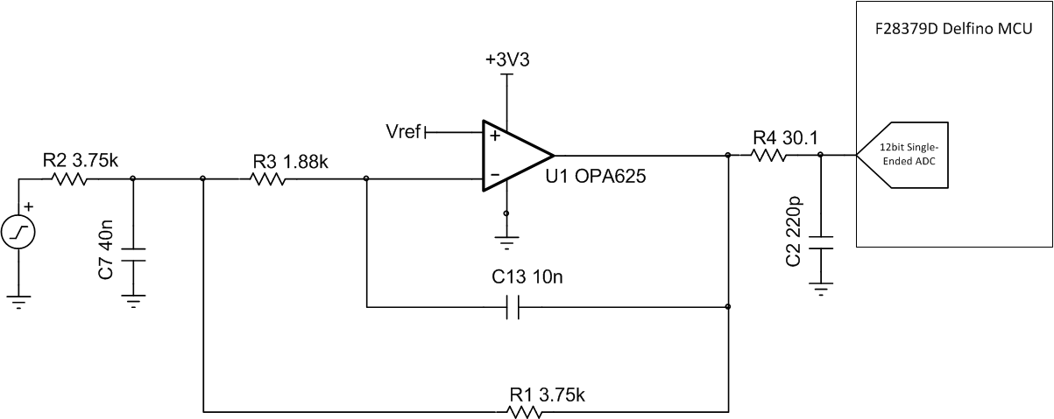
TMS320F2837xD Delfino Single-Ended 12 bit Driver
Multiple-Feedback topology with passive RC charge-bucket filter recommendations
Recommended Components
Use OPA625 in Multiple Feedback configuration.
R and C values were calculated and optimized to settle within ½ LSB.
R4 is 30.1Ω
C2 is 220pF
Note: Calculations and simulations are in this presentation

Slide 4
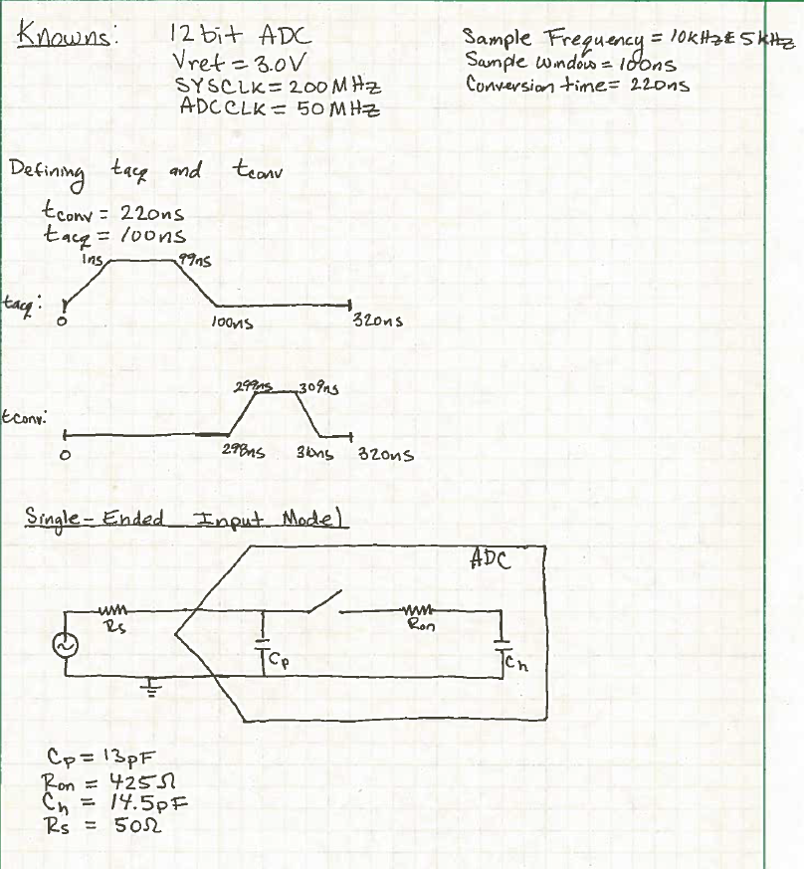
TMS320F2837xD Delfino MCU 12 bit Driver
Calculations for RC and GBW values

Slide 5
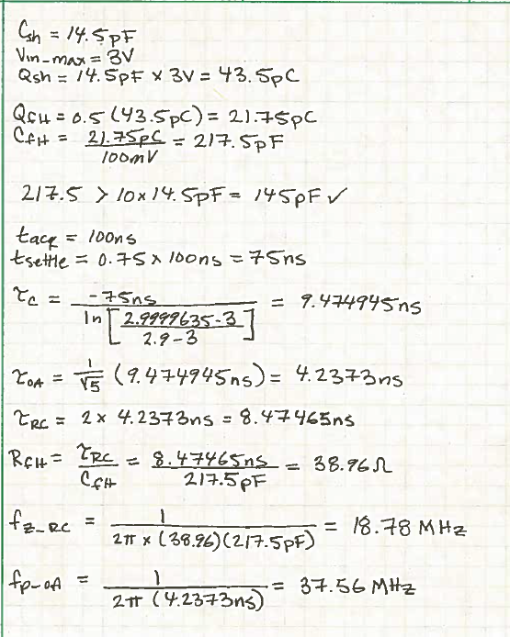
TMS320F2837xD Delfino MCU 12 bit Driver
Calculations for RC and GBW values

Slide 6
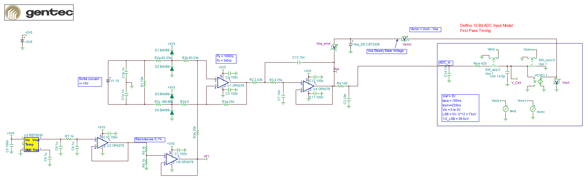
TMS320F2837xD Delfino MCU 12 bit ADC
TINATI Schematic Model of 12bit ADC with customer circuit driver
The converter was model from the F28379D datasheet page 102-103. t_{acq} (100ns) and t_{conv} (220ns) have a piecewise function made in the simulation to model the appropriate switching time to charge and discharge C_{sh}.

Slide 7
TMS320F2837xD Delfino 12 bit ADC Driver
TINATI Simulation of 12bit ADC with customer circuit driver

Slide 8
TMS320F2837xD Delfino 12 bit ADC Driver
TINATI Simulation of 12bit ADC with customer circuit driver – Zoomed-in
Does not settle within ½ LSB

Slide 9
TMS320F2837xD Delfino MCU 12 bit ADC
TINATI Schematic Model of 12bit ADC with recommended circuit driver
OPA625 is preferred for driving the ADC. This device will need to be in an MFB (inverting) configuration due to the V_{cm} ranging from [(V-) to (V+)-1.15].
Based on the input voltage for the OPA376 used as a difference amplifier, the common mode gets within the region of VCC- 1.5V where noise increase by 20x.
Based off this, it is recommend to replace the op amp in the different amplifier configuration from OPA376 to OPA378.
OPA378 is a zero-drift device which is needed for this application.
For the OPA378 the resistor values will need to be reduced to a decade less.
Number of devices: OPA2378 and OPA625 versus OPA4376

Slide 10
TMS320F2837xD Delfino MCU 12 bit ADC
TINATI Schematic Model of 12bit ADC with recommended circuit driver

Slide 11
TMS320F2837xD Delfino 12 bit ADC Driver
TINATI Simulation of 12bit ADC with recommended circuit driver

Slide 12
TMS320F2837xD Delfino 12 bit ADC Driver
TINATI Simulation of 12bit ADC with recommended circuit driver – Zoomed-in
Settles within ½ LSB

Slide 13
Op Amp Reference
For more in-depth learning about op amps and op amp stability
look at TI Precision Labs at:
www.ti.com/precisionlabs
Analog Engineer’s Pocket Reference
A “must-have” for every Board/System Design Engineer
Download: http://www.ti.com/lsds/ti/amplifiers-linear/precision-amplifier-support-community.page#pocketref
Buy Hardcopy: https://store.ti.com/Search.aspx?k=pocket+reference&pt=-1
All Embedded Schematics in this presentation can be run in the Free TINA_TI SPICE simulator available at:
http://www.ti.com/tool/tina-ti

